Slide 1
Hill AFB SBIR Phase II Everactive Batteryless/Wireless Sensors
June 2022

Slide 2
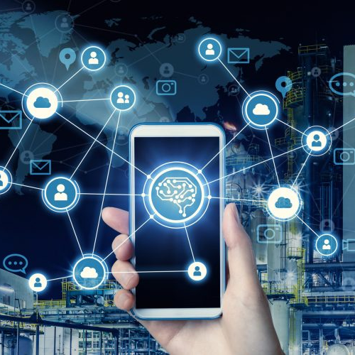
The “new normal” needs pervasive remote monitoring
Real-time visibility across all assets requires:
Continuous data streams
Maintenance-free devices
End-to-end solutions
Cost-effective deployments

Slide 3
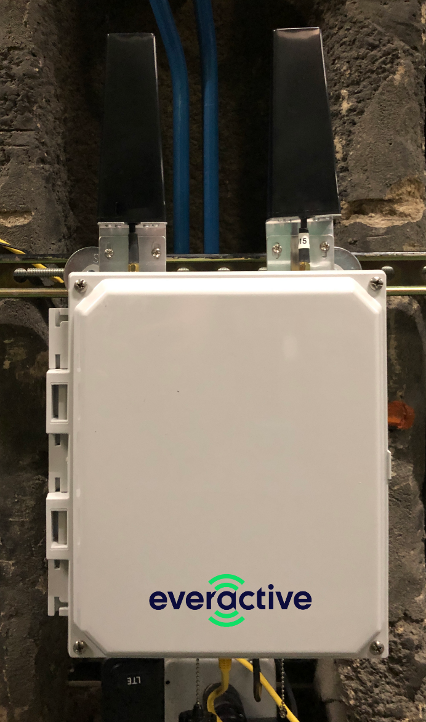
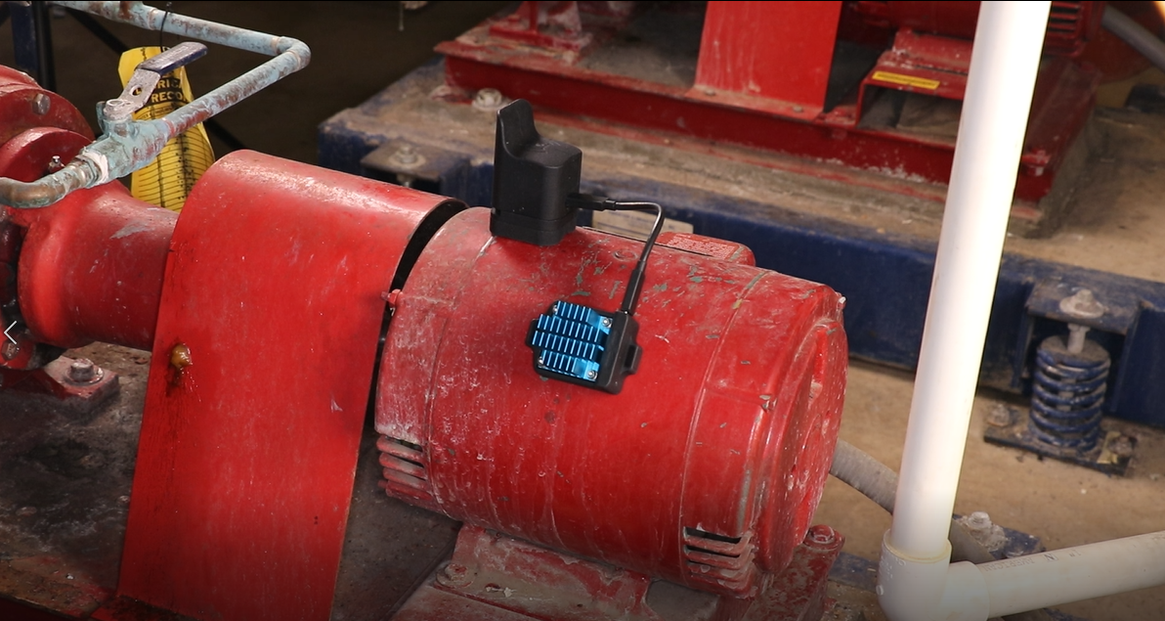
What Everactive provides: easy-to-install hardware
Eversensor
Energy Harvester
Evergateway
1.8’’
2.3’’
3.2’’
1.4’’
2.1’’
2.9’’

Slide 4
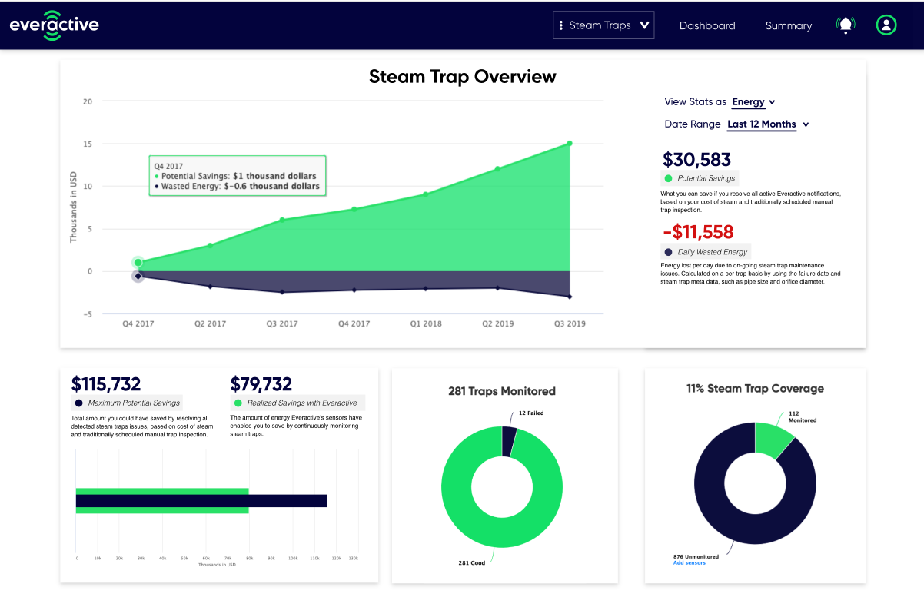
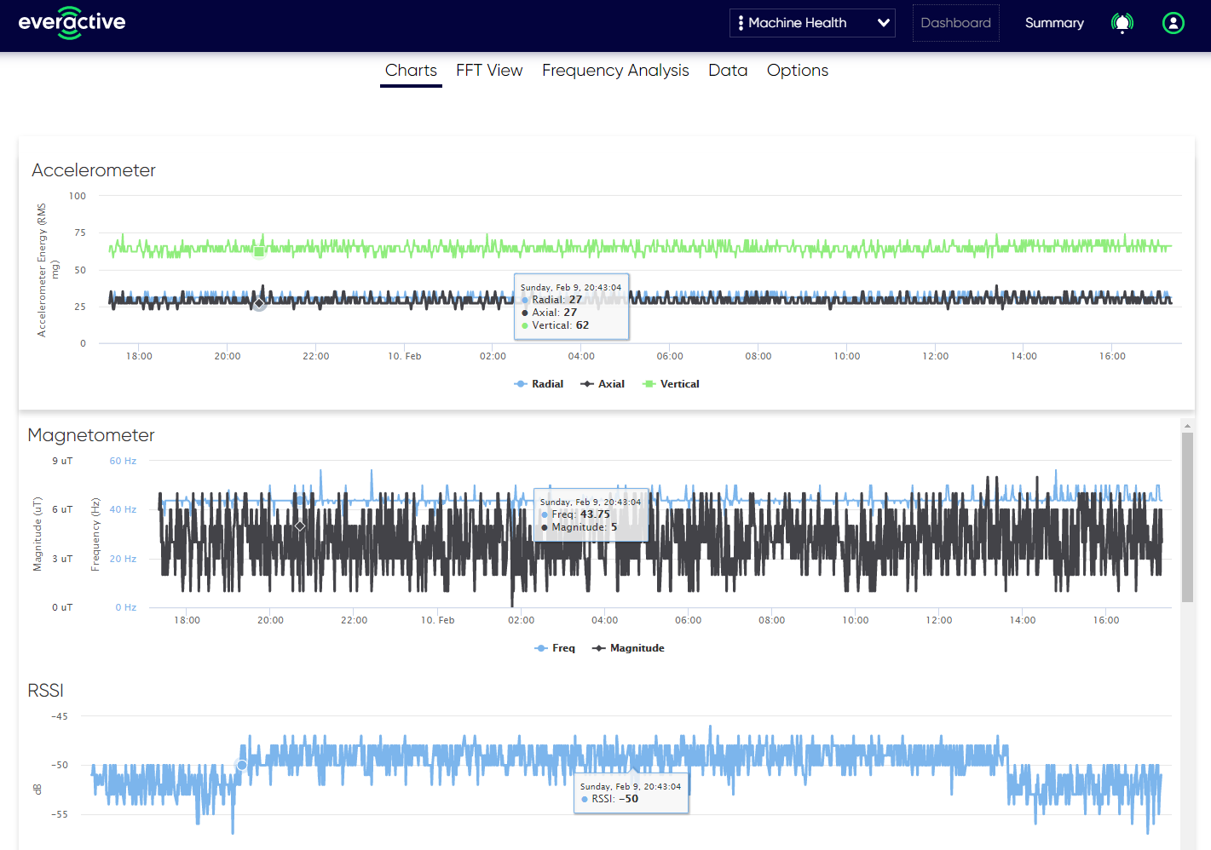
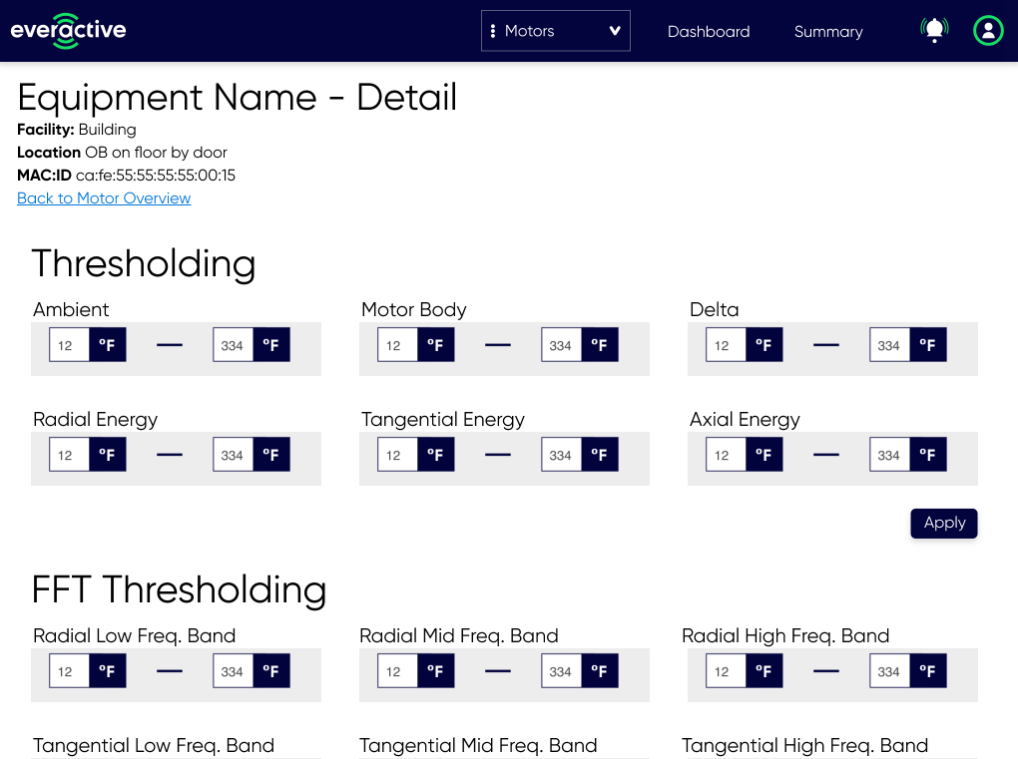
What Everactive provides: easy-to-use software

Slide 5
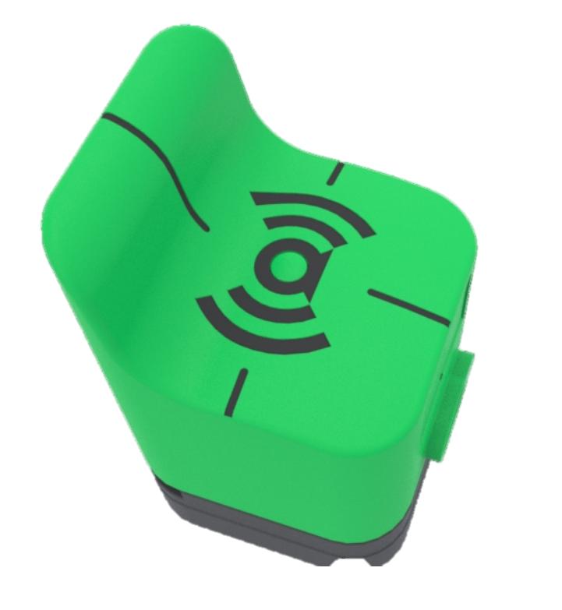
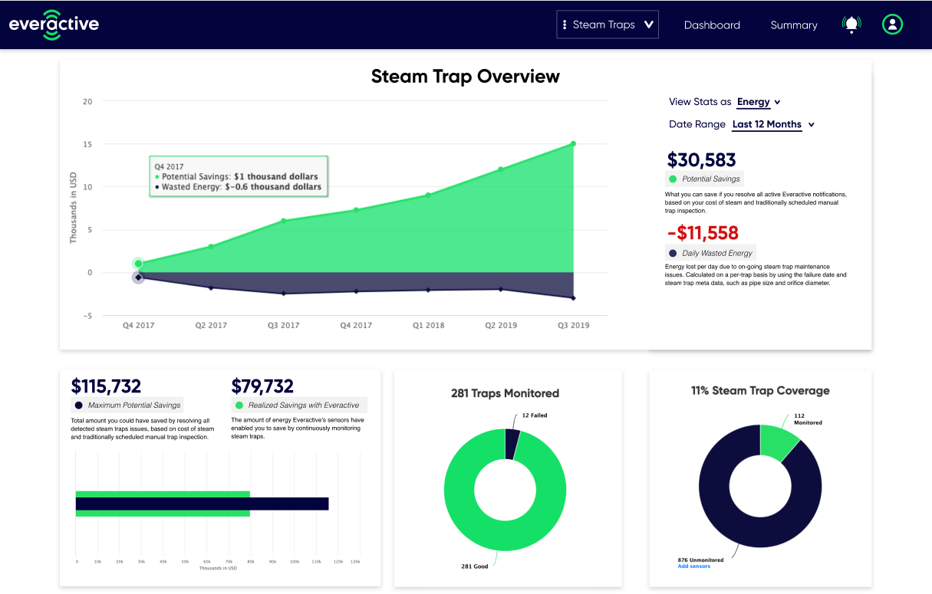
Expand across sites and with new products
Gen 2 Platform
Photovoltaic | 
Thermoelectric | 
EMF | 
Vibration | 
Harvesters
Pressure Relief Devices
Gas Detection
Corrosion
Temperature | 
Relative Humidity | 
Acceleration | 
Magnetic Field | 
Pressure | 
Ultrasound | 
Acoustic | 
Lux | 
Gases (multiple) | 
Steam Traps
Motors
Compressors
Heat Exchangers
Fans
Pumps
Sensors

Slide 6
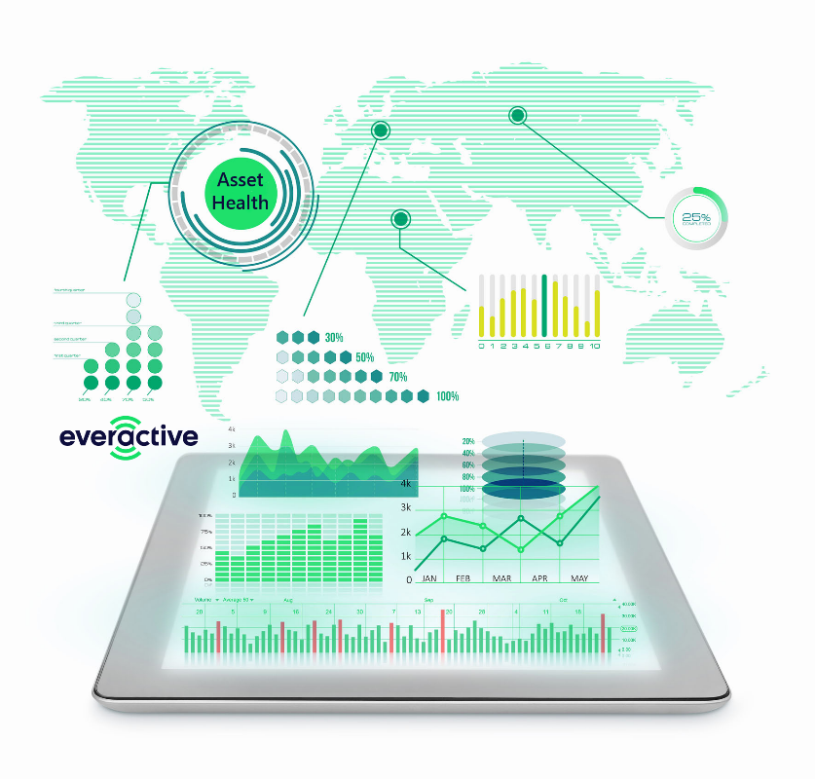
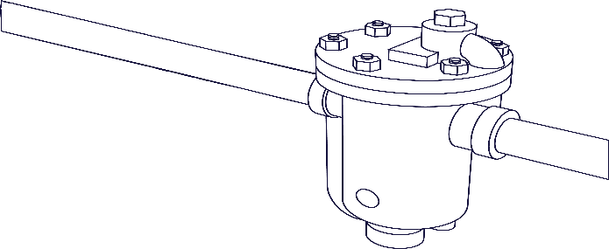
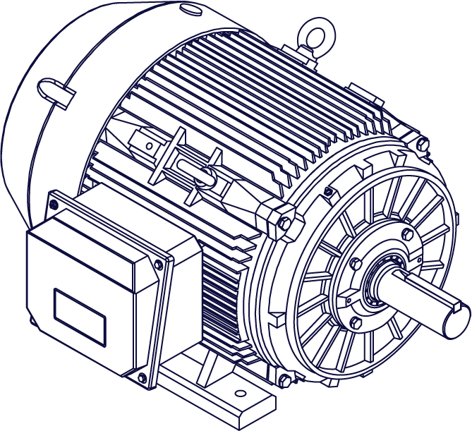
Everactive technology solves key IoT challenges
Insights from new data streams
Real-time alarms & notifications
Cross-platform APIs
End-to-end solutions
No batteries required
Continuous sensing & wireless transmission
Using only low-levels of harvested energy
IP66 | Class I, Division 2 | wide operating range

Slide 7
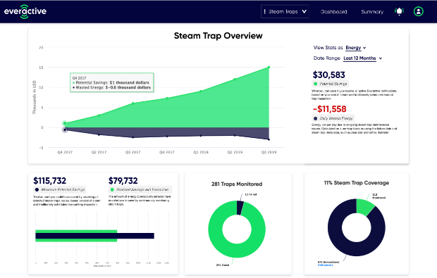
Steam Trap Monitoring
Cross-industry pain point
Compelling returns*
$50+ billion in lost energy & downtime
300+ billion gallons of water waste
300+ million metric tons of CO₂ emissions
Annual, global estimates
Upfront HW
$0
Installation per Trap
< 10 min.
Everactive STM
Net Annual Savings
$1,271,522
Annual CO₂ Savings
28k tons
Thermistor
Eversensor
Payback Period
3 months
5-Year ROI
4.2x
Thermistor
TEG
* Estimate for outfitting 1,000-trap process manufacturing facility

Slide 8
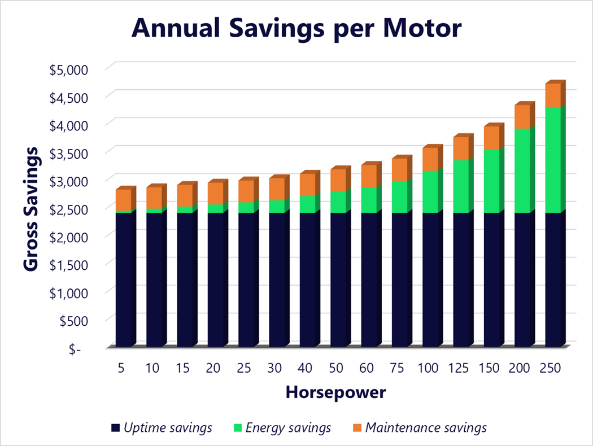
Machine Health Monitoring
Cost-effective 24/7 monitoring for all rotating equipment
Maximize Facility-Wide Returns
Deploy on “Balance of Plant”
Prevent unplanned downtime
Increase uptime & availability
Improve overall equipment effectiveness
Reduce electricity consumption
Extend motor life
Lower Total Cost of Ownership
No added, ongoing battery maintenance
No upfront capital expenditures
Subscription-based, real-time data analytics
Intervene only when & where needed
Industry | Food & beverage
Operating hrs. / yr. | 7,200
Avg. downtime | 4 hours
Motor efficiency | 88%
Avg. load factor | 75%
Inspection frequency | Quarterly
Batteryless sensors change the run-to-failure approach

Slide 9
Growing market traction
Steam Trap Monitoring
Production Release – Q1 2019
Customer Sites | Industries
12 | Pharmaceutical Food & Beverage Paper & Pulp CPG Petrochemical Facilities
Eversensors
1,000+
Thermistor
Eversensor
Thermistor
TEG
Machine Health Monitoring
Alpha Sampling – Q1 2020
Customer Sites | Industries
4 | Food & Beverage CPG Facilities
Eversensors
50+

Slide 10
Self-sustaining sensors generate impactful returns
Steam Trap Monitoring
Machine Health Monitoring
Full-year impact of 2019 deployments
Impact of just 2% improvement in motor efficiency
1,251
Total number of steam traps monitored
Annual electricity savings |  | Motor Horsepower
 |  | 75 | 120 | 200
Electricity Savings ROI |  | 3.1x | 4.9x | 8.1x
Number of Motors | 2,000 | $1.5M | $2.4M | $4.0M
 | 5,000 | $3.8M | $6.0M | $10.1M
 | 10,000 | $7.6M | $12.1M | $20.3M
34,417
Metric tons
Estimated annual avoided CO₂ emissions
59M
US gallons
Estimated annual water savings
7,323 passenger cars
89
Olympic pools
53%
Industrial motors’ share of global electricity consumption
16,689
homes’ electricity usage for 1 year

Slide 11
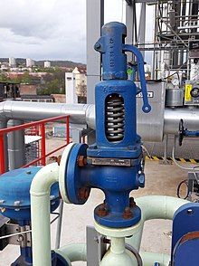
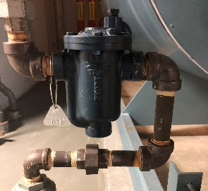
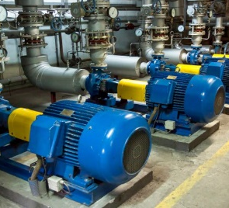
Simple expansion to monitor additional assets
Universal dashboard interface for all monitored assets
Additional
Existing
Evercloud
Forwards & backwards compatible, connects 1,000+ Eversensors
LTE / Wi-Fi / Ethernet
Everactive
Network
Evernet
Eversensors

Slide 12
Hill AFB Steam Traps
~4,000 Steam Traps
CY21
Ameresco Maint.
3,200
~CE Maint.
800
Failed Traps Yearly (1583 tested)
2021
Drip Legs Traps | Building Traps
400 | 3.5%
9%
$10,763/Month Loss
1183
$14,355/Month Loss

Slide 13
Hill AFB Steam Traps - Everactive
~600 Steam Traps
CY21
Thermistor
Eversensor
Thermistor
TEG
Everactive
400 Active
Failed Traps
Reported – CY 2021
Operating Traps
Monitored - 400
Failed Traps - 4% (16)
Realized Savings - $164K

Slide 14
Hill AFB Machine Health Monitoring
Bldg. 220: Critical to building processes, increase in amplitude showed sheaves needed re-alignment | ü
Bldg. 505: Increase in amplitude led to further analysis showing imminent bearing failure | ü
Bldg. 505: Temporarily used Everactive on an oil separator to verify it's running cycle was being completed and not losing power during off shifts | ü
Bldg. 507: Frequently used Everactive data to help investigate an intermittent issues with a new dust collector system | ü
Bldg. 503: Roof top air handler was missing base bolts. This is an issue we would have never seen. | ü
Test Stands Hill AFB: For troubleshooting purposes, our team gathered a lot of in depth vibration data from test stands at Hill AFB | ü
Test Stands Kadena AFB: Multiple assets at Kadena AFB- Though connectivity to the Everactive system has been intermittent due to remodeling and renovations in the building, we were able to install Everactive vibration sensors on more than 10 assets at Kadena AFB | ü

