Slide 1
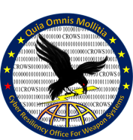
ASSURANT Overview

Slide 2
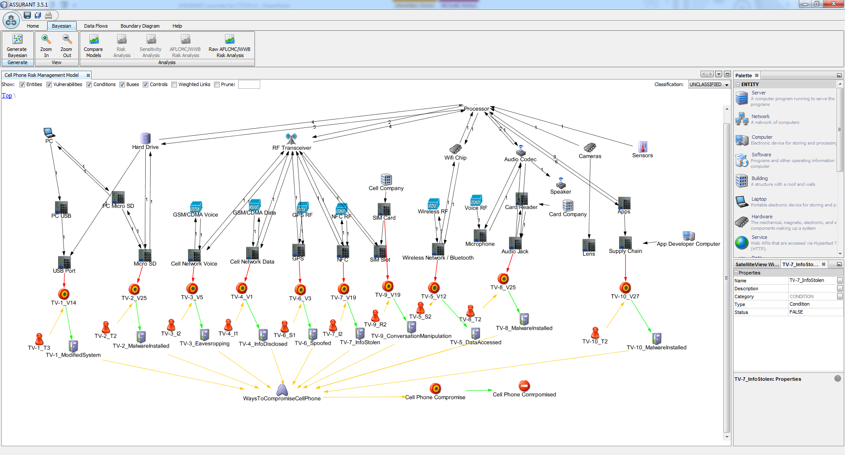
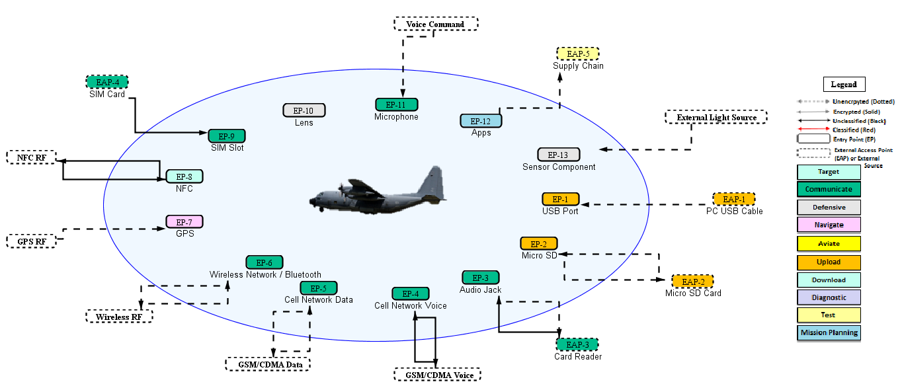
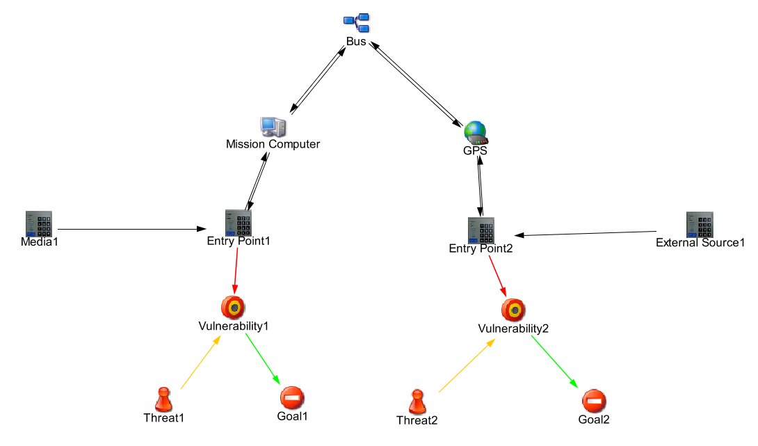
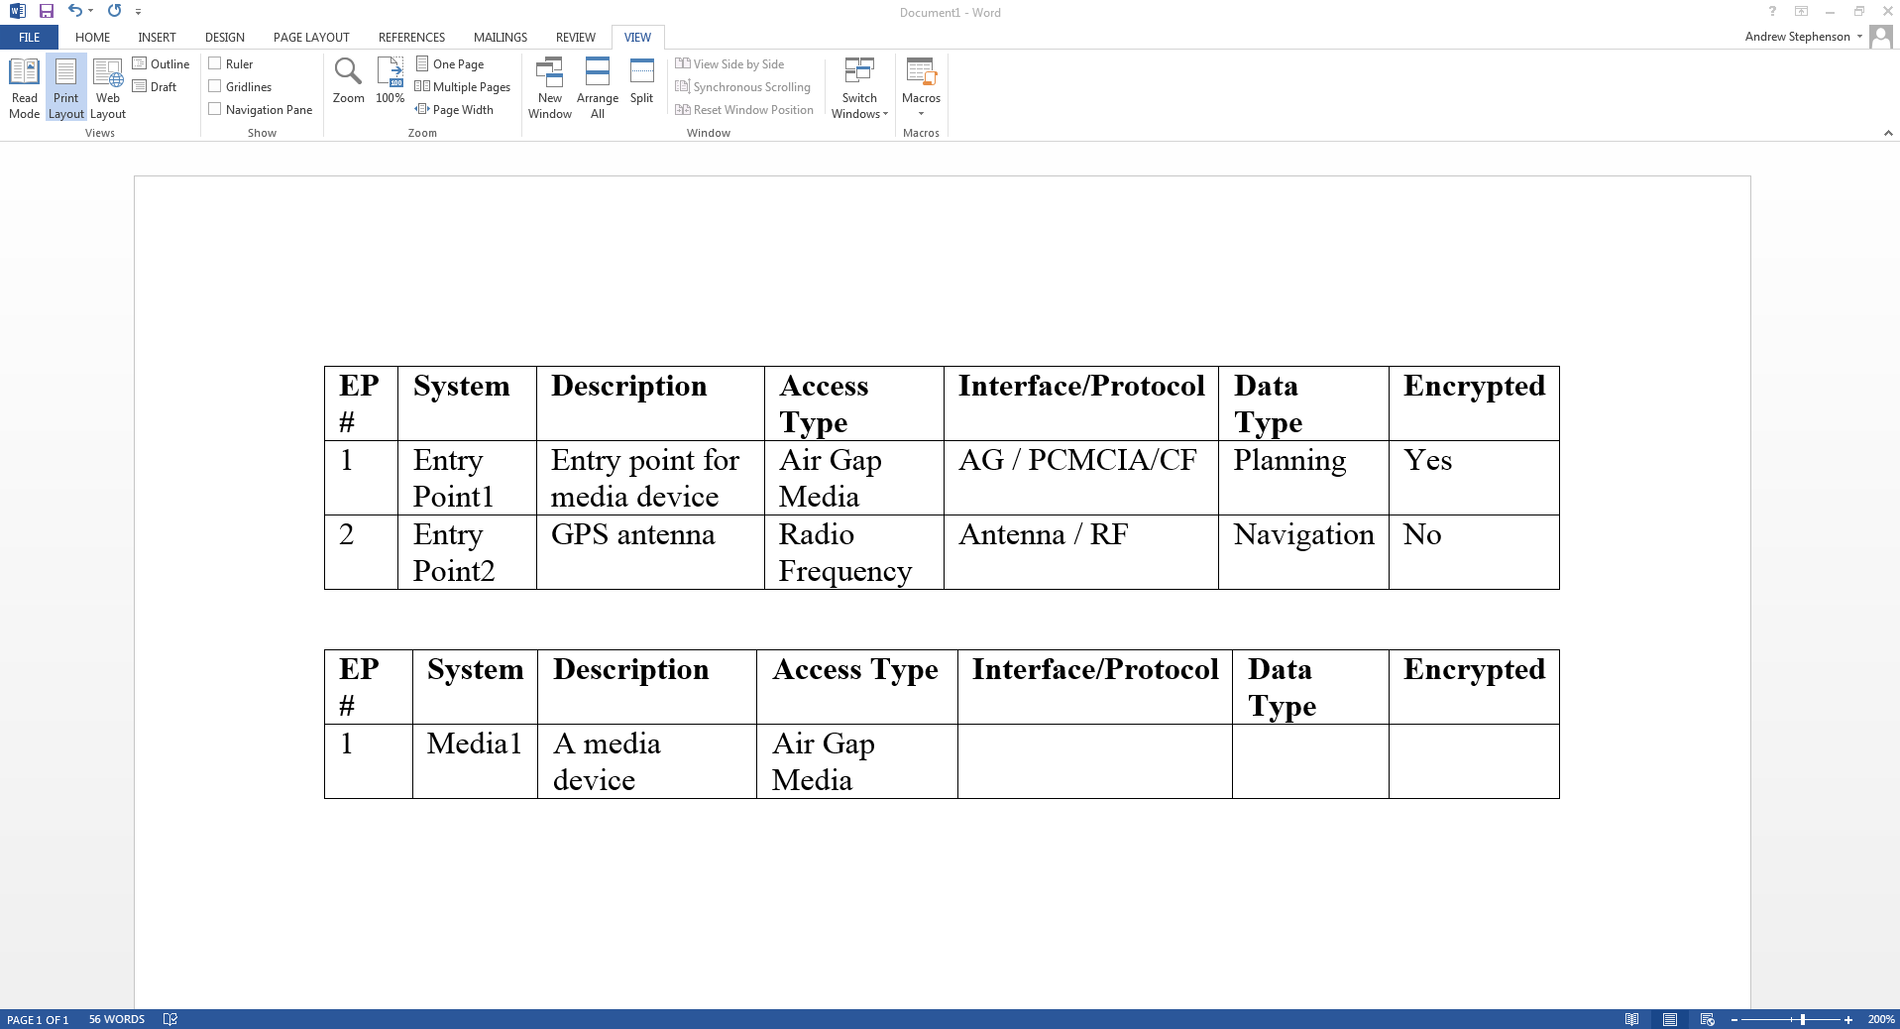
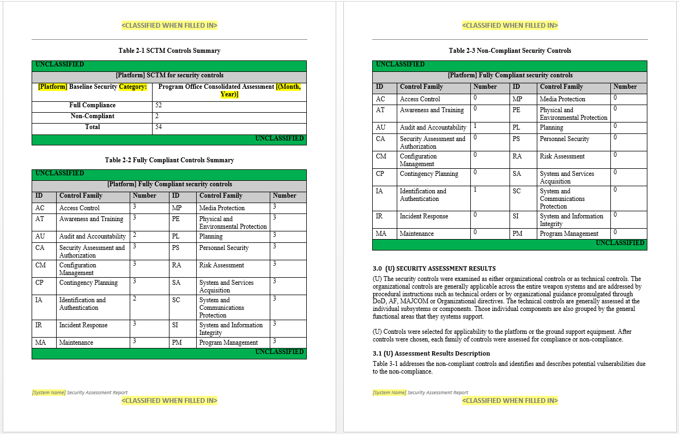
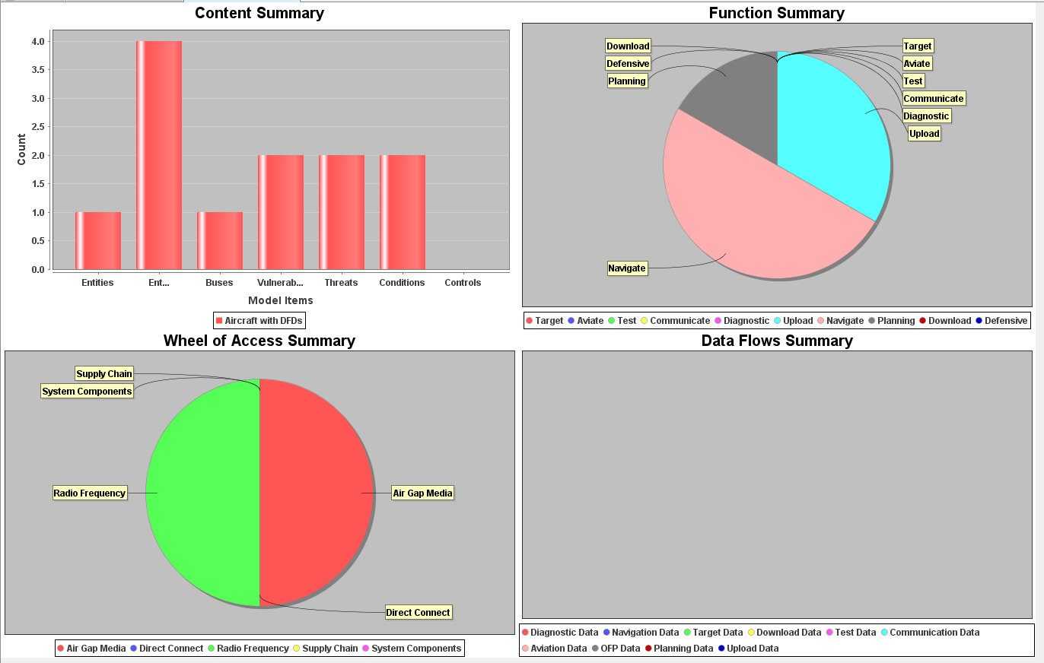
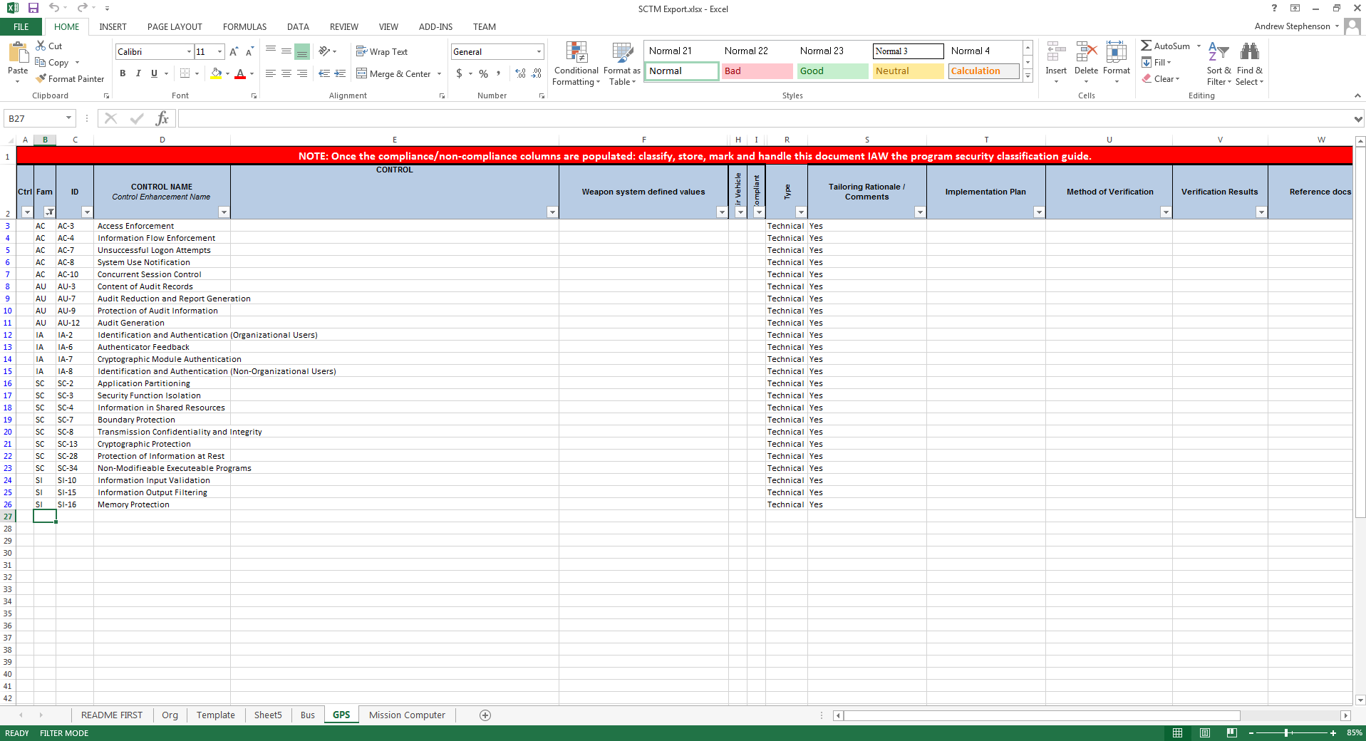
ASSURANT
Modeling
Visualization
INTRODUCTION
Modeling tool to assess cyber vulnerabilities, analyze attack paths, & quantify risk of platform IT
Modeling technique that includes cyber constructs in addition to common MBSE data
ASSURANT models are saved in Oracle DB or local file
Multiple ways to compute risk scores such as Threat (likelihood) & Vulnerability (impact), as well as USCYBERCOM RAM and Mission Risk
Analysis
Report Generation
“Model-based Cyber Analysis and Report Generation Toolkit”
PROBLEMS
GOALS
GOALSSTATUS
Short-Term: Document Generation (e.g. ATO, PPP)
Manual, Labor Intensive, Technically Complex
Takes too long to complete (i.e., 9 – 15 months)
Long-Term: Deep Cyber Attack Path & Risk Analysis
Inadequate capabilities for rigorous attack path & risk analysis for platforms
Limited ability to predict adversary attack paths
No comprehensive analysis technology that fuses results from multiple analysis techniques/tools
Model Based Cyber Analysis Tool: Develop, transition and sustain tool with flexibility/scalability to support various DoD platforms / systems / sub-systems
Field capability to automate documentation and provide configuration control of cyber data and cyber analytics
Provide rich cyber analyses including threats, vulnerabilities, mitigations, attack paths, risk and more
Replace paper reports with model-based review, including ability to rapidly consider “what if” risk scenarios

Slide 3
ASSURANT
Modeling
Visualization
KEY BENEFITS
Flexible and repeatable framework for modeling and assessing cyber threats and vulnerabilities of systems
Compatible with existing MBSE tools and data
Reduced man-hours and save resources by automating manual assessment processes and documentation
Quantify cyber risk and evaluate security controls of systems for mission assurance based on Risk
Configuration management of cyber data
Analysis
Report Generation
“Model-based Cyber Analysis and Report Generation Toolkit”
PLANS
STATUS
Automatic document generation (Current) - Generate AAR, SRTM, SAR, RAR, POA&M, etc.
Configuration Control and Cyber Analytics (Current)
Increased Interoperability & Database (Current)
Cloud compatible storage and MLS infrastructure (Current)
Platform Vulnerability Advisor (Under Development)
Platform Mitigation Advisor (Under Development)
Predictive Attack Path Analysis (Under Development)
Supply Chain Risk Analysis (Future)
Certified for use on NIPRNet and SIPRNet (Jan 2025)
JWICS certification in works
Version 4.0.1 delivered to various PEOs and PMOs across the AF, Army, Navy, and NSA
Transitioned to ~40 PMOs
500+ active users across the DoD
Primarily program management use but also Intel, Test, and Evaluation

Slide 4
Business Case
ASSURANT licenses are free to Government users
Requires Java runtime engine
Available on NIPR and SIPR (on AF approved products list)
JWICS approval in works
Technology is developed based on end user community feedback
ASSURANT team has a Government hosted Teams page used to monitor user enhancement requests, bug reports, and general discussions
500+ users across AF, Army, and NSA
40+ PMOs
Estimated 40% reduction in time for ATO package creation for PMOs
Incremental technology rollout with improved feature sets in coming years
3 month spiral cycle

Slide 5
User Interface

Slide 6
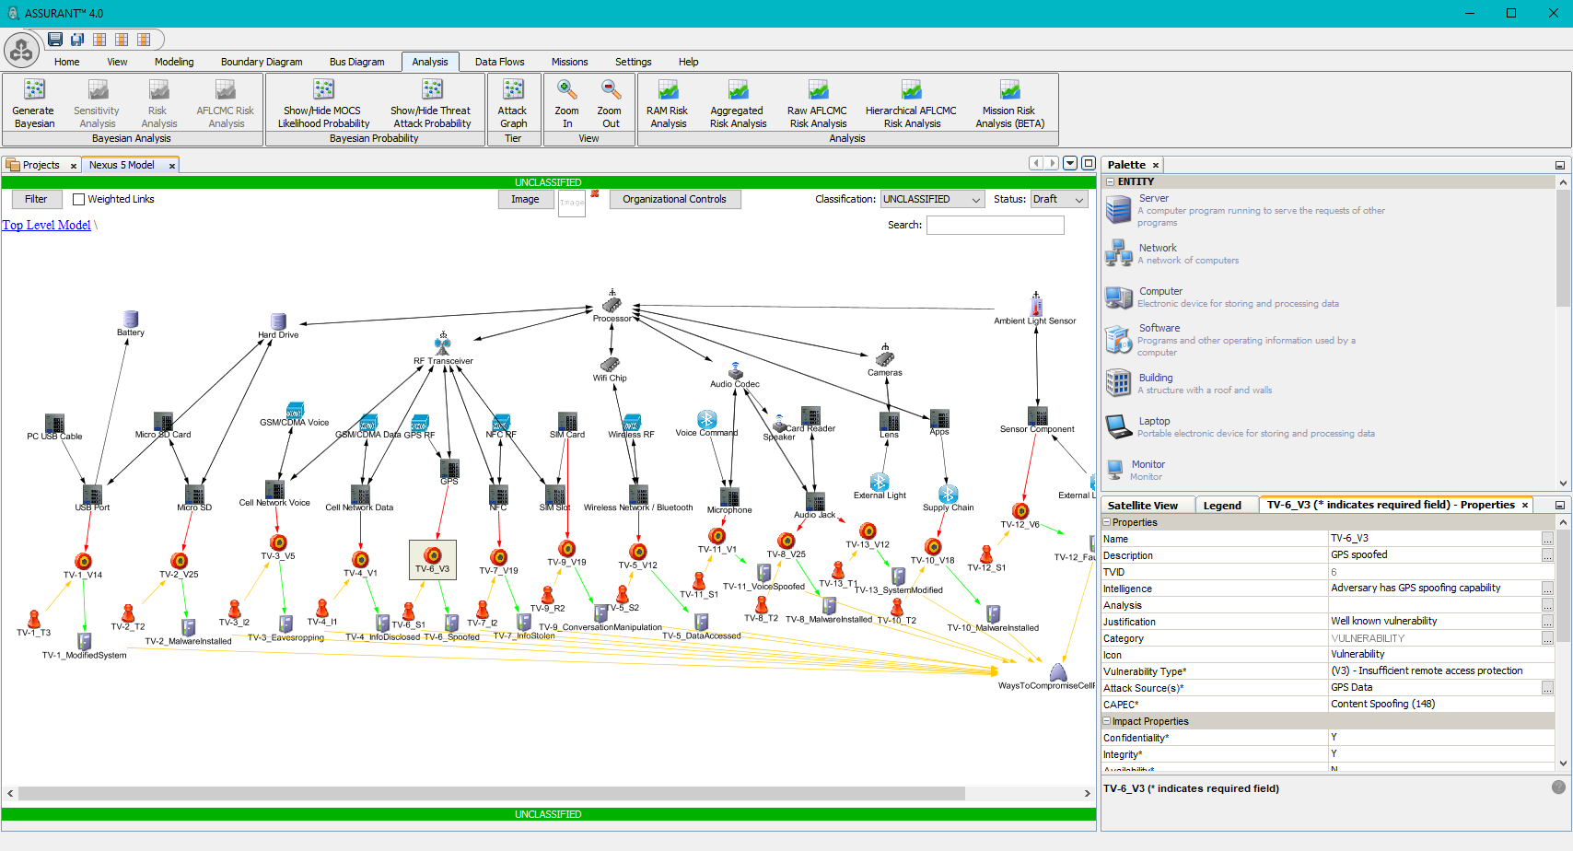
User Interface
Graphical drag-and-drop model development
Familiar interface similar to MS Office and other modeling products
Hides and shows capabilities based on user selection
Minimizes user errors
Many visualizations and
modeling support utilities
to improve user experience

Slide 7
Interoperability
Currently integrated with:
SysML Tools
Cameo, Rhapsody, EA, etc.
Blade Risk Manager
eMASS
MITRE TRACE
AFRL CSA
Risk Scoring Tool
CKURITY
OACRA
Future plans to integrate with:
AFSIM
CTTX
DAAT
COLE/MAESTRO
More

Slide 8
Capability Summary
Cyber modeling
Capture components, connections, entry points, vulnerabilities, threats, mitigations, missions, and more
Visualization
Automatic generation of boundary diagram, bus diagrams, attack paths, risk matrices, and more
Analysis
Attack Path Analysis: Data flows, statistical, probabilistic, etc.
Risk Analysis: Multiple methodologies, applied to missions
Report Generation
ATO reports, threat analysis, criticality analysis, etc.

Slide 9
Deployment
ASSURANT is designed to run on a variety of deployment environments
Deployment options include:
Standalone desktop application
Standalone desktop application with API and database
Client based desktop application with server API and database
Client based desktop application with cloud hosted API and database
Full cloud deployment with web-based UI, API, and database

Slide 10
Questions
Drew Stephenson (andrew.stephenson.6.ctr@us.af.mil)
Jong Hwang (jong.hwang@us.af.mil)
Michael Hazlett (michael.hazlett.2.ctr@us.af.mil)

