Slide 1
USAF Rapid Sustain Office (RSO) Advance Manufacturing Program Office (AMPO)
Advance Manufacturing Program Office I 10.26.2021
Controlled by: RSO
Controlled by: Advance Manufacturing Program Office
CUI Category: N/A
POC: Travis Grohoske
Distribution Statement: A

Slide 2
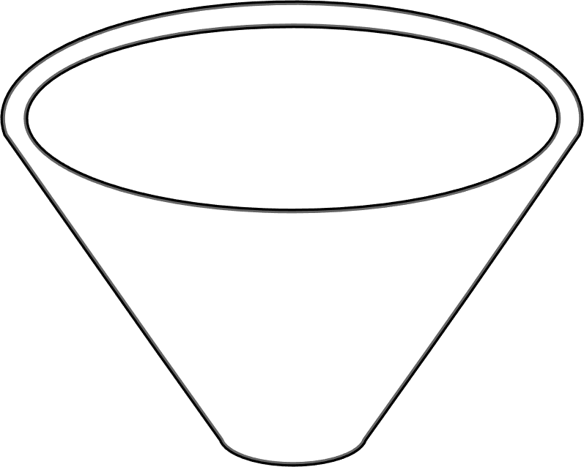
DAF Additive Manufacturing Eco-System
Promote DAF adoption of AM:
Prototyping in force
Re-manufacturing aids
Legacy parts & sustainment
New parts and capabilities
Process es
Materials
Industry
HIGHER EDUCATION
DAF
Needs
Explore
Evaluate
TECHNOLOGY
Mature
Deploy
Standardize
CAPABILITY
New Advanced Manufacturing requirements
Notes:
-The DAF AM Eco-system includes key leaders from AFRL, AFLCMC, and AFSC for a team approach to developing and adopting AM​
-- It is critical to include partners from academy and industry to gain a competitive advantage ​
-- We focus teams on their strengths with AFRL taking command of lower TRL/MRL projects to mature the technology's​
-- The RSO focus on scaling and developing value in additive manufacturing process with higher readiness levels​
-Proven repeatable process that constantly evaluates the state of DAF Needs, Processes and Materials​

Slide 3
AM Program Office Execution
Material and Machine Qualification
Procurement documents
Material Characterization
Requirement's definitions
Personnel Certification
Technician training
Engineering training
Technical Data
Periodic maintenance
Facility guidelines
Maintain Advance Technology and Training Centers (ATTC)
Dayton, Ohio
Middle, Georgia

Slide 4
Capabilities – Printing and Post Process
METAL PRINTERS AND POST PROCESSING
EOS M400-4 (2)
EOS M290 (15)
Delta H Aluminum Furnace (2)
Ipsen Vacuum Furnace (2)
Hexagon Shop Floor CMM (2)
POLYMER PRINTERS
Stratasys Fortus F900 (5)
Stratasys Fortus 450mc (3)
Desktop Printers (7)
Mitsubishi Wire EDM (3)
Haas CNC Mill (3)
Haas CNC Lathe (2)
Manual Mill (3)
MATERIALS¹
Antero 800NA
Manual Lathe (2)
MATERIALS
ULTEM 9085 Natural², Certified Grade (CG)
Ti-6Al-4V (Titanium)²
CoCrMo (Cobalt Chrome)²
ULTEM 9085 Natural²
17-4PH SS (Stainless Steel)
AlSi10Mg (Aluminum)
ULTEM 9085 Gunship Gray
NA718 (Nickel Alloy)
F357 Al (Aluminum)
ULTEM 9085 Black

Slide 5
Size Limitations
POLYMERS
Fused Deposition Modeling (FDM)
36 inches
Stratasys 450mc F900 equipment
24
Size: 36 x 24 x 36 inch build volume
36
METALS
Direct Metal Laser Melting (DMLM)
12.8 inches
9.8
EOS M290 equipment
Size: 9.8 x 9.8 x 12.8 inch build volume
9.8

Slide 6
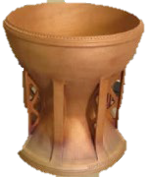
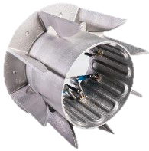
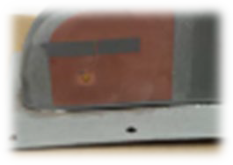
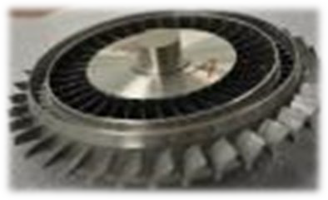
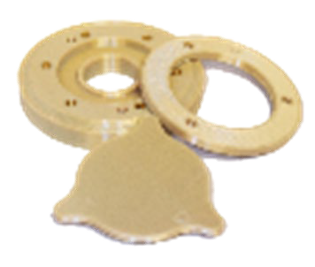
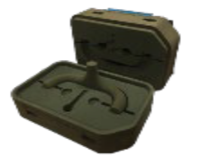
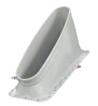
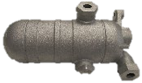
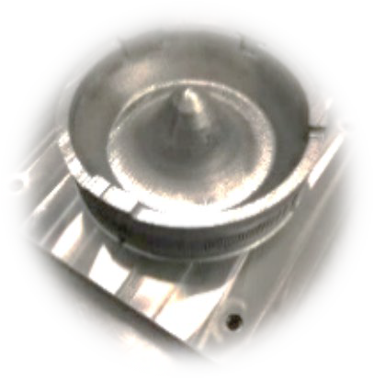
Identified DAF Application Areas
Enhanced Capability
Immediate Innovation
Complex Geometries & Integration
Lead Time Reduction
Manufacturing Process Aids
Parts Replacement
Affordability

Slide 7
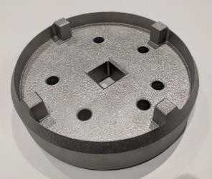
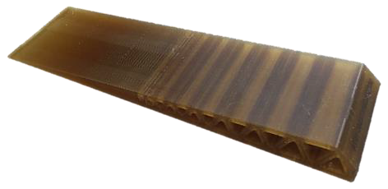
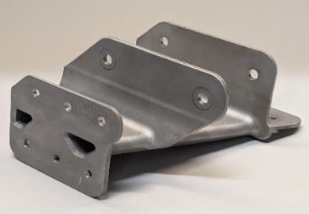
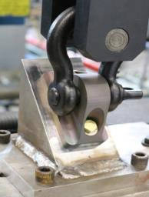
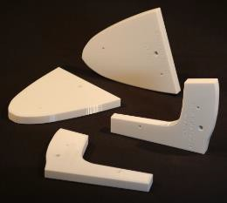
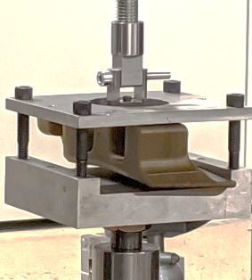
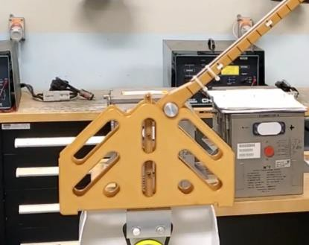
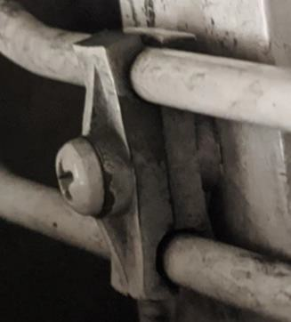
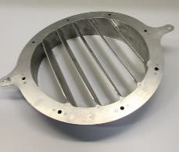
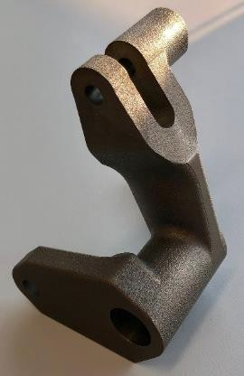
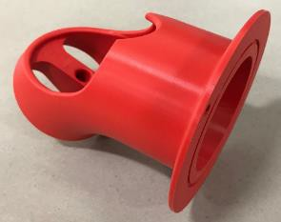
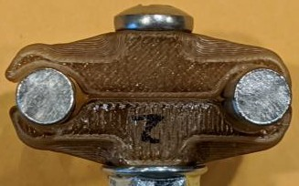
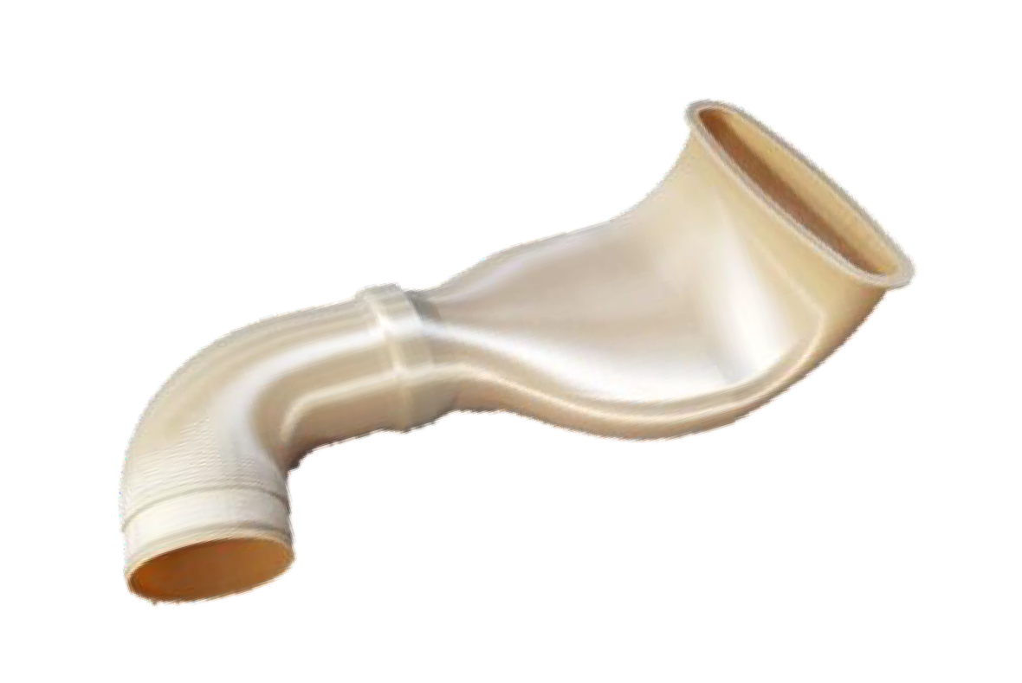
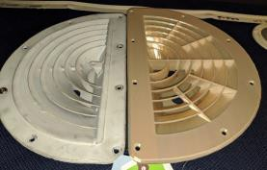
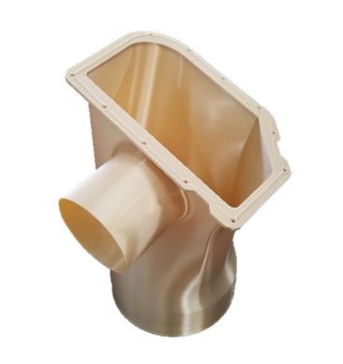
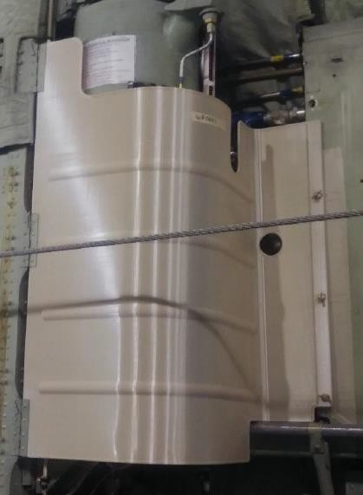
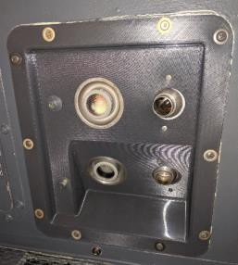
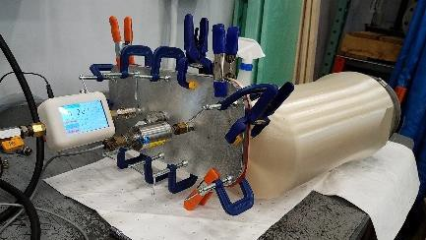
GENERAL APPLICATIONS
Aircraft Metals Replacement (DMLM)
Phenolic replacement (FDM Antero)
Tooling and fixtures
Aircraft Polymer panels and covers (FDM Ultem 9085)
Aircraft Polymer ducts (FDM Ultem 9085)

Slide 8
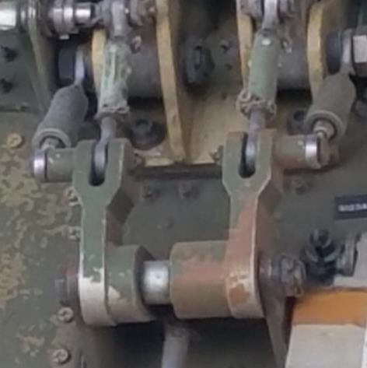
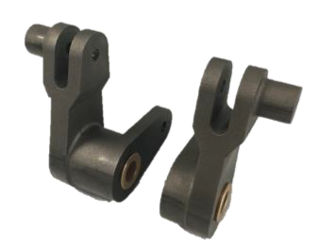
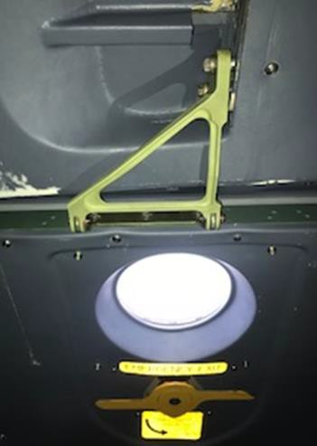
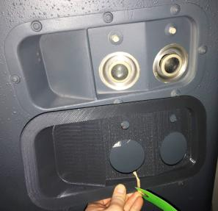
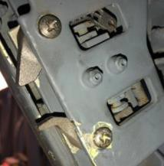
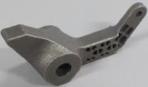
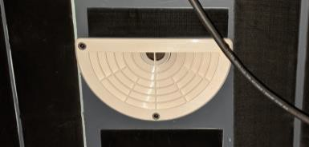
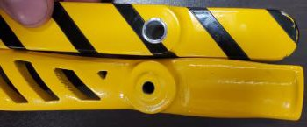
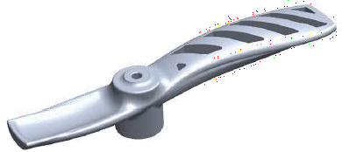
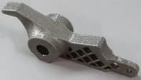
C-5 GALAXY
OVER 60 UNIQUE FLYING PART NUMBERS!
Aft Ramp Bell Cranks Original: Aluminum 7075-T651 AM: Titanium Ti-6Al-4V
C-5 Upper Forward Service Door Support Original: Aluminum 7075-T6 AM: Titanium Ti-6Al-4V
Troop Reading Light Mount Original: Phenolic Fiberglass AM: Ultem 9085
Ladder Stops
Original: Aluminum 7075-T651
AM: Titanium Ti-6Al-4V
Flight Navigator A/C Diffuser
Original: Painted sheet metal
AM: Ultem 9085
Seal Retention Handle Original: Aluminum A356 AM: Aluminum AlSi10Mg-T6

Slide 9
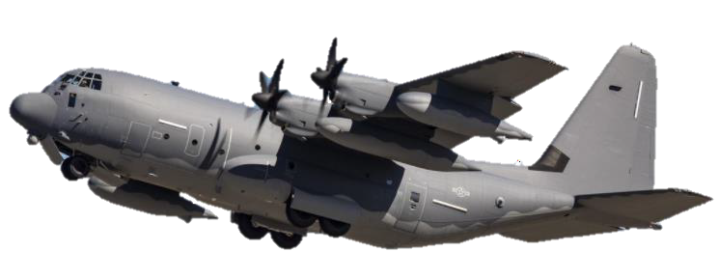
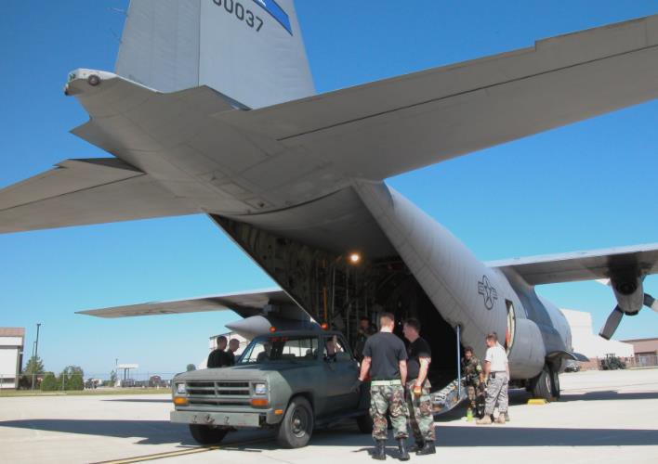
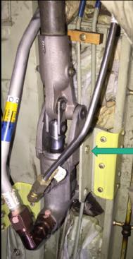
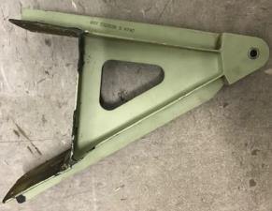
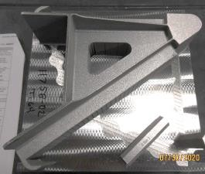
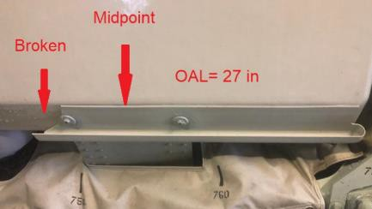
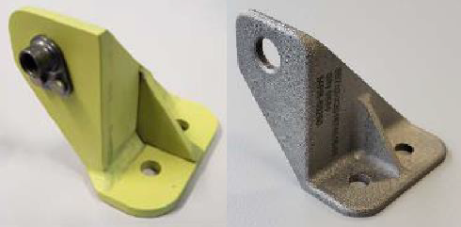
C-130 HERCULES
Utility Hydraulic Panel
Original: Lexan
AM: Ultem 9085
Hydraulic Pump Support
Original: Aluminum 7075
AM: Aluminum AlSi10Mg
Platform Support Fitting
Original: Aluminum A357-T61
AM: Titanium Ti-6Al-4V
Latrine Drip Shield
Original: Plastic
AM: Ultem 9085
Hydraulic Line Bracket Original: Aluminum 6061-T6 AM: Titanium Ti-6Al-4V

Slide 10
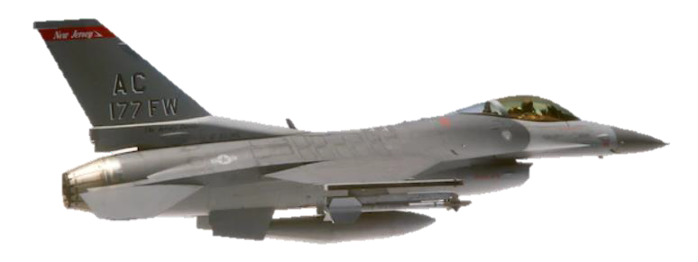
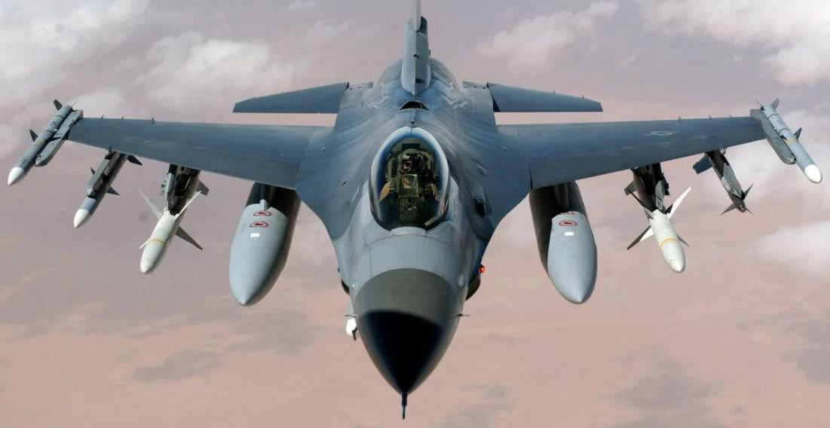
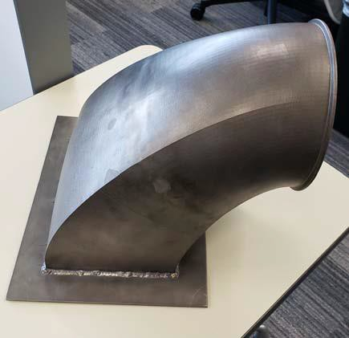
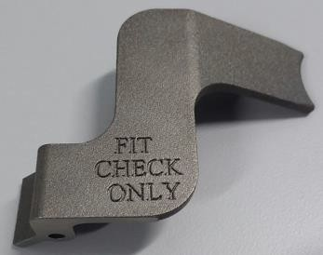
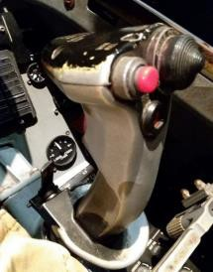
F-16 FIGHTING FALCON
Jet Fuel Starter (JFS) Test Duct
Original: Stainless Steel, 17-4PH
AM: Welded Nickel Alloy 718
Hydraulic Tubing Support
Original: Nylon 66
AM: Antero 800NA
Hands-on Throttle And Stick (HOTAS) Paddle Prototype Original: Aluminum 6061-T6
AM: Titanium Ti-6Al-4V

Slide 11
ADVANCED M ANUFACTURI NG
C-5 AFT RAMP BELL CRANK
BACKGROUND
These C-5 bell cranks prevent the aft ramp pressure door hinges from over extending. Parts fail due to an extended lifetime of corrosion and wear. Diminishing source of supply results in long lead times for traditional part replacement. DMLM provides an AM solution with a titanium alternative bell crank.
DEVELOPMENT RESULTS
1.5X+ material strength improvement
Planned and executed qualification testing to include dimensional inspection, computerized tomography
(CT) scan, tensile bar test, and component level loading
Proved out failure in shear bolts prior to bell crank failure
Geometry ultimately optimized for light weight using finite element analysis (FEA) simulation
AM process simulation implemented to optimize print process
ORIGINAL MATERIAL:
Aluminum 7075-T651
AM MATERIAL:
Titanium Ti-6Al-4V
KICKOFF:
APR 2017
FIT CHECK:
NOV 2017

Slide 12
ADVANCED M ANUFACTURI NG
C-5 INTERIOR PANELS
BACKGROUND
The C-5 Galaxy has been transporting cargo since 1970. With nearly 50 years of abuse, many of the interior panels and covers have deteriorated beyond repair with no immediate source of supply. FDM has delivered a robust AM solution with Ultem 9085, a polyetherimide polymer which meets stringent flame, smoke, and toxicity (FST) requirements of 14 CFR 25.853 and is approved for aircraft interior applications via Airworthiness Circular AC-18-04.
DEVELOPMENT RESULTS
ORIGINAL MATERIAL:
Kydex/Polymer
AM MATERIAL:
Ultem 9085
KICKOFF:
Various
INSTALL:
Various
Tech data packages delivered for 30+ unique P/Ns, with 50+ flying panels
Existing print capabilities available at Travis AFB
Airworthiness Circular to support interior aircraft application approval
3’x2’x3’ part size capability

Slide 13
ADVANCED M ANUFACTURI NG
C-5M HUMP PANEL WEDGE SPACERS AND SUPPORT BLOCKS
BACKGROUND
Wedges and support blocks provide underlying shape of the C-5 upper hump aerodynamic
panel over the wing splice. This panel has exhibited adhesion bond issues with existing
phenolic parts. AM eliminates health hazards with machined phenolic dust. AM Antero 800NA offers a polymer replacement with excellent chemical and thermal performance.
DEVELOPMENT RESULTS
Qualified 84 unique blocks and 12 unique wedges
Integrated components, eliminating over 300 fasteners and 84 sheet aluminum straps per aircraft
Developed bond surface preparation method for existing aircraft sealant
Led qualification testing including ASTM roller peel and fastener pull out combined with chemical and thermal environmental exposure
Lead time and cost savings addressing true air craft readiness issue
ORIGINAL MATERIAL:
Phenolic
AM MATERIAL:
Antero 800NA
WEDGE KICKOFF:
NOV 2018
WEDGE INSTALL:
MAR 2019

Slide 14
ADVANCED M ANUFACTURI NG
C-130 HYDRAULIC PUMP SUPPORT
BACKGROUND
This bracket supports the hydraulic hand pump used for manual operation of the rear cargo ramp when power is down. Existing machined Aluminum 7075 bracket fails frequently (2/month), has zero supply balance and difficulty in local manufacture or procurement.
DEVELOPMENT RESULTS
Laser scan of fractured part for reverse engineered CAD model
FEA and design optimization for ~2X part strength
Designed for AM with minimized post processing and machining
Qualification test plan development and execution with CT scanning and application specific load testing
ORIGINAL MATERIAL:
Aluminum 7075
AM MATERIAL:
Aluminum AlSi10Mg
KICKOFF:
11 NOV 2019
INSTALL:
04 JUN 2020

Slide 15
ADVANCED M ANUFACTURI NG
F-15 ECS LOUVER
BACKGROUND
The F-15 louver keeps birds and debris from entering the ECS duct system. The original six piece welded assembly experienced frequent failures due to weld cracks between the individual louvers and housing. DMLM delivered a one piece AM design from Nickel Alloy 718 for improved durability and increased temperature performance.
DEVELOPMENT RESULTS
Improved fit to aircraft outer mold line
Increased design robustness with filleted louvers to housing
Increased thermal performance with Nickel Alloy 718
Extended lifecycle for reduced downtime and maintenance hours
Increased aircraft readiness
ORIGINAL MATERIAL:
Titanium Unalloyed
AM MATERIAL:
Nickel Alloy 718
KICKOFF:
AUG 2019
INSTALL:
SEP 2020
Weld Crack

Slide 16
ADVANCED M ANUFACTURI NG
F-15, M61 CANNON TURNAROUND GUIDES
BACKGROUND
The turnaround guides are part of the ammunition feed system on an M61 Vulcan Cannon. They are a consumable wear item with limited source of supply and long lead times. AM provides a solution with DMLM Titanium Ti-6Al-4V for reduced lead time and increased life cycle.
DEVELOPMENT RESULTS
Prepared four part numbers with minor adjustments for improved printing with DMLM
Produced 36 parts in 3 DMLM builds with minimal post processing
Performed dimensional qualification of all components
Delivered 15 parts to Program Office for live fire qualification testing
ORIGINAL MATERIAL:
Aluminum A356-T6
AM MATERIAL:
Titanium Ti-6Al-4V
KICKOFF:
MAR 2019
PART DELIVERY:
SEP 2019

Slide 17
ADVANCED M ANUFACTURI NG
HH-60 FLARE DISPENSER
BACKGROUND
The flare dispenser is mounted on the side of the HH-60 Pave Hawk for the purpose of delivering flares. The existing Aluminum 7075 mounting brackets were exhibiting stress corrosion cracking. DMLM Titanium Ti-6Al-4V provides a robust AM solution for the conversion of the entire Flare Dispenser assembly.
DEVELOPMENT RESULTS
Re-designed mounting features to greatly reduce crack potential
Applied FEA and geometry optimization for increased strength vs weight
Produced 8 AM components for left and right hand assemblies
Developed and executed qualification test plan including strain gaging, impact testing, tensile specimens, and CT evaluation
Successfully fit-checked mounting to HH-60 Pave Hawk
ORIGINAL MATERIAL:
Aluminum 7075
AM MATERIAL:
Titanium Ti-6Al-4V
KICKOFF:
JUN 2019
DELIVERY:
NOV 2020

Slide 18
ADVANCED M ANUFACTURI NG
ARNOLD ENGINEERING DEVELOPMENT COMPLEX (AEDC) PRESSURE RAKE TEST RIG
BACKGROUND
A research group at AEDC investigate the printing of a single piece pressure rake test rig for air flow experimentation. Existing pressure rakes are typically multi- piece fabrications with many delicate pitot tubes. The proposed AM rake concept was a single piece rig with four internal rake probes comprising 28 total pitot tubes, each with internal channels routed through the duct to a single outlet port location.
DEVELOPMENT RESULTS
ORIGINAL MATERIAL:
NA
AM MATERIAL:
Stainless Steel 17-4PH
KICKOFF:
AUG 2018
DELIVERED:
MAR 2019
Optimized initial customer design for DMLM to print without support
Successfully printed and cleared powder from 28 channels at .080” diameter and up to 14” long, thus demonstrating feasibility
Leveraged polymer 3D printing for protective packaging
Protective packaging
Cross-section and network
of hollow channels

Slide 19
Total Parts Delivered
Part Category | Parts Delivered |  |  |  |  |  |  |  | Total Unique Part #s | Total Parts
 | Metal |  |  |  | Polymer
 | Aerospace |  | Other |  | Aerospace |  | Other
 | Unique Part #s | Total Parts | Unique Part #s | Total Parts | Unique Part #s | Total Parts | Unique Part #s | Total Parts
Completed Projects | 77 | 382 | 49 | 168 | 159 | 859 | 100 | 1778 | 385 | 3187
Active Projects | 7 | 24 | 0 | 0 | 12 | 72 | 3 | 7 | 22 | 103
Total Projects | 84 | 406 | 49 | 168 | 171 | 931 | 103 | 1785 | 407 | 3290

Slide 20
Notes:
End Card – Put this slide at the end of presentations.

