Slide 1
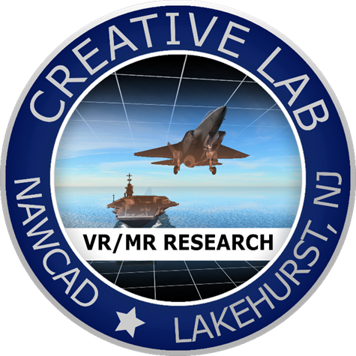
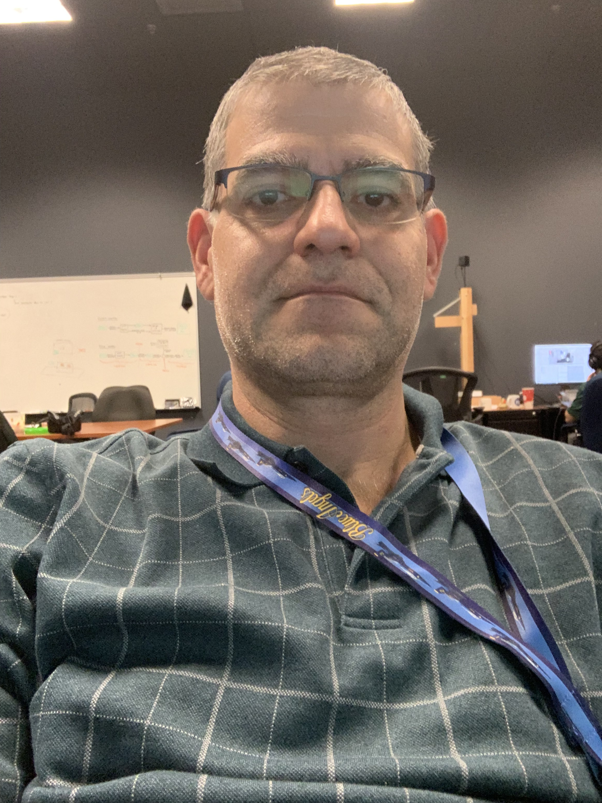
Augmented Reality Remote Maintenance Support Service
(ARRMSS)
7 DECEMBER 2020
Presented to: Maintenance Innovation Challenge
Presented by: Aristides Staikos
Training /Training Support Branch
CREATIVE Lab
Naval Air Warfare Center Aircraft Division Lakehurst
Joint Base MDL, NJ 08733
Office: (732)323-7238
Cel: (732)997-9161
Email: aristides.staikos@navy.mil

Slide 2
Background
Current CONOPS for unresolved maintenance issues involve a Subject Matter Expert (SME)/NATEC representative traveling to a location to help with troubleshooting/repair
Increases repair time
Increases cost
Creates a cascading effect on schedule
Negatively impacts equipment and aircraft availability
Hinders Fleet readiness

Slide 3
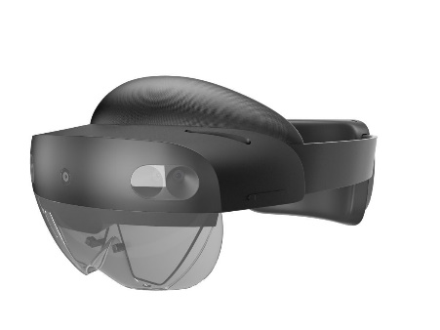
Augmented Reality
Augmented reality (AR) is an interactive experience where the objects that reside in the real world are enhanced by computer-generated content, also known as augmentations or holograms
Using a headset, such as the Microsoft HoloLens, or a tablet computer, holograms and other information are overlaid in the real world
Information about the surrounding real world of the user becomes interactive and digitally manipulated
NAWCAD Lakehurst established the “AR for Maintainers Vision” in which AR would play a key role in Naval Aviation Maintenance
ARRMSS is part of that vision and is being designed for it.

Slide 4
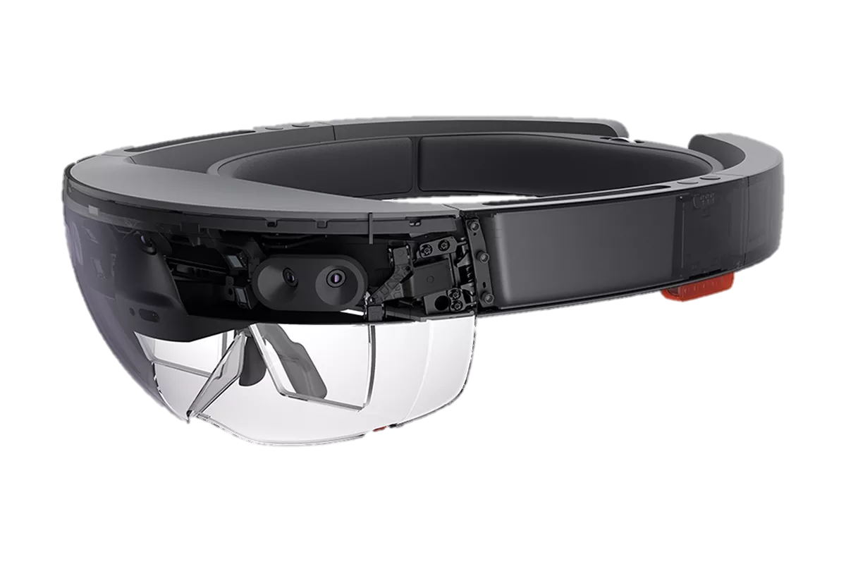
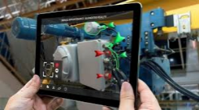
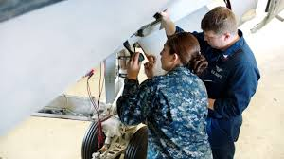
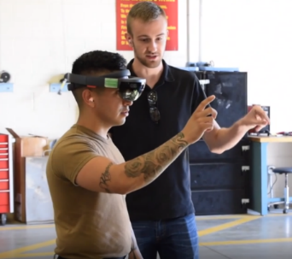
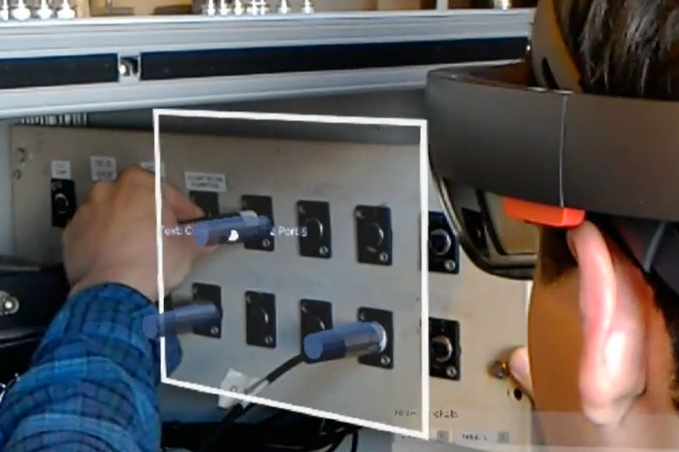
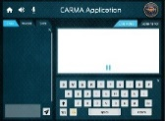
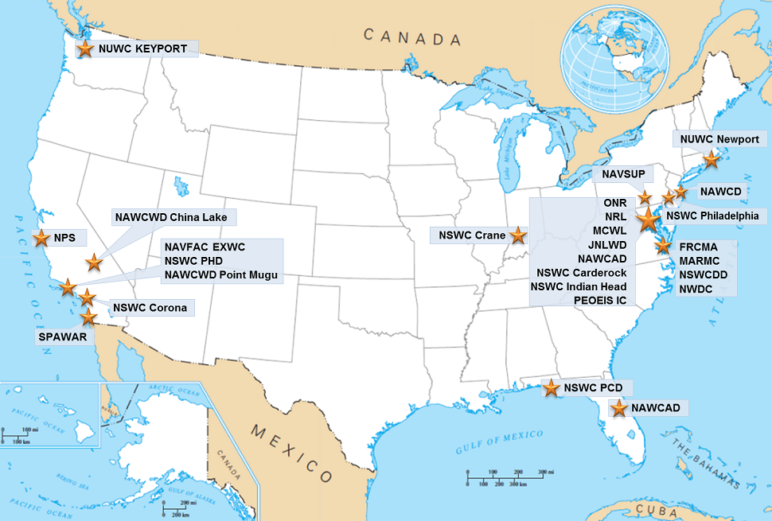
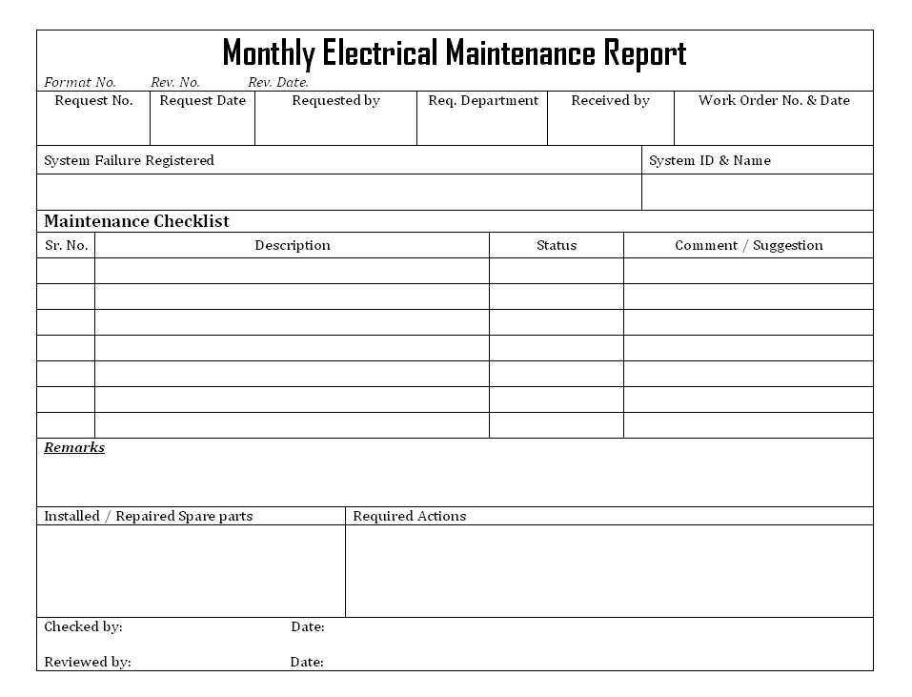
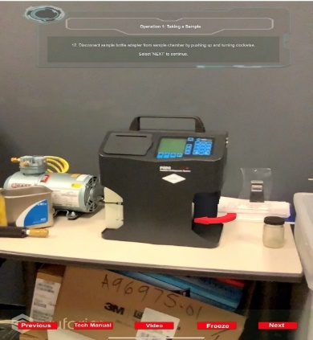
AR for Maintainers Vision
Networking for Mixed Reality
AR Device Ruggedization
Remote Maintenance Assistance
219WFD-ROT-IC-18-001 Collaborative Augmented Reality Maintenance Assistant (CARMA)
Maintenance Object Recognition
6
Maintenance Report Generation
Maintenance Procedure Database
Local Guided Operation/Maintenance

Slide 5
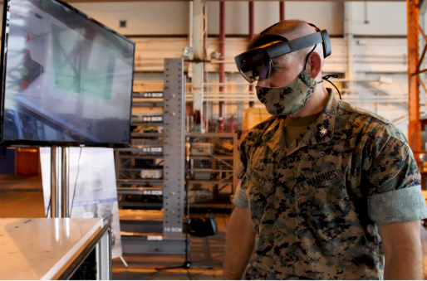
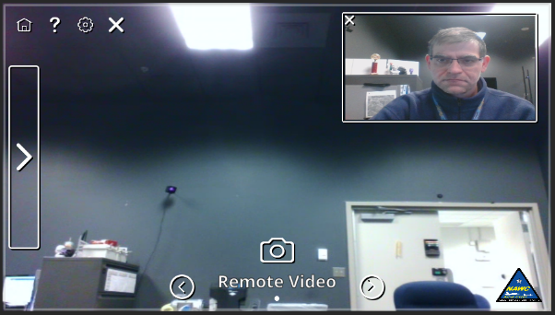
ARRMSS Overview
Augmented Reality Remote Maintenance Support Service (ARRMSS) is an enabling technology for the AR for Maintainers Vision
ARRMSS provides the on-demand ability for a fleet maintainer to communicate directly with a remote Subject Matter Expert (SME) as though they were co-located in a maintenance space
Video and audio transmissions combined with spatial mapping data to allow users on both ends of a network to troubleshoot problems and step through particularly challenging repair tasks/engineering investigations collaboratively, regardless of geographic location.
Audio
Video
Text
Images
Documents
Holograms

Slide 6
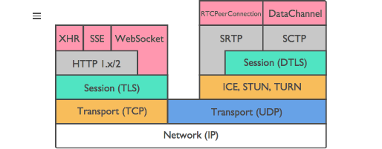
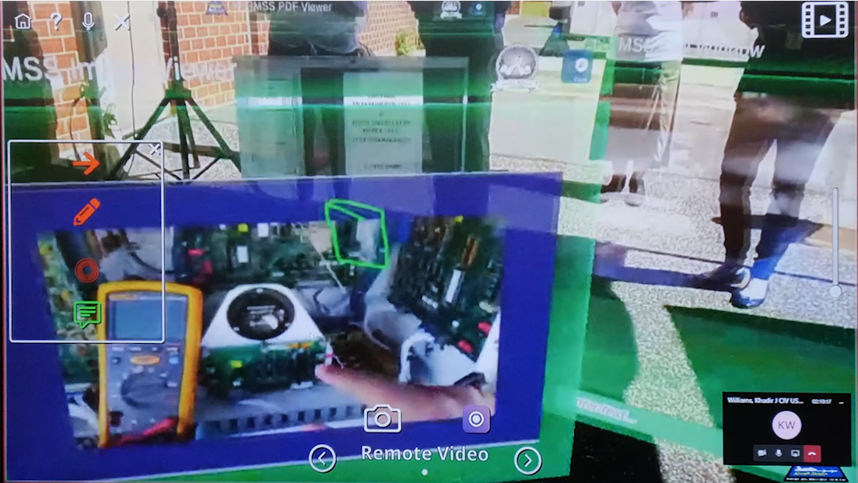
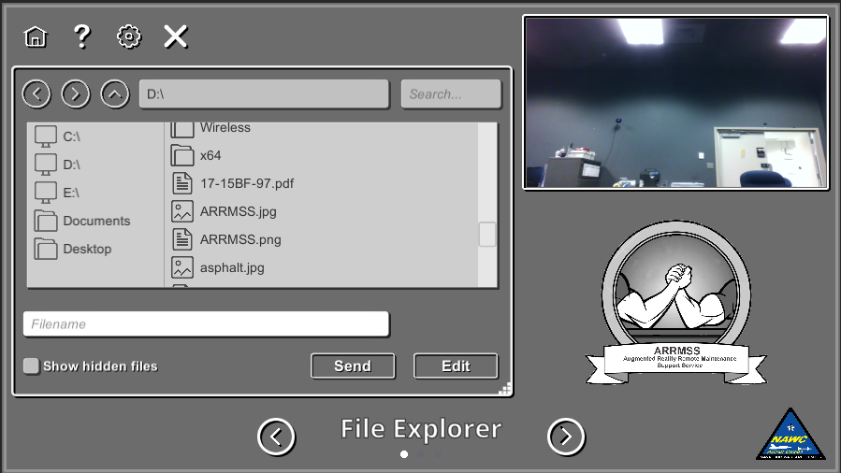
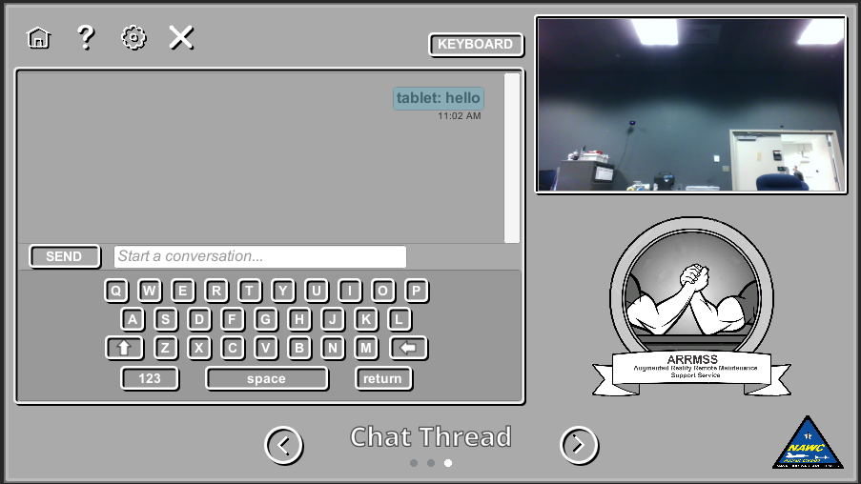
ARRMSS Overview (cont.)
ARRMSS is an in-house designed application framework that connects a SME (using a Windows PC/tablet) to a maintainer (wearing a HoloLens 1 or 2) and allows for the transfer of applicable data over a DoD network
Internet standards-based Audio/Video/Data Transmission Protocols
Remote Expert and User Hologram Placement
Novel algorithm developed to minimize bandwidth usage
Network Adaptability
Session Recording
PDF and text document sharing
3D Model Sharing
Photo Sharing/Editing
WebRTC Protocol Stack

Slide 7
ARRMSS Overview (cont.)
COTS
Commercial Cyber Best Practices
Navy
Adopted DoD Cyber Requirements Upfront
COTS
Limited Network Flexibility
Navy
Dynamic Bandwidth Adaptation 64 kbps – 2 Mbps
COTS
Cloud Dependence
Navy
Data Stored ONLY on End User Devices
COTS
Recurring License Costs
Navy
In-House Software Support Activity
COTS
Obsolescence Risk
Navy
100% Data Rights and Internal Sustainment
COTS
Limited Feature Flexibility
Navy
Developers on staff New Features upon Request

Slide 8
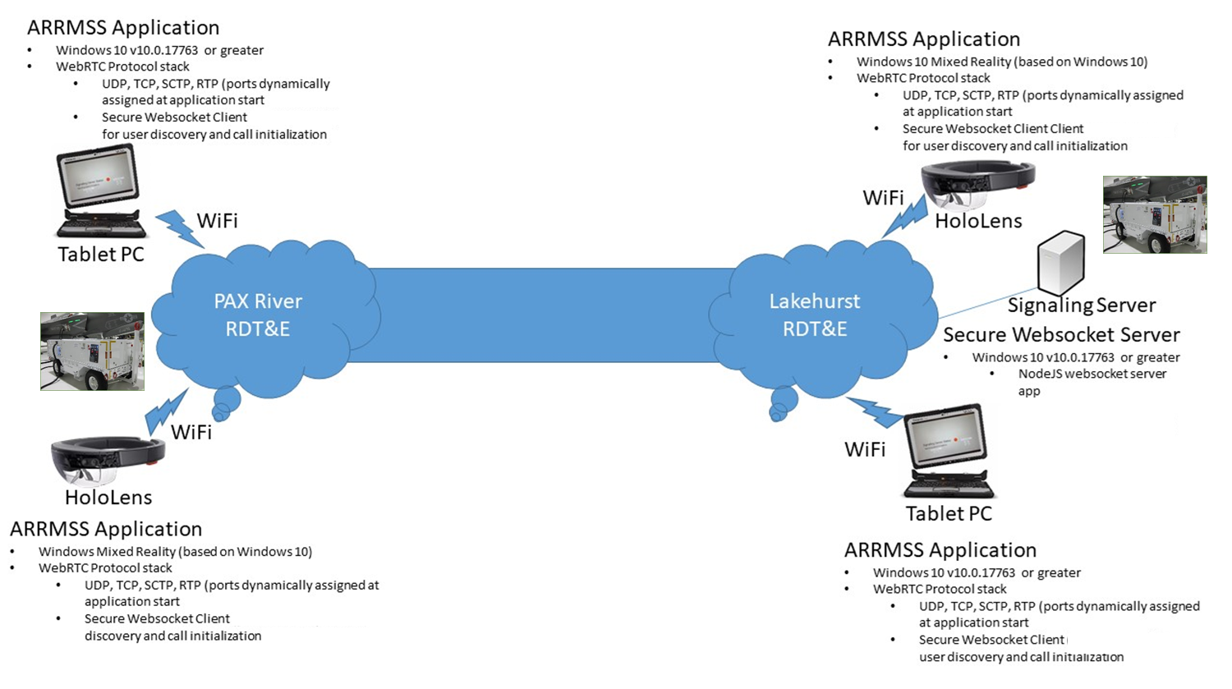
ANTx 2020 Technology Demonstration

Slide 9
ARRMSS Video

Slide 10
Questions

