Slide 1
Additively Manufactured High Temperature Friction Stir Tooling through Thermal Spray Techniques
Fardad Azarmi¹, Martin McDonnell²
Department of Mechanical Engineering, North Dakota State University, Fargo, ND, 58108, USA.
US ARMY FCDD-GVS.

Slide 2
Outline
Introduction to Friction Stir Welding (FSW)
FSW Tooling
Introduction to Thermal Spraying
New Design for FSW Tooling System
Project Plan

Slide 3
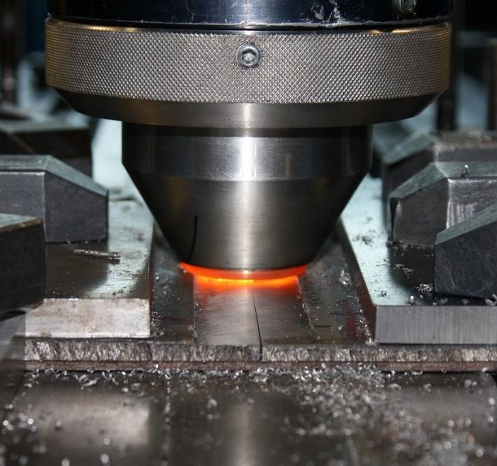
Friction Stir Welding (FSW)
The technology was introduced to the industry in 1991 by UK Welding Institute.
A Solid State process capable of producing very high strength joining of a wide range of materials (metals & alloys)
New Design for FSW Tools
Introduction to Thermal Spraying
FSW Tooling
Introduction to FSW
Project Plan

Slide 4
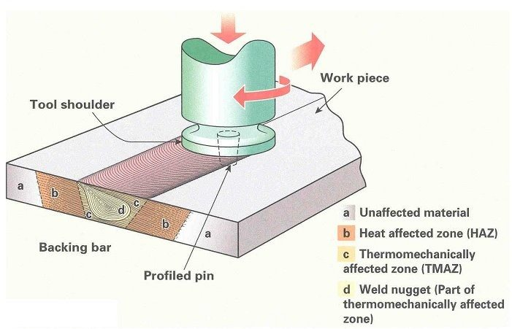
Friction Stir Welding (FSW)
Rotational and translational movement of a cylindrical tool on the surface of rigidly clamped parts.
Friction and deformation resulting from tool movement cause plasticization.
Joining of two parts by deformation.
New Design for FSW Tools
Introduction to Thermal Spraying
FSW Tooling
Introduction to FSW
Advantages
Compared to the Traditional Joining Techniques
Lower apparent energy input
Lower cost
Less distortion
Less residual stress (build up)
Process take place entirely in solid state condition
No melting
No re-solidification
Small heat affected zone
High quality Welding
No porosity (very low)
No oxidation (very low)
Application:
Marine, boats, and ships
Aerospace
Military
Railways
Automotive
Electronics
And more….
Project Plan

Slide 5
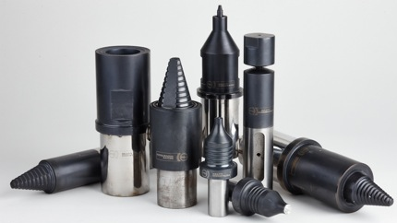
FSW Tooling
FSW Tool Materials:
Tool Geometry & Materials
H13 Tool Steel
Nickel Cobalt Alloy
Tungsten Carbide
Boron Nitride
….
FSW Tools provide both rotational and weld movement and speed. Force (pressure) is also transferred through tool components on the work piece.
New Design for FSW Tools
Welding efficiency can be highly affected by FSW Tools. Since, the shape and material of the tool play an important role in the heat generation and heat loss during the process.
Introduction to Thermal Spraying
FSW Tooling
Introduction to FSW
Optimum tool design results in high quality welding with desired speed.
Project Plan
Picture Source: https://www.phase-trans.msm.cam.ac.uk/2011/tools.html

Slide 6
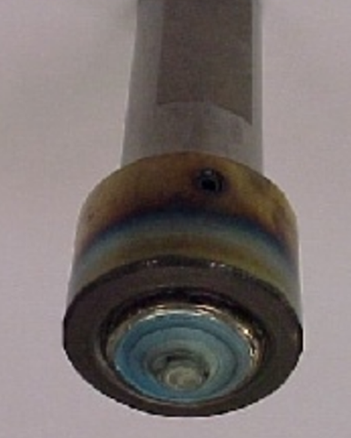
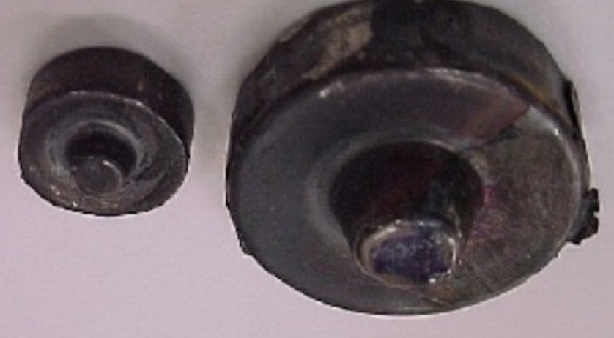
FSW Tooling
Problems with FSW Tools:
Low heat generation. (Tools with relatively low COF)
High rate of heat flow to the tool during the process. (damage in Tool and short service life)
Provide inadequate rotation and translation speed.
Breakage of pin (nib) inside the work piece during process. (Low strength Tools and low heat generation)
Restriction in applied pressure on the work piece. (Low strength Tools)
Inability in joining dissimilar materials.
New Design for FSW Tools
Introduction to Thermal Spraying
FSW Tooling
Introduction to FSW
Project Plan
Picture Source: Oak Ridge National Laboratory (ORNL)

Slide 7
FSW Tooling
An Optimum Tool Design Will Provide:
High heat generation on the work piece.
Low heat flow to the tool.
Optimize material flow around the nib (pin).
Reduction of heat loss.
Increase of both welding speed and rotation speed.
Increase plasticization of work piece.
Increase tool life.
Lower the cost of the system.
New Design for FSW Tools
Introduction to Thermal Spraying
FSW Tooling
Introduction to FSW
Project Plan

Slide 8
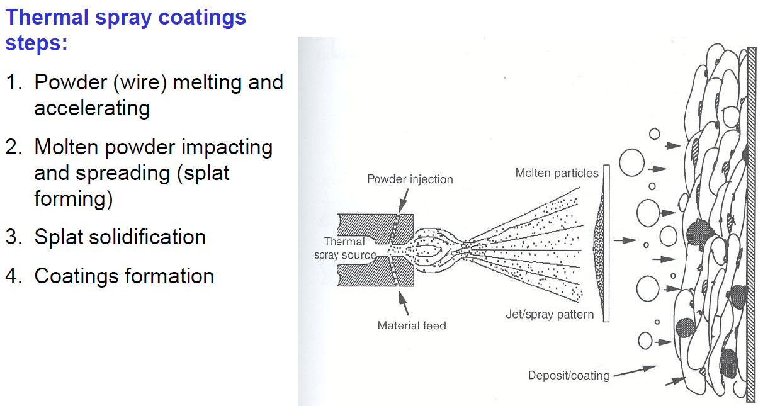
Thermal Spraying
Deposition of a coating layer on the surface of the materials
Increases: base material's resistance to corrosion, erosion,
cavitations, friction, and abrasion.
Fabrication of near net shape parts and components
Fabrication of graded materials (Functionally gradient materials, FGM)
New Design for FSW Tools
Introduction to Thermal Spraying
FSW Tooling
Introduction to FSW
Project Plan

Slide 9
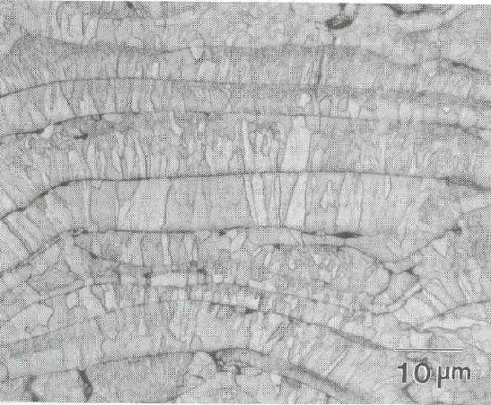
Thermal Spraying
Coating Formation and Build-up Process
Powder
Droplet
Splat
Coating
New Design for FSW Tools
Introduction to Thermal Spraying
FSW Tooling
Introduction to FSW
Project Plan
Coating Cross-section

Slide 10
Thermal Spraying
Thermal Spraying Technologies
Combustion
Electric
Kinetic
Low Velocity
High Velocity
Flame spray
HVOF
HVAF
D-Gun TM
Wire arc spray
Plasma
Cold spray
Direct current (DC)
Radio frequency (RF)
Atmospheric
Inert
Shroud
Vacuum
New Design for FSW Tools
Introduction to Thermal Spraying
FSW Tooling
Introduction to FSW
Project Plan

Slide 11
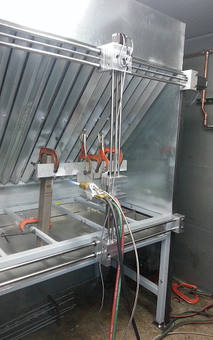
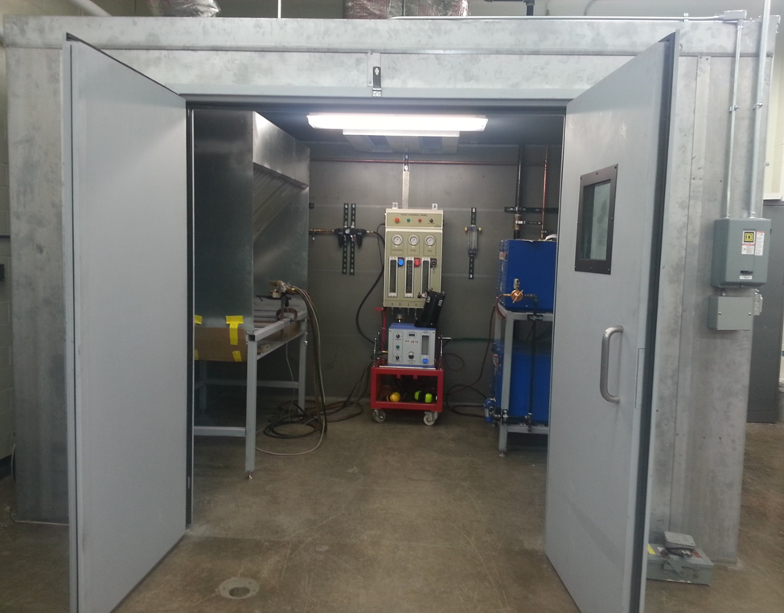
Hard Coating Research Lab (HCRL) – ME Department (NDSU)
Thermal Spraying
Established in 2013- Funded by EPSCoR IIP Major Equipment
Director: Fardad Azarmi
New Design for FSW Tools
Introduction to Thermal Spraying
FSW Tooling
Introduction to FSW
Project Plan
Automatic Spraying

Slide 12
Objectives:
New Design For FSW Tools
Develop new tools to advance FSW technology to increase its efficiency and service life, followed by decreasing the maintenance tooling costs.
- We have proposed:
Evaluation of the capability of thermal spray solution for depositing of high temperature materials onto FSW tools.
New Design for FSW Tools
Introduction to Thermal Spraying
FSW Tooling
Introduction to FSW
To this end:
Utilization of a rapid and affordable technology for deposition of high temperature (refractory) materials.
Apply a hard coating on the surface of FSW tools to improve the performance, increase life, and enhance their appearance.
Develop a near-net shape forming processes by thermal spraying to produce a multifunctional component.
Project Plan

Slide 13
Scope of the Work:
Project Plan
The study will be accomplished in three major categories:
Process Development
New Design for FSW Tools
Introduction to Thermal Spraying
FSW Tooling
Introduction to FSW
B. Property Characterization
C. Post-deposition Development
Project Plan

Slide 14
Scope of the Work _{(Continued)}:
Project Plan
The study will be accomplished in three major categories:
C. Post-deposition Development
Identify an effective heat treatment process to improve properties of the new tools. (Post-deposition process).
Develop a risk management model to quantitatively measure the service life of the new FSW tools. (Risk management)
Evaluate the performance of newly developed FSW tool. (Performance evaluation)
New Design for FSW Tools
Introduction to Thermal Spraying
FSW Tooling
Introduction to FSW
Project Plan

Slide 15
Acknowledgement
U.S. Army CCDC Ground Vehicle Systems Center

Slide 16
Questions?

