Slide 1


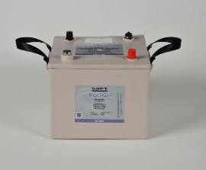
Mobile Energy Storage Platform
April 2021

Slide 2
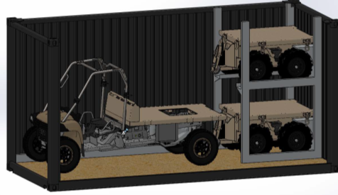
Mobile Energy Storage Platform (MESP)
Components:
ULTV (2,000lbs carry / 3,500lbs pull)
Li6T Energy Storage On-Demand
Houses 16 Li6T batteries; 28KWH of power
ISO TEU Configured
Status: Possible solution to EABO mobile energy sustainment shortfalls for CLB; the trailer houses a bank of rechargeable Li6T batteries to distribute energy and leverage mobile electrical energy generation, storage, and an on-demand delivery system to power current Marine Corps assets, such as Network On The Move (NOTM). Purchasing two units in FY21 to support demonstrations.

Slide 3
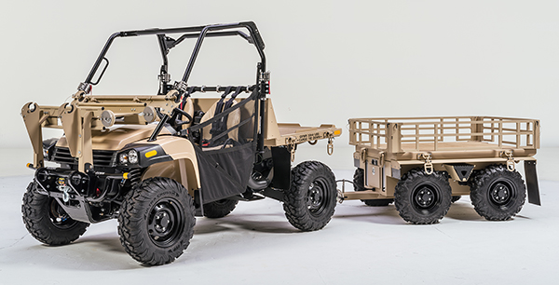
The battery control system will allow the modular integration of batteries, plug and play of charged batteries, and be adaptable to new battery upgrades. This directly aligns with a trailer based Family of Systems whereby Li6T batteries will support other technologies as they are developed. The batteries will be charged by a high power generator native to the utility terrain vehicle (UTV) that serves as the prime mover. These agile systems will be agnostic to what they will power. The bed space of the trailer will be preserved for a client system.
A power “lego” concept is employed that will permit all Li6Ts to be used in parallel to support large power needs, or permits that dislodgement of individual batteries to support smaller, distributed power needs. All of these mission sets will require various level of power generation capabilities. This concept is low cost and high impact in terms of enabling the power generation requirements of stand-in forces executing EABO.

Slide 4
Questions???
The only way to get BETTER capability, is to get DIFFERENT capability.

