Slide 1
CUI
TOOELE ARMY DEPOT
Joint Technology Exchange Group
Erin Trinchitella
Base Operations Directorate
Tooele Army Depot
As of 15 Apr 2021
Controlled by: Tooele Army Depot Base Operation Directorate
CUI Category(ies): Privacy
Limited Dissemination Control: FEDCON
POC: Erin Trinchitella, DSN 790-2033
Version: 1.1

Slide 2
You can’t outload ammunition without light

Slide 3
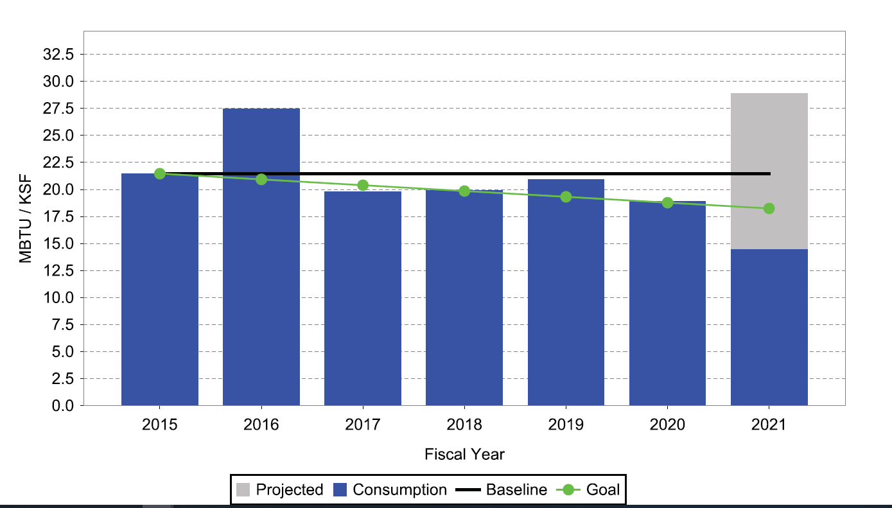
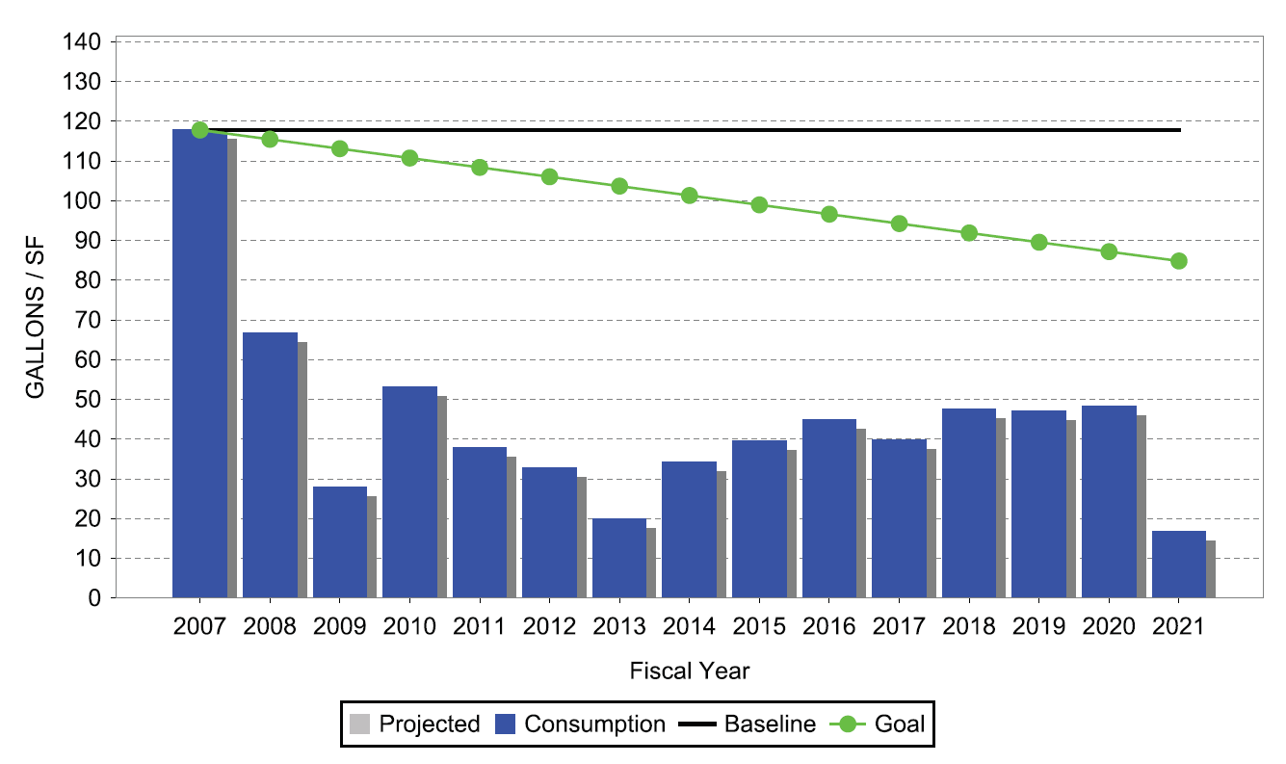
Energy resilience
Energy resilience begins with energy reduction
TEAD’s Energy Program is based on meeting or exceeding the goals required in Executive Order (EO) 13693, along with Energy Resiliency & Energy Security.
Energy independence
Support TEAD’s mission to the warfighter through ensuring operational readiness even when the power goes out.
TEAD’s energy intensity progress graph – reduce energy use 2.5% annually through FY25
TEAD’s water intensity progress graph – reduce energy use 2% annually through FY25

Slide 4
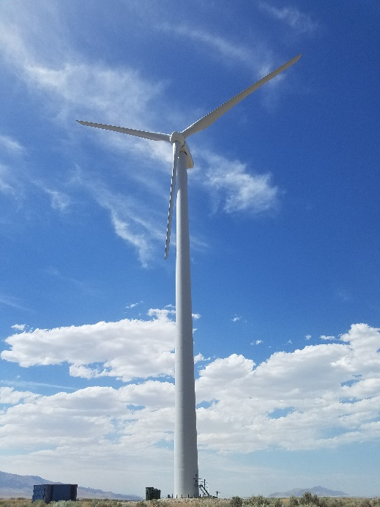
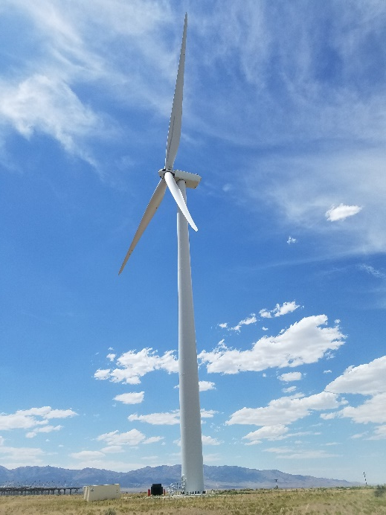
Proven technology
CPC Wind Turbine –
1.5 MW
$4.8M
Completed July 2010
Savings to date - $546K
GE Wind Turbine –
1.7 MW
$6.6M
Completed July 2016
Savings to date - $1,049K

Slide 5
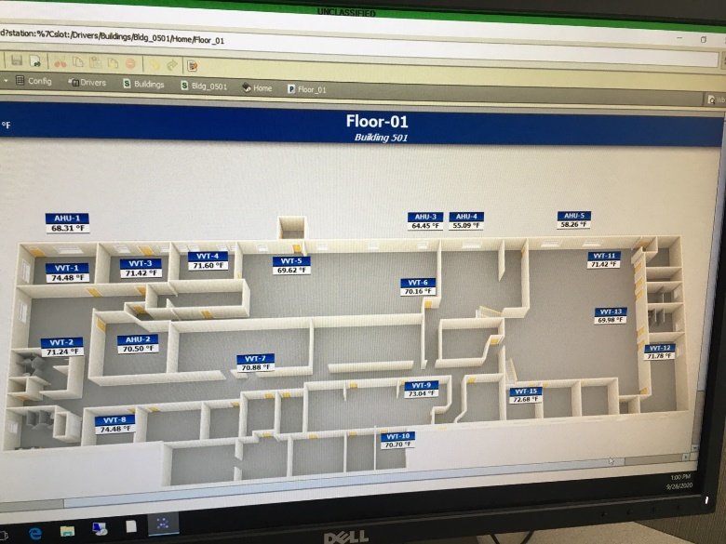
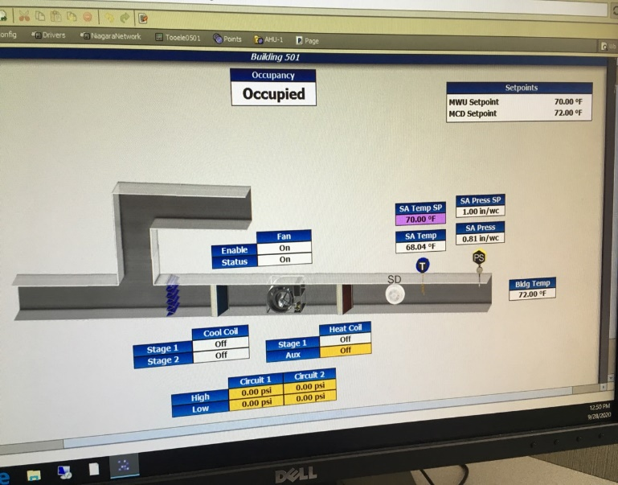
Proven Technology
EMCS –
$2.7M
Completed February 2017
Remotely operated to control TEAD’s heating and air conditioning in 50 buildings.
Provides energy savings and reduces maintenance costs while optimizing occupant comfort!

Slide 6
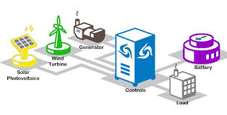
Proven technology
$6.6M
Completion date: late FY21
Allows TEAD to operate mission critical areas in the event of a power outage
Battery storage capacity: 1MW

Slide 7
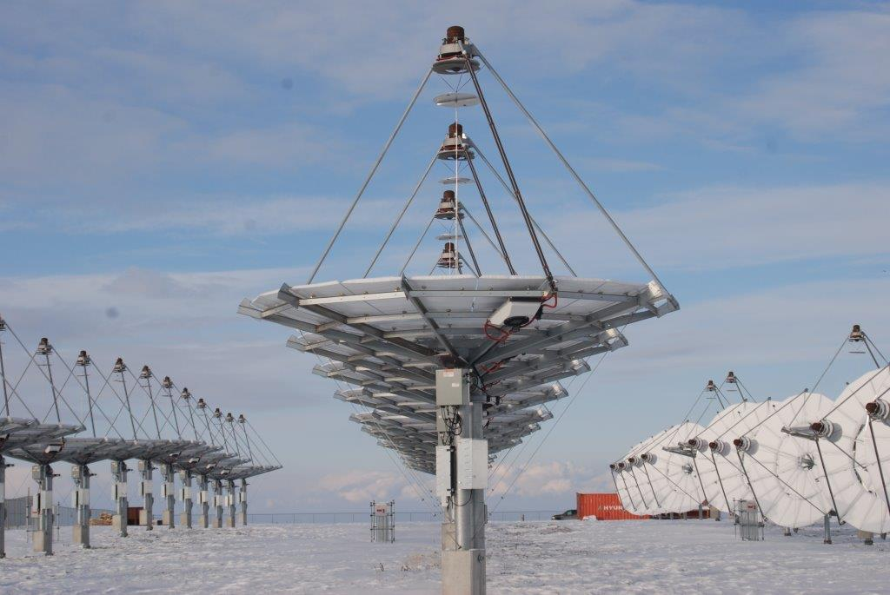
Emerging Technology
Stirling Solar Array –
1.5 MW
$13.8M
First phase completed in 2017
Savings to date - $0

Slide 8
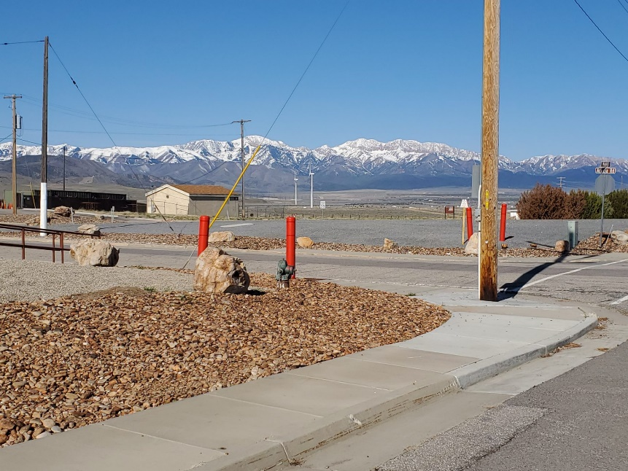
Water program
Completed projects -
Replaced 8.7 miles of main and laterals
Replaced 3 of 5 water storage tanks
On-going projects –
Installation of xeriscape
Future projects –
Replacement of water lines at TEAD-South
Installation of water meters on all buildings

Slide 9
Future Projects
Natural Gas Lines and Fuel Swapping –
$8.2M
Install natural gas lines throughout the depot and building envelope improvements
Anticipated award date: 22 July 2021
Photovoltaic Solar –
$6.4M
Installation of a 2.0MW Photo Voltaic Solar Array
Army Corp of Engineers (COE) working on the Ready to advertise (RTA)

Slide 10
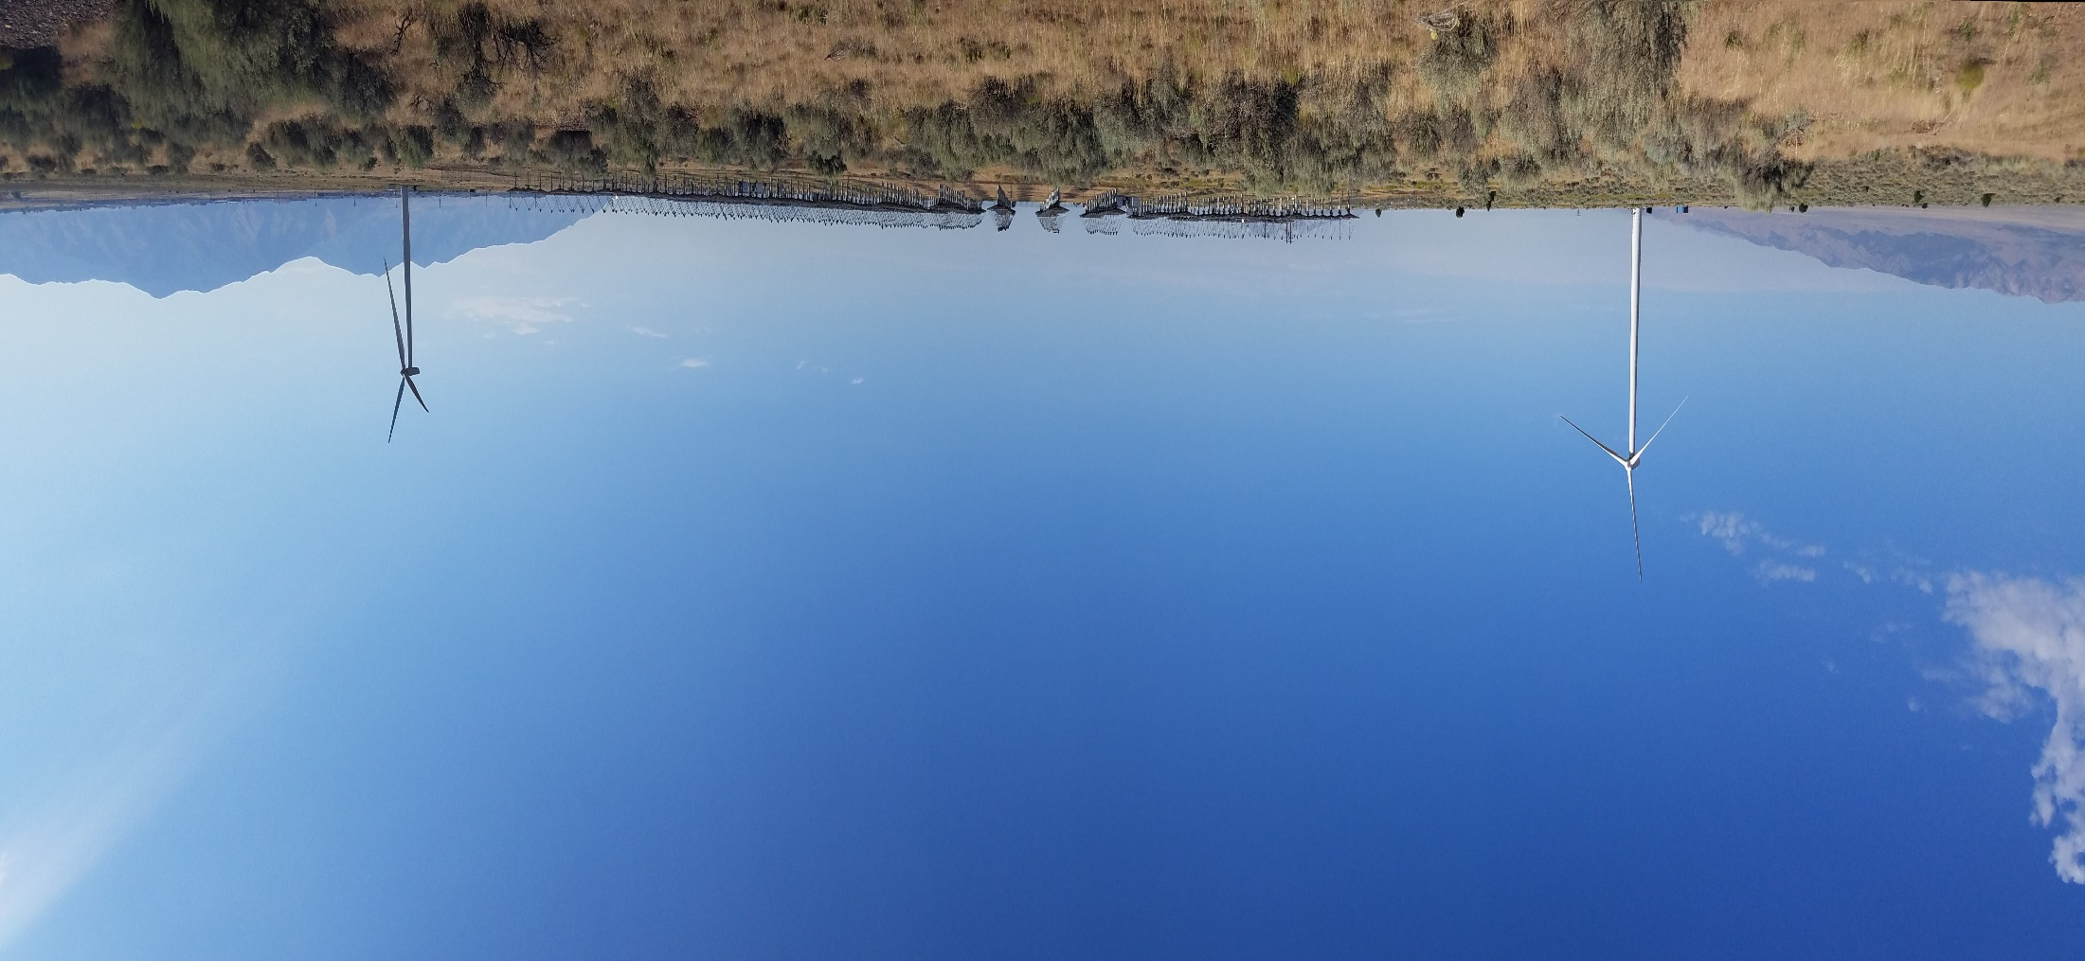
Questions

