Slide 1
Norfolk Naval Shipyard Sarcos Defense US NAVY Phase II SBIR Guardian DX
Prepared by:
Dale Berkley
NNSY Technology Insertion Manager
DISTRIBUTION A. Approved for public release: distribution unlimited.

Slide 2
NNSY and SARCO’s Collaboration
Sarcos under the phase II SBIR was to design, fabricate, and construct a tele-operated, dual-armed (7-DOF arm with 3-DOF End Effectors), dexterous robot prototype system
NNSY was to support this effort in providing information, tools, and technical resources in the development of end-effectors. NNSY would also provide real world industrial use cases.

Slide 3
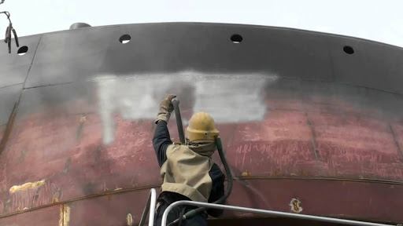
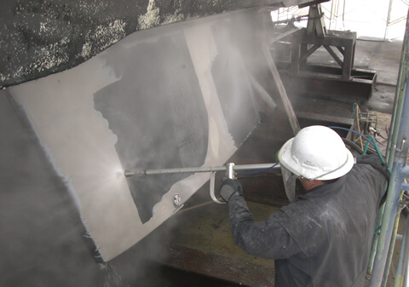
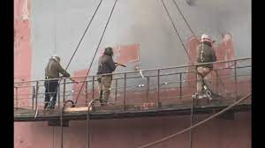
NNSY Industrial Environment
NNSY has several operations that are hazardous, unpleasant and require certain physical and mental qualities to perform.
Operators to perform these jobs are becoming more difficult to find due to the nature of the task.
Often times these jobs are exposed to the elements and at significant height and risk to the operator.

Slide 4
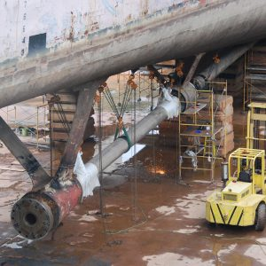
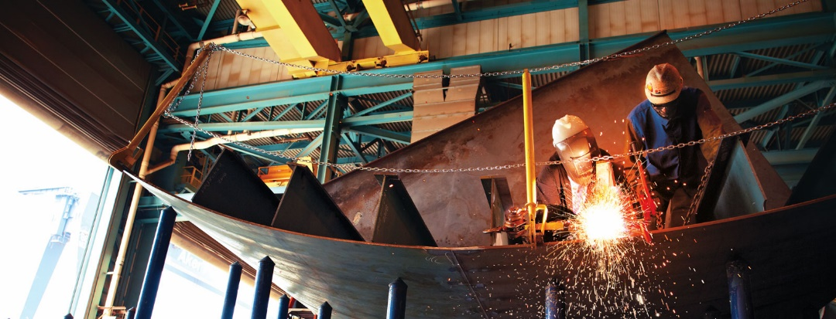
Naval Shipyard current Methodology
Often these tough jobs are contracted out to supplement the shipyards workforce.
Many of the jobs require high lifts, JLG’s, or scaffolding to perform, requiring additional resources and manpower to accomplish.

Slide 5
Approaching Challenges
Task 1: New Multi-DOF Wrist
Task 2: 3 DOF End Effector Development
Task 4: Robot Vision System
Input Device Design
HMD and Gimbal
SenSuit® design
Understanding new technology and how to best apply in a shipyard environment would be the first challenge .
Explaining the technology and how it could benefit the workforce, and have mechanics and supervisors support the project is the greatest challenge.
“We have always done it this way”

Slide 6
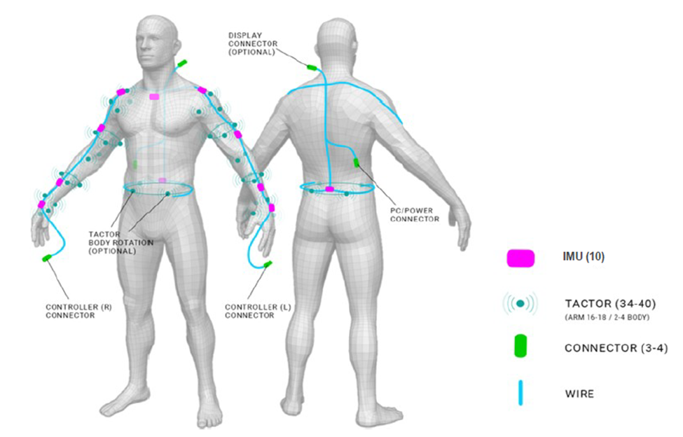
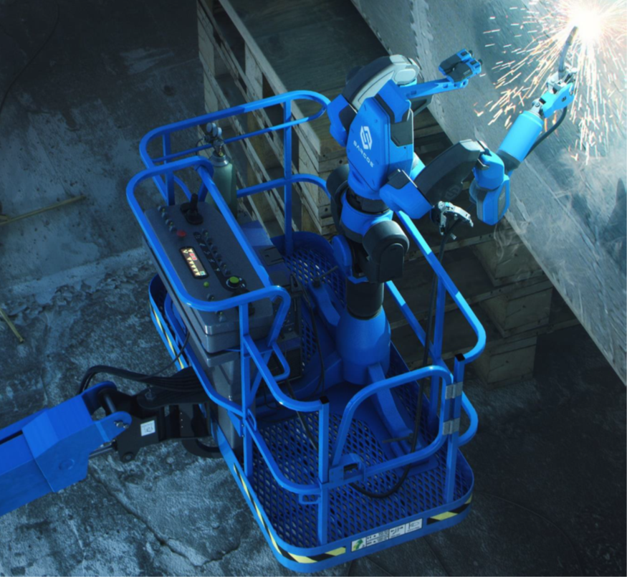
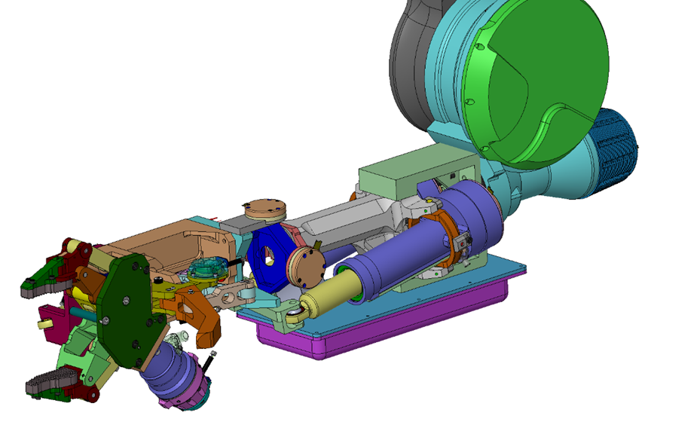
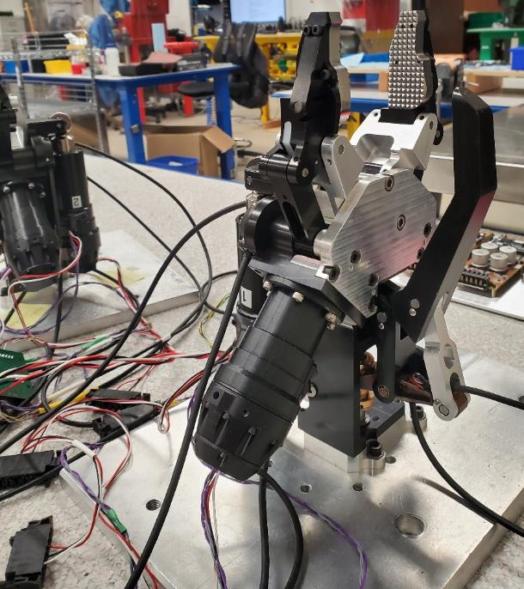
Future of Naval Ship Repair
Naval shipyards need technology that will advance the capabilities of the mechanics physical abilities.

Slide 7
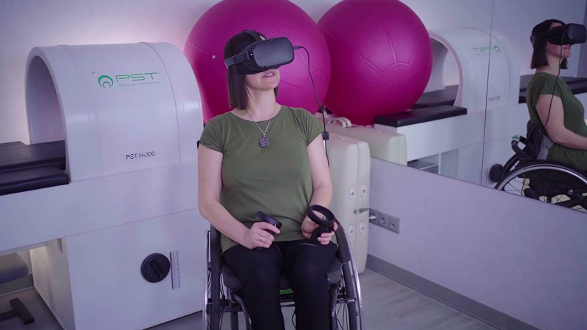
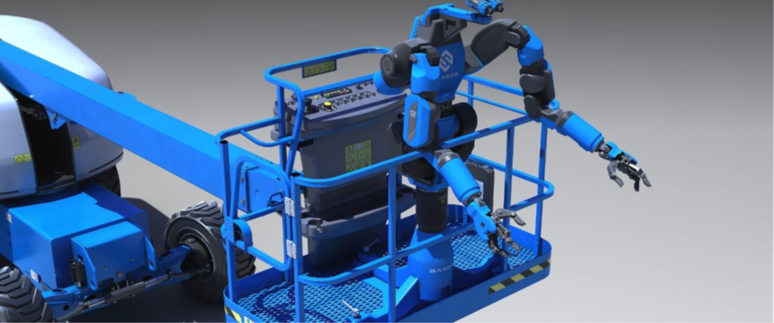
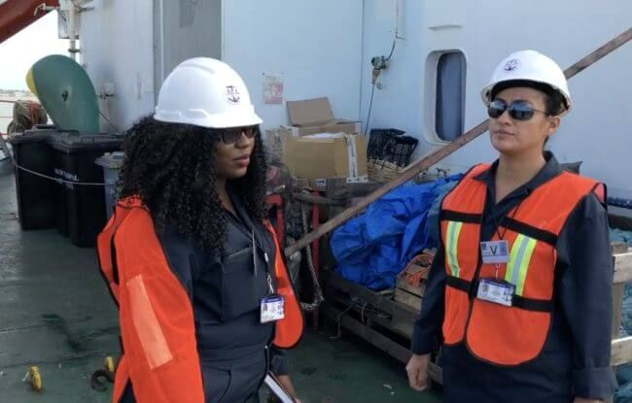
Potential Benefits
Decrease in man hours required to complete the task due fatigue or inclement weather.
Safer work environment.
More efficient task completion.
Expansion of the available pool of capable employees.
First Time Quality.

Slide 8
Questions?

