Slide 1
160th SOAR(A)
Troubleshooting Analysis Group
JTEG Technology Forum
03 March, 2020
UNCLASSIFIED
USASOAC AMSO

Slide 2
Certification Test Protocol (CTP)
Presently the Electrical Wiring Interface System (EWIS) considerations are not fully defined in the Total Cost of Ownership. EWIS tracking deficiencies:
EWIS is not fully defined as a system (No Work Unit Code.)
EWIS failures are not tracked under the Reliability & Maintainability (R&M) program.
EWIS failures cannot be directly tied to high No Fault Found (NFF)/ Cannot Duplicate (CND) rates.
Test methods are not defined. Continuity is NOT a qualitative measurement.
UNCLASSIFIED
USASOAC AMSO

Slide 3
CTP Timeline
    Joint OSD & 160th SOAR effort for CTP development in 2014.
    The Automatic Wire Test Set (AWTS) was chosen because of it’s multi-stimulus capability.
    MH-6 & MH-47 FADEC Systems were selected due to high mission aborts, high removal rates, and high No Fault Found rate.
    MH-6 FADEC test program fielded in June, 2016.
    MH-47 test program fielded at 160th Contractor Maintenance Facility in July, 2017
    Two Eclypse Field Service Representatives (FSR) were added to support development of additional systems in 2018.
    AWTS testing added to MH-6 Major Maintenance Event (MME) and Maintenance Manual in 2018.
    Work Unit Code (09X01) added in 2019.
    Procured an addition 10 Test Sets (TCU & SM) in 2019.
    Procuring Test Adapter Cables to deliver with test sets by end of 2020.
    R&M data repository, add AWTS to MH-47 MME, and expand WUC by 2021.
UNCLASSIFIED
USASOAC AMSO

Slide 4
AWTS/CTP Implementation
Aircraft single ended test (single ended)
  AWTS is connected to the Engine Control Unit (ECU) connectors. Intent is to minimize the disturbance of the EWIS while evaluating engine sensors (speed, temperature, & passive device…), the FADEC Hydro-Mechanical Assembly (HMA), as well as airframe mounted devices (circuit breakers, switches, relays, throttle position & collective position potentiometers, etc.).
Aircraft wiring test (double ended)
  Evaluates the EWIS as an LRU or WRA as installed. Establishes individual conductor and harness condition and ensures material uniformity through the use of multiple stimuli (CTP) and pass/fail criteria.
Pass/Fail threshold established by analysis
  Pass/Fail criteria in the single ended test was established by OEM specification for each component.
  Pass/Fail criteria in the double ended test was established by calculating the nominal resistance by wire length and then adjusted or tuned as a result of sampling six aircraft. An additional resistance of 100 milliohms was added to the nominal value for in-service degradation.
  Any failure requires a corrective action and retest.
UNCLASSIFIED
USASOAC AMSO

Slide 5
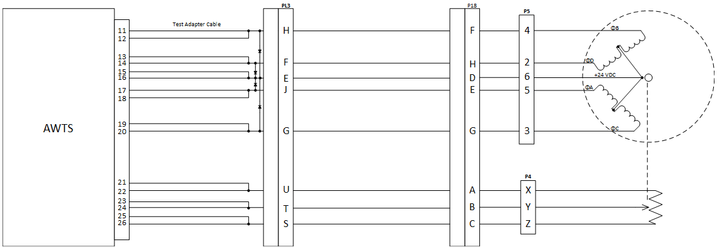
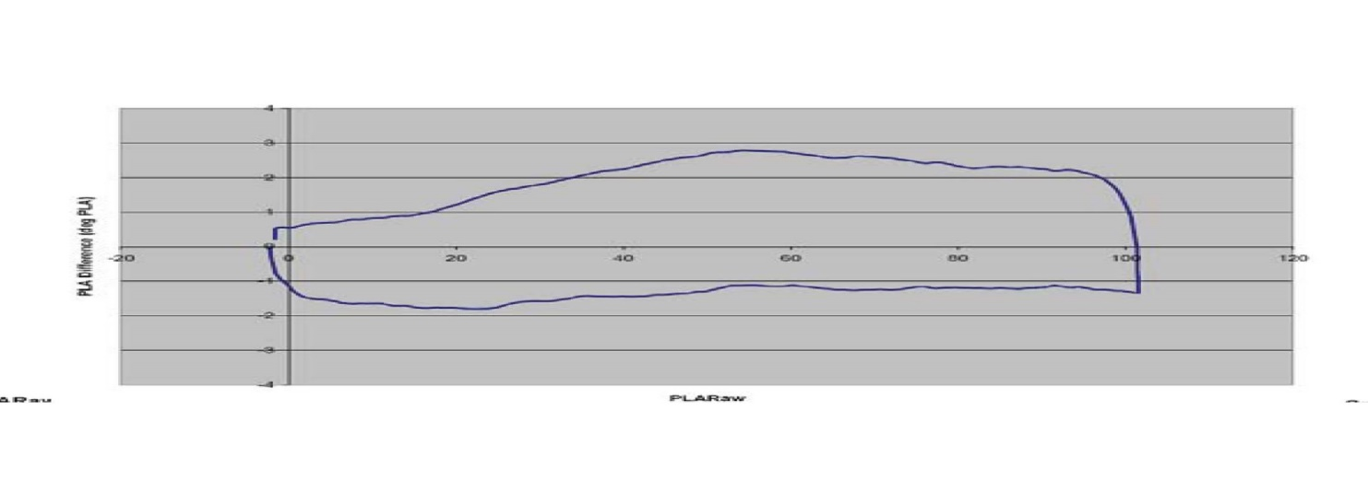
AWTS/CTP Implementation
Eclypse was able to create a test routine that can mirror a stepper motor driver.
UNCLASSIFIED
USASOAC AMSO

Slide 6
Certification Test Protocol
Improvements to the CTP:
Dwelling for 3 seconds for each test was causing the test set to overheat during summer months.
Dwell times for initial tests were reduced to ~ 100 milliseconds. If the test passes the software will go to next test.
If a test fails, the dwell times are increased to 3 second and the wire path is reconditioned up to a maximum of three times. If the wire path still fails after reconditioning the operator is notified of the failure and the software will go to next test.
If test passes during reconditioning, the software will go to the next test.
UNCLASSIFIED
USASOAC AMSO

Slide 7
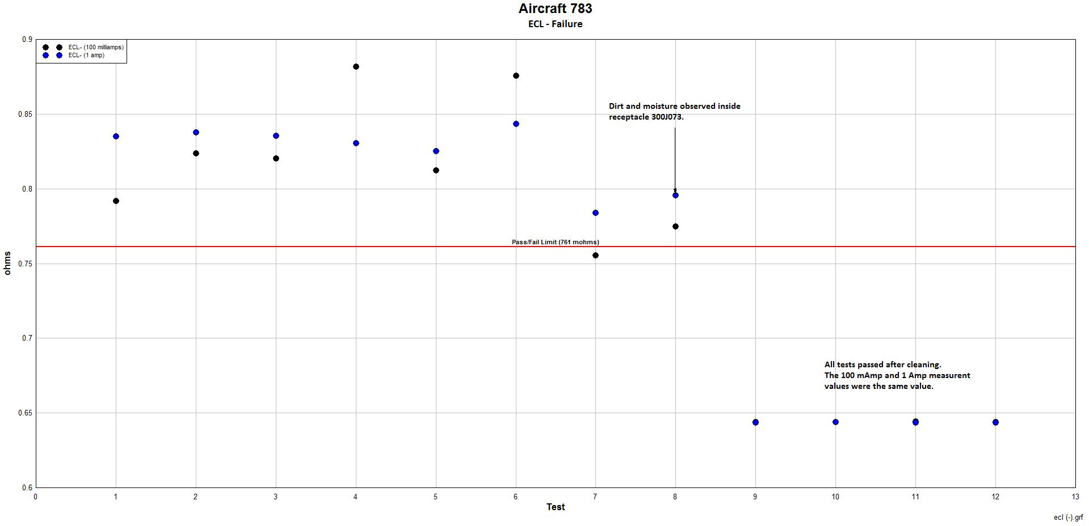
AWTS/CTP Implementation
UNCLASSIFIED
USASOAC AMSO

Slide 8
AWTS/CTP Implementation
The Aircraft Wire Test has identified a total of 469 wire failures during tests conducted on 17 aircraft (MH-47). These failures can be divided into two groups: continuity and isolation failures:
  Continuity Tests – the measured resistance between the two ends of an electrical path where low resistance results are expected (typically <1 ohm).
  Isolation Test – the measured resistance between one wire path to all other wires in a harness, the shield, and chassis/airframe ground where no continuity should exist (typically > 32 Mohms).
UNCLASSIFIED
USASOAC AMSO

Slide 9
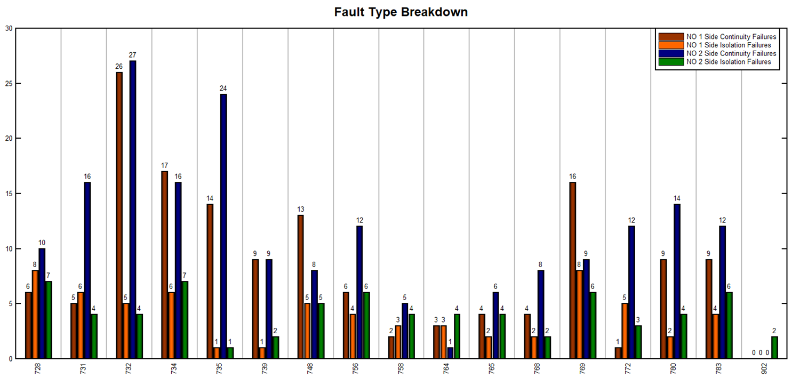
AWTS/CTP Implementation
UNCLASSIFIED
USASOAC AMSO

Slide 10
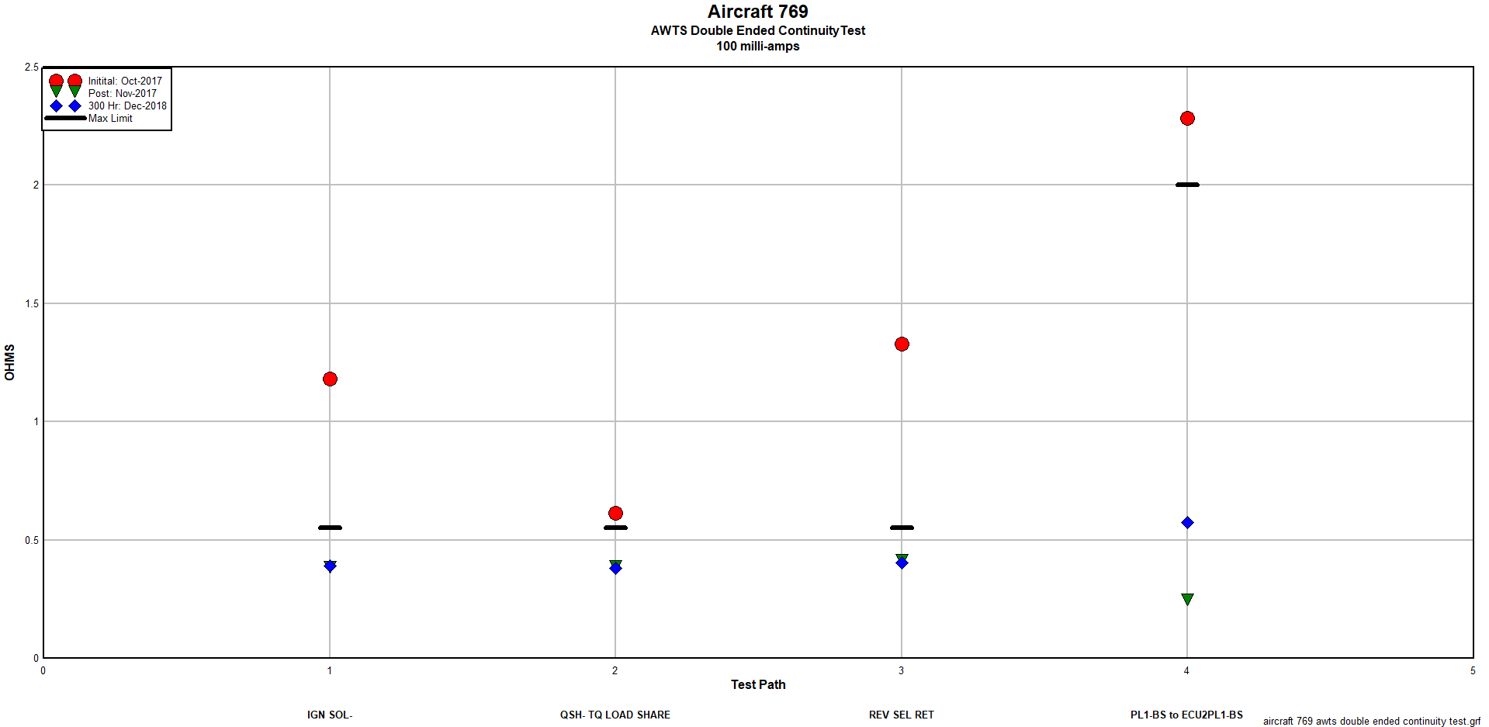
AWTS/CTP Implementation
UNCLASSIFIED
USASOAC AMSO

Slide 11
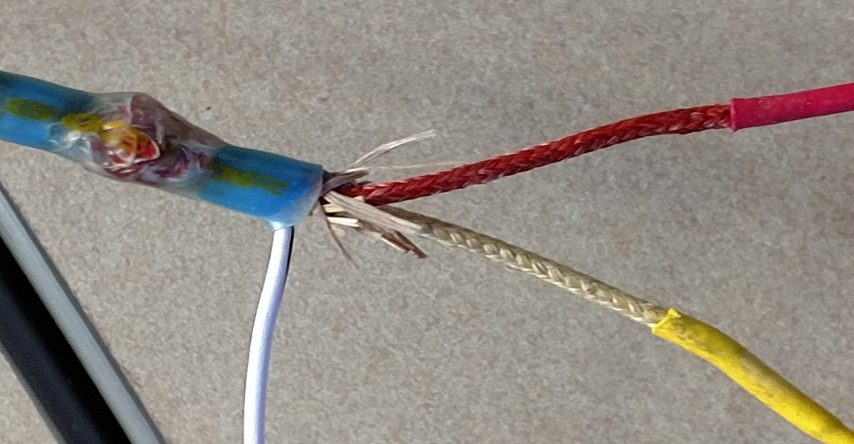
MH-47G FADEC AWTS Tests
136 Isolation failures were detected. Approximately 80% of all isolation faults were caused by moisture intrusion in the thermocouple wires. The materials used in the Alumel/Chromel insulation is made of a cloth. Over time, the cloth wicks moisture inside the outer jacket causing short circuits between the wires, and from the wires to shield.
Cloth outer insulation
UNCLASSIFIED
USASOAC AMSO

Slide 12
AWTS/CTP Implementation
The Technology Applications Program Office has assigned a Project Manager and established a Configuration Control Board (CCB).
Eclypse application software will be installed on logbooks. Test data will be migrated to a central repository.
Data will be analyzed and presented on the Commanders Dash Board.
CCB will convene and approve any software change is made or new test program is developed.
UNCLASSIFIED
USASOAC AMSO

Slide 13
AWTS/CTP Implementation
QUESTIONS?
UNCLASSIFIED
USASOAC AMSO

Slide 14
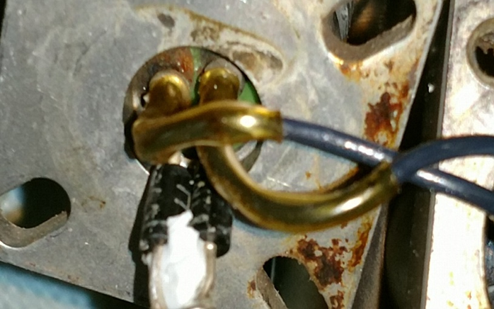
Back-Up Slides
Isolation Failure: Aircraft experiencing intermittent Fault Codes.
UNCLASSIFIED
USASOAC AMSO

Slide 15
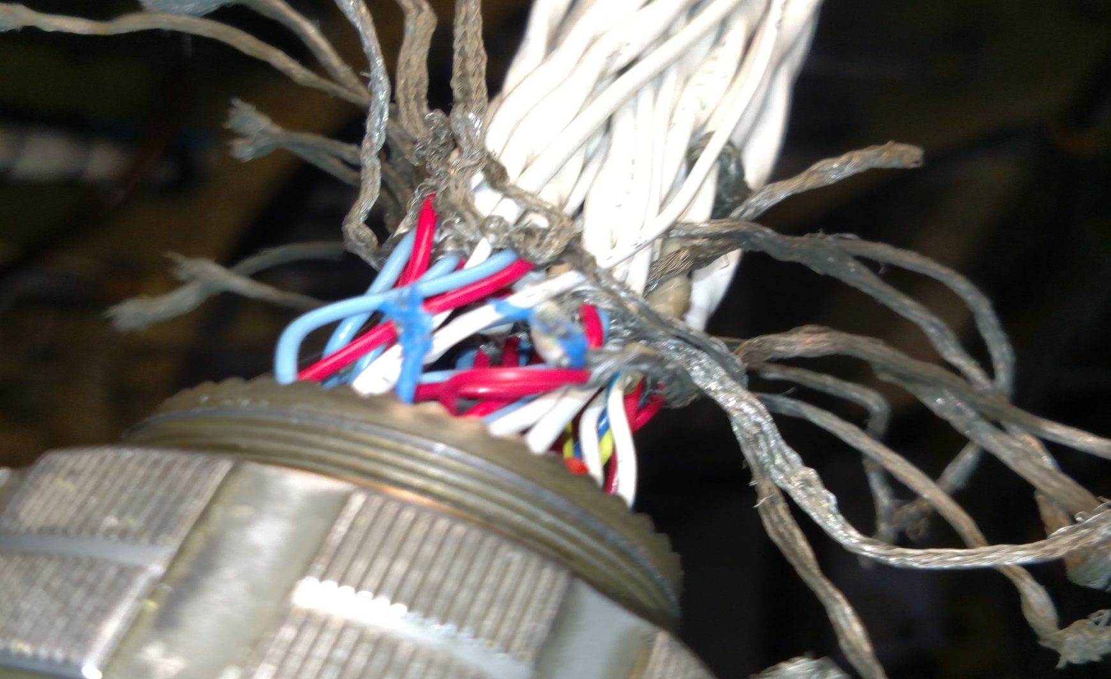
Back-Up Slides
Isolation Failure: Wire abraded by backshell
UNCLASSIFIED
USASOAC AMSO

Slide 16
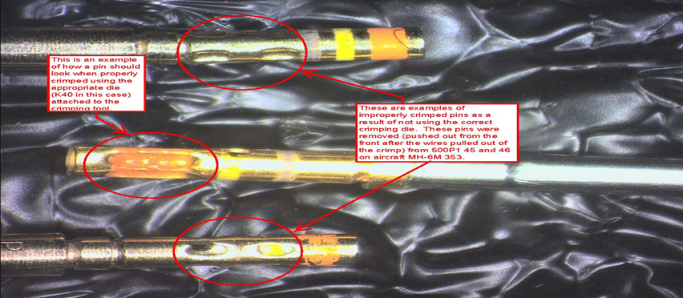
Back-Up Slides
Continuity failure caused by under crimped pins
UNCLASSIFIED
USASOAC AMSO

Slide 17
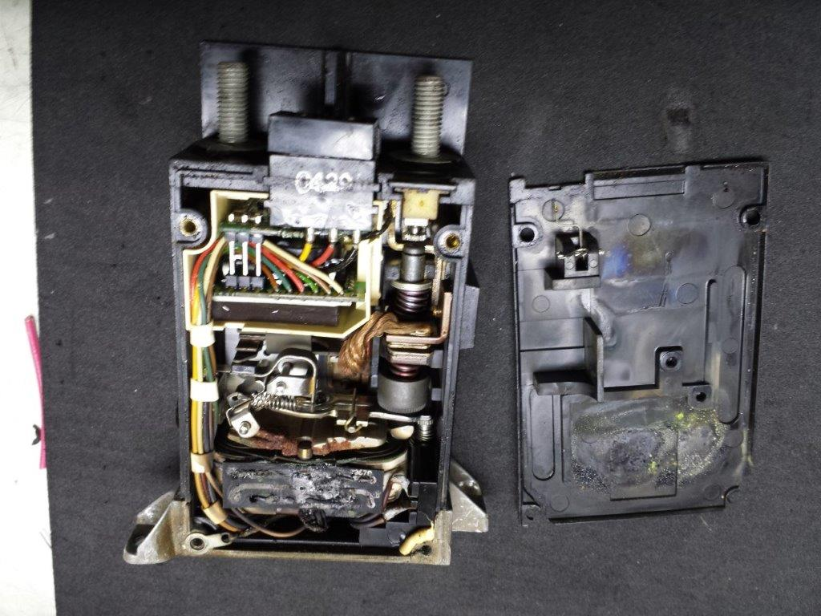
Back-Up Slides
Shorted RCCB caused failure in power path
UNCLASSIFIED
USASOAC AMSO

Slide 18
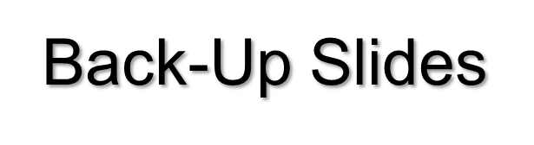
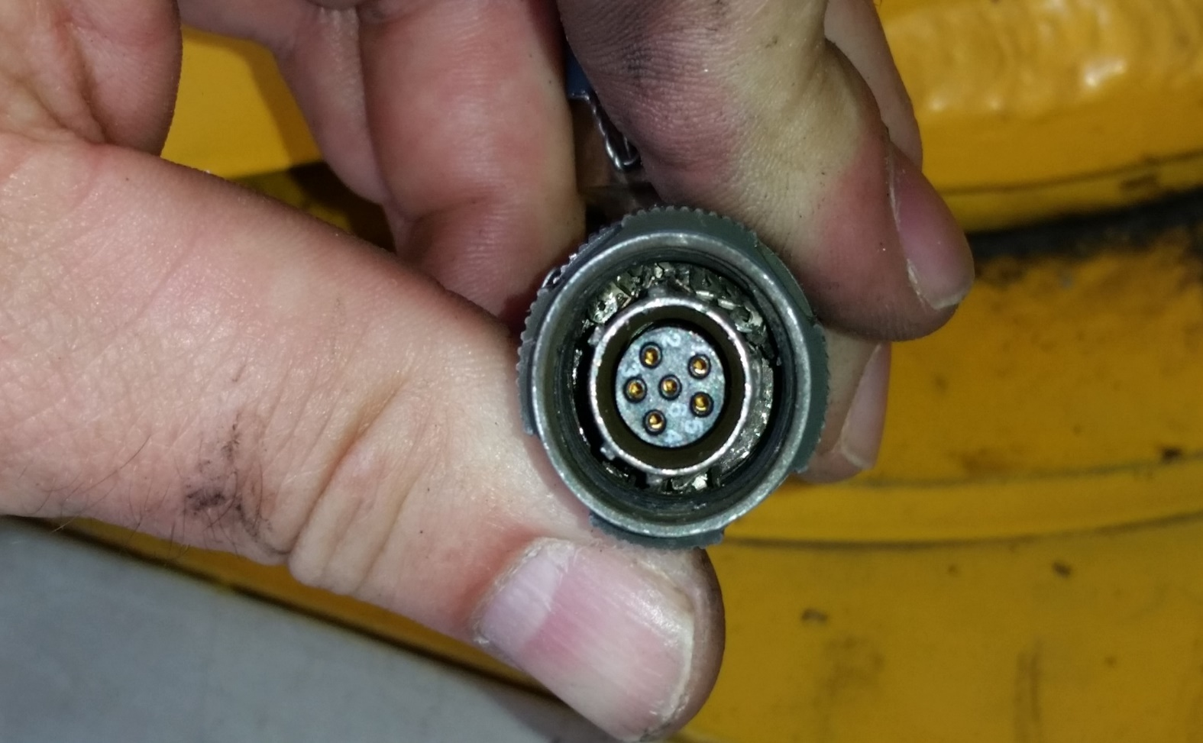
Single-Ended Test: continuity test identified a crushed connector on the Fuel Control
UNCLASSIFIED
USASOAC AMSO

