Slide 1

JAMWG Update to JTEG
Ms. Kelly Visconti
OSD ManTech CTR
Support
kelly.t.visconti.ctr@mail.mil
https://www.CTO.mil @DoDCTO

Slide 2
Overview
Department of Defense (DoD) Additive Manufacturing (AM) Strategy
  Modernize National Defense Systems
  Increase Material Readiness
  Enhance Warfighter Innovation & Capability
Office of the Under Secretary of Defense (Research & Engineering) (OUSD R&E) Role and Approaches
  Lead and Facilitate Collaboration
  Partner with External Stakeholders
  Invest in R&D to Address Foundational AM Challenges
DoD AM Policy

Slide 3
DoD AM Strategy – Why?
Modernize Defense Systems
  New geometries enabled by AM
  Part reduction
  Faster prototype and build cycles
  Faster, lighter, stronger, more impactful systems
Increase Material Readiness and Efficiency
  Address part obsolescence
  Reduced logistics footprint
  Rapid tooling and job aids
  Increased system availability and lower cost
Enhance Warfighter Innovation & Capability
  Training or job aids
  Innovative solutions in theater
  More responsive and capable units

Slide 4
DoD AM Strategy Goals
Integrate AM into the DoD and defense industrial base.
Align AM activities across the DoD Agencies and external partners.
Advance and promote agile use of AM.
Expand proficiency in AM: learn, practice, and share knowledge.
Secure the AM workflow.

Slide 5
OUSD R&E Role
Lead and Facilitate Collaboration Across DoD to Address Barriers
Partner with External Stakeholders to Accelerate AM Adoption
Invest in Solutions to Foundational AM Challenges:
  Validated and controlled materials and manufacturing processes
  Secure data access and exchange
  Design for AM
  Qualified and trained personnel
  Rapid parts qualification and certification
Notes:
Congressional Briefing 11_19: DOPSR 20-C-0038-1

Slide 6

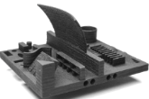
Joint Additive Manufacturing Working Group (JAMWG)
Across the DoD Enterprise: Research & Engineering, Acquisition, Sustainment and Logistics
DoD AM Vision
Disseminate Information
Joint AM Investment Strategy
Share Best Practices
Joint Qualification Approaches
Organization:
Objectives:
Steering Group
Working Group
Data & Model Sharing Council
Qualification & Certification Council
Education & Workforce Development Council
Business Practices Council
Outcomes:
Opportunities:
Digital Thread
Workforce Development
Communications Tools
Business Practices
Qualification Tools
Cybersecurity
Standard data packages
  JAMMEX - Secure DoD
  3D file exchange
  Advanced Tools for Rapid Qualification
Notes:
Cleared per DOPSR Case #19-S-0309.
Chaired by OUSD(R&E) Technology & Manufacturing Industrial Base, these groups provide strategic alignment, collaboration, and enterprise-level guidance
JAMSG and JAMWG objectives are to:
Develop a DoD AM vision and strategy
Disseminate information on DoD AM efforts throughout the Services/Components
Coordinate and provide recommendations for a joint AM investments
Identify and share AM best practices
Encourage joint approaches to accelerate AM qualification and certification
JAMSG and JAMWG representation from the following communities:
DOD Services and Components – OSD, Army, Navy, Air Force, Marine Corps, Defense Logistics Agency, Missile Defense Agency
Life-cycle activities: Science & Technology, Prototyping, Development, Acquisition, and Sustainment
DMS&T is funding projects in support of JAMWG priorities to:
Connect the Digital Thread across DoD
Create Advanced Tools for Rapid Qualification

Slide 7
OUSD R&E Funded JAMWG Projects:
Priority #1 - Digital Thread
JAMMEX: Joint Additive Manufacturing Model EXchange
Vision: JAMMEX will be a single portal for flexible, secure catalogue of downloadable 3D models.
Each Service to manage permissions and connections to their data repositories.
JAMWG identified the need to share approved 3D print files that could be used in theater and organically across DoD.
The Defense Wide Manufacturing Science and Technology (DMS&T) is funding the JAMMEX Pilot to be completed June 2020.
SIMPLIFIED SHARING
VARIETY OF FILES & FORMATS
ACCESSIBLE & SECURE
Increasing Efficiency – Connecting 3D Print Files Across DoD
Notes:
Congressional Briefing 11_19: DOPSR 20-C-0038-1

Slide 8
OUSD R&E Funded JAMWG Projects:
Priority #2 - Rapid Qualification
JAMWG identified a common DoD need to more rapidly qualify AM parts.
DMS&T is funding five R&D projects, kicked off in June 2019 through America Makes to develop Advanced Tools for Rapid Qualification.
JAMWG team of subject matter experts advise and support transition of the results to their DoD Components.
New Tools and Data to Enable More Rapid Qualification
Notes:
Congressional Briefing 11_19: DOPSR 20-C-0038-1

Slide 9
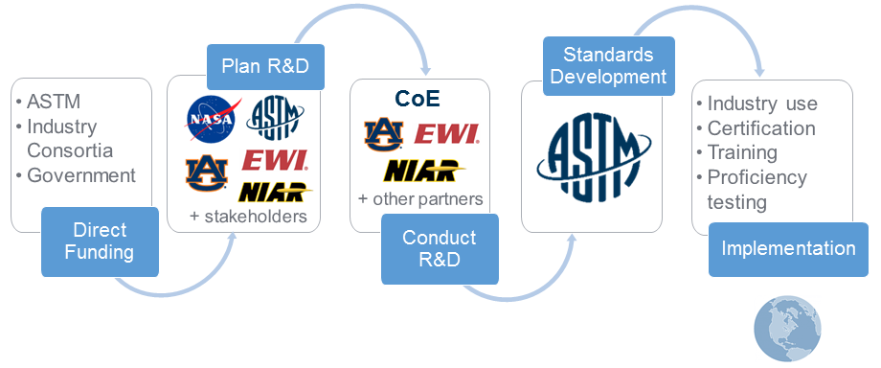
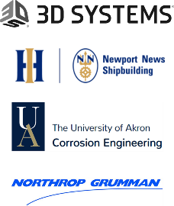
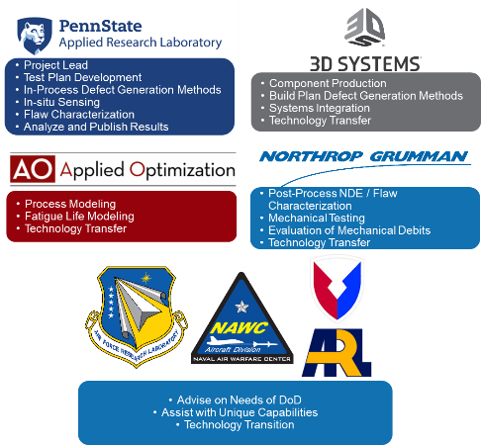
OUSD R&E Funded JAMWG Projects:
Priority #2 - Rapid Qualification
Topic 1: Surrogate Damage Generation for Laser Powder Bed Fusion Defects
Topic 2: Degradation of Polymer Parts Deployed in Harsh Environments
Topic 3: Corrosion Mechanisms of Laser Powder Bed Fusion Materials
Project
Titanium (Ti64), Laser Machines, Creating and Controlling Lack of Fusion Defects
In-situ monitoring to mechanistically understand defects and conditions to intentionally induce them
  Project
  Inconel metal printed
  Testing in the Remote Crevice Assembly (RCA) test capability at U Akron
  Understanding salt-water corrosion mechanisms
  Project
  ULTEM 9085, Stratasys Fortus 900mc Aerospace package
  Expeditionary relevant polymer materials and printers
  End Goal - Quantify service life of AM polymer parts used in austere field environments
Notes:
Congressional Briefing 11_19: DOPSR 20-C-0038-1

Slide 10
JAMWG FY20-21 Priorities
Accelerate qualification and certification of AM materials, machines and parts.
  Scope a joint AM Qualification data generation pathfinder project for metals.
  Execute pilot materials data federation project and scope) a joint AM materials database approach if appropriate.
  Increase engagement with standards development organizations.
  Promote and transition R&D to mature AM technologies that will increase reliability and accelerate qualification.
Enhance a secure common digital thread across DoD and industry.
  Complete demonstration of Joint Additive Manufacturing Model Exchange (JAMMEX) system, roll out to users and define future requirements.
  Common Technical Data Package standard developed, accepted by all Services and published.
  Identify challenges and scope possible solutions to key cyber-physical security needs for AM across DoD.
Expand proficiency in AM: learn, practice and share knowledge.
  Identify common requirements, complete asset mapping and a path to fill in gaps with joint Education and Workforce (EWD) Development programs to support Service Implementation plans.
  Develop an artisan/technician certification program and share outcomes across DoD.
Develop DoD and supply chain integration policies and guidance.
  Publish DoD Instruction (Policy) on AM.
  Share and issue best practices for AM acquisition and cataloging.
  Provide policy and guidance to integrate the supply chain.
Improve internal and external communication effectiveness on AM.
  Publish DoD AM strategy.
  Develop AM communication plan and utilize AM collaboration tools.
  Share information on metrics to capture value of AM and agree on common metrics.
Notes:
Revised Priorities Oct 2019. Based on work over the last year, input from AM Workshops and refinement of the needs.
Highlight one under each that are particularly aligned with Industry to talk through. Suggest Scoping the joint data project. Cyber-physical security. EWD broadly. Policy update/work with DLA on the JAMA project. And Metrics.

Slide 11
OUSD R&E Approaches
Lead and Facilitate
Partner
Invest in R&D
  Joint AM coordination and collaboration
  Funding to support joint priority AM projects
  Develop DoD AM Strategy
  Develop DoD AM Policy
  Manufacturing Innovation Institutes:
    America Makes
    Manufacturing times Digital (MxD)
    Lightweight Innovations for Tomorrow (LIFT)
    NextFlex
  Other Partnerships:
    NDIA Manufacturing Division
    Additive Manufacturing for Maintenance Operations
  Manufacturing of Gradient Index (GRIN) Polymer Lenses for Military Optics
  Cold Spray Additive Manufacturing (AM) & Structural Repair (SR)
  Enhanced Energetics
  Conformal Antennas
Notes:
Congressional Briefing 11_19: DOPSR 20-C-0038-1

Slide 12
DoD Manufacturing Innovation Institutes (MIIs): Chartering Tenets
Advancing Research
& Technology
Establishing & Growing Manufacturing Ecosystems
Securing
Human Capital
Partner with industry to investment in applied research & industrially-relevant manufacturing technologies
Establish regional manufacturing hubs and ecosystems for long-term, national Impact
Develop manufacturing-specific education & workforce development resources to ensure innovative technology is manufacturable
Industry driven, public-private partnerships are a resource for the entire DoD and other Federal agencies
Tenets support DoD ManTech’s congressionally mandated mission to support the Warfighter while promoting the U.S. manufacturing base companies, expertise, & intellectual property
Notes:
Modified from previously cleared slide in 101_DoD ManTech 20190617. AQC-404 June 2019

Slide 13








Current DoD MIIs with Substantial AM Activities
      America Makes: The National Additive Manufacturing Innovation Institute
      Est. AUG 2012 (Youngstown, Ohio)
      MxD: Manufacturing x Digital (Formerly DMDII)
      Est. FEB 2014 (Chicago, Ill.)
      LIFT: Lightweight Innovations For Tomorrow
      Est. FEB 2014 (Detroit, Mich.)
      AIM Photonics: American Institute for Manufacturing Integrated Photonics
      Est. JUL 2015 (Albany & Rochester, N.Y.)
      NextFlex: America’s Flexible Hybrid Electronics Institute
      Est. AUG 2015 (San Jose, Calif.)
      AFFOA: Advanced Functional Fabrics of America
      Est. APR 2016 (Cambridge, Mass.)
      BioFabUSA: Advanced Regenerative Manufacturing Institute
      Est. DEC 2016 (Manchester, N.H.)
      Advanced Robotics for Manufacturing (ARM)
      Est. JAN 2017 (Pittsburgh, Pa.)
Notes:
Cleared per the 101_DoD ManTech 20190617. AQC-404 June 2019

Slide 14
DoD AM Policy
Mar 2019: The Under Secretary for Defense for Acquisition and Sustainment, in coordination with the DoD Services and Agencies, released a 12 month interim Directive Type Memorandum (DTM), “The Use of Additive Manufacturing in Support of Materiel Sustainment.”
Oct 2019: Department of Army released Advanced Manufacturing Policy – a “unified strategy to enable the Army to leverage the full potential of advanced manufacturing and maintain a competitive edge.”
Anticipated Spring 2020: DoD permanent Additive Manufacturing policy to include other portions of the acquisition lifecycle such as S&T, development, and production.
Notes:
Establishes initial Department-wide AM policy on Material Sustainment and assigns roles and responsibilities necessary for advancing the use of AM across DoD’s sustainment enterprise.
Assigns responsibilities of the various DoD Components
Provides a procedural policy on use of AM, technical compliance, acquisition, reverse engineering, technical data, training, and collaboration for the DoD.
Using the DTM and other policies as a base, drafted document and is going through coordination now

Slide 15
Summary
Lead and Facilitate
Partner
Invest in R&D
  Joint AM Groups Coordination and Collaboration
  Joint Priority AM Projects
  Institutes with AM projects
  America Makes, MxD, LIFT, NextFlex
  AM for GRIN Polymer Lenses for Military Optics
  Cold Spray AM for Structural Repair
DoD AM investments advancing the state of the art
Optimized investments addressing joint Service AM requirements - total lifetime est. savings $97M (cold spray)
Increased efficiency - connecting 3D print files across DoD
New tools and data to enable more rapid qualification and use of AM Parts - Reduction of the cost and lead time to fabricate replacement components for legacy aircraft as well as for tooling, fixtures, jigs, masks, and other support equipment
Portable, field deployable equipment - handheld equipment for field armor repair
Education and workforce development - certification pathway for civilian artisan community (apprentice, journeyman, master craftsman); workforce education and technology demonstrations for future implementation of additive manufacturing and related advanced manufacturing processes
DoD Investing in AM to Support Modernization, Material Readiness and Warfighter Capability
Notes:
Congressional Briefing 11_19: DOPSR 20-C-0038-1

Slide 16
Backup

Slide 17

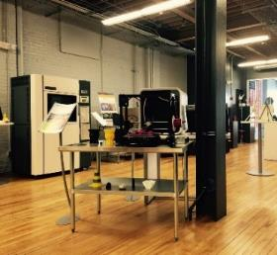

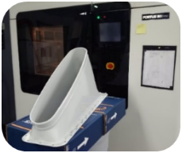
America Makes
The National Additive Manufacturing Innovation Institute
TECHNOLOGY DEVELOPMENT
Since launching in 2012, America Makes has executed over 63 projects against a consortium developed AM technology roadmap. Projects range from those addressing design tools, materials, and processes to those supporting an integrated value chain.
DoD APPLICATIONS
America Makes delivered AM repair and replacement solutions along with training for DoD sustainment organizations to improve warfighter readiness. America Makes coordinated the AM community to prioritize and accelerate formation of standards and specifications critical to industry and organic DoD adoption of AM.
WORKFORCE READINESS
Application-based training programs were developed to fill a critical training gap for design and materials engineers to improve Design for AM (DfAM) skills. America Makes is developing the next generation of workforce training program to generate industry accepted labor certifications and credentials for DoD personnel.
FACILITIES & CAPABILITIES
America Makes is an impartial convener of AM stakeholders, a coordinator of technical and workforce information, and an activation catalyst through the execution high-impact projects.
  Established: August 2012
  Hub Location: Youngstown, Ohio
  Lead: National Center for Defense Manufacturing and Machining (NCDMM)
  Mission: Accelerate the adoption of Additive Manufacturing (AM) in the United States industrial base to reduce cost, reduce lead time, and increase capability of DoD warfighter products.
Notes:
Cleared per the 101_DoD ManTech 20190617. AQC-404 June 2019

Slide 18
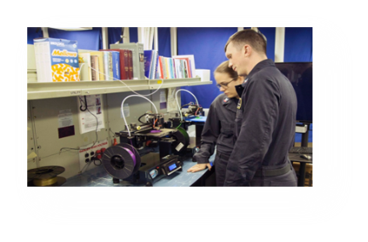





America Makes: Workforce Development Project
Department of the Navy (DoN) America Makes Program
Workforce Challenge:
  Artisan/technical skill sets required for civilians using AM are developed through on-the-job training, and remain more art rather than science
  Without formalization, AM will be challenged to scale for fleet use and result in AM benefits not being fully realized by DoN and the other Services
Objectives:
  Develop formalized AM education, training, and certification programs for civilian artisans, working in shipyards, regional maintenance centers, warfare centers, etc.
  Developed via America Makes to ensure Industry buy-in and standards integration
  Includes curriculum development (e-learning and instructor led content)
Benefits:
  Certification pathway for civilian artisan community (apprentice, journeyman, master craftsman)
Kickoff: October 2019
Notes:
Congressional Briefing 11_19: DOPSR 20-C-0038-1

Slide 19
America Makes:
Maturation of Advanced Manufacturing for Low-Cost Sustainment (MAMLS)
Air Force Directed Program through America Makes
Objectives:
  Accelerate implementation of advanced manufacturing technologies that improve rapid part replacement or support agile maintenance processes.
  Enable on-demand replacement of critically damaged or obsolete components that do not meet economic requirements of conventional supply chains.
  Accelerate rapid design and fabrication of shop tools such as assembly aids, jigs, and fixtures for sustainment operations.
  Identify technology gaps and workforce issues to be solved prior to implementation and address as many possible.
  Conduct air worthiness pathfinding research to develop data and process strategies to qualify additive manufactured parts for various part families.
Benefits:
  Reduction of the cost and lead time to fabricate replacement components for legacy aircraft as well as for tooling, fixtures, jigs, masks, and other support equipment.
  Workforce education and technology demonstrations for future implementation of additive manufacturing and related advanced manufacturing processes
Execution:
  3 Phases; 63 Projects; Engaged 60 America Makes partners
Notes:
Congressional Briefing 11_19: DOPSR 20-C-0038-1

Slide 20
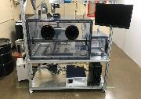
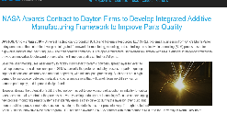
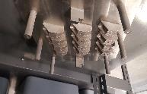
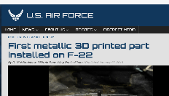

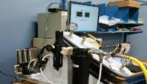



Impact of MAMLS
MAMLS team member University of Dayton Research Institute (UDRI) developed an open research laser powder bed system (Advanced Technology Laser Additive System) which is now licensed by the Universal Technology Company and commercialized as OPENSLMTM. The OPENSLMTM system is now accelerating AM implementation through new research activities.
MAMLS developed initial process parameters for titanium laser powder bed fusion structural repair brackets with team member Lockheed in both the first and second phases. That process development led to the first qualified metallic printed part installed on the F-22.
MAMLS conducted initial manufacturing development trials for a replacement C-17 avionics cooling duct with team member Boeing. The manufacturing development led to the qualification of an Ultem printed duct as an alternative source for the “no-bid” part and is now being flight tested.
MAMLS developed and demonstrated numerous polymer shop maintenance aids at various member locations for improved, more efficient sustainment operations.
  - These many projects also trained maintenance personnel on additive processes at both government and industry locations.
OPEN RESEARCH SYSTEM COMMERCIALIZATION
PROCESS DEVELOPMENT FOR F-22 IMPLEMENTATION
Printed Duct
PROCESS DEVELOPMENT FOR C-17 IMPLEMENTATION
Qualification Testing
Maintenance Covers, Jigs, etc.
Replacement Parts for Equipment
Component Masking
FABRICATION OF SHOP MAINTENANCE AIDS
Notes:
Congressional Briefing 11_19: DOPSR 20-C-0038-1

Slide 21

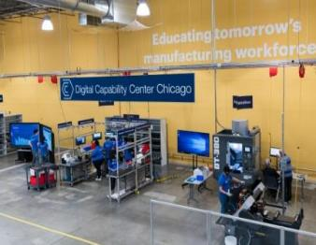
MxD
Manufacturing x Digital (formerly DMDII)
TECHNOLOGY DEVELOPMENT
Since launching in 2014, DMDII has completed 35 projects with 15 projects ongoing. Projects seek to solve technology challenges in digital manufacturing that are too big for any one organization.
DoD APPLICATIONS
In 2018, MxD executed a Model Based Enterprise assessment of Rock Island Arsenal that provides Army leadership with a roadmap for leveraging digital manufacturing technologies that would increase technical workforce productivity 40-45% and lower maintenance downtime by 30-50%.
WORKFORCE READINESS
The year 2018 marks one year since MxD’s creation of the first massive open online course on digital manufacturing and design being available to anyone online. More than 30,000 people have accessed the curriculum so far.
FACILITIES & CAPABILITIES
MxD also launched the National Center for Manufacturing Cybersecurity. The hub will be a testbed for the creation and adoption of new cybersecurity technologies to help secure the supply chain and the warfighters who rely on these capabilities.
Established: February 2014
Hub Location: Chicago, IL
Lead: UI LABS
Mission: Accelerate the development and transition of digital manufacturing technologies into the DoD. Provide the U.S. government and American manufacturers with the digital tools needed secure the manufacturing enterprise, reduce development & production cost, and accelerate product development.
Notes:
Cleared per the 101_DoD ManTech 20190617. AQC-404 June 2019

Slide 22
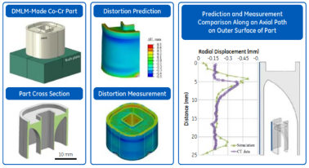
MxD Project Example:
From Art to Part
INDUSTRY CHALLENGE
PROJECT SOLUTION AND OUTCOMES
VALUE AND EFFICIENCY
3D printing of alloy structures enables entirely new classes of parts.
Design-validate iterations can take at least 10 weeks for a complex part.
Holistic look at optimizing a substantial subset of the manufacturing process chain used to take a design from concept to the final part.
Physics-based software modules for Powder Bed Fusion AM that integrate into native Computer Aided Design (CAD) environments
  Preprocessing tool that outputs producibility index and support structure generation
  Mesoscale laser scanning module that simulates melt pool based on geometry and scanning paths
  Macroscale thermal stress modeling using Finite Element Modeling (FEM) based distortion and stress prediction
  Geometry compensation tool based on distortion field
Replace empirical process know-how with physics-based understanding for Powder Bed Fusion AM
An integrated framework and underlying toolsets to accelerate the Powder-bed Fusion Additive Manufacturing (PBFAM) process certification by shifting > 60% process iterations to the virtual world, leading to a 3X reduction in the certification time, up to 60% energy and raw materials savings
5X reduction in process development cycle time & rework, enabling faster design iterations
Objective: Multidisciplinary virtual toolset for laser power-bed fusion additive manufacturing & multi-step post processing certification
Team: GE Global Research, University of Cincinnati, University of Illinois at Urbana-Champaign, TechSolve
DMS&T investments advancing the state of the art
DMS&T: Defense-wide Manufacturing Science & Technology
Notes:
Congressional Briefing 11_19: DOPSR 20-C-0038-1

Slide 23

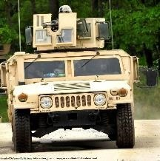
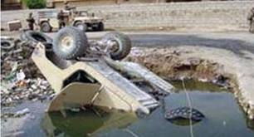
LIFT
Lightweight Innovations for Tomorrow
TECHNOLOGY DEVELOPMENT
Since launching in 2014, LIFT has completed 13 projects with 16 projects ongoing. Projects work to develop and deploy new lightweight manufacturing technologies and processes for products that can be applied to vehicles in the air, land, or sea.
DoD APPLICATIONS
LIFT is leading a project that will reduce Humvee rollovers by 74%, reducing fatalities of military service members. The project will provide validation of quality retrofit installation on the Humvee fleet, including training soldiers on the installation process.
WORKFORCE READINESS
“Operation Next”, created by LIFT and piloted at Ft. Campbell, Kentucky, launched to provide military service members with industry-driven education and skills during their transition period prior to separation. To date the program has 25 graduates and 27 currently enrolled.
FACILITIES & CAPABILITIES
The LIFT High Bay in Detroit is the nation’s premier light weighting applied research and development facility. The facility is uniquely positioned to help revolutionize manufacturing through lightweight innovation and education.
  Established: February 2014
  Hub Location: Detroit, MI
  Lead: ALMMII
  Mission: Develop advanced lightweight materials manufacturing technologies and implement educational programs to train a workforce confident in deploying new technologies in defense and commercial applications.
Notes:
Cleared per the 101_DoD ManTech 20190617. AQC-404 June 2019

Slide 24
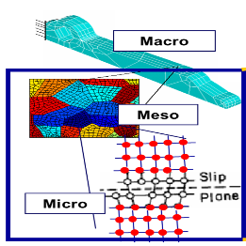
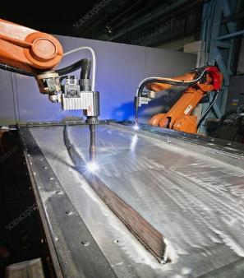
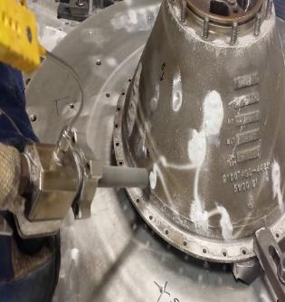
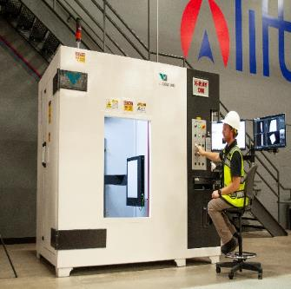

LIFT
Additive Manufacturing Focus Areas
  Integrated Computational Materials Engineering (ICME)
  Weld Arc Additive Manufacturing
  Cold Spray Additive Manufacturing
  Non-Destructive Quality Inspection
Multiscale material simulation for various types of additive material deposition.
Low cost additive manufacturing process
Ablative layers for hypersonics
Inexpensive repair of corrosion issues
Large scale Computed Tomography (CT)
Efficient AM strategy for small/medium manufacturers
60kg weight capacity, 600mm x 900mm sample envelope
Predictive performance and quality of materials.
Internal flaw detection, failure analysis, reverse engineering
v
Value/ Efficiency:
“Design for AM” optimization.
Portable/Field deployable equipment.
Handheld equipment for field armor repair
Partners with LIFT:
University of Michigan
Ohio State University
United Technology Research Corp.
Michigan Technological University
General Dynamics Land Systems
VRC Metal Systems
VJ Technologies
Notes:
Congressional Briefing 11_19: DOPSR 20-C-0038-1

Slide 25

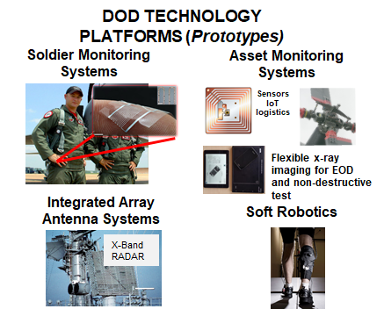
NextFlex
America’s Flexible Hybrid Electronics Manufacturing Institute
TECHNOLOGY DEVELOPMENT
Since launching in 2015, NextFlex has executed 61 projects (33 Core R&D, 21 Education and Workforce Development, 7 Commercial). NextFlex has an additional 34 agency funded projects totaling ($24M to date). Projects integrate digital printing processes with thin semiconductors to achieve low-cost-low-volume stretchable, bendable, conformable, & flexible electronic devices and sensors.
DoD APPLICATIONS
The institute is leading DoD electronics technology transitions through FHE prototypes to include; warfighter health monitoring, platform monitors, 3D antenna systems, and soft robotics.
WORKFORCE READINESS
NextFlex launched FlexFactor to expose students to opportunities in advanced manufacturing careers. The multi-week high school program provides a user guide to engage national school systems.
FACILITIES & CAPABILITIES
The NextFlex Technology Hub includes capabilities where FHE devices and manufacturing processes can be prototyped, materials can be tested, and pilot-scale manufacturing can be proven at the NextFlex Technology Hub.
Established: August 2015
Hub Location: San Jose, California
Lead: FlexTech Alliance
Mission: Pioneer Flexible Hybrid Electronics (FHE) manufacturing to serve our nation’s warfighters and the U.S. Electronics Assembly industrial base.
Notes:
Cleared per the 101_DoD ManTech 20190617. AQC-404 June 2019

Slide 26

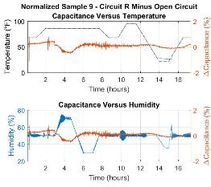
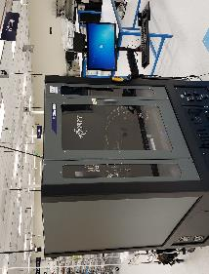
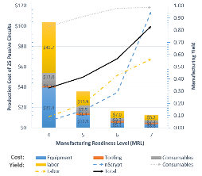
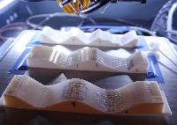

NextFlex AM Project Example:
3D Patterning of Embedded Flexible Hybrid Electronics
Objectives: Mature multilayer patterning technologies for flexible hybrid electronics combined with fused deposition modeled (FDM) printed structures, when printed onto three dimensionally contoured geometries.
OmniConverter
Process Cost Model
Multilayer Circuits
Printing w/ 3 axis
Environmental Tests
nScrypt at NextFlex
Printing
w/ 5 Axis
Key Deliverables:
nScrypt 3Dn 500
Design to Print Software Update
Material Information
Multilayer Print Processes
Cost Model
Major Accomplishments and Demonstrations:
Omniconverter Software (design to print time reduced to minutes)
Multilayer passive circuits on Kapton & 3D printed hemispherical ABS surface
Repeatable multilayer printing on variety of 3D surfaces (up to 30º off axis)
Limited environmental testing of dielectrics between conductors
Value: Technical and production flexibility
Notes:
Congressional Briefing 11_19: DOPSR 20-C-0038-1

