Slide 1
Director, Corrosion Policy and Oversight
Mr. Robert A. Herron
Notes:
Corrosion and Corrosion Prevention and Control, I could probably spend the time showing multiple pictures or case studies of weapon systems, support equipment, components, facilities that are corroded but you work with these systems and know these systems. You’re the system designers, engineers, operators, and maintainers. So, we would probably just get into the discussion of who has seen the worse corrosion on our respective systems. OR
NEXT SLIDE

Slide 2
CPO Lines of Effort
Overarching:
Develop and recommend any CPC policy guidance
Provide oversight and coordinate efforts within the Department to mitigate corrosion in design, acquisition / construction, and maintenance of weapon systems and facilities
Collect, review, validate, and distribute information on proven CPC methods and products
Annual review of MilDep CPC programs and funding levels
Research and Development:
Coordinate R&D program for CPC technologies and processes
Acquisition:
Monitor Acquisition practices to ensure CPC planning is appropriate
Sustainment:
Transition new corrosion prevention technologies into operational systems
Sustainment
Acquisition
R&D
Notes:
Tie this back to R&D, Sustainment, and Acquisition GEAR slide
Policy Development and Implementation - Acquisition
Weapon System Program Reviews - Acquisition
Workforce Development - Sustainment
Corrosion Metrics Collection and Analysis
Specifications and Standards – Sustainment, Acquisition
Demonstration/Implementation Projects through Military Departments – R&D
Technical Corrosion Collaboration – R&D

Slide 3
Corrosion Policy and Oversight
Where Do We Want To Go? What do we want to achieve?
Establish common goals that are proactive and outcome focused; contribute to and supports the Department’s Strategic Goals and Objectives
Obtain Leadership “Buy-in”
Collaborate with Military Department CCPEs to achieve common goals and outcomes
CPO desire to support and be a resource to Military Department CPC Programs and their associated outcomes
Notes:
not reactive to the law or to audits
As a result of “Doing the Right Thing”, the requirements (or intent) of the law will be met

Slide 4
Corrosion Policy and Oversight
Corrosion Messaging
Costs
Do not limit the discuss to technology, component costs or process costs
Be prepared to discuss Enterprise Impacts such as Supply Chain, Contract Costs, Process Through Put time, etc.
Readiness
Enhance Warfighter Capability
Learn to describe our efforts as an “Enabler”

Slide 5
Opportunities to Achieve Cost Reduction Goals and Improve Readiness
Cost and Readiness Impacts are associated with:
Preventive Mx
Corrective Mx
6 Areas of Opportunity to affect change:
Acquisition Decisions
Field Level Mx Processes
Depot Level Mx Processes
Technologies
Component Improvements
New
Transition of Existing Technologies
Facilities Design and construction
Accountability
Readiness

Slide 6
CPO - Expected Outcomes
Focus on reducing costs attributed to corrosion and the deterioration of weapon systems and facilities
MilDep Corrosion Program objective(s) that contribute to and support the DoD Strategic Goals and Objectives
Impact Readiness
Corrosion Costs includes Mx labor, Parts, and Materials which can be associated with system downtime (system readiness), supply chain burden, and military personnel readiness
The Change in Strategic Focus will facilitate achieving the intent and requirements of 10 USC 2228 while focusing on Cost and Readiness Outcomes.

Slide 7
CPO Immediate Priorities – Program Foundational Documents
Develop new DoD Corrosion Strategy
Establish the DoD Goals and supporting Objectives
Establish meaningful metrics
Establish a duration and milestones
Draft a CPC IPT Charter
Operationalize the CPC IPT to support the Strategy
Revise the DoDI 5000.67

Slide 8
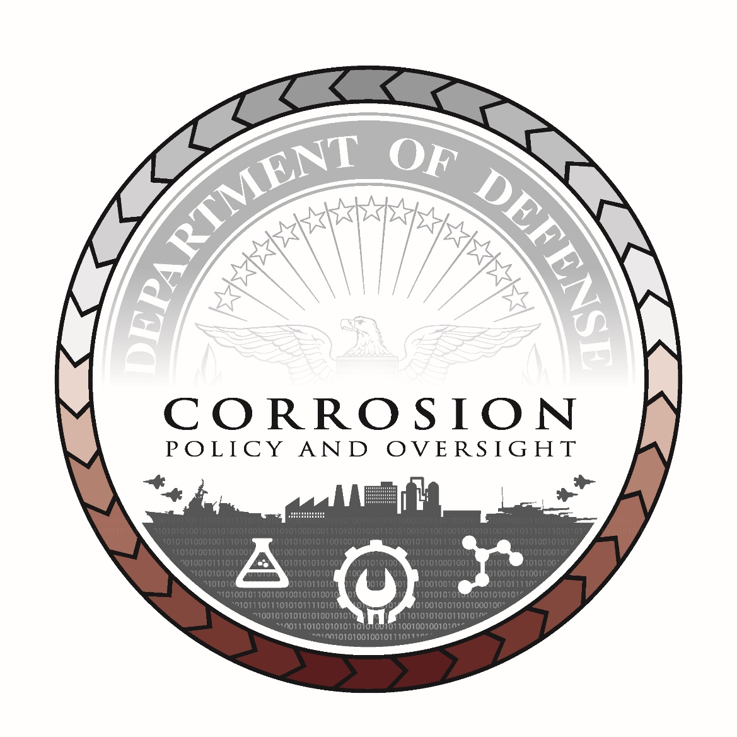
New Seal

