Slide 1
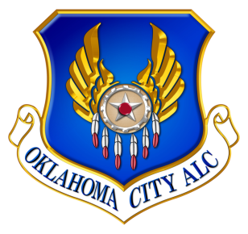
Oklahoma City Air Logistics Complex
Tinker Aerospace Complex History
Dr. Kristian Olivero
OC-ALC/EN
Kristian.Olivero@us.af.mil

Slide 2
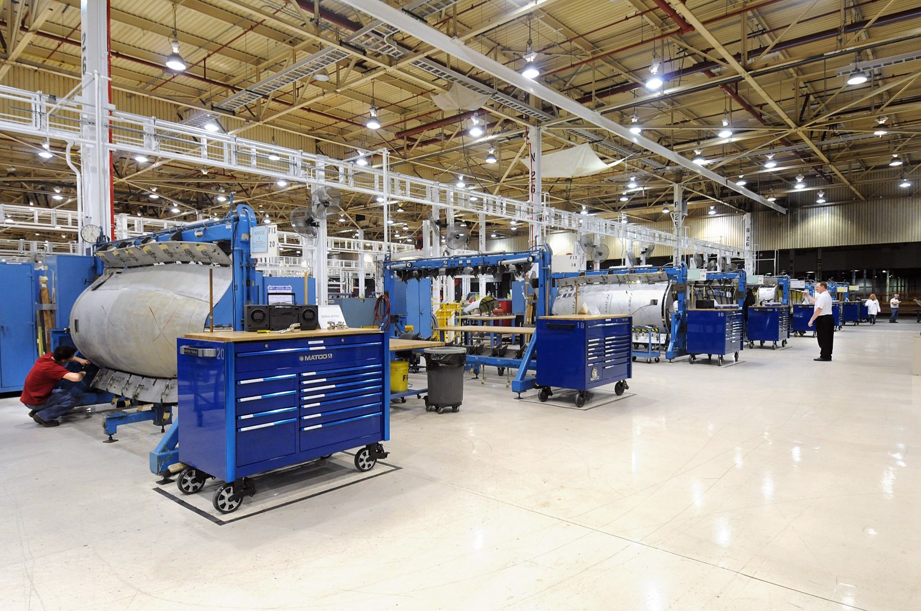
B9001

Slide 3
THEN
General Motors (GM) Oklahoma City Assembly
1979 Produced first automobiles: Chevrolet Citation and Pontiac Phoenix
1979- 2,400 employees built Buicks, Chevrolets, 2006 GMCs, Isuzus, Oldsmobiles & Pontiacs
Produced 5 millionth car
2005 GM announced plant closing
2006 Last vehicle from assembly line: a white Chevrolet TrailBlazer EXT
Key to Building 9001, 2008

Slide 4
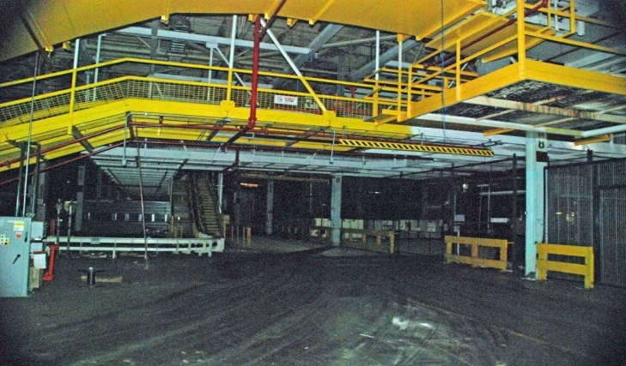

Slide 5
COMMUNITY SUPPORT
2008
Voters approved $55M bond issue to purchase GM Oklahoma City Assembly
Oklahoma County purchased assembly plant; entered 50-year, $1/year lease with U.S. Air Force
Ceremonial lease signing with Senator Inhofe and community leaders
Outstanding partnerships between U.S. Air Force, civic leaders and surrounding communities
Key to Building 9001, 2008

Slide 6
FROM AUTOS TO AIRCRAFT
2009
430 acre complex, 3 buildings, 3.8M square feet of production facilities leased from County
Created 5-year phased occupancy plan
Began demolition/renovation of 2.7M square feet of industrial and administrative space
Removed 26K tons of automobile manufacturing related infrastructure
Key to Building 9001, 2008

Slide 7
NOW
Oklahoma City Air Logistics Complex
2009 First workloads relocated: TF-33 Two Level Maintenance Engine Repair and Consolidated Sheet Metal
2015 1,844 employees in shops including: KC-135 Boom, B-1 Stabilizer Repair, F-101 and F-110/118 Engine, KC-46 Software Integration Facility and Pacer Comet IV, Test Program Set, Industrial Installations, and Main Tool Issue Center
Other agencies in facility include: 448th Supply Chain Management Wing, 72nd Air Base Wing, Boeing and Defense Logistics Agency
Key to Building 9001, 2008

Slide 8
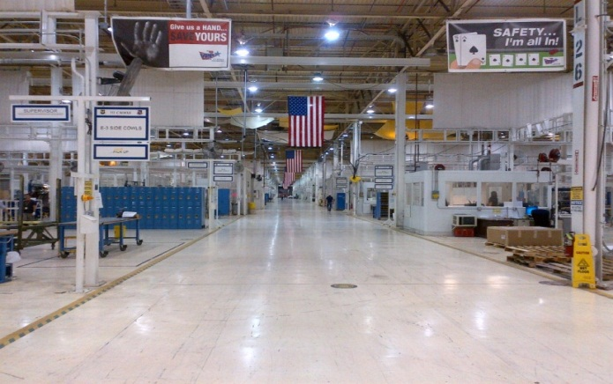
Notes:
- Design and Construction of shops has been primarily accomplished by organic MXSG resources

Slide 9
Concluding Remarks
Building 9001 is a remarkable addition to OC-ALC
Community support was significant factor
Business processes are a huge innovation opportunity
Number of unanticipated challenges
Kristian Olivero
Kristian.Olivero@us.af.mil
405-409-7753 (cell)

