Slide 1

USNA Mission and Corrosion
Mission of USNA “To develop Midshipmen morally, mentally and physically and to imbue them with the highest ideals of duty, honor and loyalty in order to graduate leaders who are dedicated to a career of naval service and have potential for future development in mind and character to assume the highest responsibilities of command, citizenship and government.”
Main Purpose of the corrosion activities at USNA is to increase awareness of corrosion and corrosion prevention in military systems and of the impact of that corrosion on cost, material readiness, and mission for the future leaders of the US Navy and Marine Corps. (As is true for the other service academies with respect to the Services that they support).

Slide 2
Faculty and Staff Active in Corrosion at USNA
CAPT (select) Brad Baker, USN, PMP, Mech Engr Dept
PROF Steven Graham, Chair, Mech Engr Dept
PROF Michelle Koul, Mech Engr Dept
PROF Patrick Moran, Mech Engr Dept
ASST PROF Emily Retzlaff, Mech Engr Dept
Mr. Brian Russell, Tech Supervisor, Materials/Mechanics Labs
PROF Joel Schubbe, Mech Engr Dept
Materials/Mechanics Labs Tech Staff

Slide 3
Investigation into the Localized Corrosion Behavior of AM 15-5 PH and AM 17-4 PH Stainless Steel
ENS Joshua Hanna, USN (USNA Class of 2018)
CAPT (select) Brad Baker, USN
PROF Patrick Moran
Mechanical Engineering Department
United States Naval Academy
June 29, 2018
Acknowledgements: OSD-CPO, NAVAIR, USNA Bowman Scholar Program

Slide 4
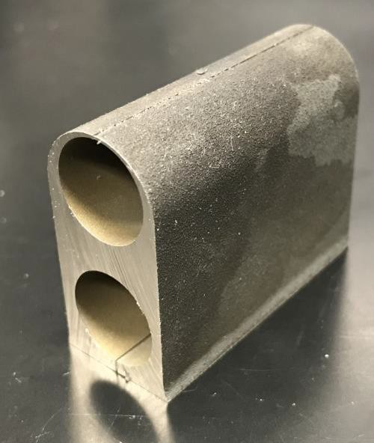
Materials Tested (AM Matls from NAVAIR)
* Wrought 17-4 PH in H1100
[solutionized at 1900F typically for 1 hr, then air cooled,
then aged at 1100F for 4hr, followed by an air cool]
* AM 17-4 (5A3, Ar, L205A) H1025
[solutionized at 1900F for 1 hr, HIP 2125F at 15 ksi for 4 hr]
*AM 15-5 (4A3, L204A) H1025
[solutionized at 1900F for 1 hr, HIP 2125F at 15 ksi for 4 hr]
EDXRM Results from USNA
 | C | Si | Cr | Mn | Fe | Ni | Cu
Wrought 17-4 | 1.78 | 0.19 | 15.21 | 0.96 | 74.73 | 3.82 | 3.30
AM 17-4 | 1.76 | 0.00 | 15.40 | 0.03 | 76.66 | 3.03 | 3.12
Spec. | 0.07 max | 1.0 max | 15-17 | 1.0 max |  | 3.0-5.0 | 3.0-5.0

Slide 5
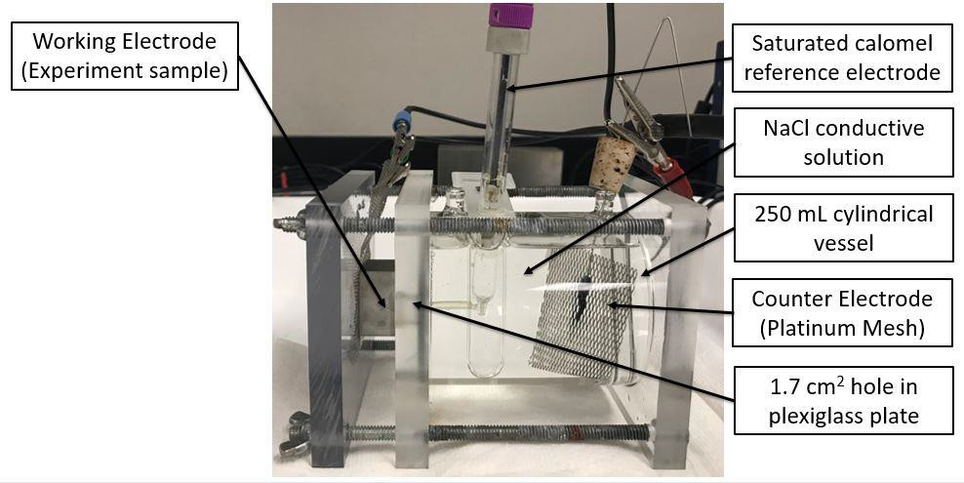
Electrochemical Polarization Experiments
Samples ground to 600 grit finish, cleaned and air dried, 18 hrs at OCP,
600 mV/hr scan rate, exposed area of 2.27 sq cm, ambient temperature

Slide 6
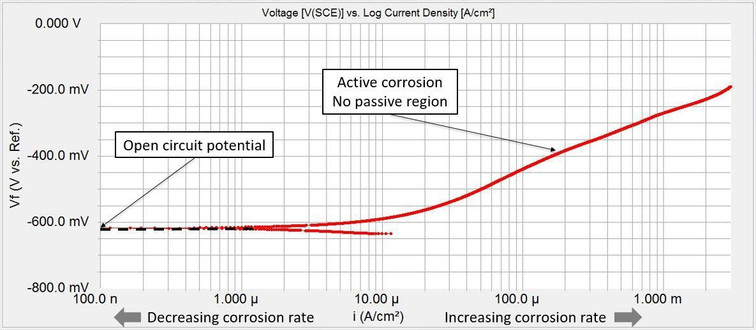
Polarization Results for As Received AM Surface of AM 17-4
(active corrosion, no passivity observed)

Slide 7
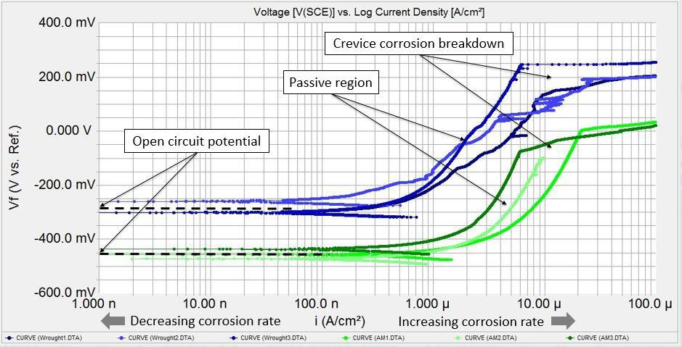
Polarization Results for Prepared AM Surfaces of AM 17-4 (Green) and Wrought 17-4 (Blue)
AM 17-4 exhibits lower Ecorr, higher passive current densities, higher susceptibility to crevice corrosion

Slide 8
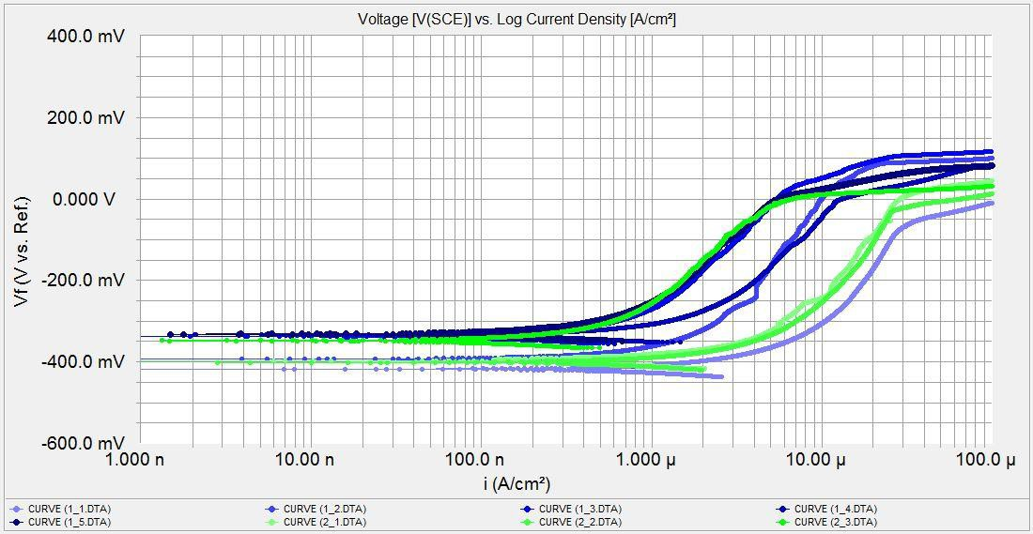
Prepared Surfaces of AM 15-5 with varying
Depth from As Manufactured Surface
AM 15-5 behavior in same range as AM 17-4, corrosion resistance improves with depth from surface,
stable behavior at approx 100 mils depth but not quite as good as worst Wrought 17-4 behavior

Slide 9
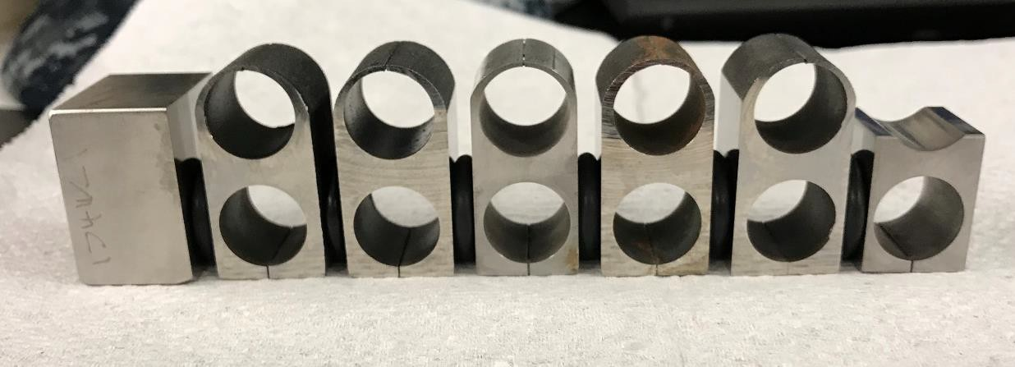
Crevice Corrosion Exposure Testing
(3 weeks in salt fog at 32C)
O-rings used as crevice formers, one wrought 17-4 face, 5 faces of AM 17-4 including one as
manufactured, 6 faces of AM 15-5 including one as manufactured, AM faces at varying depth from surface

Slide 10
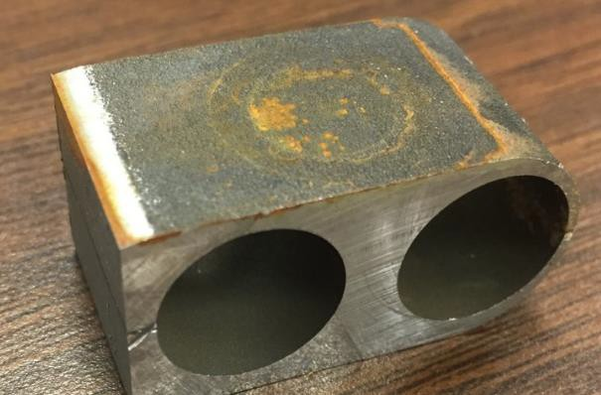
Crevice Corrosion Testing Results
NO crevice corrosion observed on
ANY surfaces for this 3 week exposure.
Referring here to crevice corrosion under
the o-rings! More on surface corrosion
to follow.
Uncertain of influence of longer testing
Duration.

Slide 11
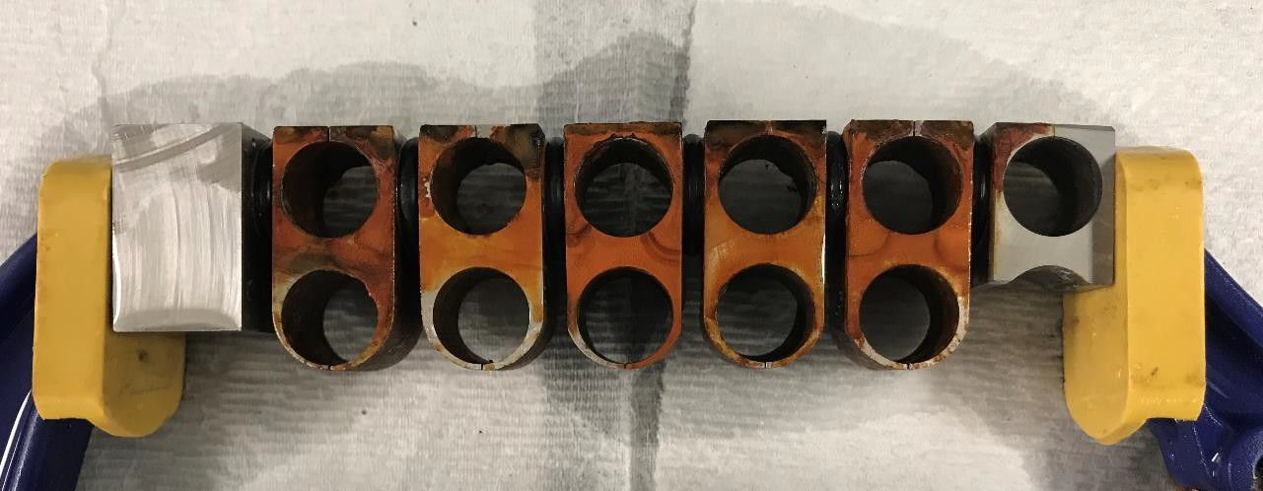
Crevice Corrosion Testing Results (continued)
All upward facing surfaces of AM materials showed “rusting” after the test, wrought 17-4 showed NONE.
Some of these AM surfaces are very deep into the material, these were all cut but not polished surfaces.

Slide 12
Findings from this Investigation
As Manufactured AM surfaces corrode rapidly and show no sign of passive behavior (possibly due to heat tinting?).
Much lower corrosion rates observed and passivity observed when the AM As Manufactured surface roughness is (just barely) removed, BUT corrosion behavior is worse than the wrought 17-4 control including higher susceptibility to crevice corrosion.
AM materials corrosion behavior improved with depth from the As Manufactured surface BUT still not equivalent to the 17-4 control used in this study.
No evidence of crevice corrosion in any materials tested for the 3 week salt fog test conducted. Longer duration tests recommended.
Surface “rusting” observed in crevice corrosion tests for AM materials even deep into the material (not observed for the wrought 17-4).

Slide 13

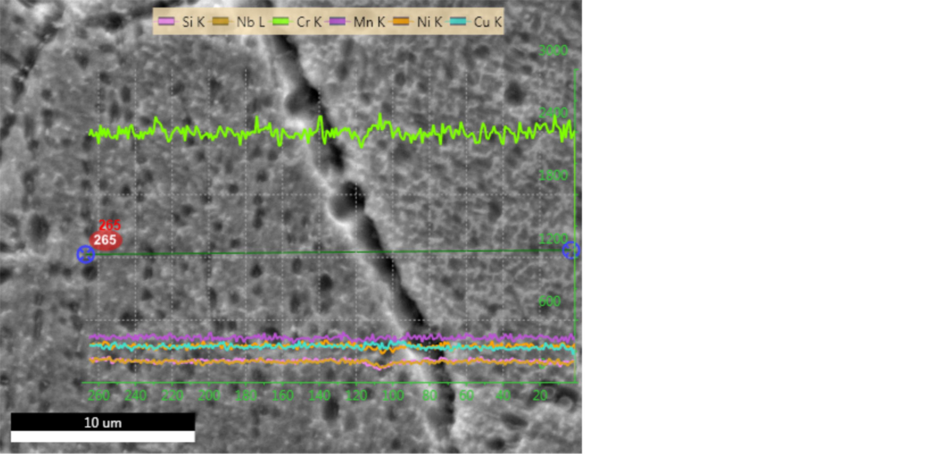
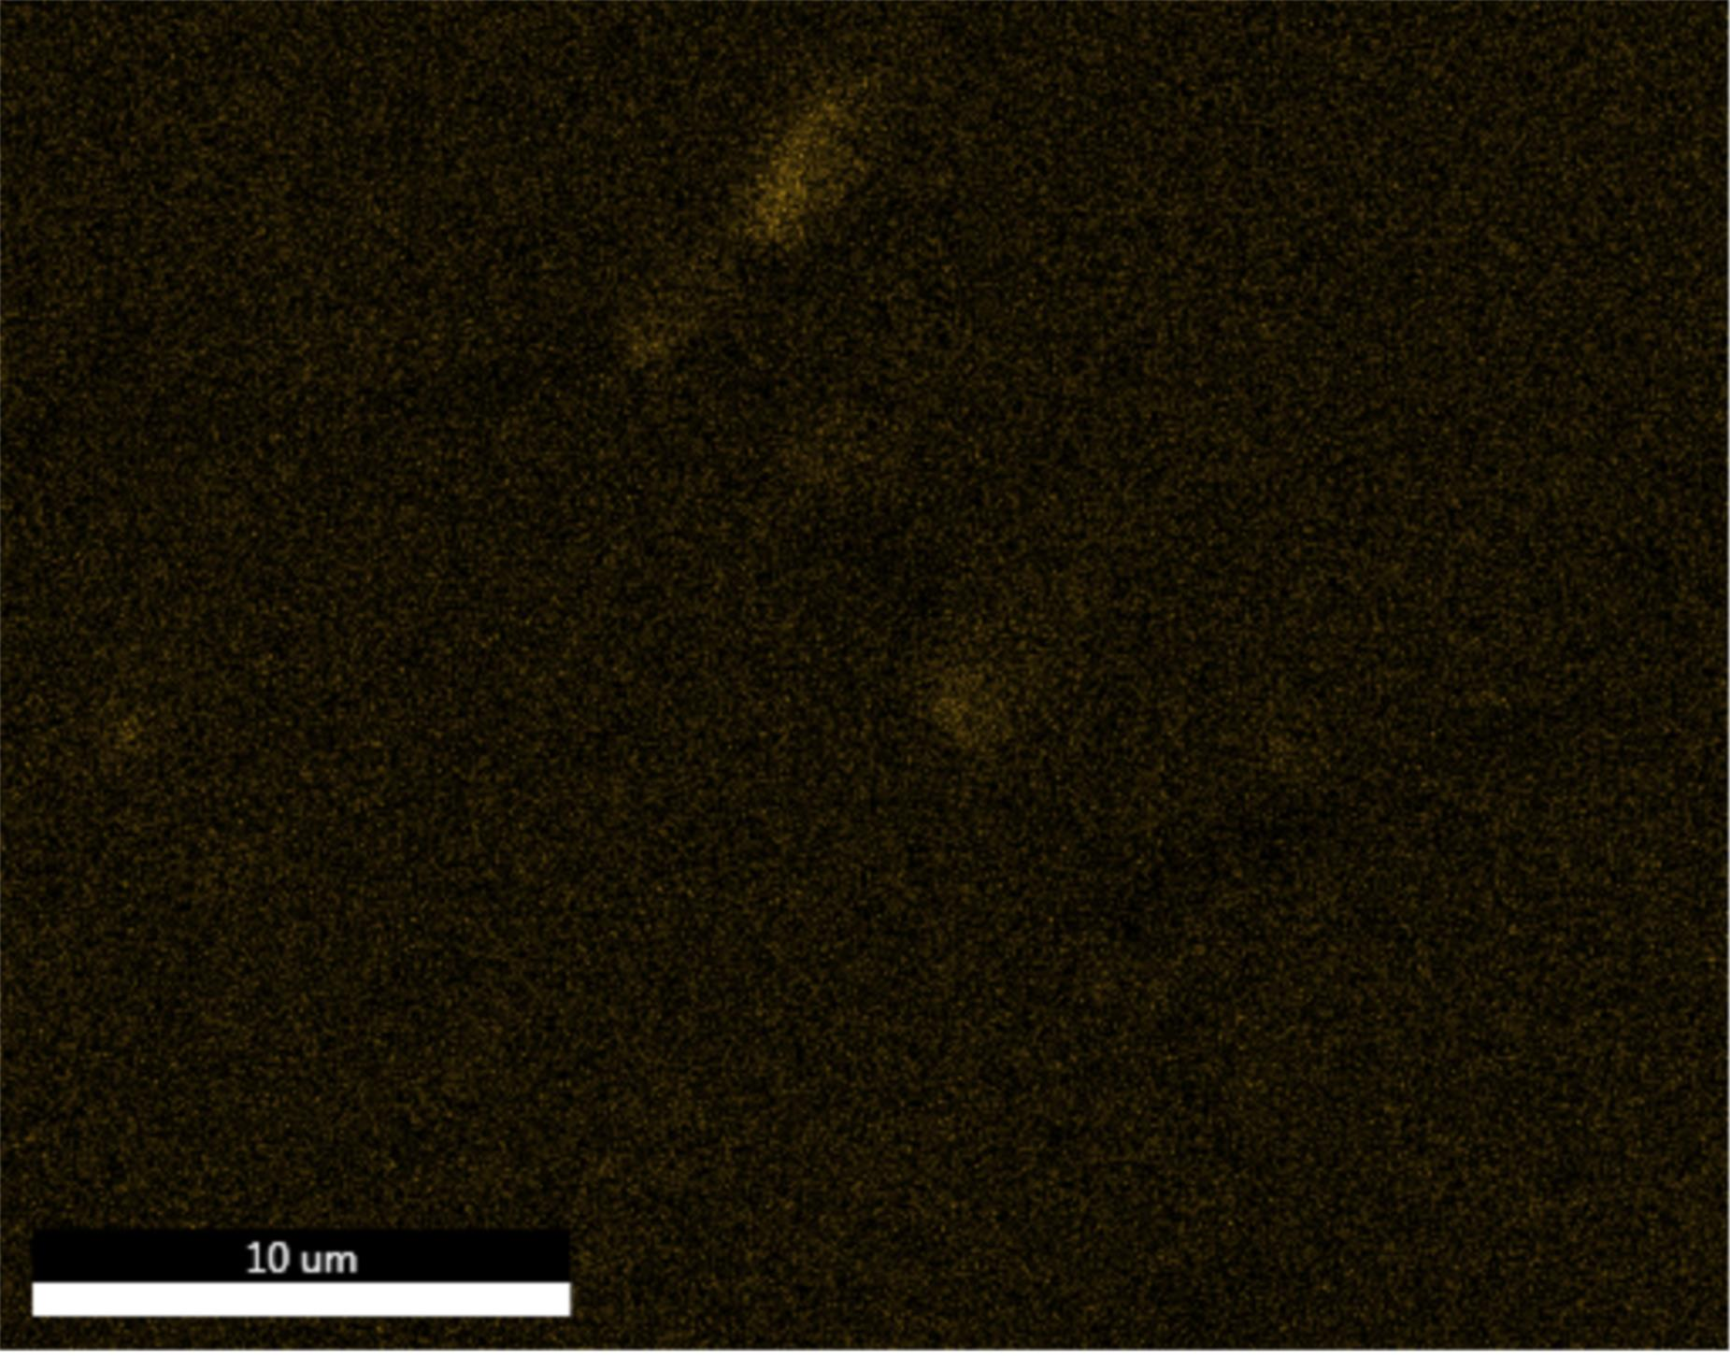
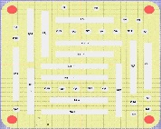
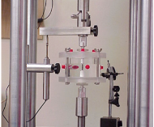
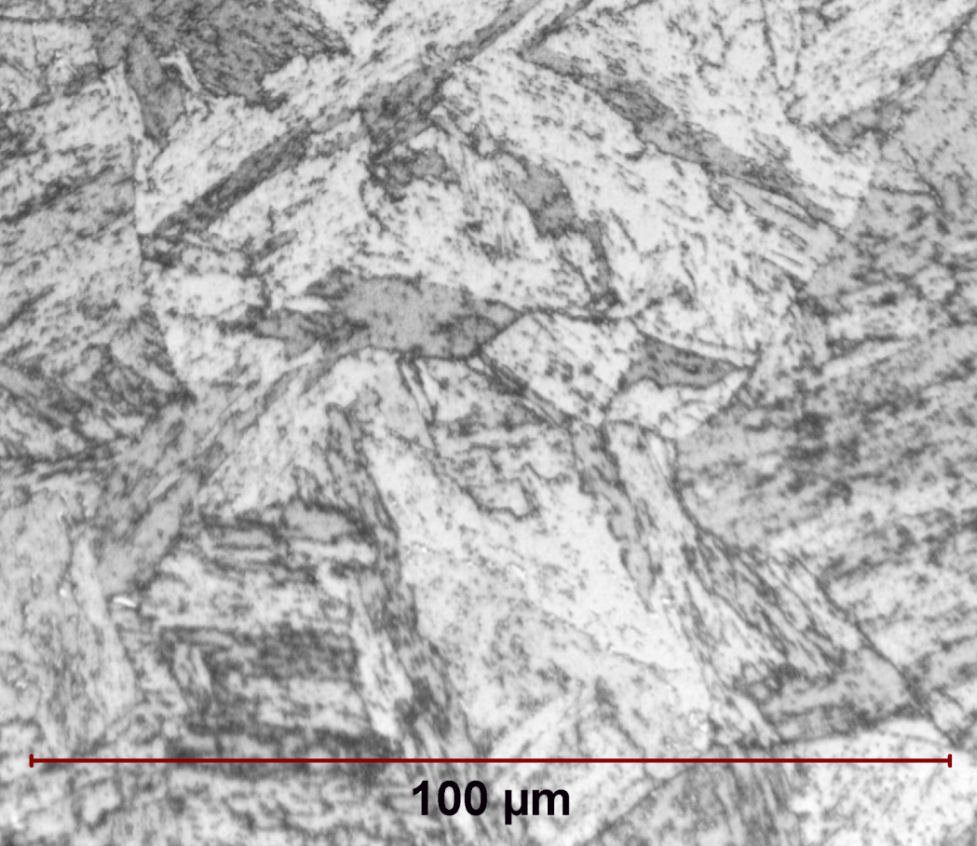
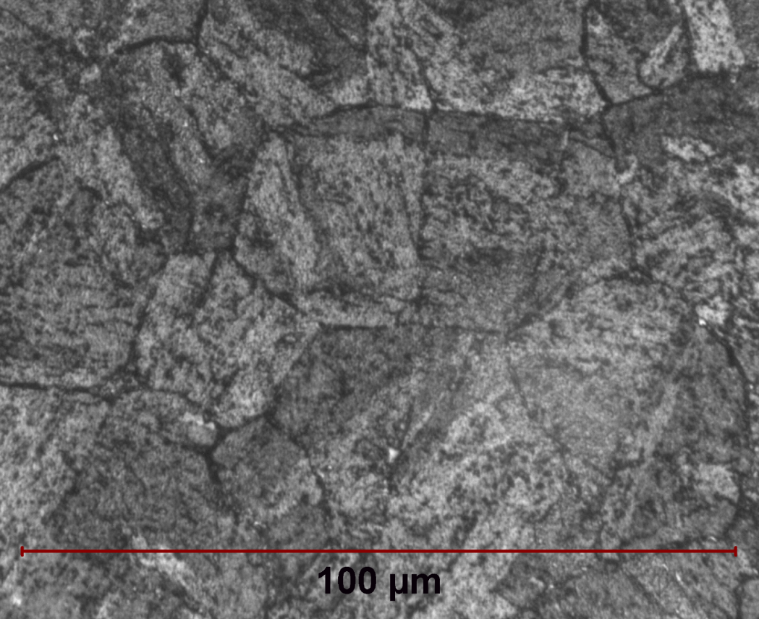
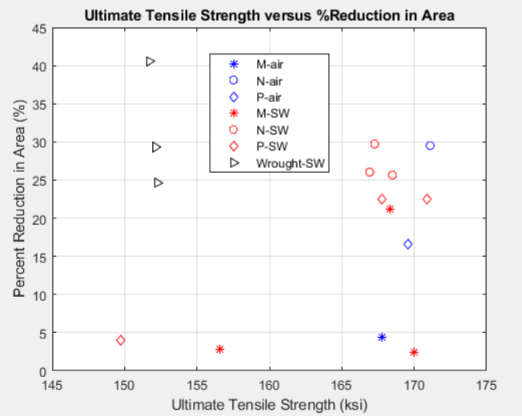
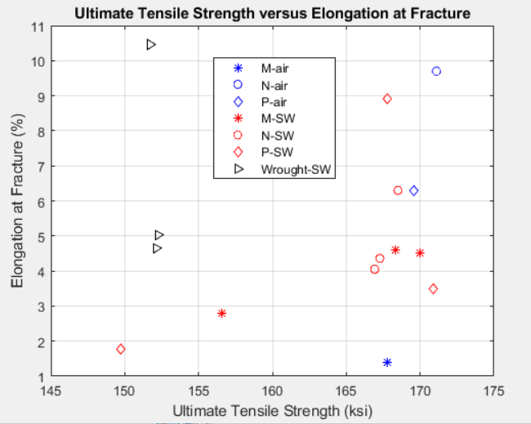
Stress Corrosion Cracking Analysis of Additively Manufactured 17-4PH Stainless Steel Through Constant Extension Rate Testing
ENS Connor J. Panick, USN, Class of 2018
Advisor: Professor Michelle G. Koul, USNA Mechanical Engineering Department
United States Naval Academy
Abstract:
Additively manufactured (AM) stainless steels represent a category of materials of growing interest for the U.S. Navy due to the versatility of ship-board manufacturing via 3D printing that cannot be accomplished through traditional manufacturing methods. One such stainless steel of interest is 17-4 Precipitation-Hardenable (PH) Stainless Steel (Table 1). When subject to additive manufacturing via Selective Laser Melting (SLM), directionality of the steel microstructure can result, which can lead to orientation-dependent material properties and, perhaps, stress corrosion cracking susceptibility. Through the use of Constant Extension Rate Testing (CERT) in a corrosive environment, the goal of this research project was to characterize the stress corrosion cracking susceptibility of AM 17-4PH and identify any possible directionality issues; and compare to its wrought counterpart. Porous regions within the bulk material were detected that result in visible corrosion and appear to reduce the strength and ductility of the alloy. The presence of these defects appear to mask any dependence on directionality. Additional research was also performed in an effort to understand the corrosion mechanism within the porous regions of the AM specimens. A phenomenon such as sensitization was seen as a potential corrosion-driving issue.
CERT Experimental Results:
The following images were taken of the fracture surfaces of AM and wrought 17-4PH samples:
An EDS line scan was performed across a grain boundary within an unfused 17-4PH particle in a void region within specimen M2 (Fig. 9).
The line scan revealed no notable difference in chromium content between the center of each grain and the grain boundary.
An additional EDS line scan was performed across a grain boundary within a non-void region adjacent to the void scanned in Figure 9. This line scan also yielded no noticeable chromium concentration changes.
Cleavage Fracture
Microvoid Coalescence
Fig. 9: Line Scan Across Unfused Particle Grain Boundary (M2)
Unfused Particles in Void Region
EDS Scan Region
Experimental Procedure:
The 4.5-in long (gage diameter = 0.25-in) AM 17-4PH Stainless Steel Tensile Specimens were SLM manufactured as shown in Figure 1 and processed to the H1100 condition. In the SLM manufacturing process, the pre-fused metal powder is laid down in the x-y plane and the laser follows a single pre-set direction (x or y), for each successive build layer in the z direction [1]. The build was designed, in part, to test whether these two directionality factors result in anisotropy of AM 17-4PH material properties. Constant Extension Rate Testing (CERT) involves the application of a slow, constant extension rate to a tensile specimen until fracture [2]. Testing was performed at an extension rate of 9.0 x 10 ⁻⁷ in/s (rate selected after reviewing relevant technical literature) while immersed in 3.5 wt% NaCl solution (Figure 2). The slow extension rate is used to allow sufficient time for corrosion processes to take place and measure susceptibility to stress corrosion cracking via reductions in strength or ductility. A single test took approximately 60 hrs to complete. Applied load and elongation were recorded and strength and elongation at fracture were calculated. Reduction in area at fracture was calculated from the minimum diameter of the fractured specimens. Specimens were cleaned with methanol before microscopic examination.
After CERT testing and secondary electron microscopy (SEM) inspection, samples from the fracture region were cut longitudinally from specimens M2, P2, and W10. The samples were mounted with graphite mounting compound and then sufficiently polished and etched. Additional samples along the radial and longitudinal planes were taken from specimens M2, N2, and W19 in the unstressed regions of each specimen. Of these samples, all were polished, but only the samples along the radial plane were etched. Mounted samples were then composition-mapped using energy dispersive spectroscopy (EDS), and the various compositions were recorded. EDS line scans were also taken across the grain boundaries in specimen M2.
Fig. 5: Typical AM Fracture Surface (P2)
Fig. 6: Close up of Void Region (P3)
Potential Niobium Carbide Along Grain Boundaries
Typical (uncorroded) AM fracture surfaces exhibit a combination of cleavage fracture, intergranular fracture and microvoid coalescence (Fig. 5), while the wrought samples showed predominantly microvoid coalescence.
Corroded AM fracture surfaces exhibited void regions (Fig. 6) with unfused 17-4PH particles
Fracture surfaces without corrosion did not exhibit unfused void regions.
Table 2: Experimental Material Property Data
Fig. 10: Polished and Etched Void Region (M2)
Fig. 11: EDS Scan – Niobium Concentration (M2)
Specimen | UTS (ksi) | Yield Strength (ksi) | % Elongation | % Reduction in Area
M Orientation (SW) | 170.0 156.6 168.3 | 163.1 153.1 162.5 | 4.5 2.8 4.6 | 2.8 21.2 2.40
N Orientation (SW) | 168.5 167.3 166.9 | 162.2 159.5 161.2 | 6.3 4.4 4.0 | 25.6 29.7 26.0
P Orientation (SW) | 170.9 149.7 167.8 | 163.3 N/A 160.6 | 3.5 1.8 8.9 | 22.6 4.0 22.6
Wrought L (SW) T (SW) T (SW) | 151.7 152.3 152.2 | 146.4 148.3 148.4 | 10.5 5.0 4.6 | 40.5 24.7 29.3
Initial EDS scans performed on an unfused particle grain boundary in specimen M2 (voids and corrosion present) in void region below fracture surface (Fig. 10). The sample used in this case was sectioned longitudinally and just below the fracture surface of specimen M2.
EDS scan produced normal distribution and concentration of chromium, which was inconsistent with the sensitization hypothesis as to the corrosion mechanism driving the corrosion in specimens M2 and P3.
M2 grain boundary EDS scan did reveal the presence of potential niobium carbides along the grain boundaries within the unfused particle (Fig. 11).
Table 3: EDS Scan Composition Data
Sample | Cr (wt%) | Ni (wt%) | Cu (wt%) | Mn (wt%) | Si (wt%) | Nb + Ta (wt%)
M2 (20 keV) (15 keV) | 18.47 15.77 | 4.60 4.50 | 7.67 6.17 | 1.74 1.34 | 1.05 0.40 | 0.00 0.57
P2 (20 keV) | 15.60 | 4.65 | 5.55 | 1.44 | 0.52 | 0.62
W10 (20 keV) | 14.15 | 4.90 | 6.00 | 2.02 | 0.27 | 0.52
Table 1: Specified chemical composition of 17-4PH steel in wt. %, balance Fe
C | Mn | P | S | Si | Cr | Ni | Cu | Nb+Ta
0.07 | 1.00 | 0.04 | 0.03 | 1.00 | 15.00 - 7.50 | 3.00 - 5.00 | 3.00 - 5.00 | 0.15 - 0.45
Ultimate tensile strength, yield strength, percent elongation at fracture and percent reduction in area data were collected for wrought and AM samples of each orientation (Table 2).
Wrought specimens were machined in the longitudinal (L) and both transverse (T) directions of a 5T x 5T x 8L-in H1100 bar.
Test Chamber (3.5 wt% NaCl)
EDS scans were performed on etched samples cut longitudinally and just below the fracture surfaces of specimens M2, P2, and W10. M2 was scanned twice in two different regions of grain boundaries within two distinct unfused particles. The second EDS scan used a lower voltage of 15 keV (as opposed to 20 keV).
Scans did not reveal any evidence of carbide precipitate formation or elemental depletion along/near grain boundaries.
The first scan of specimen M2 (taken form a longitudinal section just below the fracture surface) yielded a high chromium content (18.47 wt%) and a high silicon content (1.05 wt%).
Y
X
P - Orientation
EDS and Optical Microscopy Experimental Results:
The following images and EDS scans were taken of the sectioned surfaces of 17-4PH samples. Marble’s Reagent was used as the etchant for all etched samples:
Conclusions:
Both air and solution-tested tensile AM specimens (without voids) had high strength but low and variable ductility as compared to wrought material of the same condition.
Microscopy revealed that the two AM specimens that showed markedly low strength and ductility were samples with unfused void regions on the fracture surface.
The same two AM specimens were the only two specimens that showed visible rust along the gage length, indicating corrosion susceptible material associated with unfused regions.
The appearance of the void areas appears to indicate that it is two dimensional in nature and lies in the x-y plane, perhaps occurring between successive layers of the build.
The Selective Laser Melting (SLM) process affected measured material properties via the presence of unfused void regions. These large defects masked any effects grain boundary delta ferrite observed in the AM material, which likely resulted in some microscopically ductile intergranular fracture.
EDS scans on stressed and unstressed regions of different build directions yielded no evidence of consistent elemental variation.
Line scans across grain boundaries within unfused grains in specimen M2 void regions did not yield any evidence of increased chromium concentration or segregation/depletion at grain boundaries.
Based on EDS results, the corrosion mechanism of the susceptible material could not be identified.
Z
(out)
M - Orientation
N - Orientation
Specimen Location
Optical microscopy images of AM specimens (see M2 in Fig. 7) display a martensitic microstructure similar to the wrought condition (see W19 in Fig. 7) and no evidence of retained austenite. Future microhardness measurements will be performed to confirm this observation.
In the AM samples examined (M2, N2, P2) grain boundary attack was observed, which has been attributed to the presence of grain boundary delta ferrite in AM 17-4PH manufactured via selective laser melting [3] (see Fig. 8).
Fig. 1: Specimen Build Plane
Fig. 2: CERT Apparatus
Fig. 7: Optical Microscopy Images of Etched Radial Sections: W19 (left) and M2 (right)
Figure 8 displays a comparison between an optical image of the etched radial surface (left) and an SEM image of the fracture surface (right) of specimen M2.
These delta-ferrite at the grain boundaries likely contributed to the observed intergranular fracture.
References:
[1] “About Additive Manufacturing – Powder Bed
Fusion,” Loughborough University Website, accessed December 1, 2017,
http://www.lboro.ac.uk/research/amrg/about/the7categoriesofadditivemanufacturing/powderbedfusion/.
[2] M. Henthorne. “The Slow Strain Rate Stress Corrosion Cracking Test—A 50 Year Retrospective.” Corrosion 72, 2016.
[3] Carelyn E. Cambell, Eric A. Lass, and Sudha Cheruvathur, “Additive Manufacturing of 17-4 PH Stainless Steel: Post-processing Heat Treatment to Achieve Uniform Reproducible Microstructure,” The Minerals, Metals, and Materials Society, 2015.
Acknowledgements:
Dr. Airan Perez, Corrosion Control Science & Technology Program, Office of Naval Research
Materials and machining support: Naval Air Warfare Center – Aircraft Division, 4.3.4.1 - Metals and Ceramics Branch.
Equipment and general support: DOD Corrosion Policy and Oversight Office , USNA Bowman Scholar Program
Sample preparation support: Mr. Mike Spencer, USNA Technical Support Department, Center for Materials Characterization.
Fig. 3: % Reduction in Area vs. Ultimate Tensile Strength
(SW = salt water)
Fig. 4: Elongation at Fracture vs. Ultimate Tensile Strength
(SW = salt water)
Fig. 8: Optical Image (left, etched) and SEM Image (right, fracture surface) of Specimen M2

