Slide 1
Miniature/Microminiature (2M)
Module Test & Repair (MTR) Program
AN/USM 726
2M
Rich McConell, SEA 04RM33
COM 202-781-3259 DSN 326-3259
Richard.McConnell@navy.mil

Slide 2
What is the NAVSEA 2M MTR Program ?
NAVSEA 04 provides over 245 ships and shore activities with capabilities to repair circuit card assemblies (CCA) and electronic modules (EM) which results in reduced OPTAR expenses, averts/corrects CASREPs (casualty reports) and supports unit self-sufficiency.
Technicians are provided with special purpose test equipment, 2M repair equipment, Gold Disk diagnostics and repair procedures to support CCA and EM repairs.
5 training courses taught at six Navy training sites, 5 NEC (Navy Enlisted Classification) codes and certification/inspection processes for technicians, 2M MTR work centers/shops and training sites.
The Module Test & Repair Tracking System (MTRTS) is a 2M MTR reporting system resident on the AN/USM-674/726 test systems. MTRTS provides quarterly metrics IAW Joint Fleet Maintenance Manual (JFMM) policy.

Slide 3
Benefits of 2M MTR Utilization
Improves readiness, self-sufficiency & sustainability of systems/equipment
Since we began tracking metrics in April 1996 to the end of CY 2017 Navy commands outfitted with 2M MTR capabilities reported over 211,000 repairs, which resulted in 13,000+ CASREPS averted or corrected and $770+M in OPTAR cost avoidance.
Results in reduced requirements to carry on-board repair parts (OBRPs).
Minimizes diminishing manufacturing sources and material shortages (DMSMS) issues
Minimizes “No Failure Evident” cards being sent to depots
Sailors/Marines are eligible for a $5,000 Monthly CNO Gold Disk Award and a Letter of Commendation from OPNAV N8.
Module Test and Repair quarterly reporting can provide system PM/ILSM/Engineering Agent/OEM with repair and failure data
3

Slide 4
Engineering Agents, Customers and Sponsors
484 Total DoD Commands
HQMC (I&L) / 64 Commands MARCORSYSCOM TMDE
Other Customers
Nat’l Guard
USAF
USCG
USA
FMS
USMC (ground)
Echelon 3 & 4 Commands
Surface Ships, Subs, Shore Commands
NUWCDET
FEO NORFOLK
NSWC CRANE
5,854 Gold Disks
448 Test Systems*
597 Gold Disks
202 Test Systems*
* AN/USM-674/726
Naval Aviation:
AIMDs, MALS & FRCs
GOALS
Maintain standard 2M MTR HW/SW/ILS
2. Obtain maximum synergy from shared and unique infrastructure
389 Gold Disks
133 Test Systems*
NAVAIR (PMA 260)

Slide 5
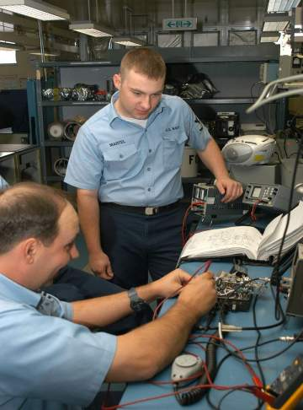
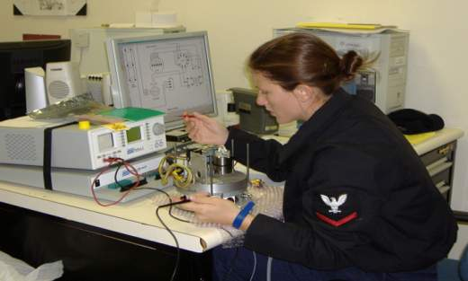
2M MTR Navy Technicians
9 electronics background rates are eligible (ETs, ATs)
Technician proficiency is maintained through a 18-month recertification requirement
The benches are also inspected on a 18-month cycle
5
Notes:
5

Slide 6
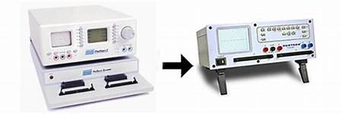

AN/USM-674 Test Station to
AN/USM-726 Test Station

Slide 7
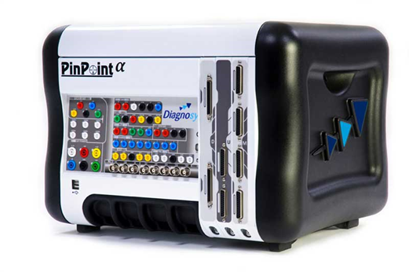
AN/USM-676 PinPoint
Test Station
PinPoint Alpha
Enhanced diagnostic testing for DoD self-sustainability

Slide 8
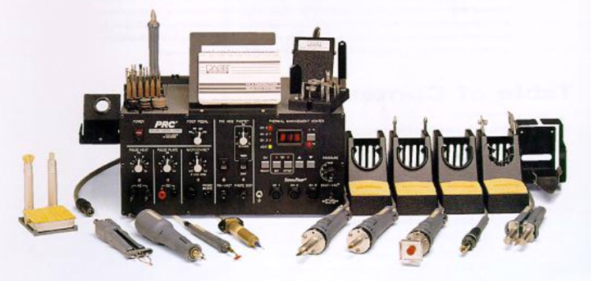
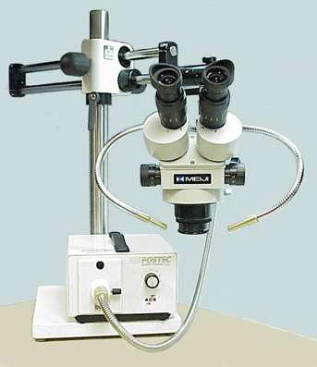
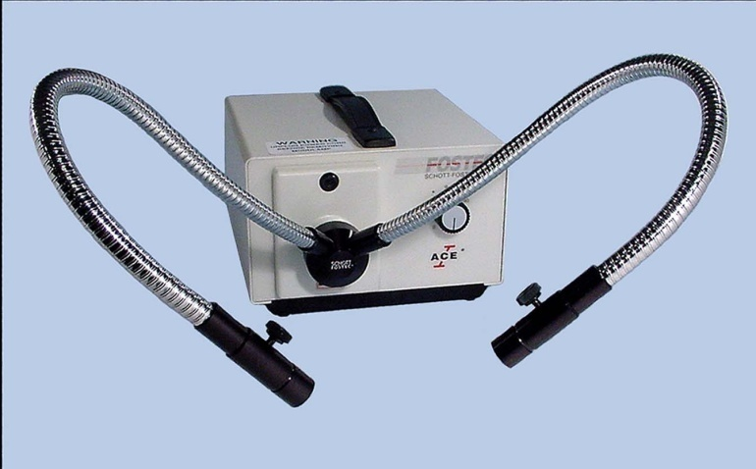
Standard 2M Workstation
Configuration (PRC 2000-SMT)
Microscope, tools and ESD material are not shown.
Supplemental
Lighting
Source
Microscope Assembly
8

Slide 9
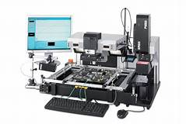
Looking to the Future of
I-Level Repair
BGA - Ball Grid Array
SMT - Surface Mount Technology
9

Slide 10
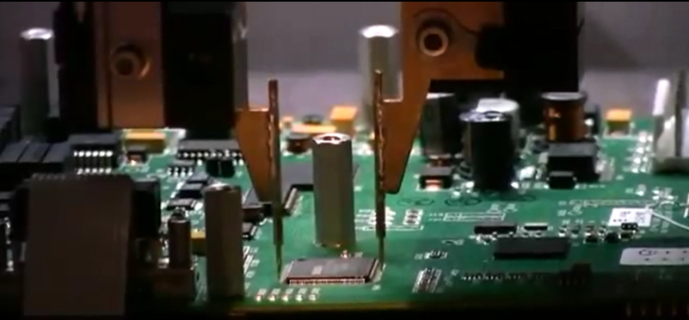
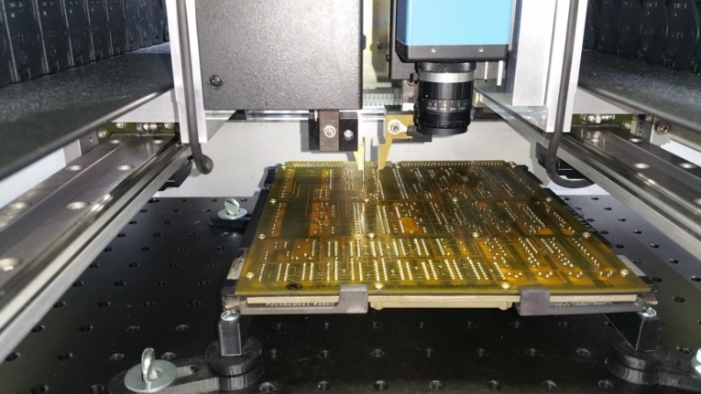
The Next Step – Ready For Issue (RFI) Testing
Advanced Circuit Card
Automated Test
(ACCAT)
ACCAT allows:
Use of guided probes to:
Measure outputs of any pin on a component or a test point
Input signals anywhere on the board
Analog Signal Analysis (V-I Testing) of the board
10

Slide 11
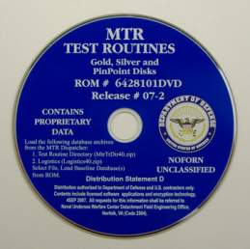
Gold Disk DVDs
MTR TEST ROUTINE DVD-ROM used with USM-674 & USM-676 Test Systems
Distributed quarterly to over 500 DoD and USCG commands
Contains all Gold Disk diagnostics test routines for the 2M/MTR Technician
DVD includes over 7,000 test routines
The MTR GOLD DISK provides logistics information and computer aided diagnostics procedures in support of 2M MTR processes.
11
Notes:
11

Slide 12
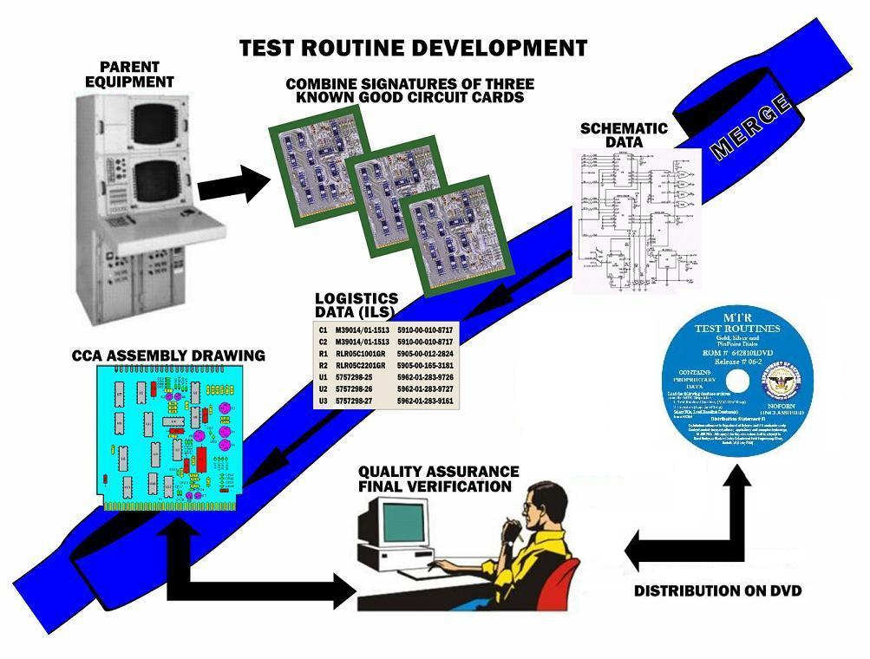

Slide 13
Training for 2M MTR
Completion of first 3 individual courses results in NEC 730A (Navy/Coast Guard), MOS 8641 (USMC), MOS94Y (Army)
AN/USM- 674
A-100-0076
5 days
NEC - N/A
Miniature
Electronic Repair
A-100-0072
26 days
NEC 784A
Microminiature
Electronic Repair
A-100-0073
12 days
NEC 783A
2M MTR Pipeline
A-100-0008
47 days
NEC 730A
(only at Navy
Training Sites)
School Locations
Navy (6): CSCS LS Norfolk / CSCS LS San Diego / CSCS Det Mayport /CSCS Det Pearl Harbor
CNATTU Whidbey Island / CNATT Det Atsugi
USMC (1): MCCES 29 Palms, CA
USAF (1): 372nd Training Squadron, Detachment 11 (AETC) Davis Monthan AFB Atsugi
USCG (1): TRACEN Yorktown

Slide 14
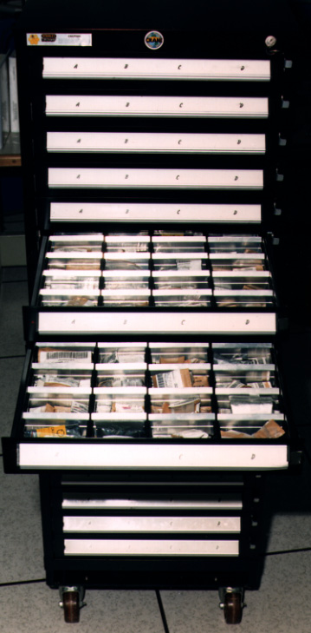
2M Piece Parts
Surface ships, SSBNs, SSGNs and shore commands have a piece-parts APL (allowance parts list) .
NUWCDET develops the piece parts APL based on ship class Gold Disks, piece parts reported utilized in MTRTS and Fleet Readiness Action Team (FRAT) requests. FRAT is Fleet’s piece parts help desk which identifies and supplies piece parts not available in the supply system.

Slide 15
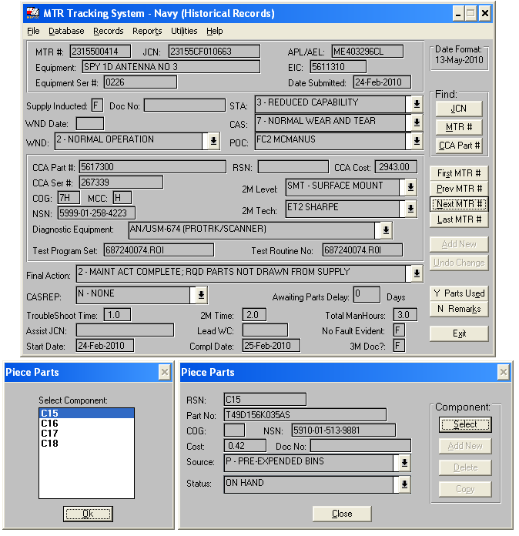
Commands with 2M MTR repair capability use the MTR Tracking System (MTRTS) to document 2M repairs. Each quarter Navy commands submit MTRTS reports to NUWC Det FEO. The metrics are combined to produce MTRTS totals reports for distribution to OPNAV, TYCOMs, ISICs and PMs.

Slide 16
Ongoing Initiatives
Continue development of Gold Disks for Fleet nominated and high cost/high failure, out of production and low stock CCA/EMs.
Phased replacement of existing 2M MTR equipment and test systems w/focus on increased I-Level capabilities.
Evaluate PinPoint “A” systems for use on smaller platforms.
3rd Generation Gold Disk Test system (USM-726)
Improve Fleet (O/I level) 2M MTR utilization
- Restart 2M Progressive Repair Enhancement Program (PREP) and Gold Disk Trap.
16

Slide 17
Backup slides

Slide 18
DMSMS Lessons Learned
CCA/EM DMSMS situations normally occur because OEMs or their suppliers discontinue production and divest of their depots repair support.
Use of Gold Disks may not always be the best solution but it is generally the least expensive and the most rapid solution.

Slide 19
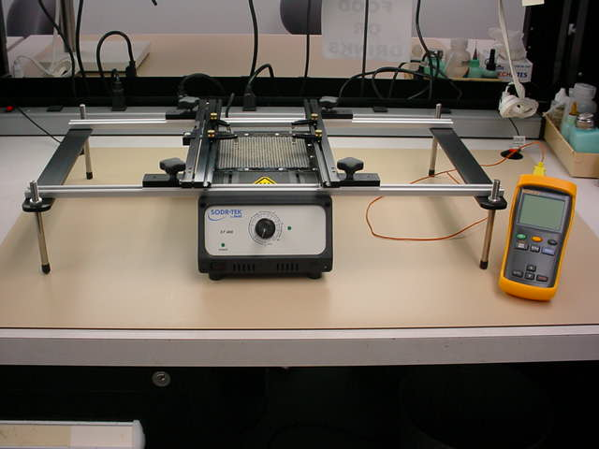
SODRTEK ST-400 RADIANT PREHEATING SYSTEM WITH
ST-550 CIRCUIT BOARD HOLDER

Slide 20
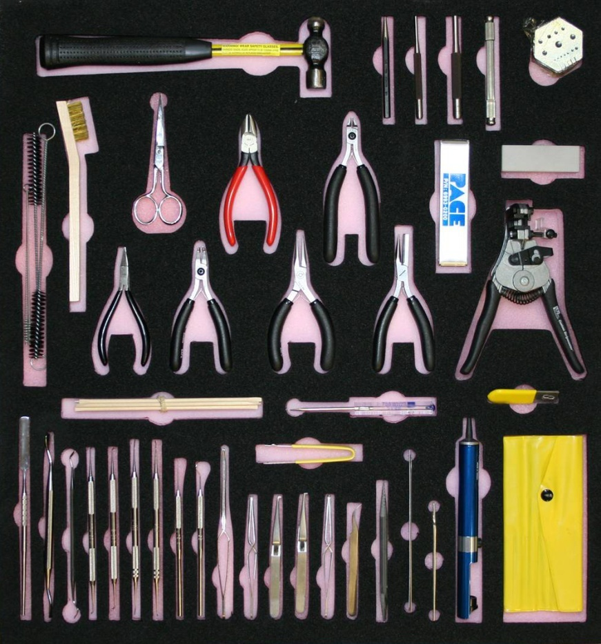
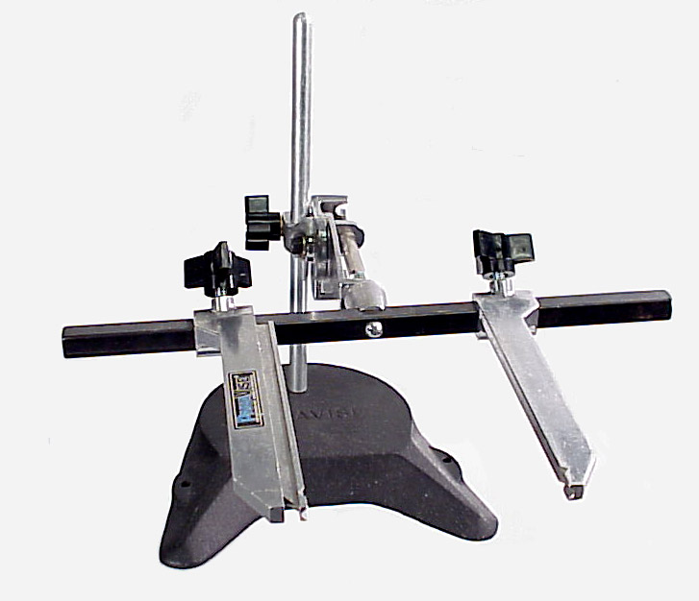
2M Repair Station Tools and Accessories
Tools & Consumables
Circuit Card & Workpiece
Holder

Slide 21
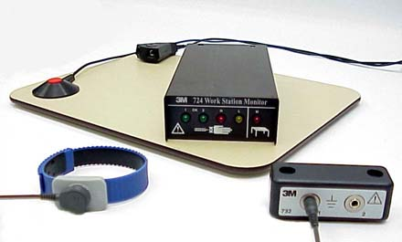
ESD Prevention Material

