Slide 1
UNCLASSIFIED//FOUO
ESPC Project Briefing
Presented by:
Brad Niles
Chief of Plant Engineering Division
Presented to JTEG
UNCLASSIFIED//FOUO

Slide 2
ESPC Projects
ESPC Combined Analysis
Task Order #1&2 - Key Elements
ECM-1 Plating Modernization
ECM-2 HVAC
ECM-3 Water/Sewer Conservation
ECM-4 Painting Modernization
Task Order #3 – Key Elements
ECM-5.1 Lighting
ECM-6.1 Building Envelope – Air Infiltration
ECM-12.2 Industrial Waste Water
ECM-15.2 Small-Scale Metal Finishing
Brad Niles

Slide 3
Task Order #1 & 2 Projects
ESPC Combined Analysis (across 17-yr project life)
Status Quo Total Cost = $317.4M
$282.0M Utility Costs (Payments to PW less Energy Savings)
$21.7M in added Equipment Maintenance
$13.7M in NESHAP Compliance Costs
CIP/MCA Total Cost = $157.6M
$158.7M Utility Costs (Payments to PW less Energy Savings)
$1.1M Savings caused by Equipment Costs and NESHAP Compliance Costs offset by Retained Value of New Equipment and Operational Savings
ESPC Total Cost = $144.7M
$138.4M to Honeywell
$67.0M Utility Costs (Payments to PW less Energy Savings)
$60.7M Savings caused by Retained Value of New Equipment and Operational Savings
Brad Niles

Slide 4
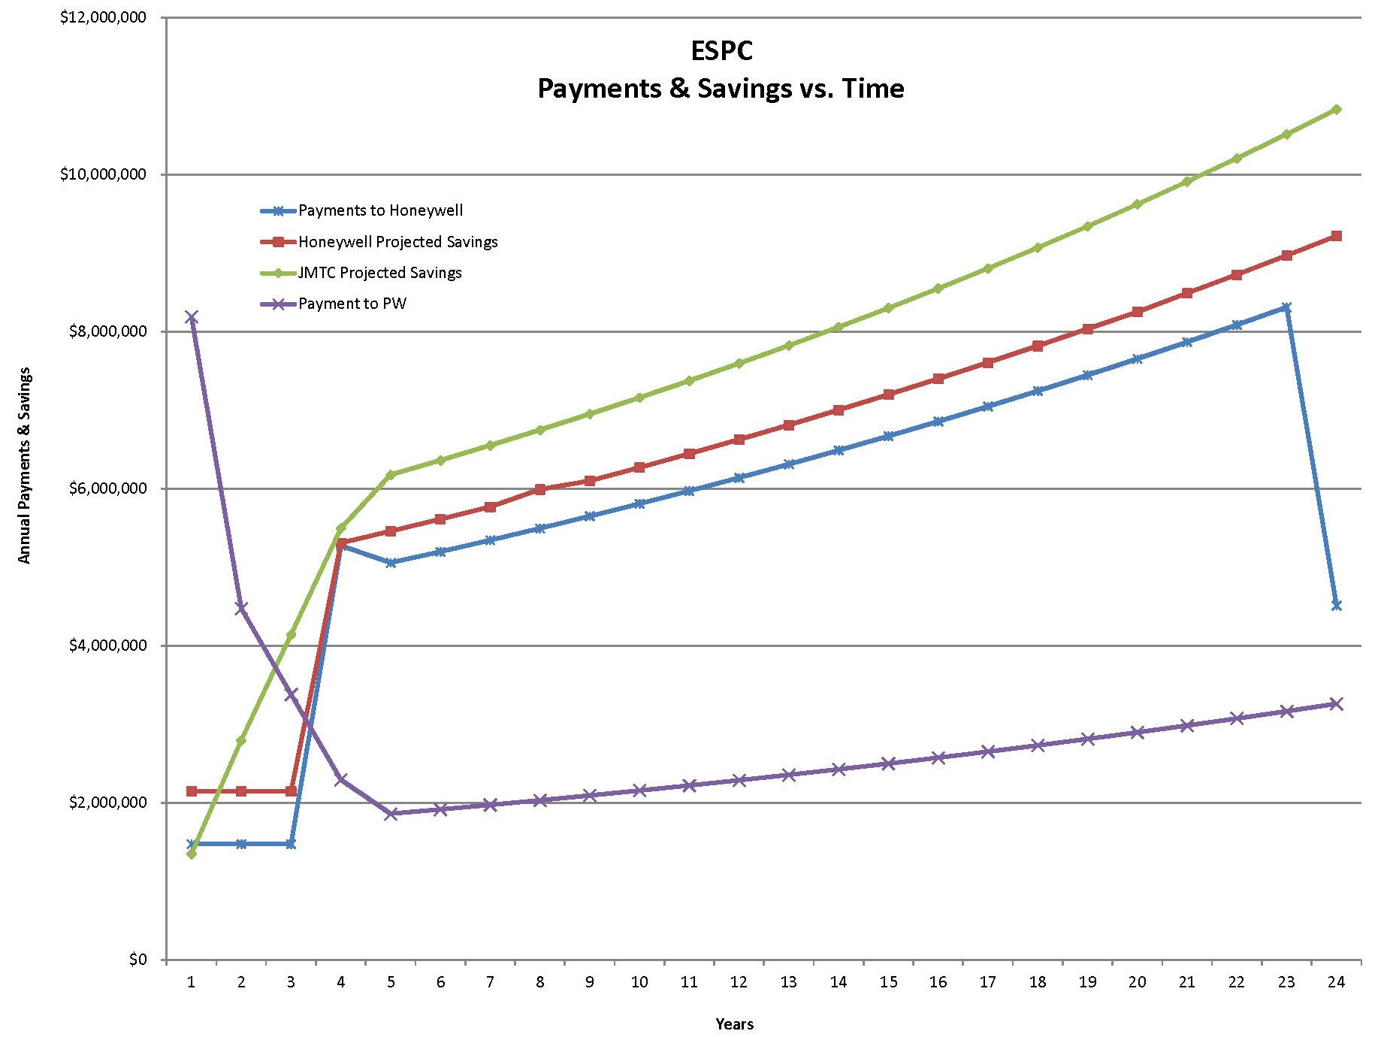
Task Order #1 & 2 Projects
ESPC Combined Analysis
Brad Niles

Slide 5
Task Order #1 & 2 Projects
ESPC Combined Analysis
Energy Only Simple Payback Period – 11.8 yrs
Energy Only Financed Payback Period – 17 yrs
Business Case Analysis (NPV) – If we had to write a check today
Status Quo = $216.4M
CIP Funded = $115.1M (assumes that funds are available)
ESPC Funded = $91.9M (best overall value & lowest risk)
ESPC Combined Analysis
Recommendation:
ESPC is the lowest cost option, has the lowest risk to the Government and provides for flexibility in the future by not dominating other funding streams. It is recommended that JMTC proceed with this option.
Continue to occupy current footprint
Continue to manufacture (including painting and plating)
Brad Niles

Slide 6
Task Order #1 & 2 Projects
ECM 1 – Finishing Line (Plate Shop) Modernization
Key Elements
Replace Existing Open Top Tanks with Enclosed Systems
Automate Process
Replace Existing Wet Scrubbers with Dry Scrubbers
Reduce Air Make-Up and Convert to Bldg Pressure Controls
New Rectifiers & Support Equipment
Period of Execution: Jan-14 thru Feb-17
Assumptions
Financial Calculations based on 2-Shift/Day 5-Day/Week Operation
Equipment will be maintained by JMTC IAW OEM instructions
Note: 90% of JMTC parts are processed through the Plate Shop
Brad Niles

Slide 7
Task Order #1 & 2 Projects
ECM 1 – Finishing Line (Plate Shop) Modernization
Other Considerations
80% Energy Reduction
1-operator per shift labor reduction (or increased capacity)
Improve Safety – Closed Top Tanks & no escape for fumes (QWE)
Improve Operation Efficiency, Output Consistency, and Recordkeeping/Documentation
Equipment has already reached expected life
More Floor Space Available while Maintaining Existing Processes
Additional Process Capabilities
Spray Booth for Larger Parts
More Scalable Process
Outsourcing Contingency Contracts will be needed
Brad Niles

Slide 8
Task Order #1 & 2 Projects
ECM 2 – HVAC
Key Elements
Replace steam comfort heat in the shops with Gas IR.
Install Large Ceiling Fans in the shops for destratification and comfort improvements (High Volume, Low Velocity)
Replace steam comfort heat in the admin areas with Gas Fired Condensing Boilers (hot water).
Install a wind break wall at the ramp from B211 into the loading dock area.
Separate the Recoil Assembly Room cooling from Cafeteria Chillers
Install a point source capture hood for the Foundry.
Brad Niles

Slide 9
Task Order #1 & 2 Projects
ECM 2 – HVAC
Other Considerations
More Efficient (heat generated at point of use instead of ¼ mile away)
Better Control of zones (set back areas when not in use)
Better Control of actual temperature (shop not at 75°F)
Very little maintenance compared to steam
Fans push heat back down to floor level (as ceiling fans at home)
Creates a cooling effect in the summer that will make shop floor feel up to 10°F cooler.
Far more efficient and effective than floor fans.
Brad Niles

Slide 10
Task Order #1 & 2 Projects
ECM 4 – Painting Modernization
Key Elements
Replace B299 Drive-In Paint Booth
Replace B299 Drive-In Blast Booth
Replace B299 Chain Paint Line
Replace B208 Drive-In Paint Booth
Brad Niles

Slide 11
Task Order #1 & 2 Projects
ECM 4 – Painting Modernization
Other Considerations
B299 will have two drive-in paint booths and a drive-in blast booth.
Rearrange so that it will not be necessary to drive through the paint booth to access the blast booth.
Gain a better curing cycle
Gain the ability to lift and manipulate large parts within the booths.
Use 75% less outside air creating energy savings.
B208 will have a new booth installed.
Use 75% less outside air creating energy savings.
Have a forced air curing cycle to reduce processing time
Better Lighting
Better Material Handling
More floor space next to the conveyor line for masking
Brad Niles

Slide 12
Task Order #3 Projects
Lighting Improvements
Plan – (7821 fixtures)
Replace all T12 technology
Retrofit or replace all non-specialty incandescent lighting
Replace high intensity discharge lighting with LED fixtures
Retrofit or replace standard T8 systems with new LED in
higher use locations.
Install wall or ceiling mounted occupancy sensors where practical
and existing sensors are not currently present.
All high bay fixtures will have integrated occupancy sensors.
All retrofit areas will increase to a 50fc minimum where applicable.
Cost – $1.58 million
Simple Payback – 14.81yrs (energy only)
Requirements – None
Pros
QWE – Improved lighting to 50-fc
Breaker will no longer be used as a light switch.
Cons
Does not result in 100% LED coverage

Slide 13
Task Order #3 Projects
Building Envelope Modifications – Overhead Doors
Plan – Install (17) new high speed doors in high traffic areas to decrease heating energy consumption by providing tighter sealing doors which reduces outside air infiltration while closed and by lessening the amount of time the doors are open further reducing the amount of outside air infiltration.
Cost – $1.18 million
Simple Payback
Guaranteed – 19.41yrs (energy only)
Assumed* – 10.22yrs (energy only)
Guaranteed calculations assume 27 seconds of fully open
time per open cycle. However, if the current doors are not
closed for 105 seconds then the baseline heating energy
increases by 60% or $100,000 per year.
Requirements – Reduced Building 299 East and West door sizes
Pros
Increased Comfort and QWE
Labor and Maintenance savings

Slide 14
ESPC Projects
Assumptions and Guaranteed paybacks
Honeywell Guaranteed project simple payback – 13.84yrs
JMTC Assumed Payback – 12.12yrs
Financed Payback – 15.5yrs (2yrs less the TO #1 and #2)
Some types of cost savings cannot be guaranteed because it is
difficult or impossible to accurately trend the M&V data. For
Example: employees leaving overhead doors open when trucks
are being unloaded or equipment moved. With this being an ever
changing variable Honeywell is unable to guarantee savings. This
makes our payback numbers much more conservative that they
will actually be.
Task Order 3 is looked at by Honeywell as a stand alone
project. They have factored in a full on-site team. Their current
on-site team will be able to support this through at least February
of 2017. This in-turn will be cutting our cost for indirect overhead
in half and enhancing our paybacks. For every month we can use
existing team we will save approximately $60,000.

Slide 15
ESPC Projects
Take-Away
Identifying Projects
Look at where your dollars are going.
Look at what infrastructure is needing replaced.
Looks at QWE projects.
See if energy saving can fund resolutions.
Be specific about expectations, assumptions, and measurements
Watch specifically when payments are due and how much.

Slide 16
ESPC Projects

