Slide 1
860th AMXS Modified Home Station Check

Slide 2
860th AMXS HSC MANNING
MANNING:
52 Authorized HSC personnel
44 Assigned HSC personnel
29/30 APG
15/22 JETS
WORK SCHEDULE:
Monday 0600 – 0600 Friday
24 hr Coverage with two 12 hr shifts
4 days on 3 days off
Schedule subject to shift days with HSC/MSN requirements
Without an HSC - 5 days 8 hour shifts augmenting flight line

Slide 3
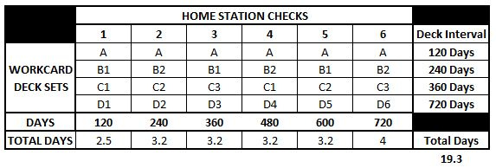
CURRENT FLEET HSC FLOW
All 6 HSCs consume approximately the same amount of man hours and calendar days to complete
Workload for APG/Propulsion is offset to balance man hours
1, 3, and 5 HSCs are Propulsion heavy
2, 4, and 6 HSCs are APG heavy

Slide 4
MODIFIED HSC FLOW
720 Day Cycle (Six - 120 Day Inspection Intervals)
Had to zero out fleet to start modified process with 13 #6 inspections in a row
Balanced Work-flow Across Propulsion & APG
Four Small (1 Day) Inspections
One Medium (3 Days)
One Large (5 Days)

Slide 5
IMPACTS
Impacts
Improved Fleet Health Through Mx Consolidation
TCTO/TCI/OTI/DD’s/Tire insp During HSC
Reduced Home Station Check down-time by 31% going from 19.3 days of scheduled mx per aircraft to 13.2 days over a two year inspection cycle
Increased Squadrons Aircraft Availability (AA) by 78 days over a two year inspection cycle

Slide 6
Questions ?

