Slide 1
Weapon SN Extraction Accountability, Count with Technology (XACT)
Harry Bailey, MFSC
Mike Addington, KPMG
Chad Jones, KPMG

Slide 2
Phase I- POC
Business Objectives
Project Objectives
Conduct solution planning with the Innovation Team to develop end state architecture including user experience mock-ups to stream line serial number extraction and reporting processes
Improve the speed or velocity of acquiring / reading a weapon’s serial number
Digitize the recording of a weapon’s serial number / identity at the initial inventory step and use this digitized record through ingestion into GCSS
Enable the advancement of the “Smart Warehouse” concept by improving processes such as weapon’s inventory and processing
Demonstrate the use of AI technologies, specifically Deep Learning to improve accuracy of Serial number extraction for in-scope weapon types and models as listed below
Improve the accuracy or yield to read a weapon’s serial number digitally to an acceptable value defined by LOGCOM Leadership
Project Goals
The ability to digitally read Serial Numbers on Weapons and Gear creates a fundamental shift in performance leading to a highly functioning Warehouse Operation enabled by Technology. Additionally, this enablement sets the foundation for one of the key elements of a Smart Warehouse.
No | Weapon Type | NSN
1 | M16A4 | 1005-01-383-2872
2 | 81mm Mortar | 1015-01-164-6651
3 | Pistol, Semiautomatic, M9 | 1005-01-118-2640
4 | Machine Gun, 7.62mm | 1005-01-412-3129
5 | Illuminator, Infrared (IR) | 5855-01-447-8992

Slide 3
Phase I- Success Criteria
No | Deliverable | Measurements | Comments
1 | Phase 1 PoC Software | Accuracy of Deep Learning Model for extracting serial number for 5 in-scope model weapons | KPMG team will use following two measures for deriving accuracy of the Deep Learning Model. KPMG will be able to provide methodology for predicting accuracy after sprint 3 Precision Recall
2 | End State Architecture | Articulation of user experience | KPMG will be documenting user persona / skills and tasks required to support end state processes
2 | End State Architecture | Roll out plan for moving from 5 in-scope model weapons to cover all 80+ weapon types | KPMG will provide end state architecture (application, information, technical and infrastructure) roadmap with implementation plan for rolling out serial number extraction application for all weapon types

Slide 4
Deliverable 1: Serial Number Extraction PoC Software
Overview
Team trains PoC Software using 80%
of tagged Images of models from
repository
Team utilizes remaining images of test
the accuracy of the model.
If desired precision and accuracy is not
achieved, team analyzes the quality of images
and defines the requirements for next set of
images for training
Develop Log-in page
Allow User to load image/s
Display extracted SN data
Develop screen to allow SME to
accept or reject extracted SN data
Resize Images so that serial number
information has same number of pixels.
Crop the images so that 90% is facing the label
Store images on a common data store
accessible by project team
SME loads weapon image/s in PoC SW
SME views results of extraction
If extracted outed is same as of image,
SME accepts the results
If extracted output is not correct, SME will
provide the correct results for training the model
1. Image Processing
4.Train DL Model
5. User Experience (PoC Portal)
7. Model Training with Business SME
2. Develop CNN Model
3. Develop model for extraction rules
6. Develop Performance Measurement Report
Worked with various Neural net based technologies
to determine best one for the project
Apply Serial number extraction rules to reduce the search space
Play with different imaging pre-processing to determine best option for
Model to provide best yields
Develop Confidence factor for extracted SN data
Develop Performance Analysis report for test data set

Slide 5
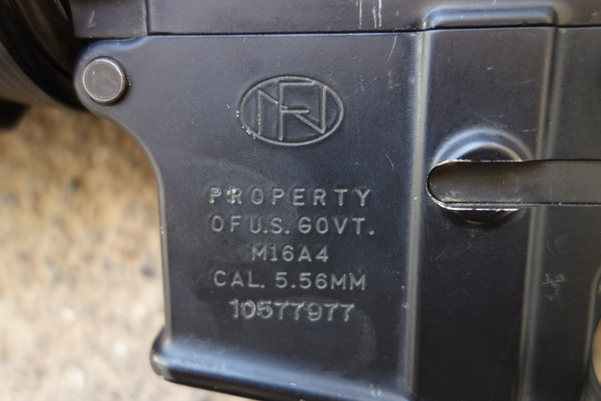
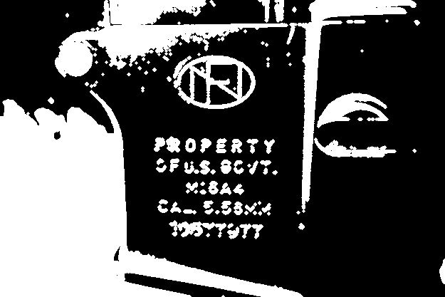
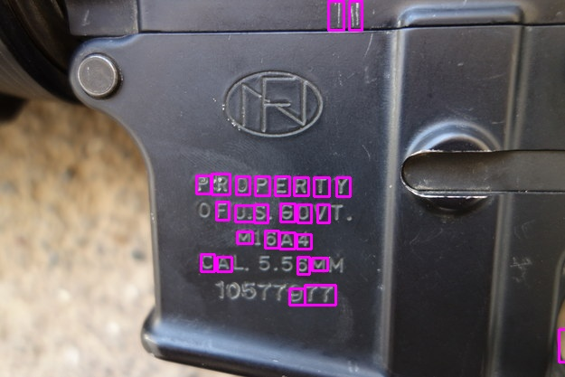
Deliverable 1: Serial Number Extraction PoC Software
Step 1. Image Processing - Bounding Box Analysis

Slide 6
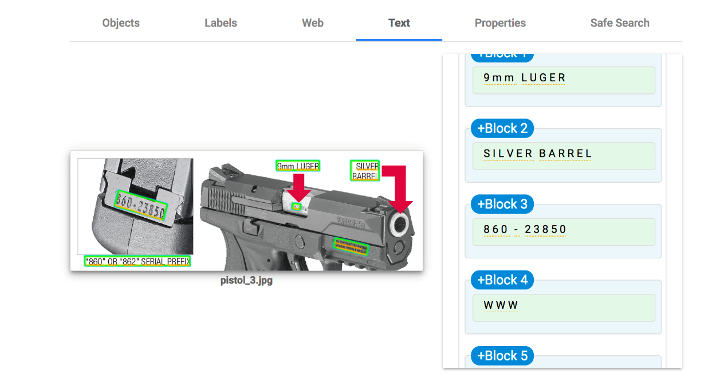
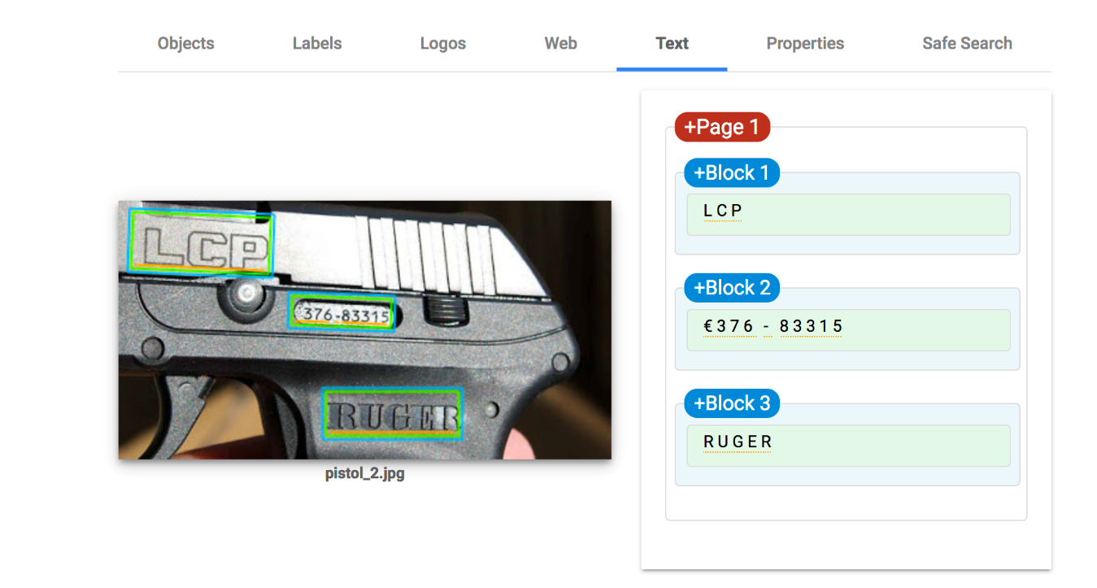
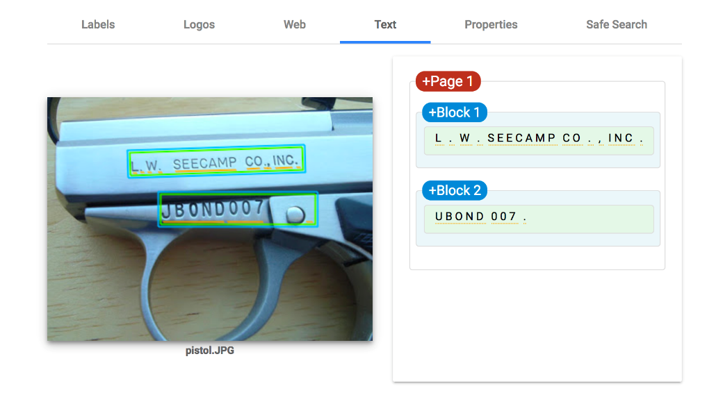
Step 2. Develop CNN Based Model
(for character recognition)
Deliverable 1: Serial Number Extraction PoC Software

Slide 7
Deliverable 1: Serial Number Extraction PoC Software
Step 3. Develop model for applying Serial Number extraction rules
No | Weapon Type | NSN | NIIN | Serial Number extraction Rules
1 | M16A4 | 1005-01-383-2872 | 01-383-2872 | Always 8 digit numeric code
2 | 81mm Mortar | 1015-01-164-6651 | 01-164-6651 | Not available in master file digits, examples 133780 or 1332693
3 | Pistol, Semiautomatic, M9 | 1005-01-118-2640 | 01-118-2640 | Always 7 digit numeric, occasionally 7 digit followed by 8 digit as alpha
4 | Machine Gun, 7.62mm | 1005-01-412-3129 | 01-412-3129 | 1 or 2 alpha followed by 5 or 6 numeric, example CD19409 or U101114
5 | Illuminator, Infrared (IR) | 5855-01-447-8992 | 01-447-8992 | 4 to 6 numeric followed by 1 to 2 alphas, example 4634A, 158999A or 146373AA
Manu-facturer
Weapon
Type
NSN
Serial
Number
NIIN
213 unique NIINs
(from Master Weapon file in GCSS)
Serial # - M16A4
10100172
10100205
10100463
10106543
10128336
10146812
10154541
10154723
10155004
10155033
10155634
10161020
10161063
10161103
Serial # - Pistol M9
1001062
1001915
1001926
1001930
1001933
1001934
1001948
1001949
1001951
1002074
1002091
1002615
1002692
1002745
Serial # - Machine Gun
CD19233
CD19281
CD19282
CD19283
CD19284
CD19285
CD19322
CD19323
CD19324
CD19326
CD19327
CD19328
CD19340
CD19341
Serial # - Infrared
085620A
088035A
094649A
097252A
146373AA
158999A
159342A
159886A
169247A
169292A
169541A
178321A
178709A
4634A
3378 SNs
1069 SNs
768 SNs
14 SNs

Slide 8
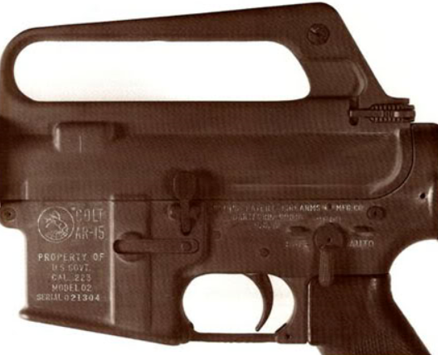
Deliverable 1: Serial Number Extraction PoC Software
Learning &
Measurements
Step 4: User Experience
Collect Feedback
AI Models
Extraction
Results
Image Processing
1. Weapon Classification
AI Model
2. SN Extraction AI
Model
3. Rule Pattern Matching
AI Engine
Run Performance Analysis
Display Serial Number
Weapon Type
Load Image
Export Results
Accept
Load Image
Run Performance Analysis
Verify Result
Weapon Type: M614
Serial Number: O21304
Accept
Reject

Slide 9
Deliverable 1: Serial Number Extraction PoC Software
Step 5: Develop Performance Measurement Report

Slide 10
LOGCOM Phase 1 PoC
Deliverable 2 – Final Report - Development Plan
1. Review Current State Processes
4. Review PoC Findings
6. Define End State Processes
7. Develop End State User Mock-ups
2. Define Application Architecture
3. Define Information Architecture
5. Define Technical Architecture
8. Define Infrastructure Architecture
9. Develop Implementation Roadmap
Week 1 | Week 2 | Week 3 | Week 4 | Week 5 | Week 6 | Week 7 | Week 8 | Week 9 | Week 10
1.1 Conduct Tour of Weapon Warehouse | 1.2 Review Current State Processes | 1.2 Review Current State Processes (Cont.) | 2.1 Develop Application Architecture | 3.1 Develop Information Architecture | 4.1 Assess PoC Finding from Sprint 2 | 7.1 Start on End state Mock-ups | 7.2 Build/Review End state Mock-ups | 7.3 Enhance End state Mock-ups | 7.4 Review End state Mock-ups
1.2 Review Current State Processes | 1.3 Review Fall Out Reports (Cont.) |  | 2.2 Review Application Architecture | 3.2 Review Information Architecture | 4.2 Develop End State Requirements per Sprint 2 Results | 6.1 Develop End State Processes | 8.1 Develop Infrastructure Architecture | 9.1 Develop Implementation Roadmap | 9.3 Review End State Architecture and Implementation Roadmap
1.3 Review Fall Out Reports |  |  |  |  |  | 3.1 Develop Technical Architecture | 8.2 Review Infrastructure Architecture | 9.2 Review Implementation Roadmap
 |  |  |  |  |  | 3.2 Review Technical Architecture

Slide 11
Deliverable 2: End State Architecture
Step 1: Current Process
GCSS
Due In report prepared
Weapon status and location receipted for GCSS, ready for storage/location
Warehouse Staff
ST: Receives Report
MH: Removes Weapons from packaging
MH: Reads Serial Number from Weapons
MH: Two material handlers manually verifies that all equipment listed in Due In report is present.
QC conducts physical inspection, verifies condition code of weapon, and returns weapon to container
ST: Reviews and enters Report of serial numbers, locations, weapon status into GCSS
Observations
No system or devices used for Image capturing and SN result display.
IUID is not always right. Check IUID number and compare that to SN and point out the differences
Fall-outs – Check with 7-8 individuals to verify in case SN is not readable.
Sometime, they might have to return to manufacturer in case it is a wrong serial number
They need two people for dual validation all the time – one reading and one writing the SN
Sometimes there are SN at each weapon part. Field personnel needs to know which SN is associated with a given weapon.
For SN with low readability, Field personnel is using chalk to highlight the SN.
Volumes
Average volume - 70,000 / last year or 140,000 in two years or < 300 per day
Peak volumes – 5,000 weapons in 4 days or 40,000 in 2 weeks or ~ 4000 per day

Slide 12
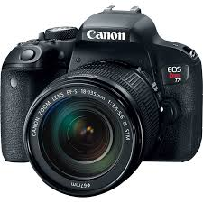
Deliverable 2: End State Architecture
Step 2: Application Architecture
Load
Image
Display
Serial Number
Collect
Feedback
Export
Result
Train
Model
Process
Image
Store
Image
Test
Data
Models
Identify
Weapon Type
Extract S.No.
Information
Refine S.No. Informaiton

Slide 13
Deliverable 2: End State Architecture
Step 5: Technical Architecture
JPG
JSON
JSON
Load
ImagE
Display
Serial Number
Collect
Feedback
Angular
Angular
Angular / Python
Keras/Python
JPG
Train
Model
JSON
Process
Image
Store
Image
Test
Data
Models
OpenCV
JSON
H5
Python
JSON
JSON
Identify
Weapon Type
Extract S.No.
Information
Refine S.No. Informaiton
Keras/Python
JSON
Keras/Python
JSON
Python
JSON

Slide 14
Deliverable 2: End State Architecture
Step 6: Proposed Process Flow
GCSS
Weapon status and location report updated directly into GCSS by SN AI App
Due In report Emailed to ST and SN Extraction Application
Warehouse Staff
ST: Receives Weapon status and location report via Email for entry into GCSS
Phase 2
ST: Physical Assets received
MH: Weapon removed from packaging and scanned
SN Extraction Application
Phase 1
Serial read by ML algorithm, checked by human participant
Serial number checked automatically against Due In report
Weapon status, location, other provenience information recorded in UI

Slide 15
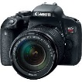
Deliverable 2: End State Architecture
Step 8: Infrastructure Architecture
GCSS
Phase 1 End State
GCSS
Phase 1 Pilot
Phase 1 PoC
Adjustments
Loader
Interim
Target
Prod
Data
Prod
Prod
Data
Prod
OTN
OTN
Test
Test
Dev
Dev

Slide 16
Project Governance
Status Report – week ending July 12 2019
TASK COMPLETED THIS WEEK
Deliverable 1: Phase 1 PoC Software
1 | Received 30+ images for 5 weapon types
2 | Created initial draft of serial number extraction rules
3 | Build a Deep Learning Model for Registration Plate and trained with 500-10K registration plat image data
4
Deliverable 2: End State Architecture
1 | Reviewed current state processes and associated reports (due-in, fall-outs)
2 | Discuss initial scope for end state
3 | Discuss Infrastructure and integration options for End state
4 | Discuss integration options for End state
TASK PLANNED NEXT WEEK
KPMG Teams
1 | Set up Development environment with Initial Registration Plate CNN model on a NIST compatible machine
2 | Conduct Image processing for in-scope Weapon images on Development environment and test few images with initial model
3 | Define future Image taking requirements with initial results
4 | Complete Sprint planning and build user interface for Sprint 1 PoC
5 | Create initial Infrastructure for first deployment of End state system and conduct SME review for feedback
Business Teams
1 | Provide 50+ images each for all 5 in-scope weapon models
2 | Finalize user experience, performance measurement and output extraction for PoC
3 | Confirm high level functional and non-functional requirements for end state system
4 | Review and Finalize Infrastructure for first deployment of End state system

