Slide 1
Reverse Engineering for DMSMS
Eric Niemasz
DISTRIBUTION A. Approved for public release; distribution unlimited.
OPSEC #: OPSEC1711
Mechanical Engineer
TARDEC – Sustainment DORE
03 DEC 2018

Slide 2
Overview
What is Reverse Engineering?
Lessons learned by TARDEC
Reverse Engineering as a part of DMSMS
A Holistic Engineering Process
Avoiding roadblocks
System Engineering Approach
Improve Readiness
Create cost savings
Documentation
Examples
RTCH RT-240 ECUs
MRAP Husky Mine Clearing Actuators and Controls

Slide 3
Definition: Reverse Engineering
Reverse engineering is the development of unrestricted technical data, adequate for competitive procurement, through the engineering evaluation of existing component.
Criteria of “Fit, Form, Function”
Fit - Dimensionally it is the same as the original
Form - Materials and manufacturing process are unchanged
Function- Performance no greater or less than original
“If these criteria are met the Logistic impact will be minimized”
Notes:
Simple definition often gets unnecessarily complicated
It is not purchasing data
The data must be complete enough for “anybody” to manufacture
It is complied by physically examining the existing component

Slide 4
When is it not reverse engineering
Any change in “Fit, Form, Function” is a deviation from Reverse Engineering, it just depends on how far. There are many factors that drive this decision but it is important to understand the difference.
For any change, you will need to consider the impact on durability and reliability, and plan to test accordingly to verify the new design as well as consider additional logistic impacts
Reverse Engineer
Redesign
Notes:
How far you deviate from RE determines how much additional testing will be required
Logistically, will you need new NSNs, MWOs, etc.

Slide 5
Ethics and Legality of Copying A Design
The ethics of Reverse Engineering fall under the legal guidance of the Federal Acquisition Regulation, specifically related to “Rights in Data”
In general:
The organization doing the reverse engineering is supplied only with a part and data which is owned by the Government
No access to proprietary data
The Technical Data being developed will only be used for government purposes

Slide 6
Lessons learned from implementing
Key stakeholders are going to resist change
Engineering changes
Logistic and provisioning changes
Procurement strategy changes
Build relationships and establish organization as SME
Documenting the value added is critical
Identify the impact of a single NSN on the platform
Deliver a holistic, system level solution
Notes:
Reverse engineering is tough on its own but as a part of DMSMS it is easier to understand the value it can provide

Slide 7
Obsolescence solutions
Cost
Readiness
Approved Alternate
Simple substitute
Complex Substitute
Life of Need Buy
Repair, Refurbishment, Reclamation
Extension of production support
Development of a new item or source
Redesign – Complex/System Replacement
Redesign – Next Higher Assembly
Less Adverse
More
Adverse
Notes:
What do we mean by holistic system engineering approach.
Consideration for alternatives

Slide 8
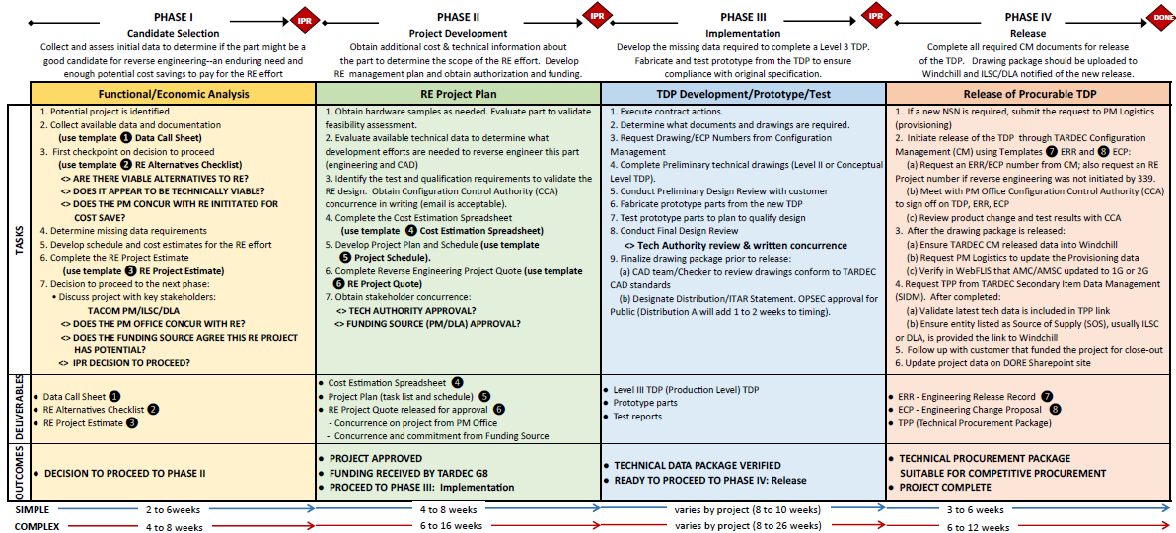
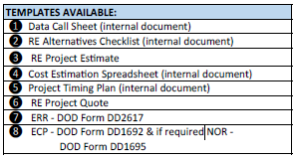
Reverse Engineering Process
KEY TO SYMBOLS USED ABOVE:
❶ to ❽ Standard templates are available for Reverse Engineering projects. They should be used for DMRE projects
<> Interim Decision Point or Approval Required
In Process Review‐‐ Decision to proceed to next phase when all deliverables of current phase are met

Slide 9
Reverse Engineering Process
Phase I:
Candidate Selection
Collect and assess initial data to determine if the part might be a good candidate for reverse engineering
Phase II:
Project Development
Obtain additional cost & technical information about the part to determine the scope of the RE effort.
Phase III:
Implementation
Develop the missing data required to complete a Level 3 TDP.
Phase IV:
Release
Complete all required CM documents for release of the TDP.
Ensure there is an enduring need or enough potential cost savings to pay for the RE effort
Develop RE management plan and obtain authorization and funding.
Fabricate and test prototype to ensure compliance with original specification.
Drawing package should be uploaded to Windchill and ILSC/DLA notified of the new release.
Objectives
Is the product a viable RE candidate?
Project plan approved and funding received
TDP complete and design verified
TPP Released for competitive procurement

Slide 10
Process Phase i
Phase I:
Candidate Selection
1. Potential project is identified
2. Collect available data and documentation
(use template ❶ Data Call Sheet)
3. First checkpoint on decision to proceed
(use template ❷ RE Alternatives Checklist)
<> ARE THERE VIABLE ALTERNATIVES TO RE?
<> DOES IT APPEAR TO BE TECHNICALLY VIABLE?
<> DOES THE PM CONCUR WITH RE INITITATED?
4. Determine missing data requirements
5. Develop schedule and cost estimates for the RE effort
6. Complete the RE Project Estimate
(use template ❸ RE Project Estimate)
7. Decision to proceed to the next phase:
• Discuss project with key stakeholders:
TACOM PM/ILSC/DLA
<> DOES THE PM OFFICE CONCUR WITH RE?
<> DOES FUNDING SOURCE AGREE THIS RE PROJECT?
<> IPR DECISION TO PROCEED?
Collect and assess initial data to determine if the part might be a good candidate for reverse engineering
Ensure there is an enduring need or enough potential cost savings to pay for the RE effort

Slide 11
Factors Impacting Reverse Engineering Viability
Is the part DOD’s demand significant enough to be profitable for new commercial sources
Parts with a large number of subcomponents that must be reverse engineered will take longer and cost more
What manufacturing process is used to make the part
Parts performing a critical mission task might require a large amount of testing to verify
Does it look technically viable with an acceptable level of risk
Notes:
Is this Reverse Engineering project to resolve a DMSMS issue or is it for cost savings

Slide 12
Business Case Development
What is the magnitude and estimated cost of the RE effort?
What is the projected life of the need for the product?
Identify additional cost avoidances.
Calculate Annual Demand Value (ADV):
Cost of part X Number units used per year
Determine Potential Annual Savings:
( Actual cost of the part – How much the part should cost )
X Number of units per year
Determine potential LIFETIME COST SAVINGS
( Annual Savings X Life of the Product ) –
Cost of RE Development

Slide 13
Phase II Overview: Project Development
Phase II:
Project Development
1. Obtain hardware samples as needed. Evaluate part to validate
feasibility assessment.
2. Evaluate available technical data to determine what
development efforts are needed to reverse engineer this part
(engineering and CAD)
3. Identify the test and qualification requirements to validate the
RE design. Obtain Configuration Control Authority (CCA)
concurrence in writing (email is acceptable).
4. Complete the Cost Estimation Spreadsheet
(use template ❹ Cost Estimation Spreadsheet)
5. Develop Project Plan and Schedule
(use template ❺ Project Schedule)
6. Complete Reverse Engineering Project Quote
(use template ❻ RE Project Quote)
7. Obtain stakeholder concurrence:
<> TECH AUTHORITY APPROVAL?
<> FUNDING SOURCE (PM/DLA) APPROVAL?
Obtain additional cost & technical information about the part to determine the scope of the RE effort.
Develop RE management plan and obtain authorization and funding.

Slide 14
Phase III Overview: Project Implementation
Phase III:
Implementation
1. Execute contract actions.
2. Determine what documents and drawings are required.
3. Request Drawing/ECP Numbers from Configuration
Management
4. Complete Preliminary technical drawings (Level II or Conceptual
Level TDP).
5. Conduct Preliminary Design Review with customer
6. Fabricate prototype parts from the new TDP
7. Test prototype parts to plan to qualify design
8. Conduct Final Design Review
<> Tech Authority review & written concurrence
9. Finalize drawing package prior to release:
(a) CAD team/Checker to review drawings conform to TARDEC
CAD standards
(b) Designate Distribution/ITAR Statement. OPSEC approval for
Public (Distribution A will add 1 to 2 weeks to timing).
Develop the missing data required to complete a Level 3 TDP.
Fabricate and test prototype to ensure compliance with original specification.

Slide 15
Phase IV Overview: Release
Phase IV:
Release
1. If a new NSN is required, submit the request to PM Logistics
(provisioning)
2. Initiate release of the TDP through TARDEC Configuration
Management (CM) using Templates ❼ ERR and ❽ ECP:
(a) Request an ERR/ECP number from CM; also request an RE
Project number if reverse engineering was not initiated by 339.
(b) Meet with PM Office Configuration Control Authority (CCA)
to sign off on TDP, ERR, ECP
(c) Review product change and test results with CCA
3. After the drawing package is released:
(a) Ensure TARDEC CM released data into Windchill
(b) Request PM Logistics to update the Provisioning data
(c) Verify in WebFLIS that AMC/AMSC updated to 1G or 2G
4. Request TPP from TARDEC Secondary Item Data Management
(SIDM). After completed:
(a) Validate latest tech data is included in TPP link
(b) Ensure entity listed as Source of Supply (SOS), usually ILSC
or DLA, is provided the link to Windchill
5. Follow up with customer that funded the project for close‐out
6. Update project data on DORE Sharepoint site
Complete all required CM documents for release of the TDP.
Drawing package should be uploaded to Windchill and ILSC/DLA notified of the new release.

Slide 16
Complete the Release Process
Ensure:
The final drawing package is released into Engineering Database
Technical Data Package is delivered to provisioning
Logistics updates the provisioning data
The new part number from the released drawing is entered into the Logistics database (ex: Cage: 19207 P/N: 12xxxxxx)
Request a Technical Procurement Package (TPP) from Secondary Item Data Management
Notify the DLA Customer that the TPP is complete
WebFlis identifies new Cage and part number as 1/G,2/G

Slide 17
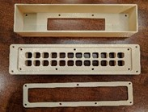
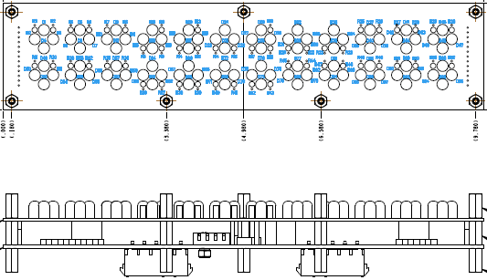
Example – Display Panel
Source Controlled envelope drawing to single source
Unit price of ~$600 should cost ~$300
ADV = ~$35K RE Cost ~$75K
Old Design
New Design
Reverse Engineer
Redesign

Slide 18
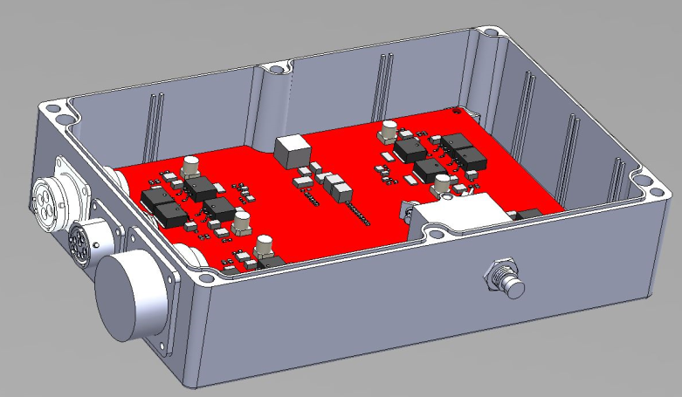
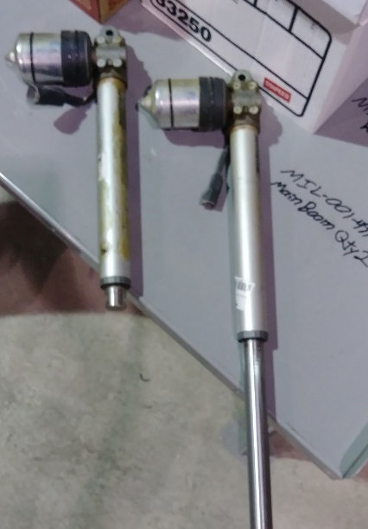
Example – Actuator Assembly
Single OCONUS source with long lead times
Unit price of ~$15,000 should cost ~$1,250
ADV = ~$1.5M RE Cost ~$275K
Reverse Engineer
Redesign

Slide 19
Questions???

