Slide 1

2019 Additive Manufacturing Workshop
Day #2 Outbrief
Cybersecurity
Co Leads:
Dana Ellis
Tim Abbott
Jim Regenor
Al Lowas

Slide 2
Cybersecurity
Objectives:
Understand the current state of cybersecurity policy and guidelines as they relate to AM
Identify key functions within AM environment
Perform gap analysis based on AM workflow and cybersecurity information system policies, identify path to solution

Slide 3
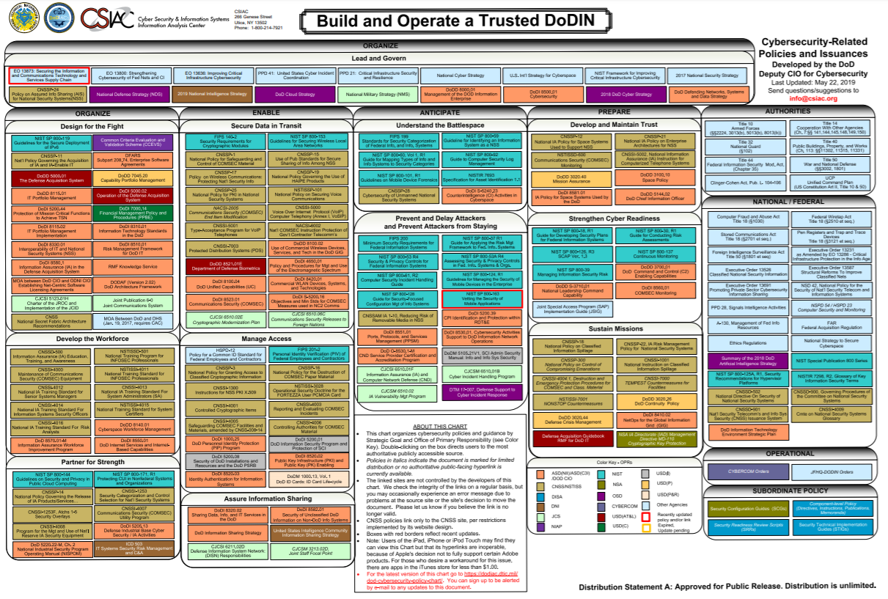

Slide 4
Provides a baseline for gap analysis
Observation: vast amount of policies exist
Orient: chart above represents the industry/government working group perspective
Decision: gap analysis that follows
Act: key takeaways

Slide 5
Cybersecurity
Challenges / Gaps Identified:
Cybersecurity knowledge combined with AM workflow application – need subject matter experts
Machine Identity
Trusted system/ecosystem approach
Lack of current secure-by-design systems
How to protect evolving cyber-physical systems from a dynamic threat environment
  Potential solution: Blockchain
Network disconnected operations

Slide 6
Cybersecurity
Key Takeaways:
Establish a cybersecurity AM strategic interest group with government and industry to collaborate on policy and address gaps
  Identify a DoD depot (e.g. Rock Island Arsenal or Tinker Air Force Base) for pilot implementation at the production level to identify and address gaps
  Partners to include: Air Force Sustainment Center, Army Rock Island Arsenal, Army CCDC, NAVWAR, other government agencies (e.g. NIST and DISA) and industry

