Slide 1
Joint Technology Exchange Group (JTEG) Forum: How the Acquisition Workforce is Being Trained on Supporting Sustainment
Bill Kobren
Director, Logistics & Sustainment Center
Defense Acquisition University
E-mail: bill.kobren@dau.mil
Cleared for Public Release

Slide 2
Life Cycle Logistics:
At the Intersection of DoD Acquisition & Logistics
Property Management
Purchasing
Contracting
Program Management
Production & Quality
Financial Management
Science & Technology
DoD Logistics
Workforce
DoD Acquisition
Workforce
Systems Engineering
Life Cycle Logistics
Distribution & Transportation
Supply Management
Maintenance Support
Test & Evaluation
KEY FOCUS: Driving greater horizontal & vertical integration across the system life cycle to facilitate acquisition & sustainment of supportable and affordable systems
Information Technology
Facilities Engineering
Audit

Slide 3
DoD Life-Cycle Sustainment Policy (Source: DoD Instruction 5000.02, Enclosure 6)
(Statute: 10 U.S.C. 2337, 2337a, 2441)
Sustainment across the life cycle
Supported by a designated Product Support Manager (PSM)
Emphasis on program sustainment and operating & support costs
Detailed planning required in support of all acquisition phases
PMs “develop and implement an affordable & effective performance-based product support strategy”
Life-Cycle Sustainment Plan (LCSP) for all programs
Outlines overarching Sustainment Metrics
Independent Logistics Assessments (ILA) prior to key decision points & milestone decisions to assess sustainment strategy
Followed by post-IOC sustainment assessments every 5 years
“The Program Manager, with support of the PSM, will…ensure that
sustainment factors are fully considered at all key life-cycle management decision points”

Slide 4
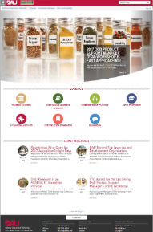
Integrated Suite of Product Support Focused Learning Assets & Related Resources
Logistics Training (13)
http://icatalog.dau.mil/onlinecatalog
/tabnav.aspx?tab=LOG
Logistics Continuous Learning (40)
http://icatalog.dau.mil/onlinecatalog/
tabnavcl.aspx?tab=CLL
Product Support Guidance Suite (13)
https://www.dau.mil/tools/p/integrated-Product-Support-Guidebook-Suite
Logistics Functional Area Gateway
https://www.dau.mil/training/career-development/logistics/
Product Support Mission Assist Workshops (5), Consulting Support www.dau.mil/consulting-services
Product Support Tools Suite (473)
https://www.dau.mil/tools/p/Integrated-Product-Support-Tools-and-Resources
Product Support Communities of Practice (3)
https://www.dau.mil/training/career-development/
logistics/p/Communities-of-Practice
Product Support ACQuipedia Suite (147)
https://shortcut.dau.mil/acq/acquipedia
Product Support Articles (41) & Blogs (1,500+)
https://go.usa.gov/xXaF4

Slide 5
System Sustainment
Life Cycle Logistics DAWIA Certification Requirements (FY19)
Designing Supportable Systems
Level I Certification
Level II Certification
CON
Level III Certification
ACQ 101
Fundamentals of Systems Acquisition Management
ACQ 202
Intermediate Systems Acquisition, Part A
ACQ 203
Intermediate Systems Acquisition, Part B
LOG 340
Life Cycle Product Support
25 hrs, online
4.5 days, classroom
25 hrs, online
35 hrs, online
4.5 days, classroom
ENG 101
Fundamentals of Systems Engineering
LOG 350
Enterprise Life Cycle Logistics Management
LOG 200
Product Support Strategy Development, Part A
LOG 201
Product Support Strategy Development, Part B
35 hrs, online
LOG 100
Life Cycle Logistics Fundamentals
22 hrs, online
4.5 days, classroom
9.5 days, classroom
LOG 206
Intermediate Systems Sustainment Management
LOG 235
Performance-Based Logistics
CLL 005
Developing a Life Cycle Sustainment Plan (LCSP)
27 hrs, online
LOG 102
Fundamentals of System Sustainment Management
16 hrs, online
CLL 015
Product Support Business Case Analysis (BCA)
27 hrs, online
25 hrs, online
CLL 001
Life Cycle Mgt & Sustainment Metrics
CLE 068
Intellectual Property
& Data Rights
LOG 103
Reliability, Availability and Maintainability (RAM)
CLL 020
Independent Logistics Assessments
22 hrs, online
CLC 011
Contracting for the Rest of Us
Choice of:
EVM 101 Earned Value Mgt OR
RQM 110 – Requirements Mgt OR
CON 121/124/127 Contract Planning, Execution and Mgt OR
LOG 204 – Configuration Mgt OR
LOG 215 Technical Data Mgt
CLL 008
Designing for Supportability in DoD Systems
Choice of:
LOG 211 – Supportability Analysis OR
BCF 216 – O&S Cost Analysis OR
ACQ 265 – Services Acquisition OR
ACQ 315 – Understanding Industry (Business Acumen)
CLL 011
Performance Based Life Cycle Product Support (PBL)
CLL 012
Supportability Analysis
15-35 hrs, online
4.0-4.5 days, classroom
Knowledge based
Application/case based
Case/scenario based
1 Year Experience
2 Years Experience
4 Years Experience
4

Slide 6
40 Logistics Continuous Learning Modules
CLL 001 | Life Cycle Management & Sustainment Metrics
CLL 002 | Defense Logistics Agency Support to the PM
CLL 003 | Supportability Test and Evaluation
CLL 004 | Life Cycle Logistics for the Rest of Us
CLL 005 | Developing a Life Cycle Sustainment Plan (LCSP)
CLL 006 | Public-Private Partnerships
CLL 007 | Lead Free Electronics Impact on DoD Programs
CLL 008 | Designing for Supportability in DoD Systems
CLL 011 | Performance Based Logistics (PBL)
CLL 012 | Supportability Analysis
CLL 013 | DoD Packaging
CLL 015 | Product Support Business Case Analysis (BCA)
CLL 020 | Independent Logistics Assessments
CLL 022 | Title 10 Depot Maintenance Statute Overview
CLL 023 | Title 10 U.S.C. 2464 Core Statute Implementation
CLL 024 | Title 10 Limitations on Performance of Depot Maintenance (50/50)
CLL 025 | Depot Maintenance Interservice Support Agreements (DMISA)
CLL 026 | Depot Maintenance Capacity Measurement
CLL 027 | Introduction to DoD Software Life Cycle Management
CLL 029 | Condition-Based Maintenance Plus (CBM+)
CLL 030 | Reliability Centered Maintenance (RCM)
CLL 031 | Performance Based Logistics (PBL) Contracting Strategies
CLL 032 | Preventing Counterfeit Electronic Parts from Entering Supply System
CLL 033 | Logistician’s Responsibilities During Technical Reviews
CLL 037 | DoD Supply Chain Fundamentals
CLL 038 | Provisioning and Cataloging
CLL 043 | Green Logistics: Planning for Sustainability
CLL 045 | Designing for Transportability
CLL 046 | The Twelve Integrated Product Support Elements
CLL 051 | System Retirement, Materiel Disposition Reclamation, Demil & Disposal
CLL 057 | Level of Repair Analysis - Introduction
CLL 058 | Level of Repair Analysis – Theory and Principles
CLL 059 | Sustaining Engineering
CLL 062 | Counterfeit Prevention Awareness
CLL 120 | The DoD Shelf-Life Program
CLL 200 | DMSMS: What Program Management Needs To Do And Why
CLL 201 | DMSMS Fundamentals
CLL 202 | DMSMS Executive Overview
CLL 206 | Introduction to Parts Management
CLL 207 | DMSMS Basic Component Research
Required for DAWIA Certification

Slide 7
Nearly 90 Interdisciplinary Product Support- Focused Continuous Learning Modules
CLL 003 Logistics Test & Evaluation
CLL 004 Life Cycle Logistics for the Rest of Us
CLL 005 Life Cycle Sustainment Plan (LCSP)
CLL 011 Performance Based Logistics (PBL)
CLL 015 Business Case Analysis (BCA)
CLL 020 Independent Logistics Assessments (ILA)
CLL 036 Product Support Manager (PSM)
CLL 040 Business Case Analysis (BCA) Tools
CLL 051 System Retirement, Reclamation, Demil & Disposition
CLL 059 Sustaining Engineering
CLE 074 Cybersecurity Across DoD Acquisition
CLM 017 Risk Management
CLM 048 Audit Readiness Requirements for DoD
Product Support Strategy Development & Execution
CLM 071 Introduction to Data Management
CLM 072 Data Management Strategy Development
CLM 073 Data Management Planning System
CLM 074 Tech Data & Computer Software Rights
CLM 075 Data Acquisition
CLM 076 Data Markings
CLM 077 Data Management Protection and Storage
CLE 012 DoD Open Systems Architecture
CLE 068 Intellectual Property & Data Rights
CLL 001 Life Cycle Mgmt & Sustainment Metrics
CLE 016 Outcome-Based Performance Measures
CLL 006 Depot Maintenance Partnering
CLL 022 Depot Maintenance Statute Overview
CLL 023 Title 10 USC 2464 Core Statute
CLL 024 Title 10 2466 Limits on Depot Maintenance (50/50)
CLL 025 Depot Maintenance Interservice Spt Agreements
CLL 026 Depot Maintenance Capacity Measurement
CLL 027 Software Life Cycle Management
CLL 029 Condition Based Maintenance (CBM+)
CLL 030 Reliability Centered Maintenance (RCM)
CLM 038 Corrosion Prevention & Control Overview
Product Support Metrics
CLL 011 Performance Based Logistics
CLL 021 Product Support Arrangements
CLL 031 PBL Contracting Strategies
CLC 011 Contracting for the Rest of Us
CLC 013 Services Acquisition
Technical Data & Intellectual Property
Maintenance Planning & Management
CLL 008 Designing for Supportability
CLL 012 Supportability Analysis
CLL 033 Logistician’s Responsibilities in Tech Reviews
CLL 043 Green Logistics-Planning for Sustainability
CLL 045 Designing for Transportability
CLL 057 LORA - Introduction
CLL 058 LORA – Theory & Principles
CLL 206 Introduction to Parts Management
CLE 001 Value Engineering
CLE 012 DoD Open Systems Architecture (OSA)
CLE 036 ECPs for Engineers
CLE 062 Human Systems Integration
CLE 074 Cybersecurity Throughout DoD Acquisition
CLE 301 R&M Engineering Overview
Product Support Arrangements
CLL 002 DLA Support To the PM
CLL 007 Lead-Free Electronics
CLL 013 DoD Packaging
CLL 032 Preventing Counterfeit Parts from DoD Supply System
CLL 037 DoD Supply Chain Fundamentals
CLL 038 Provisioning & Cataloging
CLL 062 Counterfeit Prevention Awareness
CLL 120 Introduction to the DoD Shelf Life Program
CLL 200-203 DMSMS
CLL 113 Packaging of Hazardous Materials (Future)
CLM 044 Radio Frequency Identification
CLM 200 Item Unique Identification (IUID)
CLM 201 Serialized Item Management (SIM)
CLE 040 IUID Marking
CLE 080 SCRM for Information and Communications Technology
CLB 025 Total Ownership Cost
CLB 040 Should Cost Management
CLM 021 Reducing Total Ownership Costs
CLM 032 Evolutionary Acquisition
CLE 015 Continuous Process Improvement
Product Support Affordability
CLL 004 Life Cycle Logistics for Rest of Us
CLL 046 The Twelve IPS Elements
Designing Supportable Systems
Integrated Product Support
Supply Chain Management

Slide 8
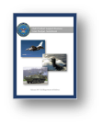
Aligned & Integrated Suite of DoD Product Support Guidance
…Reinforced by Portfolio of Targeted DAU Learning Assets
https://www.dau.mil/tools/p/integrated-Product-Support-Guidebook-Suite
Overarching Policy: DoDI 5000.02, Enclosure 6 & DoD Life Cycle Sustainment Plan (LCSP) Outline
Key Players: product support managers, life cycle logisticians, program managers, systems & sustaining engineers
Common Themes: affordability, effectiveness, integration, outcomes, life cycle management
Focus: crafting & executing well-thought out, affordable product support strategies to meet warfighter readiness & cost requirements
DAG Chapter 4
Life Cycle
Sustainment
PSM Guidebook
Product Support
Key Reference
O&S Cost Mgmt
Guidebook
Cost
Guidance
PBL Guidebook
Product Support
Arrangements
Training
13 Logistics Courses &
40 Logistics CL Modules
LOG CoP
Logistics Community &
Knowledge Repository
PBL CoP
PBL Community &
Knowledge Repository
BCA Guidebook
COA Guidance
Life Cycle Sustainment Plan (LCSP)
Product Support
Strategy Documentation
PPP Guidebook
Partnership Development
ACQuipedia
147 Logistics & Product
Support Articles
DMSMS Guidebook
SD-22 DMSMS
Mgmt Program
ILA Guidebook
Product Support Readiness
Analytical Tools
Product Support
Tools Database
IPS Roadmap
Product Support
Across Life Cycle
IPS Element Guidebook
12 Product
Support Elements
CBM+ Guidebook
Maintenance
Enablers
Product Support Strategy
Development Tool
12-Step Implementation Tool
MIL-HDBK-502A
Product Support Analysis
Supportability
Analysis Process
RAM-C Report Manual
Design for Supportability
Logistics Blog
Latest LCL & Product
Support Information
Corrosion Manual
Corrosion Prevention & Control
Notes:
Notes to Presenter - Key point: the 13 guidebooks/handbooks/manual are tightly aligned and mutually reinforcing.

Slide 9
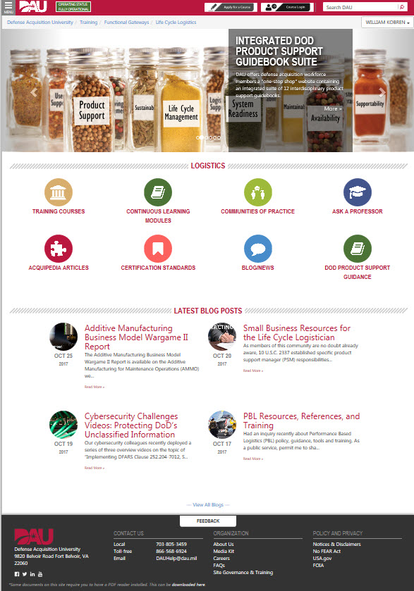
Logistics Functional Area Gateway
https://www.dau.mil/training/career-development/logistics/
Menu & Operational Status
DAU Regional Locations & Colleges
Product Support References & Tools
Product Support Policy & Guidance
Rotator Announcements
Logistics Quick Links
Training & CL Modules
Communities of Practice
Ask-a-Professor
ACQuipedia
Certification Standards
Product Support Guidance Suite
Logistics Director’s Blog
Contact & Organizational Information & Feedback

Slide 10
BACK-UPS

Slide 11
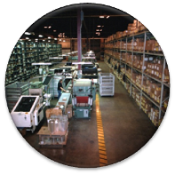
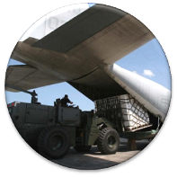
Four Logistics Workforce Categories
from 2008 DoD Logistics Human Capital Strategy (HCS)
Shortcut Link - http://www.acq.osd.mil/log/sci/log_human_capital.html
DEPLOYMENT/ DISTRIBUTION/ TRANSPORTATION
LIFE CYCLE LOGISTICS
SUPPLY MANAGEMENT
MAINTENANCE SUPPORT
Includes planning, development, implementation, and management of a comprehensive, affordable, and effective systems support strategy.
Includes procurement to disposal of defense system material, and integration of multiple material sources and processes to meet war fighter requirements.
Includes planning and executing maintenance, both scheduled and unscheduled, to defense system equipment.
Includes transportation, packaging, cargo scheduling, and dispatching of materials, support services, and personnel in response to customer requirements to move and sustain the force.
Logistics Design Influence
Forecasting and Demand Planning
Integrated Product Support Planning
Maintenance Operations
(includes depot maintenance)
Product Support & Sustainment
Physical Distribution/
Transportation Operations
Supply Planning
Production & Support
Configuration Management
Sourcing
Deployment Planning
Reliability & Maintainability Analysis
Inventory Management
Technical/Product Data Management
Supportability Analysis
Bottom line: Support the Warfighter!
11

Slide 12
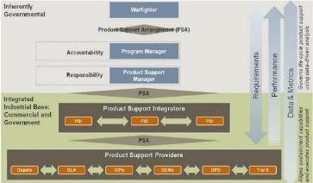
Product Support Statutory Framework (See “Product Support Statutes” ACQuipedia Article for additional details at https://www.dau.mil/acquipedia/Pages/ArticleDetails.aspx?aid=e66a7450-cd0d-48e6-b662-318df2978b35)
Title
10 U.S.C. §2208
Title
10 U.S.C. §2337
Title
10 U.S.C. §2337a
Title
10 U.S.C. §2320
Title
10 U.S.C. §2441
“Life Cycle Mgmt
& Product Support”
“Working
Capital Funds”
“Operating & Support
Costs & ILAs”
“Rights in
Technical Data”
“Sustainment
Reviews”
Title
10 U.S.C. §2366
a+b
Title
10 U.S.C. §2443
“Milestones A & B
Approval Certifications”
“Sustainment Factors in
Weapon System Design”
Title
10 U.S.C. §2474
Title
10 U.S.C. §2437
“Public-Private
Partnerships”
“Replaced System
Sustainment”
Title
10 U.S.C. §2464
Title
10 U.S.C. §2563
Title
10 U.S.C. §2466
Title
10 U.S.C. §2469
Title
10 U.S.C. §2460
“Core Logistics
Capabilities”
“Industrial Facilities’ Sales to
Persons Outside of DoD”
“50-50 Rule”
“$3M Rule”
“Depot Mainteance”

Slide 13
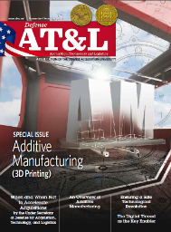
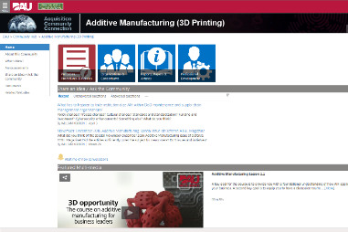
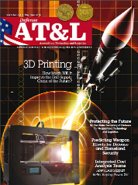
DAU Additive Manufacturing (3D Printing) Learning Assets
Additive Manufacturing Community of Practice (AM CoP) https://www.dau.mil/cop/am
Interdisciplinary focus - logistics, manufacturing, engineering, acquisition law
Twenty-six Additive Manufacturing training video vignettes in DAU Video Library https://media.dau.mil/channel/Life%2BCycle%2BLogistics/62958791
Additive Manufacturing ACQuipedia Article https://shortcut.dau.mil/acq/am
Special AM-focused Nov-Dec 2016 Defense AT&L Magazine https://www.dau.mil/library/defense-atl/p/Previous-Issues
Dec 2017 AM Lunch & Learn https://www.dau.mil/events/Lunch-and-Learn---Additive-Manufacturing-using-3-D-Printing-
PMT 401 “Hitting Print” Additive Manufacturing Case Study
Supporting Development of New DoD Additive Manufacturing Contracting Guide
3 Apr 2018 DAU Acquisition Training Symposium (Ft Belvoir VA) - "Additive Manufacturing - DLA Works to Integrate Digital Manufacturing into Defense Acquisition"

