Slide 1
2019 Additive Manufacturing Workshop JAMMEX – Day 2

Slide 2
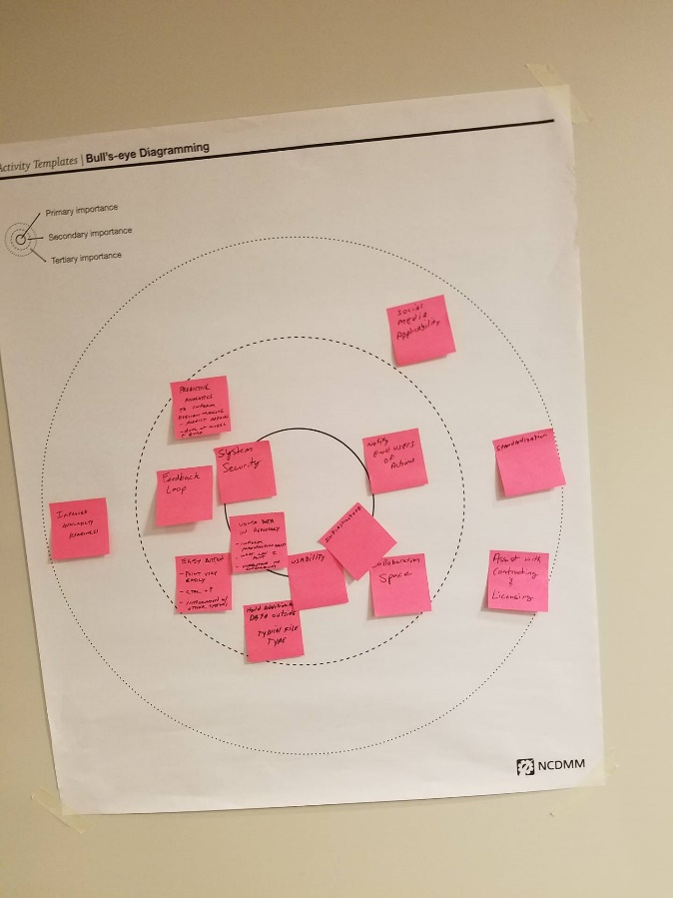
JAMMEX Future State
JAMMEX 1yr/5yr
AI/VR/AR inform decision making
50% reduction of out of stock parts
Local inventory tracking
Distributed manufacturing enabled through qualified vendor network
Joint Service Data Exchange is connected to all services
DO/BE Exercise
Prioritization
Concept Posters

Slide 3
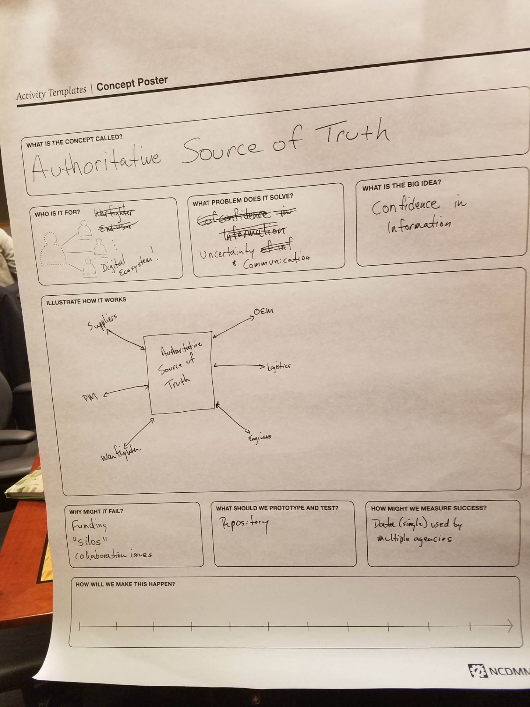
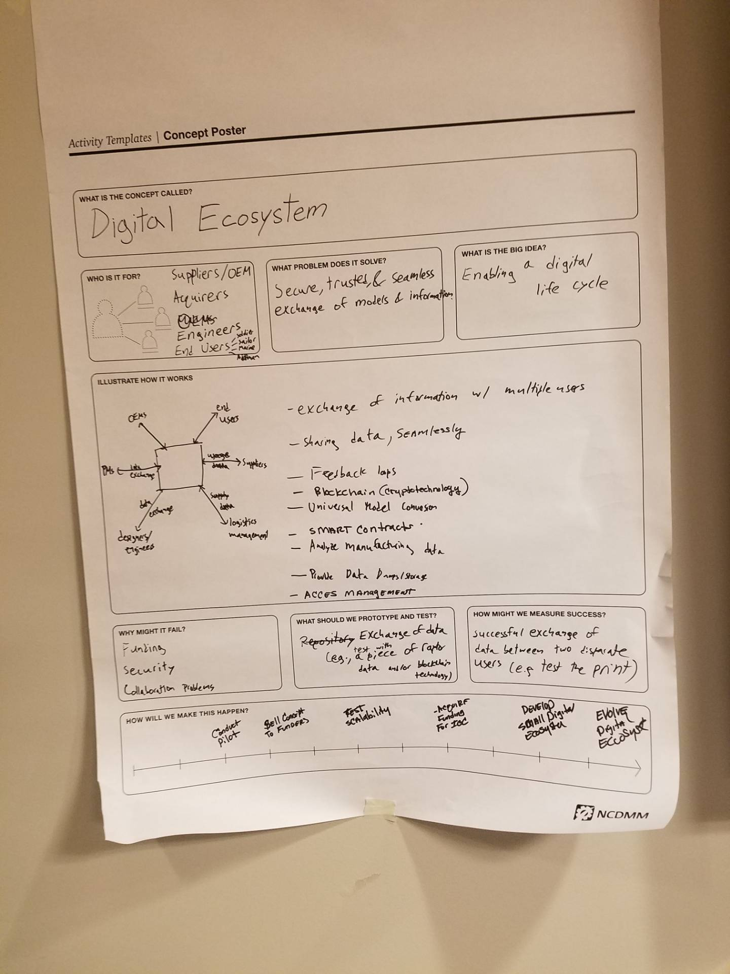
Authoritative Source of Truth
Digital Ecosystem

Slide 4
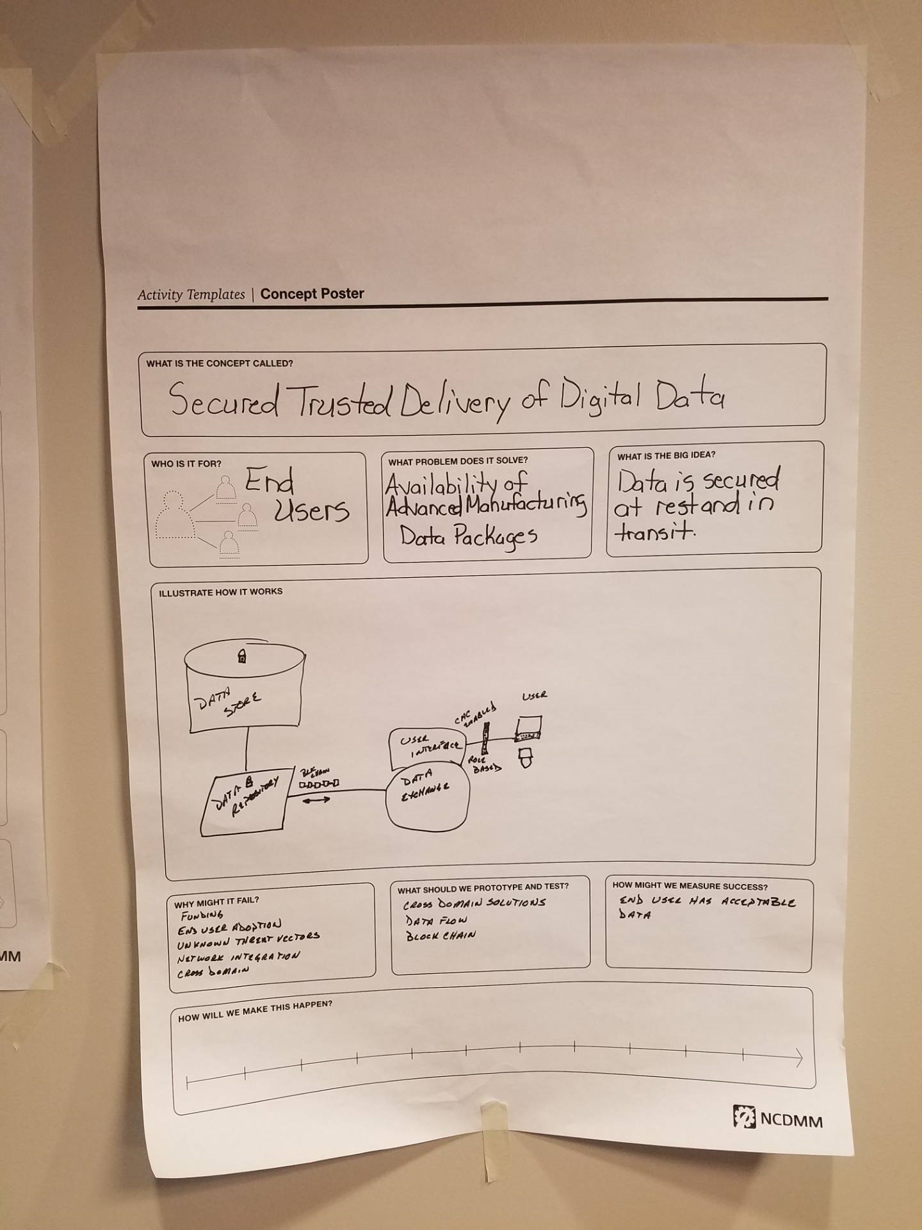
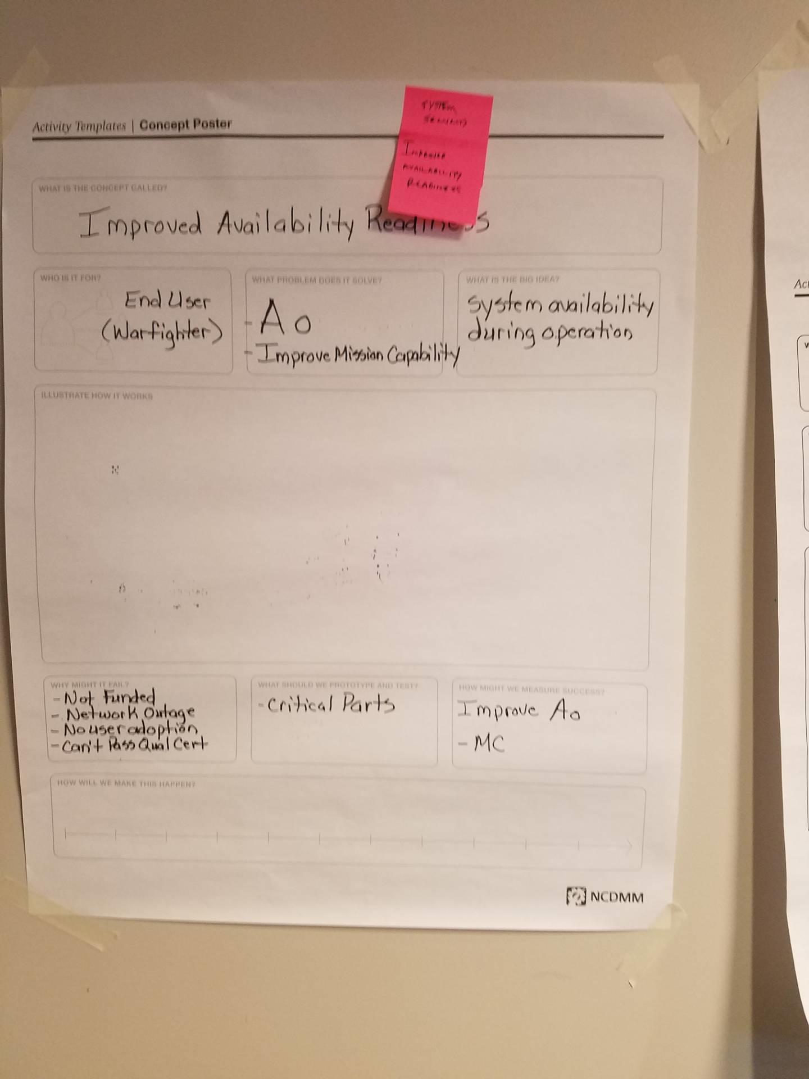
Secured Trusted Delivery of Digital Data
Improved Availability Readiness

Slide 5
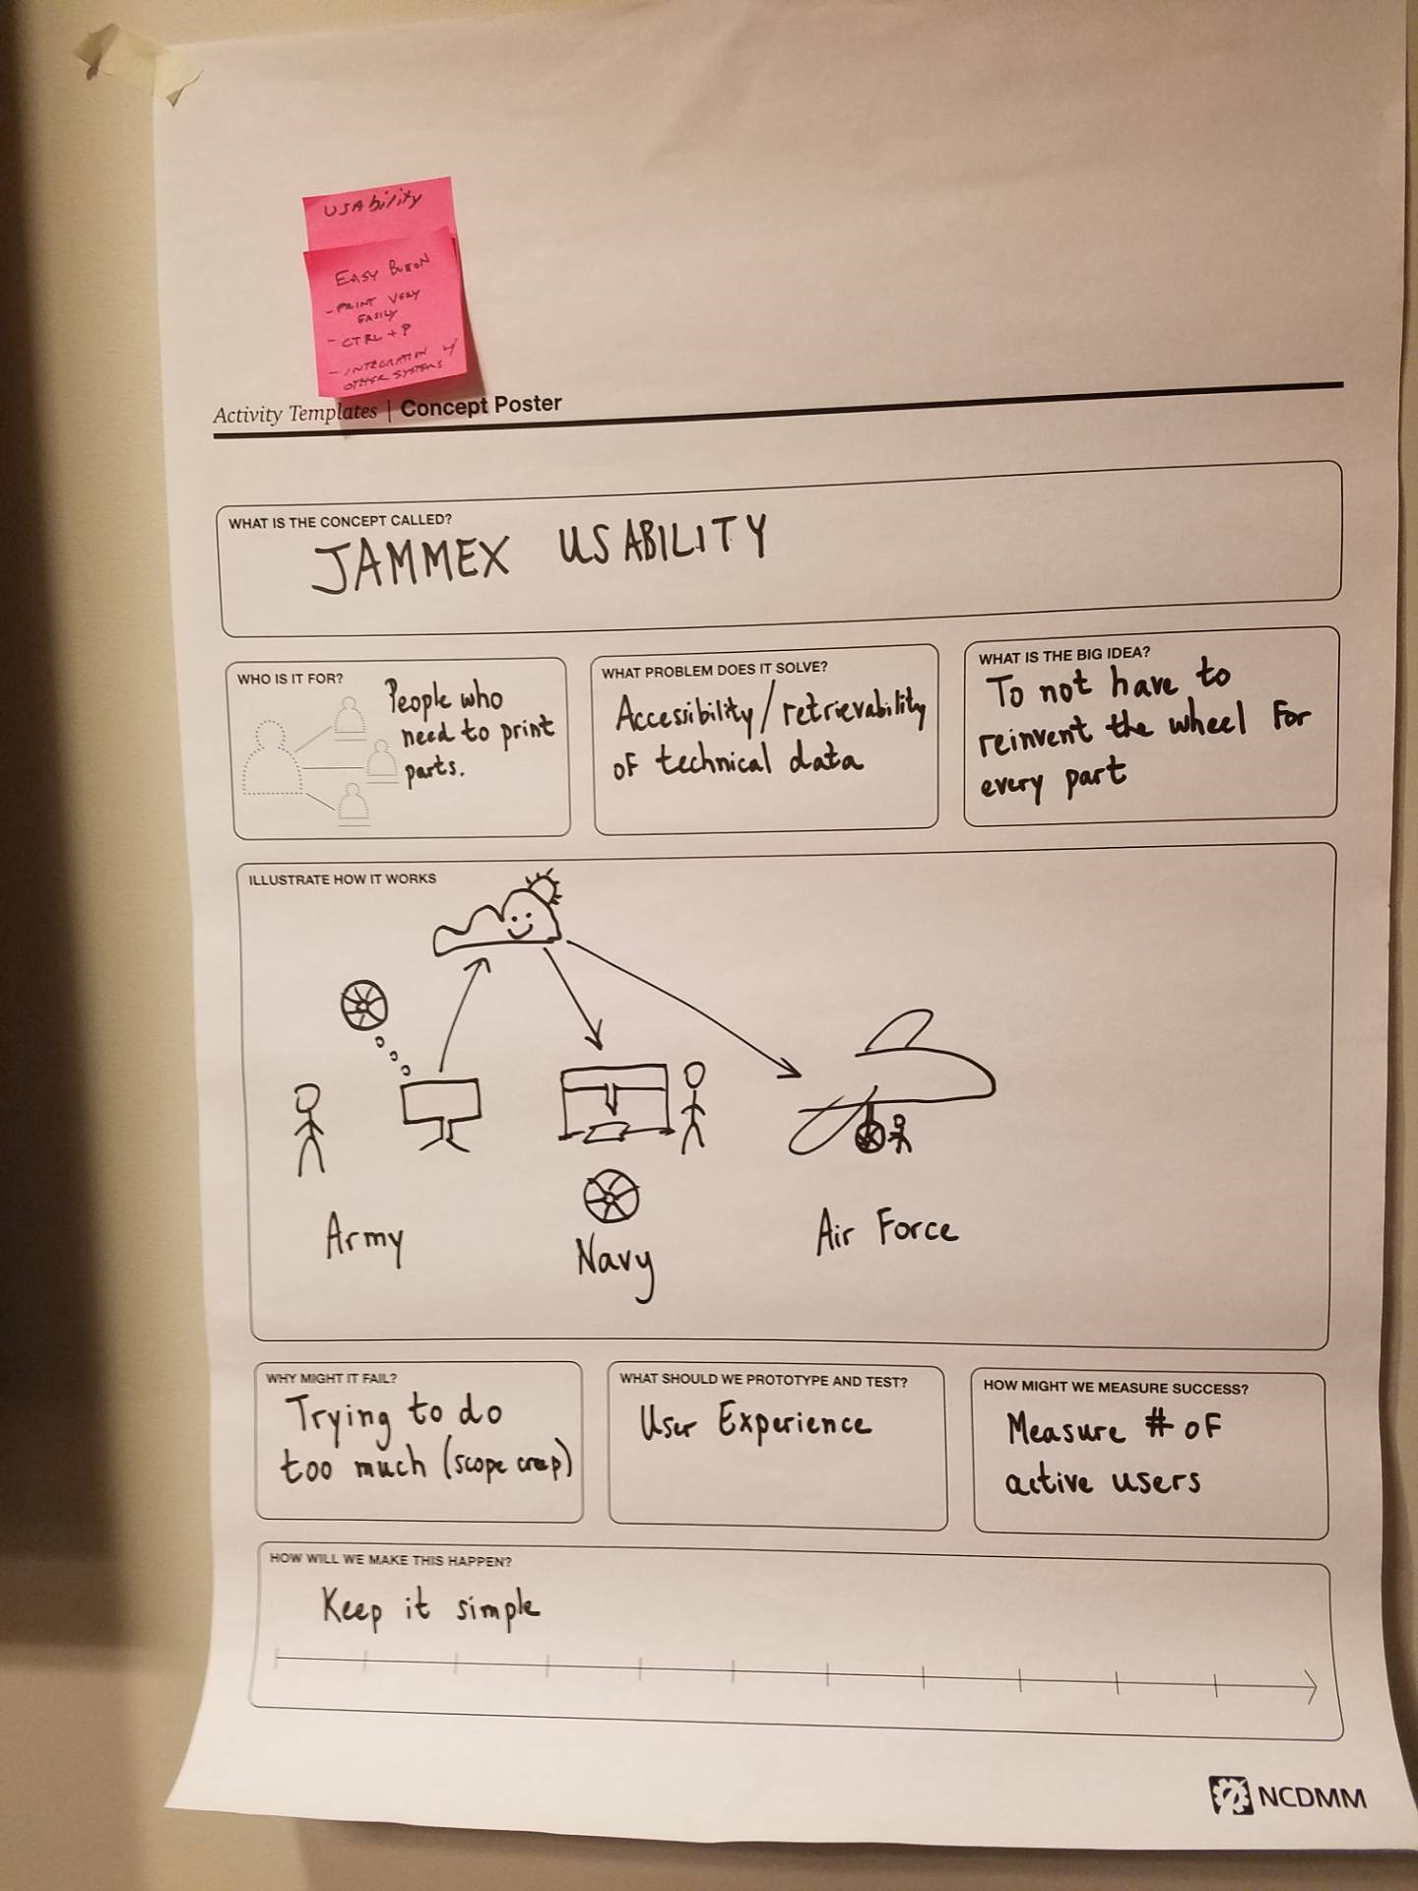
JAMMEX Usability

Slide 6
JAMMEX Next Steps
We need service level data! Interested in connecting with services
Build to begin within the DLA secure environment July 2019
User acceptance testing - Need users to review and test system, specifically forward operators.
Current gaps – risk assessment, feedback loop, completeness
Recap of input and user feedback – consolidated and shared with breakout group
Release 1.0 expected August 2019
DLA’s Technology Accelerator OTA Program – July 17
https://www.dla.mil/HQ/InformationOperations/Accelerate
1. NextGen 3D Scanners
2. Geometric Search
3. Printer Management and Security

Slide 7
JAMMEX Key Takeaways
Need data
Need user feedback
Planning future phases

