Slide 1
CECOM Equipment Diagnostic Analysis Tool – Virtual LAR (CEDAT VLAR) Overview JTEG Point of Maintenance Aids 31 Oct 17

Slide 2
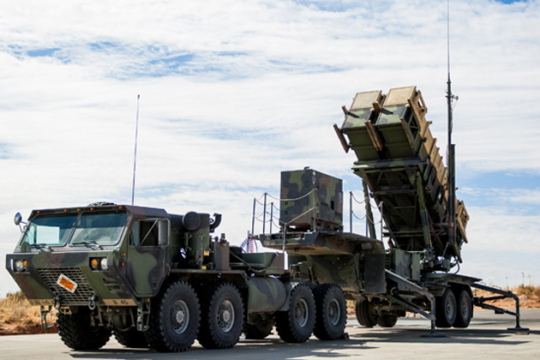
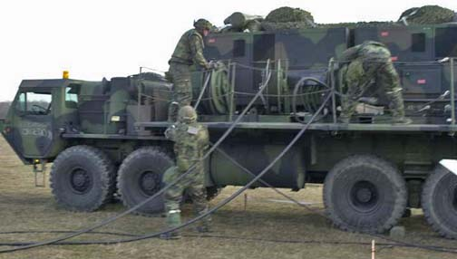
Challenges
Soldiers need:
Ready access to the collective Enterprise knowledge base at the tactical edge
Support for more effective and more efficient diagnostic processes
Expert training integrated with diagnostic processes (learn while doing)

Slide 3
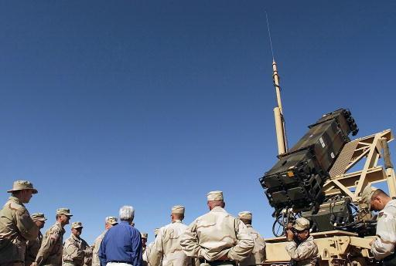
Challenges
Program Managers need:
A foundation of quality field-level maintenance data for fleet management, readiness management, and CBM + Initiatives
A means to mitigate reductions in field support personnel
A means to fill gaps in soldier training
A means to capture expert knowledge on their weapon systems

Slide 4
VLAR Background
CEDAT VLAR team developed two research questions in response to these challenges:
“How do we (CECOM) take the collective knowledge of C4ISR system operations and maintenance and encode that in a diagnostic and training tool usable by anyone, anywhere?”
“How do we extend the CECOM knowledge base to remote locations and to remote operators, and how do we make these remote operators more self-sufficient?
CEDAT VLAR has proven to be the answer to both of these questions. VLAR codifies expert knowledge and makes it accessible. Implementation of VLAR as an operator and maintainer tool reduces soldier dependency on FSR/LAR support in the field and decreases weapon system downtime. VLAR methodology and technology can be applied to any complex system.

Slide 5
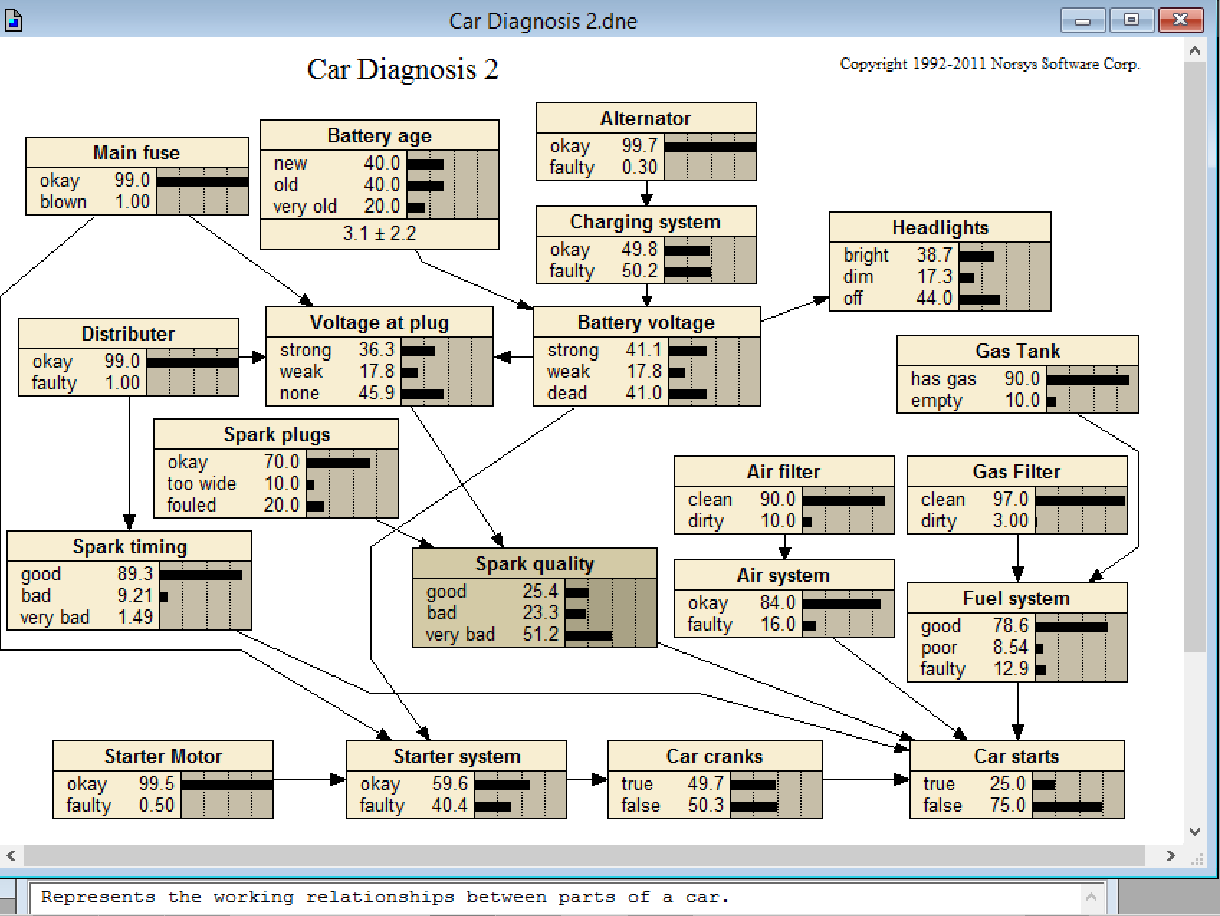
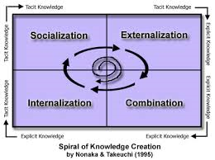
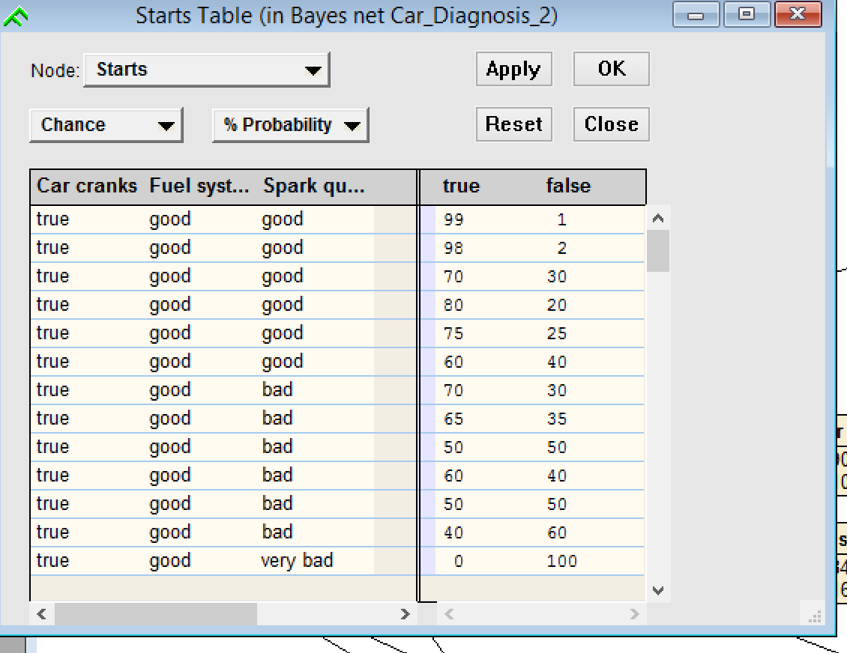
VLAR Process
CEDAT VLAR uses Causal Bayesian Networks (CBN) as its structural and mathematical underpinning. CBNs are mathematically precise, robust, omnidirectional inference engines that are widely used in Government and industry
The CEDAT VLAR team uses a unique knowledge engineering process to elicit experts and draw out advanced troubleshooting techniques and complex relationships between variables.
The resulting product is a problem set
modeled by a CBN

Slide 6
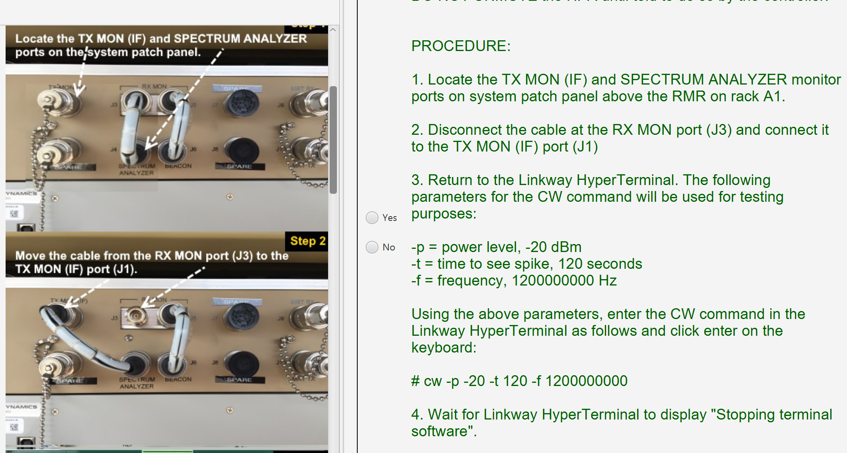
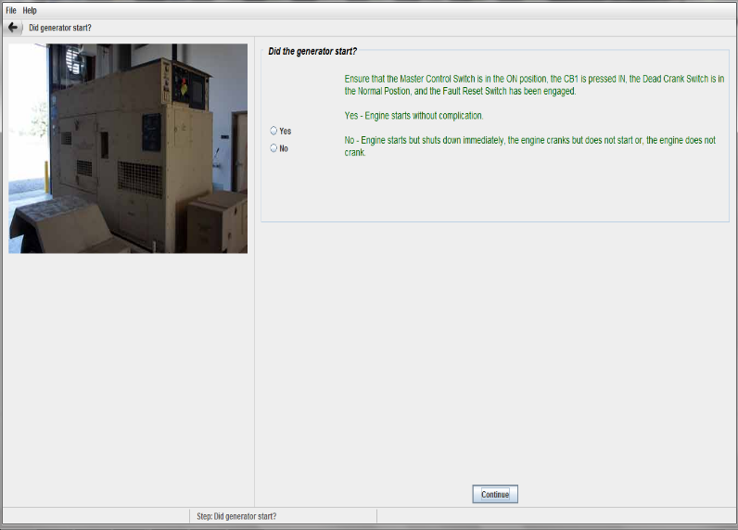
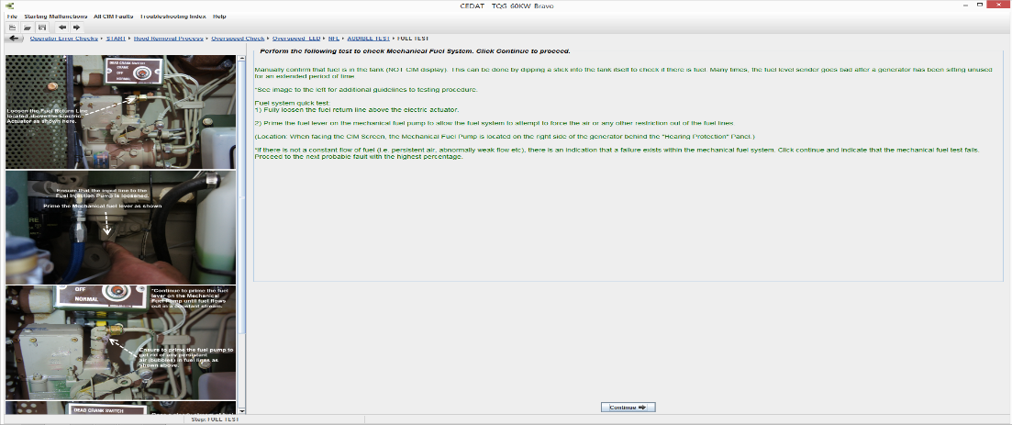
VLAR Process - GUI
The VLAR team then layers a Graphical User Interface (GUI) on top of the CBN. The GUI features simple, multimedia representations of the complex joint probability distributions underneath. The GUI enables the integrated troubleshooting and learning approach so the soldier knows the “why” as well as the “what.”

Slide 7
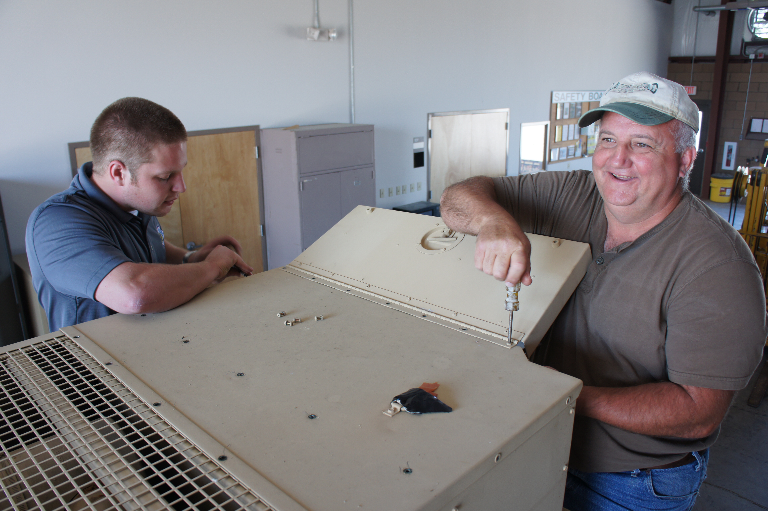
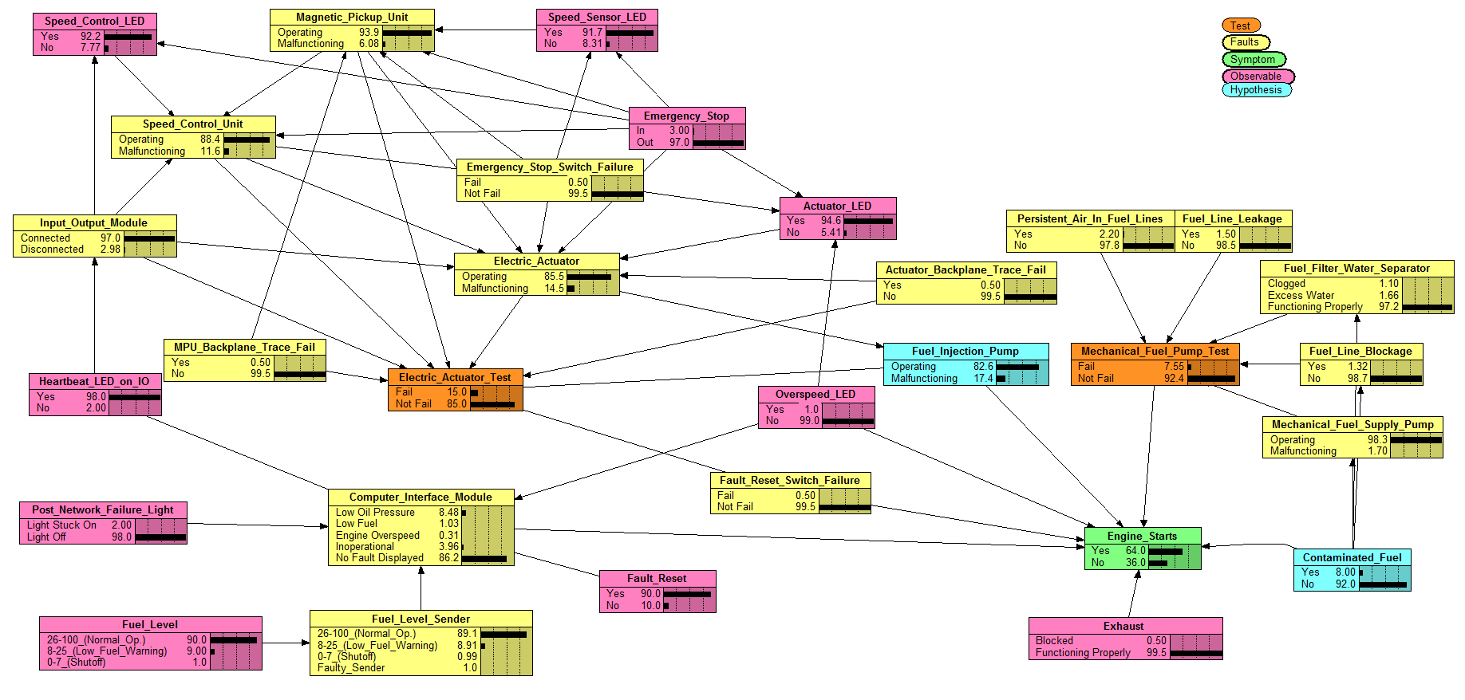
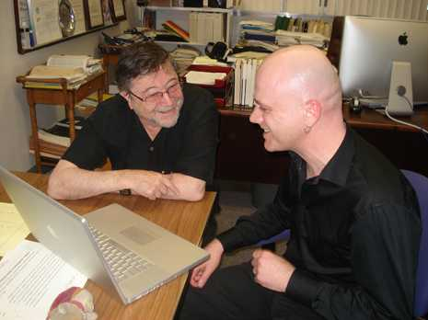
VLAR Process
CEDAT VLAR turns this knowledge engineering process:

Slide 8
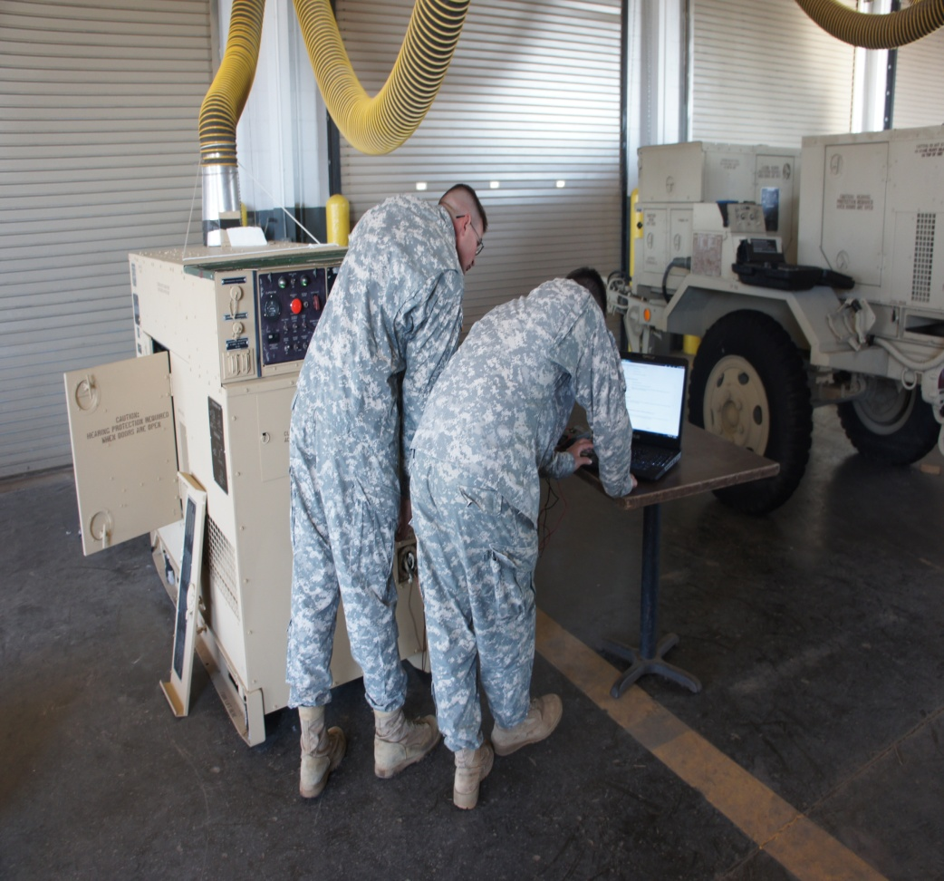
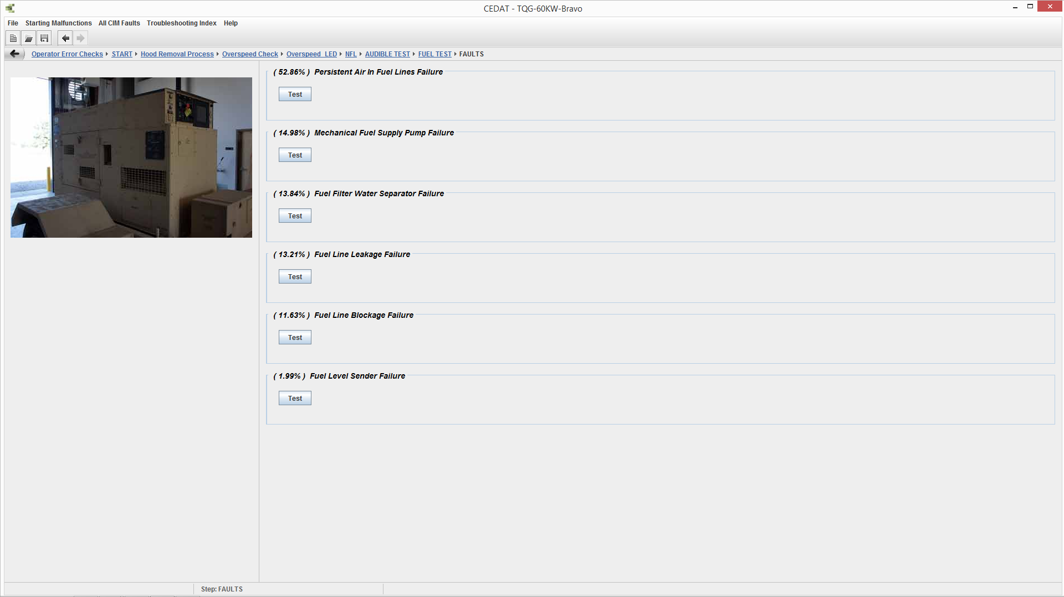
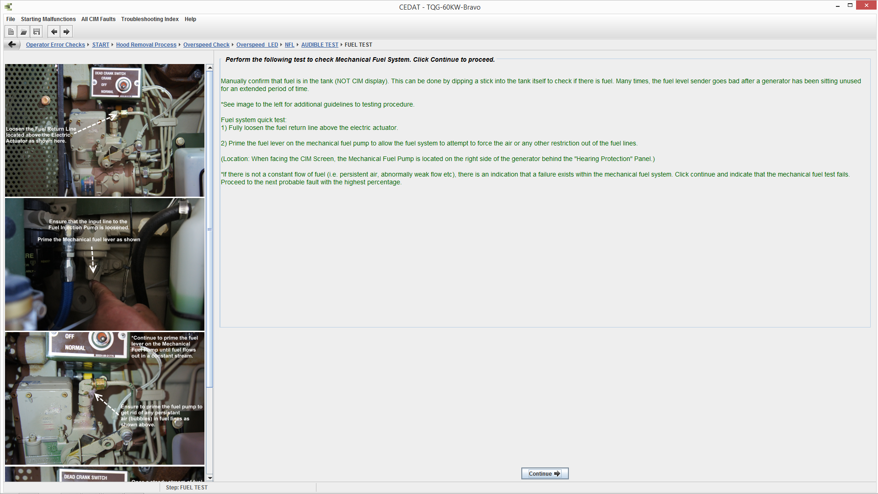
VLAR Process
Into this soldier process:

Slide 9
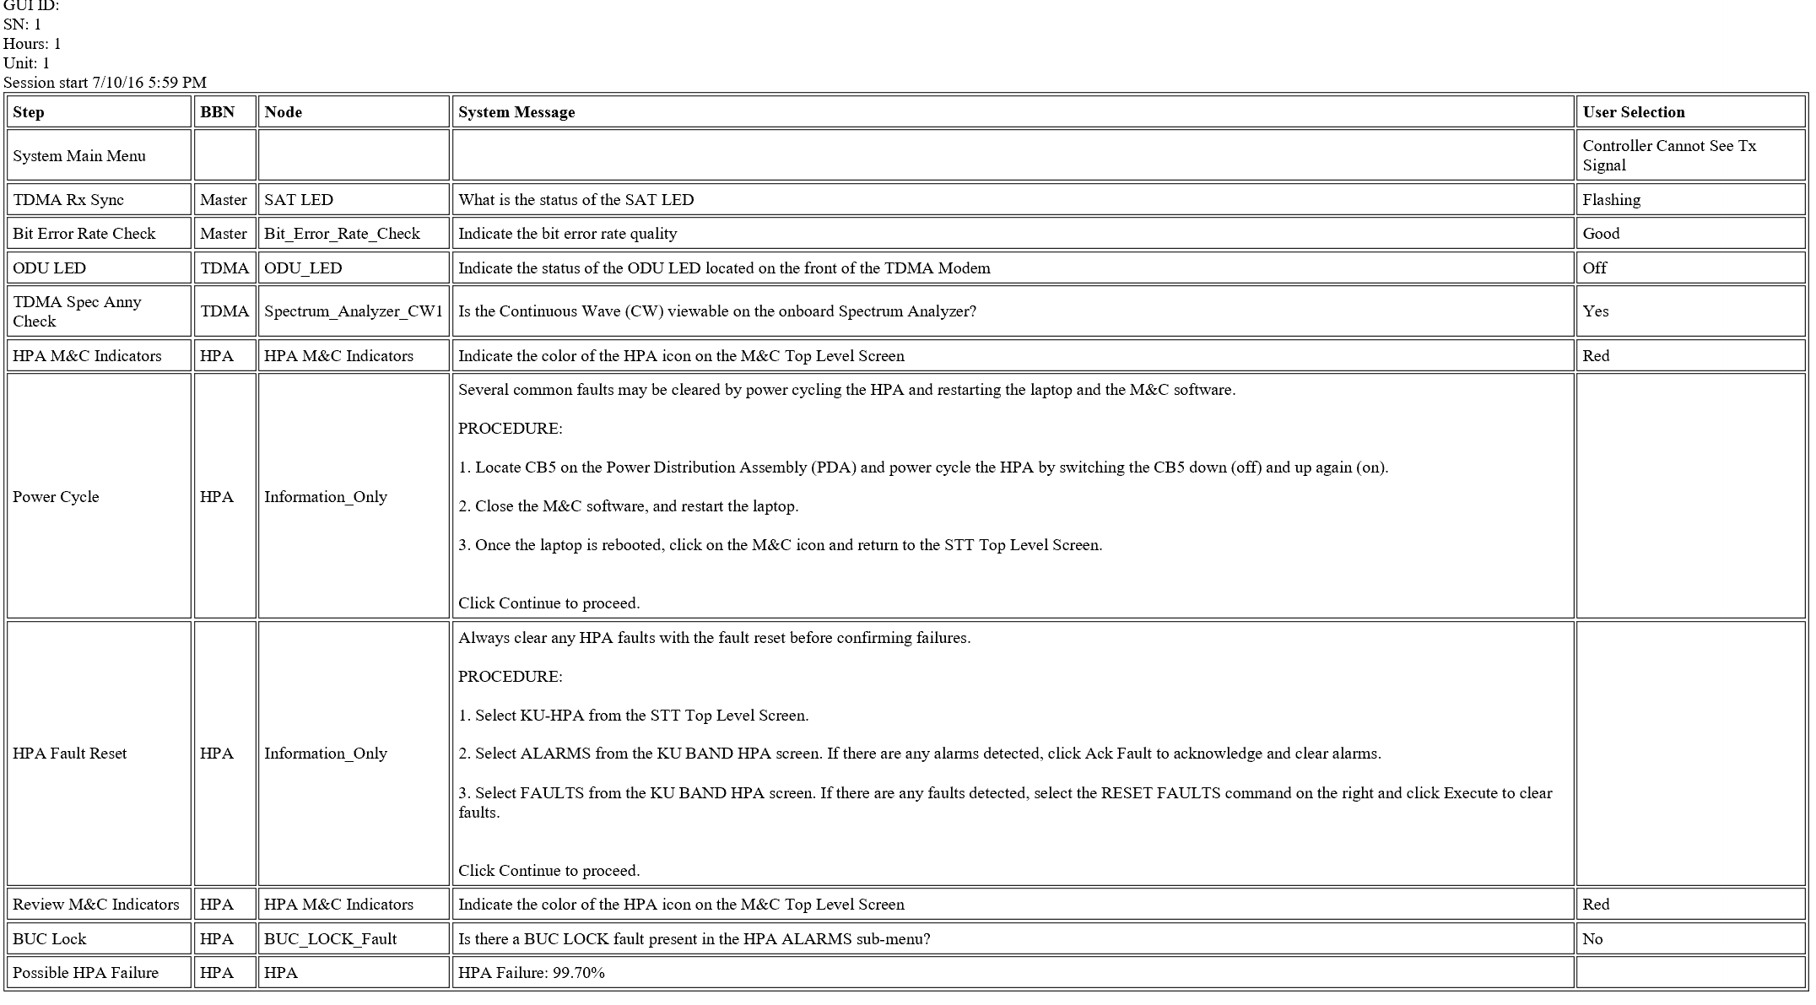
VLAR Solution
CEDAT VLAR:
CEDAT VLAR’s inherent knowledge management and systems analysis capabilities provide the critical field-level knowledge base for enterprise-level fleet management initiatives.
CEDAT VLAR enables the shift away from FSR-intensive sustainment strategies while maintaining equipment availability

Slide 10
VLAR Benefits
Based on test analysis and operations analysis, VLAR has proven the following:
30% improvement in Operational Availability
Documented over 50% decrease in troubleshooting time and 50% increase in troubleshooting accuracy
90% decrease in No Evidence of Failure (NEOF) returns
Dramatic improvements in training and in soldier knowledge retention
VLAR is a registered IT system in the Army Portfolio Management System (APMS)
VLAR software is authenticated for network use under Certificate of Networthiness (CoN) ID

Slide 11
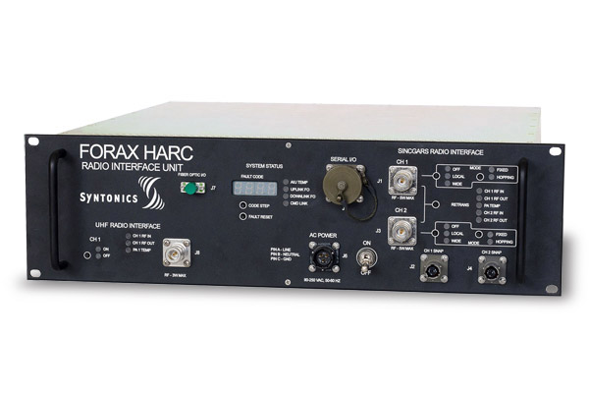
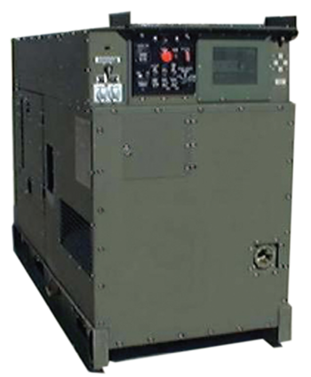
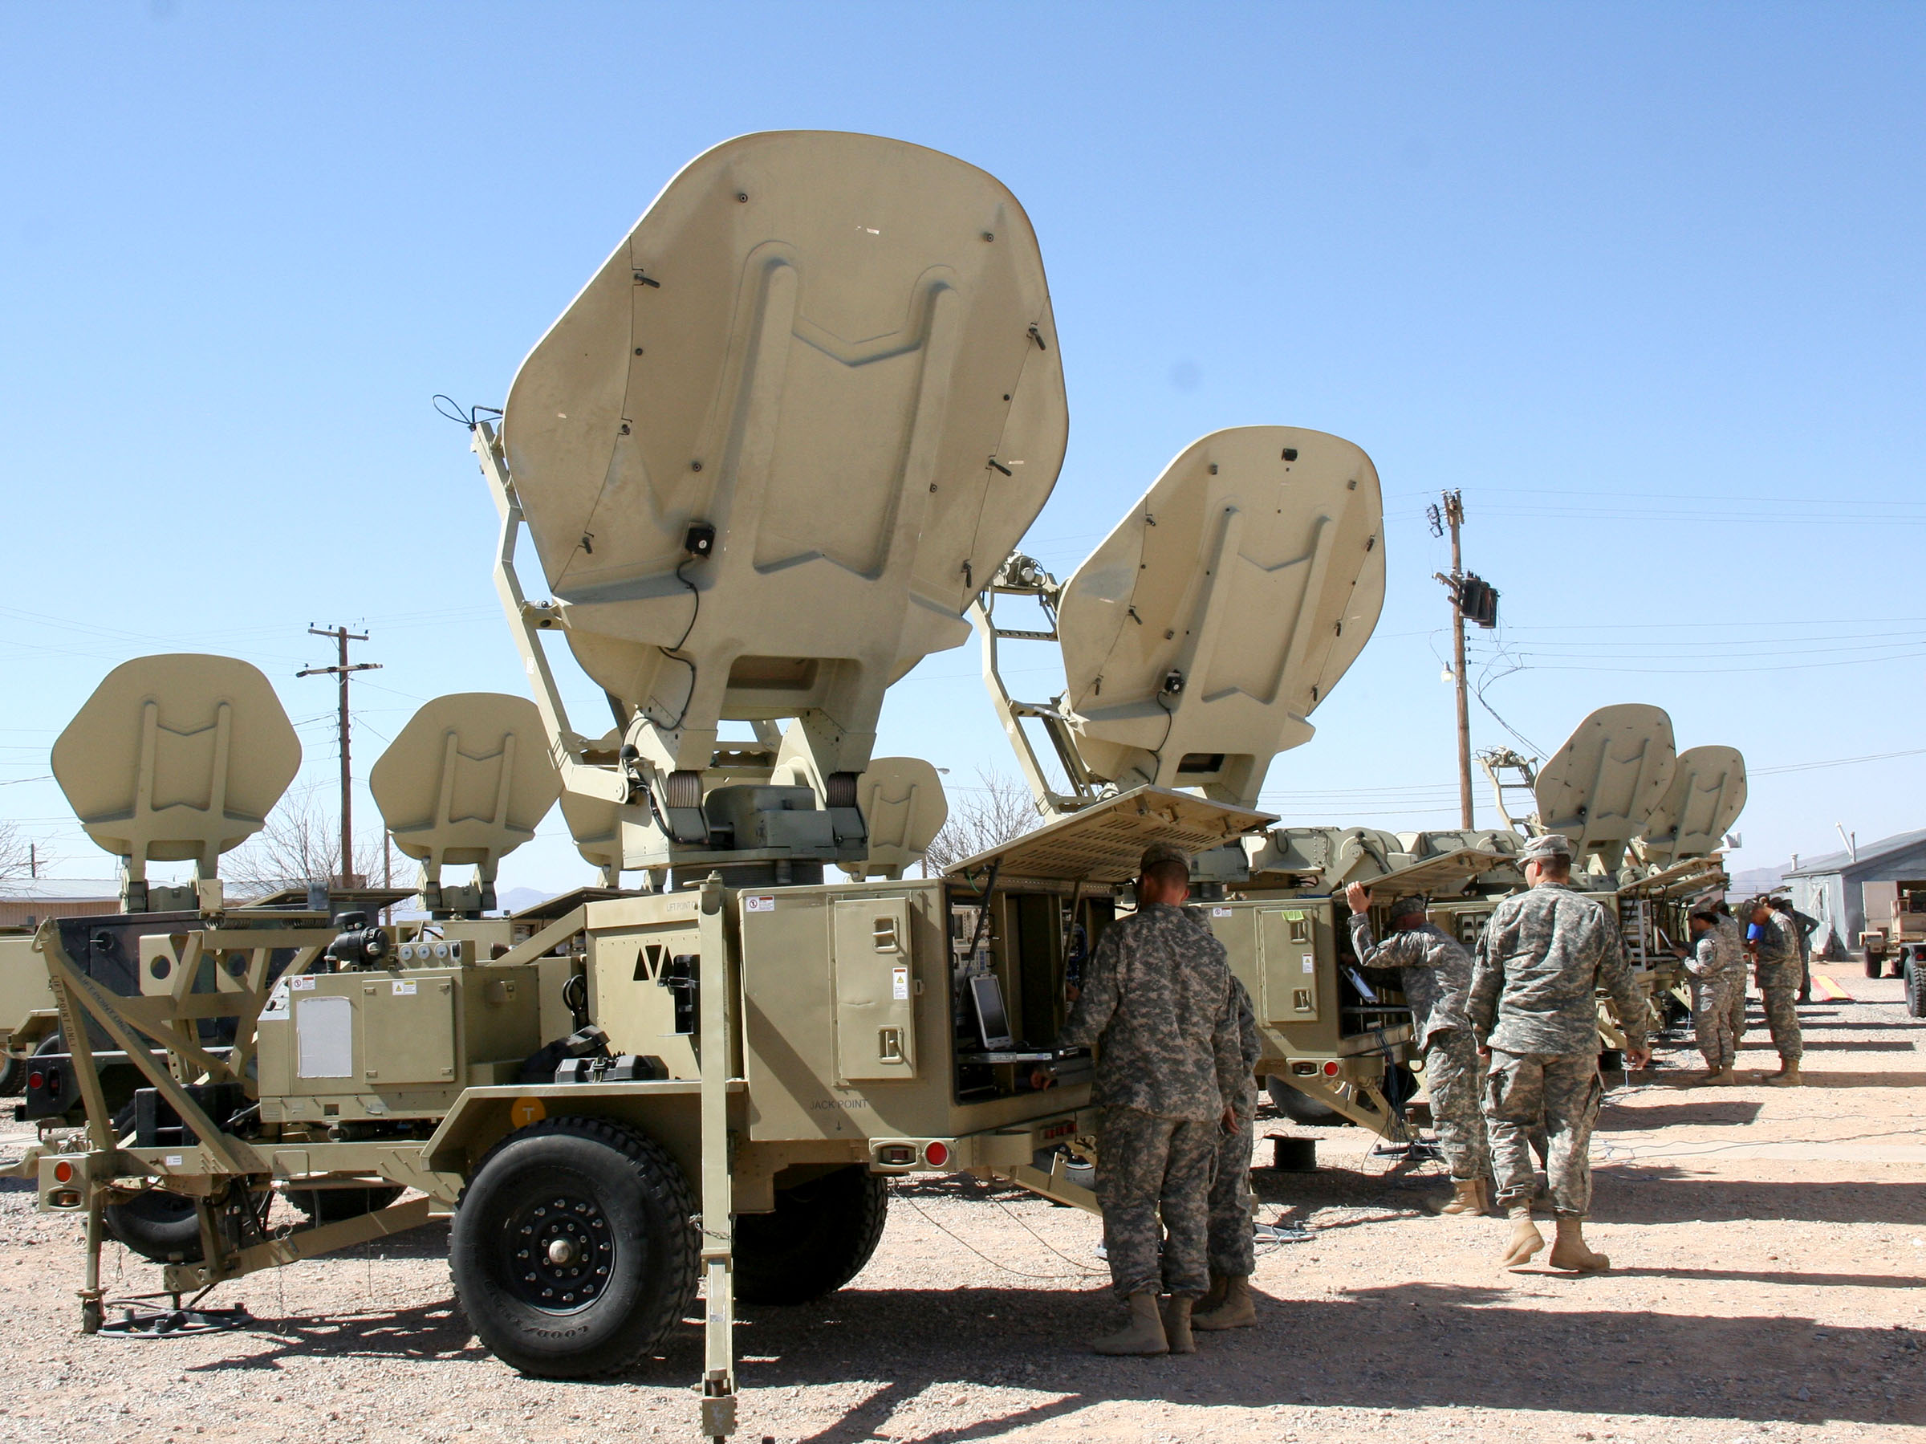
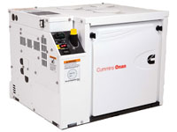
VLAR Products
Completed Efforts: 15,30 and 60 kW Tactical Quiet Generators (TQG,) HARC 4S and 2S Variants, WIN-T Increment 1 STT Transmit diagnostics, WIN-T STT Quick Reference Guide (QRG), Simple Key Loader (SKL) QRG, WIN-T Increment 2 Power Systems, and fuel consumption optimization , Electronic Shop Vehicle (ESV)
Current Efforts: WIN-T Increment 1 Lot 9 STT diagnostics
Future efforts:
AMMPS Generator, WIN-T Inc 2 STT

