Slide 1
Presented To: Joint Technology Exchange Group (JTEG) Technology Forum (Point of Maintenance Aids)
Presented by: Jeff Allen PEMA IPTL PMA260
Portable Electronic Maintenance Aids (PEMA)
Standard PEMA Cyber Solution (SPECS)
and the ThinApp Approach

Slide 2
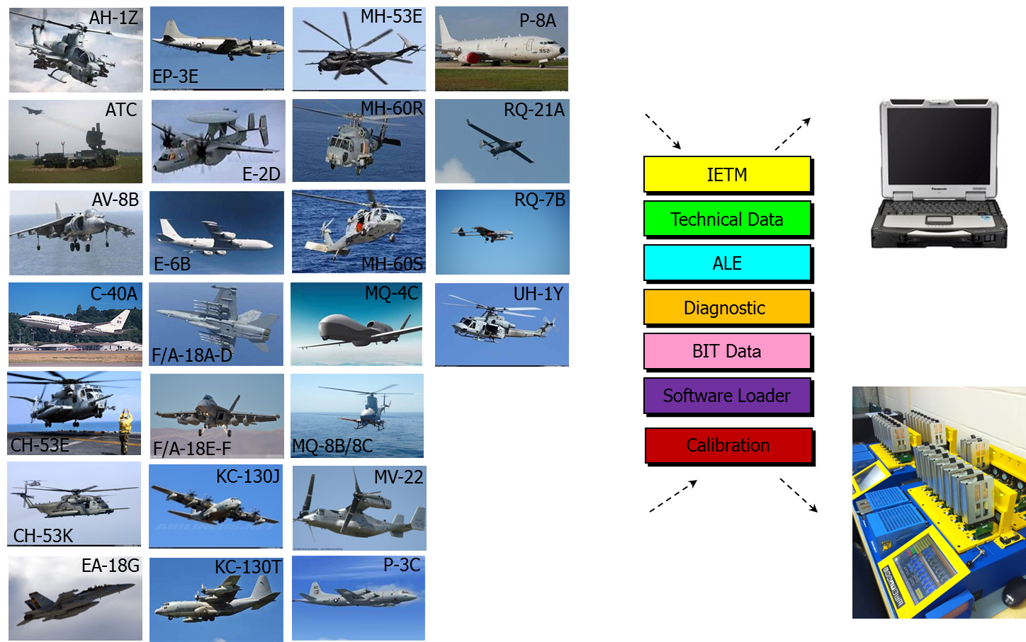
Portable Electronic Maintenance Aid (PEMA)
Customer Base:
33 Type/Model/Series aircraft across 16 PMAs supported
315 O-Level squadrons, 73 I-level, and 3 D-level at 39 sites
8 Network enclaves

Slide 3
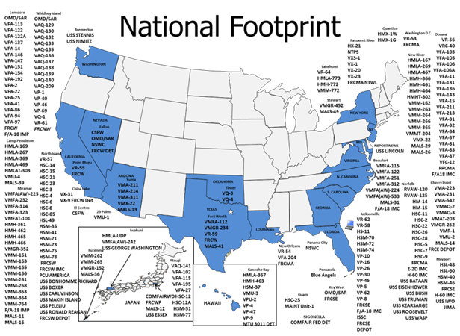
Portable Electronic Maintenance Aids (PEMA)

Slide 4
Standard PEMA Cyber Solution (SPECS)
SPECS is a standardized hardware and software solution provided by PMA-260. The aim is to support and sustain a common image that aligns with current DOD/DON IA policies and mandates. This enterprise product allows PEMA customers to leverage capability including:
Hardware
Solution
Acquisition
Operating System
Distribution
CAC Authentication
Repair
Data At Rest (DAR) FD+RSE
Tech Refresh
Core application patching
Help Desk
HBSS Development and management
IAVM Compliance and Reporting
ATO (expiration date XX)
Notes:
ATO – Authority-to-Operate
HBSS – Host Based Security System
ACAS – Assured Compliance Assessment Solution

Slide 5
SPECS Common Solution
User Software
Windows 7
Security
Symantec Endpoint Encryption
Internet Explorer 11 (OWA, DCS)
Adobe Reader
Adobe Flash
OOMA
Full Disk and Removable Storage
HBSS suite
ACAS
Data Loss Prevention
JKSearch
CAC Authentication
EIDAuthenticate
File Movement
JKCS
Configuration Management
CMDS
ActivIdentity
Tumbleweed
JTDI Website
PREP
Mandatory Profiles
CM Plan / Configuration Control Board
Notes:
ACAS – Assured Compliance Assessment Solution
CM – Configuration Management
CMDS – Configuration Management Distribution Software
DCS – Defense Collaboration Services
HBSS – Host Based Security System
JKCS – Joint Knowledge Caching Server
JTDI – Joint Technical Data Integration
OOMA – Optimized Organizational Maintenance Activity
OWA – Outlook Web Access
PREP – Platform Reconfiguration and Enhanced Preparation

Slide 6

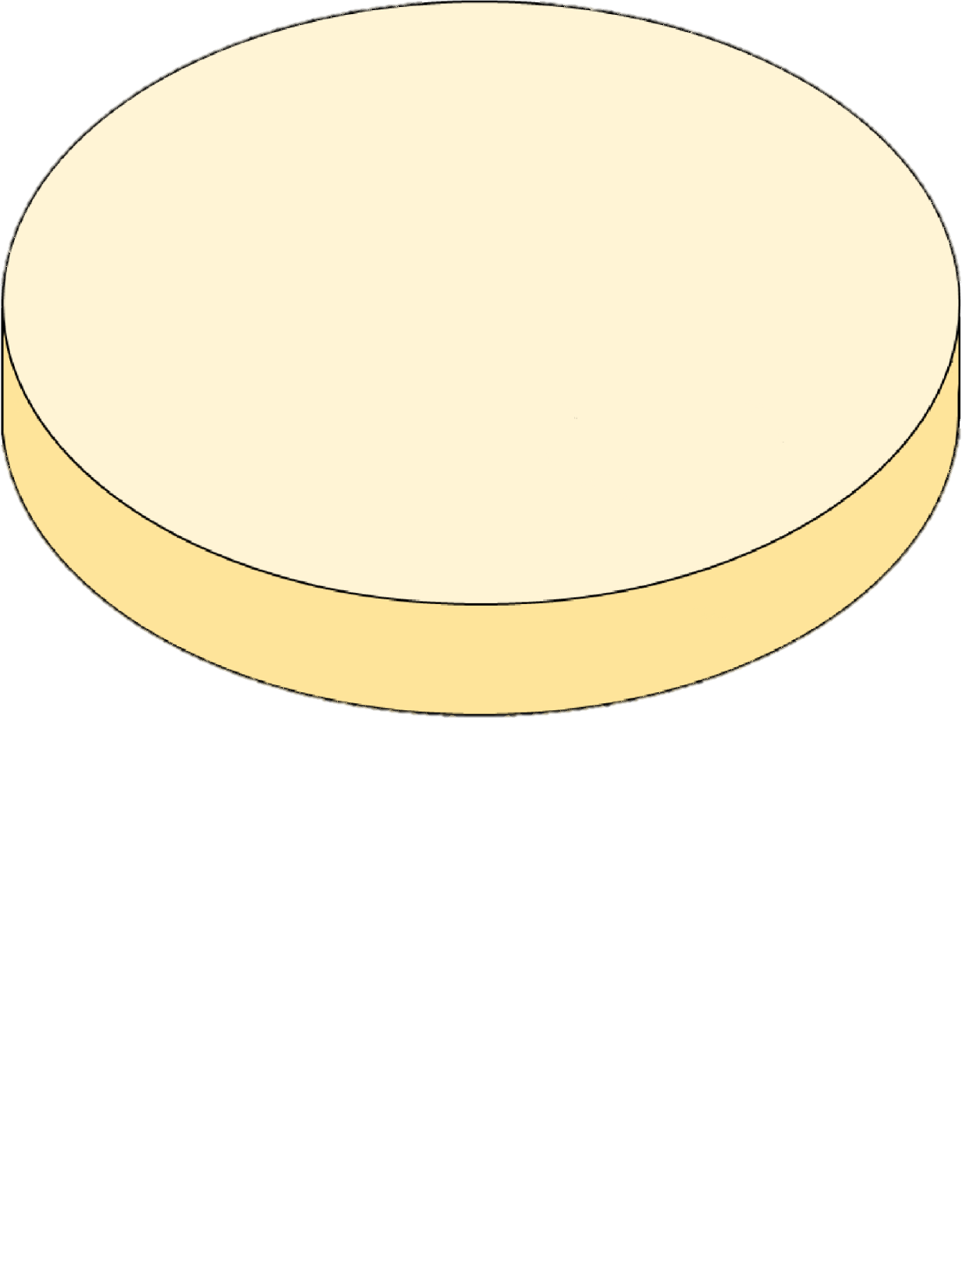

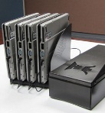
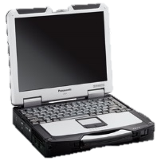

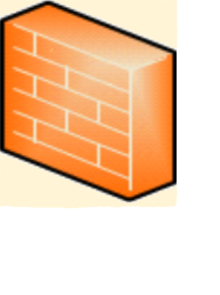


SPECS Connected OV-1
Connected
CMRS-N
Maintainer draws PEMA from work center
VRAM
Unplug, proceed to Aircraft and perform maintenance
PEMA
Domain Services:
  DNS
  NTP
JDRS Web
Returns PEMA
Cross-
Network
Boundary
DCS
CTPL updates via
CD or approved
USB hard drive
OOMA
Top Tier
OOMA
Foundation Tier
Work
Station
NMCI OWA
OOMA
Mid Tier
ACAS
JTDI Top Tier
JTDI
HBSS
NDDS
JTDI Mid Tier
NATEC
JDRS
NATEC
(TMAPS/ELMS)

Slide 7
SPECS Supporting Additional Requirements
Programs with additional requirements above and beyond the CCP core capability shall work with PMA-260 to develop a path forward. A technical analysis will determine whether to integrate into core capability or leverage core capability.
Program Offices will require an application accreditation for unique program components. Unique programs will be deployed on the Common Connected PEMA image as virtual applications. The steps required to transition to CCP are:
CCP Initial Customer Assessment Questionnaire
Technical Analysis
Program Office Memorandum of Agreement
Develop Transition Schedule

Slide 8
ThinApp Approach
BLUF
The DoD spends significant amounts of money addressing software obsolescence and compatibility across the Enterprise. Four major cost drivers are:
Updating unique software as Operating Systems change Windows XP → Windows 7 → Windows 10 and chipset changes 32-bit → 64-bit
Most unique software has dependencies that introduce cyber risk to the host system Requires Adobe Flash, Internet Information Services (IIS), Tomcat, Java, .NET Framework, etc.
Unique software products can be incompatible with each other when cohabitating on the host system. One software requiring Java Runtime Environment (JRE) 7 and another requiring JRE 8 on the same host Operating System
Getting and maintaining an Authority to Operate (ATO) is cumbersome and laborious
Technology Solution:
Convert existing applications to Virtual Applications using commercial tools like VMWare’s ThinApp
Programs will get Application ATOs with well defined accreditation boundaries. Host systems will get Type accreditations and serve all Virtual Applications (Vapp) running on host hardware.

Slide 9
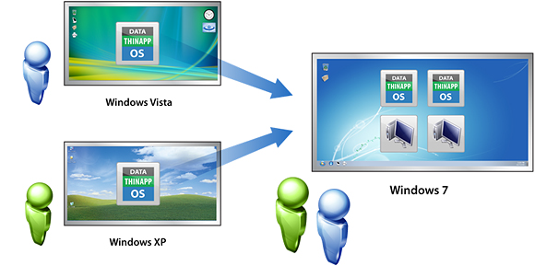
Virtualized Applications
Application virtualization is a process that packages computer programs and their dependencies from the underlying OS into a single executable bundle
  Virtualized application is not “installed” on the host computer
  Virtual layer between the program OS and the host OS
  The application runs as if it were natively installed on the host OS

Slide 10
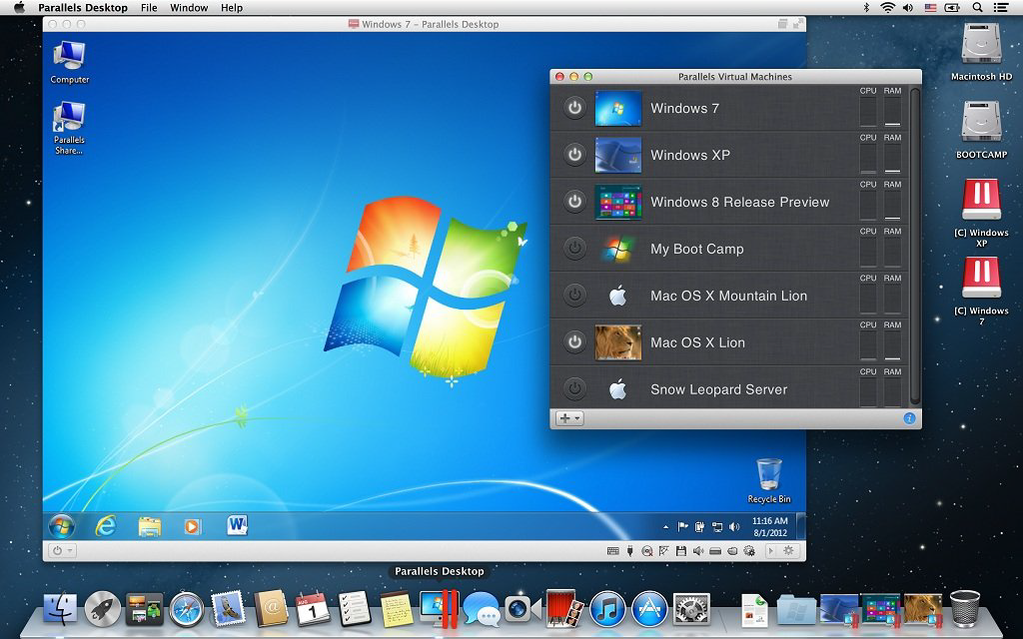
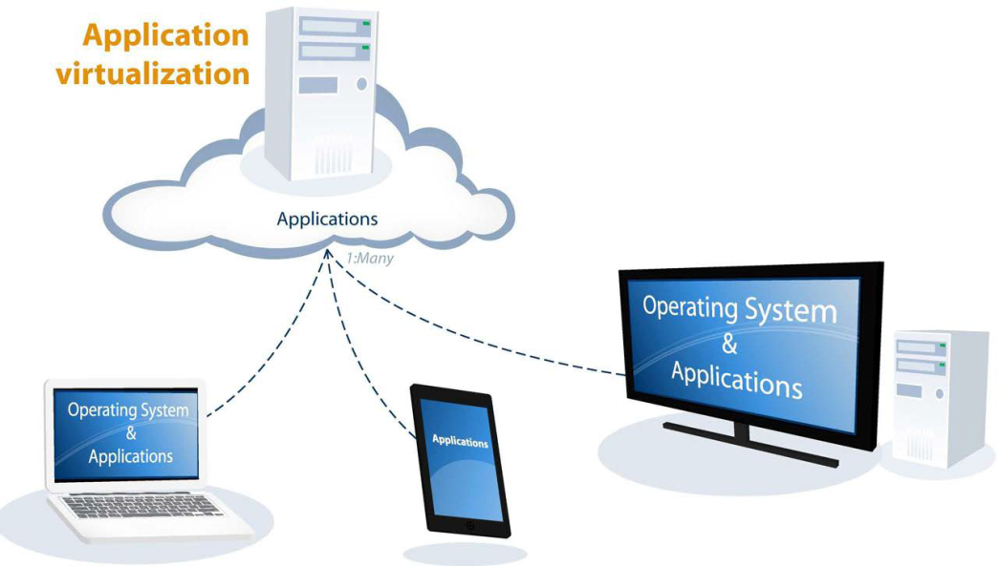
Virtualized Applications Are Not
Virtual Applications are not Virtual Machines
Virtual Applications do not have a boot screen, login, start bar, etc.
Virtual Applications are not cloud based or “thin clients”
Virtual Applications are provided and executed on each machine

Slide 11
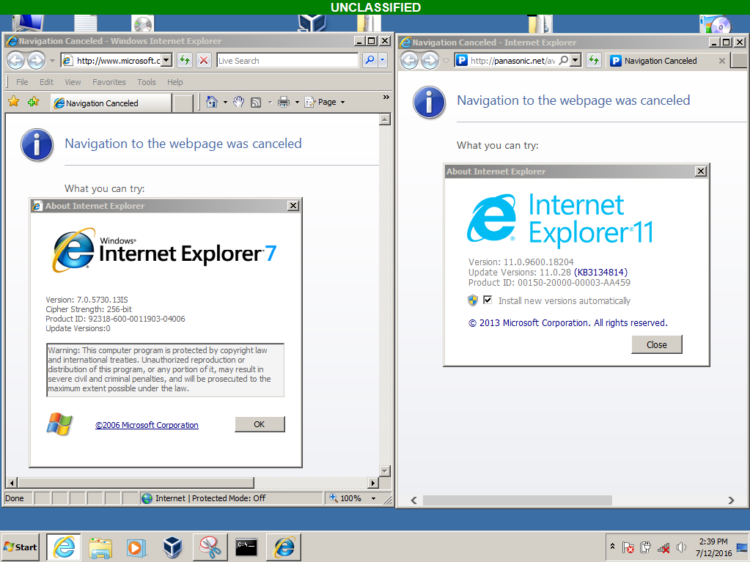
Demonstration
Example of 32-bit Windows XP Internet Explorer 7 running on a 64- bit Windows 7 Internet Explorer 11 host OS

Slide 12
Virtualized Applications Summary
Take Away
  Eliminate unnecessary sustainment costs as Operating Systems change
  Isolate software from potential hardware obsolescence
  Reduce fleet hardware footprint by cohabitating multiple software products on a single platform
  Better Configuration Management by eliminating complicated software update procedures. Simply delete the old executable and replace with the new executable. Software is up-to-date.
  ATO cost savings
  Cyber Security can be controlled for legacy software
  Advanced technology solution for all Department of Defense programs to reduce cost, improve fielded systems, and mitigate cyber risk

Slide 13
Questions
Questions?

