Slide 1
Naval Sea Systems Command (NAVSEA) Nondestructive Testing (NDT)
DoD Joint Technology Exchange Group (JTEG)
Nondestructive Inspection (NDI) Forum
Jason Hence
NAVSEA NDT & Welding Programs Manager
Distribution Statement A: Approved for Public Release; Distribution is Unlimited

Slide 2
NAVSEA NDT
NAVSEA NDT Working Group
Phased Array Ultrasonic Testing (PAUT) / Time of Flight Diffraction (ToFD)
Computed Radiography (CR)
Terahertz Imaging

Slide 3
NDT Working Group

Slide 4
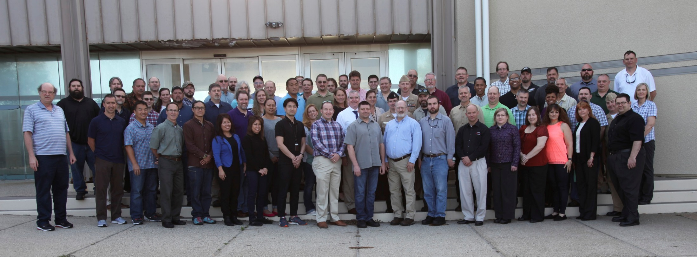
NDT Working Group
2017 NDT WG Meeting – NSWC Port Hueneme Division

Slide 5
NDT Working Group
History
Various forms of the NDT Working Group date back to the mid-1980’s
Current version began in 2001

Slide 6
NDT Working Group
Vision
To be the instrument for making or recommending improvements to NAVSEA-specified NDT processes.

Slide 7
NDT Working Group
Purpose:
Address and resolve, or recommend resolution to NDT issues associated with building, maintaining, and operating Naval ships.
Share ideas, information, successes, best practices, and failures.
Make improvements through effective integration of all stakeholders.
Receive guidance, approval, support, and/or limitations from NAVSEA 04X6.
Determine applicable action items.
Address improvement of NDT processes from an industry-wide perspective.

Slide 8
NDT Working Group
Membership
Chairperson: NDT Program Manager
NAVSEA NDT Technical Representative: NDT & E Technical Warrant Holder
Host: Rotational among stakeholders
Stakeholders:
NAVSEA
Naval Shipyards
Shipbuilders
Regional Maintenance Centers
Supervisors of Shipbuilding (SUPSHIP)
Contractors who perform NAVSEA-specified NDT
Fleet activities
Naval Warfare Centers
Defense Contract Management Agency (DCMA)

Slide 9
NDT Working Group
Meeting Format (3 days)
Presentations (Kept to a minimum)
State of NAVSEA NDT (NAVSEA NDT TWH)
Working Group Action Item Updates (NAVSEA NDT Program Manager)
Significant NDT Audit Findings (NAVSEA NDT Program Manager)
Emerging NDT Technology
Breakout Sessions
Finalize Action Items

Slide 10
NDT Working Group
Accomplishments
Revised NAVSEA NDT Standards
Phased Array Ultrasonic Testing (PAUT) requirements
Computed Radiography (CR) requirements

Slide 11
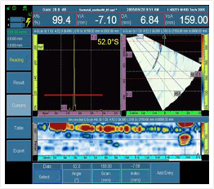
Phased Array Ultrasonic Testing (PAUT) / Time of Flight Diffraction (ToFD)

Slide 12
Phased Array UT / ToFD
What is it?
PAUT
Multiple elements (up to 256) and electronic time delays to create beams that can be steered, swept, scanned, and focused electronically
Full data storage with encoding (recording)
Reference for future inspections on the same site
Multiple angle concurrent inspections
Conventional UT
Manual scanning using single element, fixed angle transducer
No permanent record of raw data
Characterization and Sizing (UTCS) requires multiple set-ups, several angles (transducers), significant time

Slide 13
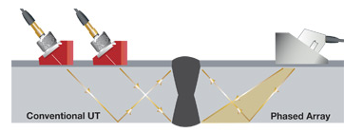
Phased Array UT / ToFD

Slide 14
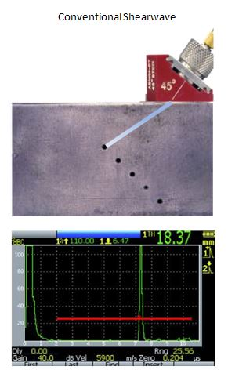
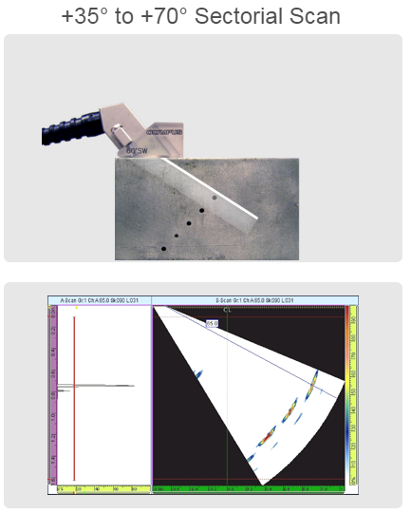
Phased Array UT / ToFD
Conventional Shear Wave

Slide 15
Phased Array UT / ToFD
ToFD
Highly sensitive “pitch-catch” technique with capabilities of detecting longitudinal and transverse flaws
Detects embedded and most surface-connected flaws

Slide 16
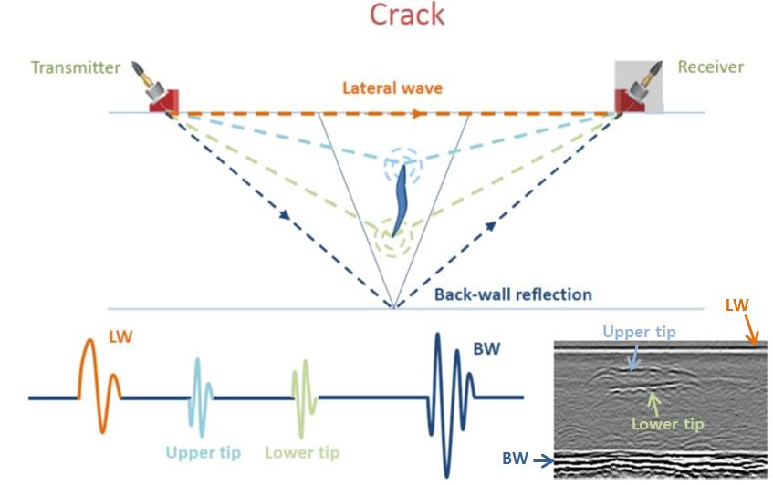
Phased Array UT / ToFD

Slide 17
Phased Array UT / ToFD
Advantages
Raw Data Collection
Data encoded and stored digitally
Composite images of discontinuities
Reduced dependence on operator to visually identify flaws while scanning manually
Repeatability
Consistent indication location/length measurements
Increased accuracy for determination of indication growth for baseline and monitoring inspections
Cost / Schedule Savings
Less time required for inspections

Slide 18
Phased Array UT / ToFD
Previous:
Radiographic Testing on piping welds
Conventional UT Shear Wave on ship structure

Slide 19
Phased Array UT / ToFD
Current:
PAUT / ToFD on piping welds down to 2-½” NPS and limited by minimum wall thickness and configuration:
Carbon Steel
Copper-Nickel
Conventional UT Shear Wave on ship structural applications
Awaiting approval to use PAUT / ToFD
Created a draft procedure, provided proof test information to NDT TWH
Inspection Personnel
Certified Level III PAUT / ToFD Examiners (PSNS & PHNSY)
Inspector candidates ready to be examined / certified

Slide 20
Phased Array UT / ToFD
End State:
PAUT / ToFD on any piping welds not limited by the material type or configuration
PAUT / ToFD on all structural applications not limited by configuration (may need to use other NDT (RT or MT every layer) on some configurations)
PAUT / ToFD for all UT Characterization and Sizing

Slide 21
Phased Array UT / ToFD
Challenges to Implementation
High equipment cost
Additional personnel training / oversight
Qualification requirements
Resistance to change
Personnel turnover / limited resources
Cybersecurity requirements

Slide 22
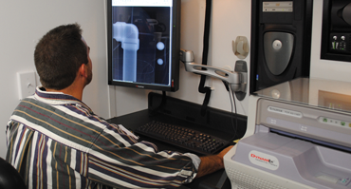
Computed Radiography (CR)

Slide 23
Computed Radiography (CR)
What is it?
Radiographic Testing (RT) process that uses digital imaging plates in place of conventional film RT.

Slide 24
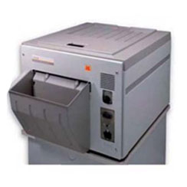
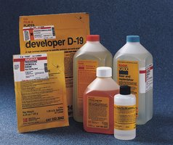
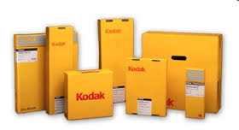
Computed Radiography (CR)
Advantages
Digital image storage eliminates the need for a physical medium (i.e., film)
Eliminates film processing equipment, chemicals, etc.
Radiographic Testing (RT) image sharing over networks

Slide 25
Computed Radiography (CR)
Current state
All Radiographic Testing (RT) performed using physical film
Film is processed (manually or automatically) using chemicals
Chemical HAZWASTE disposal / Silver recovery
Film maintained in accordance with fabrication document record retention requirements
Audits conducted where the film is stored

Slide 26
Computed Radiography (CR)
End State
All RT performed using CR
CR files transferred over Navy networks (e.g., NMCI, UNNPI, etc.)
Audits of RT records conducted with no travel necessary for the auditor

Slide 27
Terahertz Imaging

Slide 28
Terahertz Imaging
Research & Development Phase
Dr. Patric Lockhart (Naval Undersea Warfare Center – Newport)

Slide 29
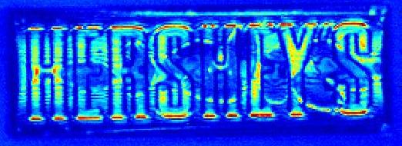
Terahertz Imaging
What is it?
Technology that lets you “see” inside or through many solid objects/coatings to detect defects in a target structure or material lying beneath.
Debonds, corrosion, voids, water intrusion, mechanical damage, internal interfaces

Slide 30
Terahertz Imaging

Slide 31
Terahertz Imaging
Advantage
Noninvasive detection of defects in certain ship structural applications

Slide 32
NAVSEA NDT
NAVSEA NDT Working Group
Annual meeting
PAUT / ToFD
Partial approval
CR
Requirements document drafted
Terahertz Imaging
R&D
Dr. Patric Lockhart

