Slide 1
FRCSW Advanced Technology Innovation (ATI) Intermittent Wiring Initiatives Overview
25 July 2017
JTEG
Brett Gardner, ATI Avionics STL

Slide 2
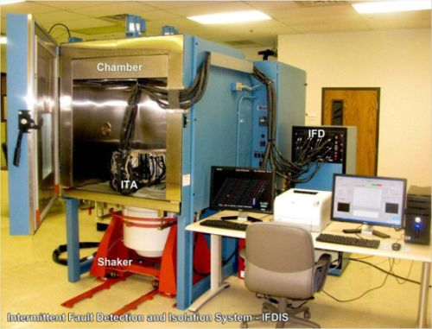
Intermittent Fault Detection & Isolation System (IFDIS)
OPERATIONAL NEED
Objective: Provide an Intermittent Fault Detection & Isolation System (IFDIS) that uses current and voltage to constantly monitor the Unit Under Test while it undergoes vibration/temperature cycles.
Value to Naval Warfighter:
Increase the quality of avionics components delivered to the fleet.
Streamline the repair process
To test this, FRCSW sent 5 ready for issue Generator Control Units GCUs to be tested with the IFDIS. Four of the five came back with intermittent faults and the exact location of the faults for easy repair.
Gap or Science & Technology Objective (STO): Reduction of Total Ownership Cost
Impact if Not Addressed:
Continue to sell units that have failures when the aircraft is in flight.
This is an SBIR project.
Picture or Graphic Here:
that illustrates technology or concept to a non-expert
Resolution <250 KB
PROPOSED SOLUTION
Intended: Test across all circuits at once to detect intermittent faults as short as 50 nanoseconds .
Technical approach:
Originally an Air Force SBIR project with Universal Synaptics.
The system passed through USAF Phase I and II and has been implemented at FRCSW a CIP project 2015/16 SBIR phase 3 purchase.
Weapon systems impacted: F-18 CGU with potential for all NAVY WRA chassis
Where this is already used: Air Force, for F-16 radar.
Other sites that can use this: FRCSE and FRCE
STATUS ASSESSMENT
TRL: Current: 9
Schedule:
IFDIS installed 2015
Expand capability for additional aircraft components through awareness; additional costs include development of unique test cable sets and test spectrum program for UUT.
FRCSW Pilot program to evaluate impact to Depot $$ to implement IFDIS testing. 10 F18 Super Hornet GCU’s will be evaluated
Performance:
CIP Funds were obligated for this project in February 2014 and fully expended 2016.
Cost:
$3,500,000 ; including TPS for all variants of F18 CGU
Current/potential Barriers:
Lack of technical requirement to direct testing.

Slide 3
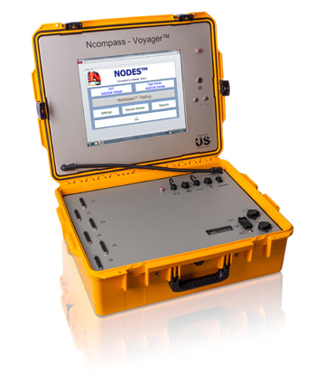
Voyager – On-aircraft Demonstration via CRADA
OPERATIONAL NEED
Objective: Demonstrate Ncompass/Voyager- Intermittent Fault Detection & Isolation System (IFDIS) capability on aircraft wiring.
Value to Naval Warfighter:
Increase the reliability of aircraft wiring in the Fleet.
Streamline the repair process.
Increased TOW for critical Aircraft systems.
Gap or Science & Technology Objective (STO): Reduction of Total Ownership Cost-increase reliability and TOW for aircraft systems.
Impact if Not Addressed:
Continue to have system failures when the aircraft is in flight due to intermittent wiring issues.
Ncompass/Voyager
PROPOSED SOLUTION
Intended: Use neural network to check all lines simultaneously and continuously. Current testing methods utilize sequential voltage checks; one connection at a time. Ncompass/Voyager technology can detect intermittent faults as short as 50 nanoseconds in aircraft wiring.
Technical approach:
Cooperative Research and Development agreement (CRADA) to demonstrate Ncompass/Voyager technology on F18 and other Navy platforms.
Weapon systems impacted: F-18, and other platforms that are available.
Where this is already used: Commercial.
Other sites that can use this: FRCSE and FRCE
STATUS ASSESSMENT
TRL: Current: 9
Schedule:
FY17 CRADA – in work ECD 12/17.
Test F18 and other platforms using AWTS TPS wiring harness.
Nose steering cable and CGU AC cables have been obtained.
Performance:
Expect improved wire testing capability.
Cost:
TBD
Current/potential Barriers:
None

Slide 4
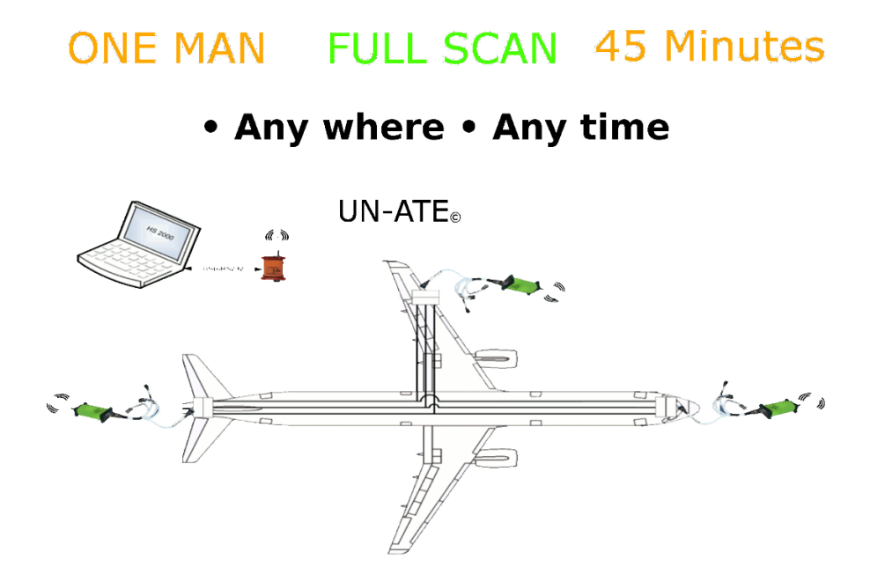
AMUET – Wireless On-aircraft Demonstration via FCT
OPERATIONAL NEED
Objective: Demonstrate Solavitek AMUET wireless Intermittent Fault detection via Foreign Comparative Testing (FCT)/NCMS project on F/A-18 aircraft wiring. Collaborate with Air Force will demonstrate intermittent and all wiring testing capabilities of AMUT System.
Value to Naval Warfighter:
Increase the reliability of aircraft wiring in the Fleet.
Streamline the repair process.
Increased TOW for critical aircraft systems.
Gap or Science & Technology Objective (STO): Reduction of Total Ownership Cost-increase reliability and TOW for aircraft systems.
Impact if Not Addressed:
Continue to have system failures when the aircraft is in flight due to intermittent wiring issues.
PROPOSED SOLUTION
Intended: Demonstrate wireless technology to detect intermittent faults as short as 50 nanoseconds in aircraft wiring using wireless capabilities.
Technical approach:
Demonstration of AMUET technology on F18 and other platforms.
Weapon systems impacted: F-18, V-22 and other platforms as available.
Where this is already used: Commercially
Other sites that can use this: All FRCs
STATUS ASSESSMENT
TRL: Current: 6
Schedule:
FY18 FCT program
Test F18 and other platforms FY17/18
Nose steering cable and GCU AC cables are the initial systems of interest, other systems tested as funding and time permits.
Performance:
Expect improved wire testing capability
Cost:
Initial Pilot $170K funded by Navy FCT office. Managed by NCMS. Cost of AMUET wireless systems and TPS TBD.
Current/potential Barriers:
Wireless capability requires IT Authority to Operate (ATO). As a back up system can operate with 10 Base-T

Slide 5
Future ATI Demonstration Opportunities
CRADA with Eclypse International to demonstrate intermittence capability of AWTS
Partner with Eclypse to evaluate technology.
Software updates to AWTS provide for intermittence capability.
Collaborate with 4.8 Lakehurst to verify intermittence capability of AWTS.
Anticipate October 2018 project start date.

