Slide 1
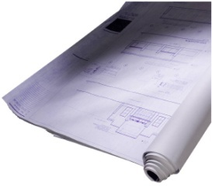
eTWD JTEG FORUM
3 February 2015
by Troy Kaichen

Slide 2
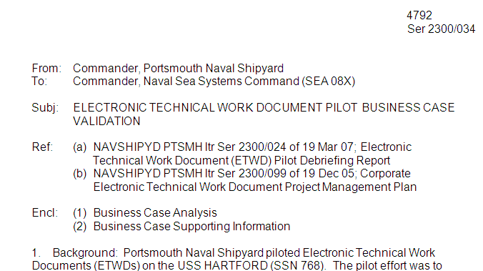
eTWD Project Overview
(History)
2003; eTWD first discussed as part of NAVSEA’s Shipyard Transformation Plan
Emphasis was on reducing the cost and overall efficiency of
maintenance.
2005-2006; pilot on the USS HARTFORD at
Portsmouth Naval Shipyard.
Integrating commercial software (i.e Solumina) with SY systems.
Validated the concept of an e-work package had potential for substantial savings.
2007; Navy System Support Group (NSSG) outlines Project Management Plan & Norfolk Naval Shipyard validates potential for savings.
2010; eTWD Project approved as part of CNO Reduction of Total Ownership Costs (RTOC) Initiative
Approved TOC project to generate 61 million in savings per year.

Slide 3
eTWD Is:
eTWD is more than an electronic work document; it’s an electronic work package
Integrates work instructions, drawings, data tables, verification signatures and work control forms into an online certifiable technical work document.
It will validate recorded data, auto-populate required forms, and enable online problem identification and resolution.
Upon job completion, certification will be an electronic function that authenticates proper accomplishment of all work or tests to specified parameters.
eTWD Will:
Provide immediate access to all data required to perform
maintenance
Provide validated, accurate and standardized collection of
maintenance information
Complete integrated electronic records for
maintenance planning activities

Slide 4
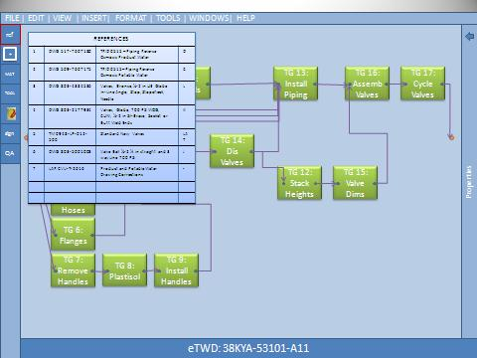
Access to Maintenance Information
Dynamic Technical Work Document for Use by the Mechanic
Data collection cells with automatic validation of min/max values
Form builder and standard forms that are linked from data cells
Hyperlinks / book marks to reference documents
Videos, 2D/3D drawings, schematics & pictures
Link text to bill of materials
Visual work instructions
Access to training material via the intranet
SAMPLES for illustration only (fictitious info)

Slide 5
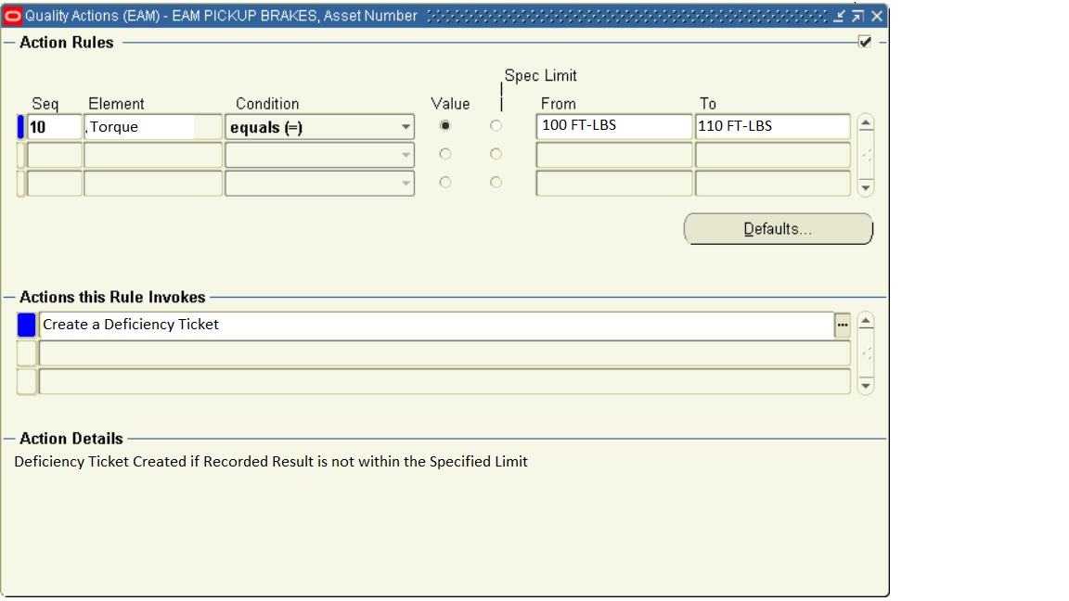
Data Collection
Collection of Maintenance Data from the Mechanic
SAMPLES for illustration only (fictitious info)
Standard forms are populated automatically from embedded data cells
Validates qualifications of mechanics
Validates recorded measurements against specified allowable limits
- Flags out-of-tolerance data collection for resolution
Automates certification of the entire technical work package
Provides capability to collect data via bar-code or RFID

Slide 6
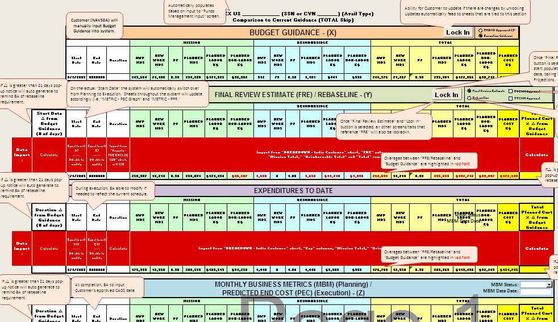
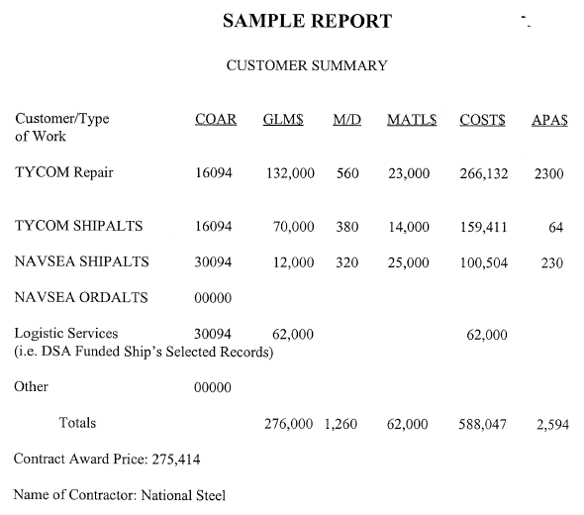
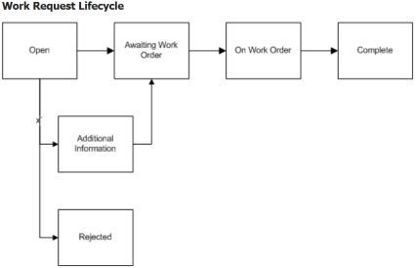
MAINTENANCE PLANNING
Use of Data by Maintenance Planning Activities
Transfer of Availability data to the Maintenance Planning Activity
Automated report generation
Searchable electronic records
Budget Management provides visibility of Project’s financial status from planning through execution
Automated new work management from identification through authorization
Automated cost reporting and metrics

