Slide 1
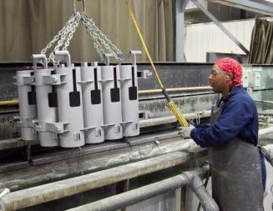
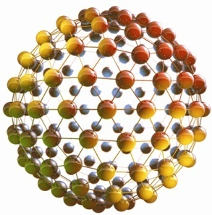
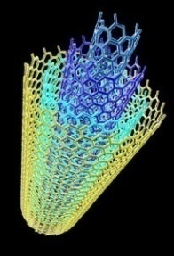
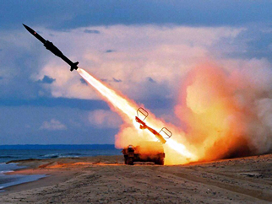
Managing Chemical & Material Risks
DoD Emerging Contaminants Program Overview
Briefing for Joint Technology Exchange Group
Paul Yaroschak, P.E.
Deputy for Chemical & Material Risk Management
Office of the Assistant Secretary of Defense
(Energy, Installations & Environment)

Slide 2
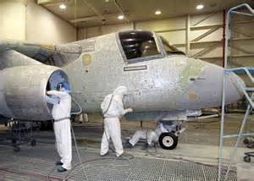
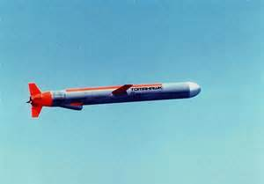
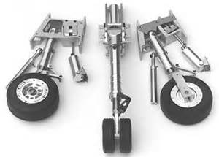
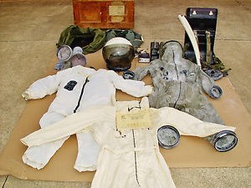
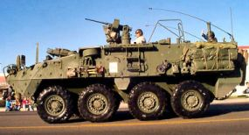
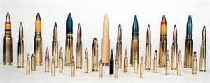
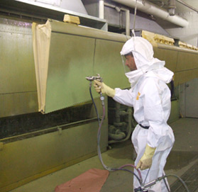
The Defense Context
Equipment, weapon systems, and platforms provided to the war-fighter are made from, and depend on, chemicals & materials.
Vital chemicals & materials needed for production, performance, and sustainment of systems are increasingly at risk from becoming non-available

Slide 3
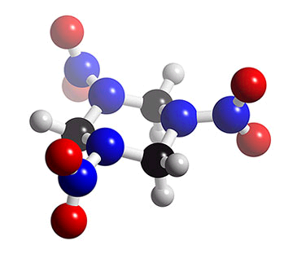
What is an Emerging Contaminant?
Chemicals & materials that have pathways to enter the environment and present real or potential unacceptable human health or environmental risks…
and either
do not have peer-reviewed human health standards
or
Standards/regulations are evolving due to new science, detection capabilities, or pathways.
Notes:
About 42 billion pounds of chemical substances are produced in or imported into the United States each day, with an additional 1,000 new chemicals introduced each year..

Slide 4
How Can ECs Affect DoD?
Present risks to operating forces, DoD employees, and/or public
Human health protection paramount
Reduce training/readiness
Restrictions on use of ranges
Restrict availability and/or cost of materials or chemicals
Adverse impact on mission-critical applications & industrial base community
Increase O&M and/or cleanup costs
Diverts resources from core mission

Slide 5
Global Chemical Management Trends
Use of Precautionary Principle
Must understand health & environmental effects before using chemicals
Biomonitoring – What’s showing up in humans?
Centers for Disease Control’s national bio-monitoring & California voluntary program
Strict Chemical Management & Green Chemistry
Cradle to grave
Evolving Risk Assessment Science & Process
EPA IRIS¹ program
International, Federal, & State Toxic Substances Laws
EPA Chemical Action Plans
California Green Chemistry Law
European Union’s REACH² regulation
Pending Toxic Substance Control Act reform
¹ Integrated Risk Information
² Registration, Evaluation, Authorization & Restriction of Chemicals

Slide 6
Part 1 – Emerging Contaminants (ECs) Program Structure

Slide 7
EC Program Strategic Priorities
National Level Issues
Strategic Process Improvements
Engage Internal & External Stakeholders
Identify, Assess & Manage DoD Risks
DoD, Federal, State, NGOs, & Industry
Internal DoD & Industry Partners

Slide 8
EC “Scan-Watch-Action” Process
Over -the- horizon
Review literature, periodicals, regulatory communications, etc.
EC News
Possible DoD impacts
Monitor events; Conduct Phase I qualitative impact assessment
Phase I
Assessment
Probable high DoD impacts
Phase II
Assessment
Conduct Phase II quantitative impact assessment; develop & rank Risk Management Options (RMOs)
RMOs to EC Governance Council
Approved RMOs become Risk Management Actions

Slide 9
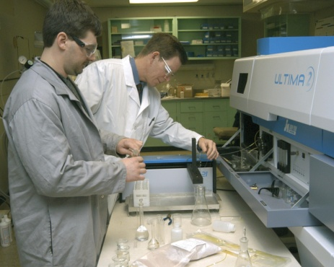
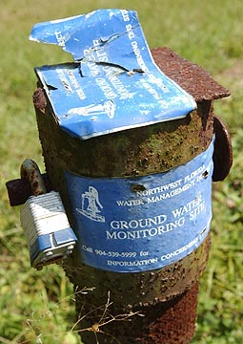
Functional Areas Assessed
Acquisitions / Research, Development,
Testing, and Evaluation
Environment, Safety & Health
Production, Operation, Maintenance,
and Disposal of Assets
Training & Readiness
Cleanup/Remediation
Notes:
ECs can impact DoD in one or more critical areas. The impacts depending on the degree of the uncertainty about the chemical, political climate, health effects, and regulatory response (ban or restrictions).
New health effects can lead to changes in surgical care for war fighters (Tungsten/Nickel/Cobalt) munitions
New standards can halt live fire training (RDX and tungsten at MMR)
Uncertainty about potential health effects can influence the direction of acquisitions programs (e.g., stop use of Hex chrome for force alternative development) and stop R&D (e.g., ARL halted all R&D on tungsten until new occuprational safety standards could be determined)
Ban on materials can results in changes in O&M practices (PFOA)
New standards and toxicity data can lower groundwater treatment goals and increase time to cleanup (TCE)

Slide 10
SF6 Phase I Impact Assessment
Sulfur Hexafluoride (SF6) is used in radar systems (e.g., AWACS aircraft); helicopter rotor-blade leak tests; discharge testing in fire suppression systems; electrical switch gear; and propulsion systems for specific weapons (e.g., MK-50 torpedo) in service and under design.
H
●
■
▲
Likelihood of Toxicity Value/
Regulatory Change
Probability of Occurrence
♦
Probability
X
Probability that Greenhouse Gas emission initiatives will restrict use/availability of SF6
H
M
L
L
Severity of Impact
H
♦
●
ES&H PO&MD of Assets
Training & Readiness Cleanup
Acquisition/RDT&E
■
X
▲

Slide 11
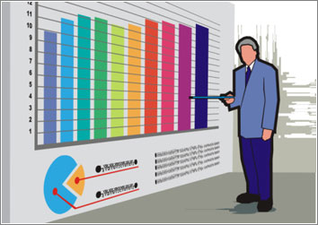
Part 2 – Progress Report

Slide 12
EC Program Scorecard – Cumulative
Potential ECs screened --- over 580
Phase I Impact Assessments completed --- 39
Phase II Impact Assessments completed --- 11
All current/former action list chemicals completed.
Risk Management Actions (RMAs) --- 66
RMA Status
Note: See EC Action and Watch Lists in Tab B

Slide 13
EC Watch List – January 2016
Tungsten/alloys
1,4-dioxane
Metal Nanomaterials
Carbon Nanomaterials
PFOS
PFOA
Nickel
Cadmium
Manganese
Dioxin
HFCs (10)
Vanadium & compounds
Cobalt
Antimony
Flame retardants (6)
Diisocyanates
NDMA
DNT
DNAN
NTO
TCE …moved from action list
Perchlorate …moved from action list
Strontium…added March 2015
Chlorinated paraffins…added June 2015
Energetic Compounds
Phase I Impact Assessment completed
Notes:
Di-nitrotoluenes (DNT)
Perfluorooctanoic acid (PFOA)
Perfluorooctyl sulfonate (PFOS)
decabromodiphenyl ether (decaBDE)
5-Nitro-1,2,4-triazol-3-one (NTO)
N-Nitrosodimethylamine (NDMA)
Trichloroethylene (TCE)
2,4 dinitroanisole (DNAN)
Hydrofluorocarbons (HFCs)

Slide 14
EC Action List – January 2016
Royal Demolition eXplosive (RDX)
Hexavalent Chromium (Cr6+)
Naphthalene
Beryllium
Sulfur Hexafluoride (SF6)
Lead
Phthalates
1-Bromopropane
TBBPA…added by ECGC in DEC 2015
Phase II Impact Assessment completed.
RDX = Cyclotrimethylenetrinitramine
TBBPA = Tetrabromobisphenol_A

Slide 15
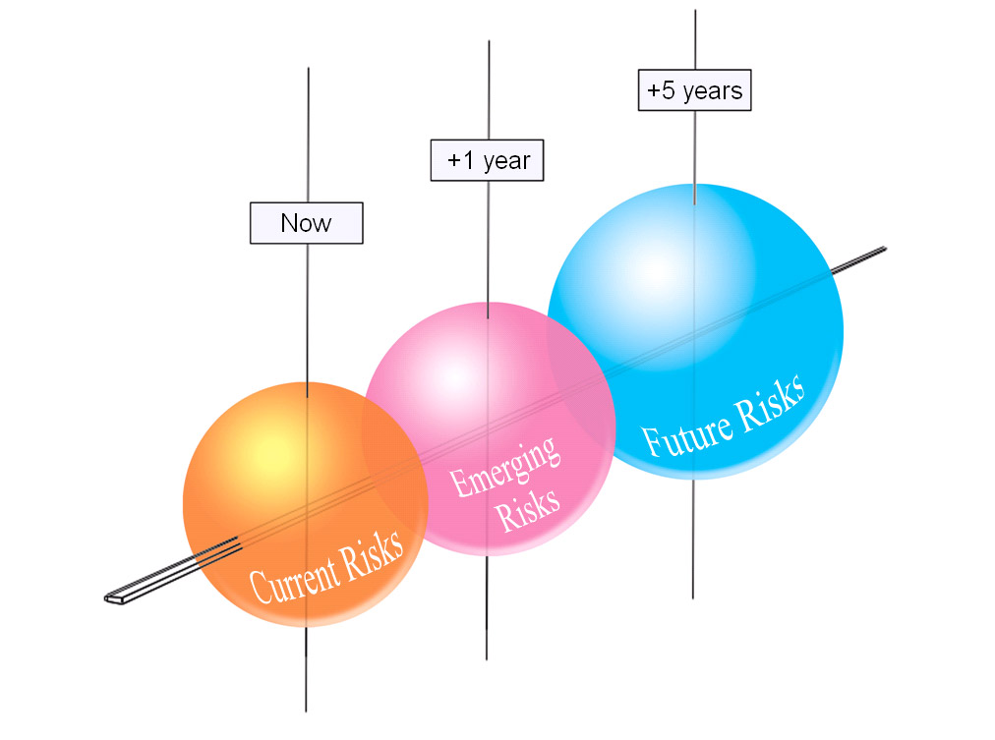
Part 3 – Risk Management Actions

Slide 16
Example Risk Management Actions Completed
Perchlorate RDT&E; DoD Policy; Over 50,000 samples taken; Congressional Myth-busters brief
Hexavalent chromium RDT&E; USD(AT&L) policy; Defense Federal Acquisition Regulation
SF6¹ policy on capture & recycling
Beryllium life cycle study
Development of innovative naphthalene dosimeter for fuel handlers
RDX² toxicological studies
Coordination with Program Manager for chem/bio protection equipment related to phase-out of phthalates
¹ Sulfur Hexafluoride ² Cyclotrimethylenetrinitramine

Slide 17
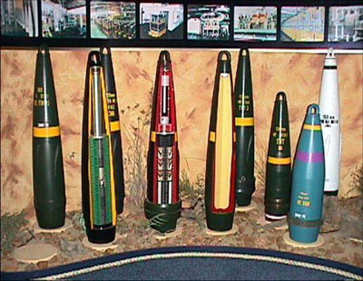
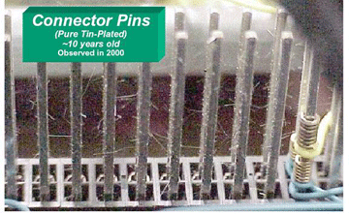
Lead – Why on the Action List?
Evolving science & regulations may pose a risk to personnel & range operations…most munitions contain lead
Lead-free electronics pose a risk to DoD supply chain…short-circuiting in components
Range Instructor

Slide 18
Background for Lead - Risk Management Actions Taken -
DoD-Industry Consortium on lead-free electronics
Develop technologies to detect lead-free circuit boards
Develop viable lead-free solders
RDT&E on lead free munitions
National Academy of Sciences (NAS) Study for DoD
Concern: Lead exposures to personnel such as small-arms range instructors given new human health science
Conclusion: “A review of the epidemiologic and toxicologic data allowed the committee to conclude that there is overwhelming evidence that the OSHA standard provides inadequate protection for DOD firing-range personnel and for any other worker populations covered by the general industry standard.”
Development of DoD-specific Blood Lead Level standards
Development of a DoD occupational exposure limit to follow

Slide 19
2014 ECGC Actions & Status
Elevated 1-bromopropane (1-BP) to EC Action List
Completed Phase II Impact Assessment; Implementing risk management actions (See Tab C)
Endorsed issuance of DoD-specific Blood Lead Levels
Proposed changes to DoD 6055.05-M, Occupational Medical Examinations and Surveillance Manual, being reviewed by OSHA & NIOSH (See Tab D)
Explore feasibility of capturing chemical/material content of items in supply chain
Completed gap analysis of DoD & industry procedures, policies, regulations
Held national Roundtable with DoD and industry to explore current and potential solutions
Completed feasibility study

Slide 20
2015 ECGC Recommendations
Elevate TBBPA (flame retardant) to EC Action List
Endorse recommendation for AFFF supplies
Endorse recommendation for capture of data on specified chemicals in acquisitions

Slide 21
Part 4 – Evolving Risks

Slide 22
EPA’S TSCA Chemical Work Plans
EPA using authorities under TSCA Section 6
90 high priority chemicals identified for risk assessments (called safety assessments)
Assessments examine human health and environmental risk based on exposure scenarios – how chemicals are used
Assessments done much faster than IRIS assessments
EPA then mandates risk management actions that can include manufacturing/use bans
5 assessments completed; risk management actions pending

Slide 23
EPA Chemical Assessments
Completed
Methylene Chloride (Dichloromethane)…used in paint removers
Antimony Trioxide (ATO)…flame retardant; catalyst in making PET plastic
HCCB…fragrance in consumer products)
Trichlorethylene (TCE)…solvent
NMP…used in paint removers)
Risk
No risk, as used

Slide 24
EPA Chemical Assessments
Underway
1-Bromopropane
1,4-Dioxane
Brominated Phthalates cluster (TBB & TBPH)
Medium/long chain chlorinated paraffins
Used to make jet engine fuel nozzles; high strength nickel-steel fuel line tubing for aircraft; gear box control lines for weapons platforms; aircraft fasteners; tank gun barrels; energetics
EPA letter to manufacturers states manufacturing ban by May 2016

Slide 25
Evolving Risks/Issues for DoD
New science on human health effects of ECs
EPA “IRIS” hazard assessments underway/planned for many chemicals & materials important to DoD
New toxicity studies/hazard assessments are a precursor to cleanup and drinking water standards, use restrictions, or bans
New explosive compounds are ECs (e.g., DNAN¹)
Toxicology & fate/effects not fully understood; presents risks to ranges due to residual contamination
EC program conducting Phase I Impact Assessments to assess and mitigate risk
Also developing physical, chemical, toxicological data needs for newly developed chemicals
¹ 2,4-Dinitroanisole, an energetic compound replacement for TNT

Slide 26
Evolving Risks/Issues for DoD
Serious chemical availability issues with potential impacts on readiness…hard to quantify impacts
Flame retardants: used in systems, platforms, equipment; phased out prematurely due to EPA pressure on manufacturers
Phthalates: used as plasticizers; being phased-out; risks for DoD is use in DoD Chem/Bio protection equipment and munitions
NMP: paint stripper for landing gear, etc.
Chlorinated paraffins: Used in metal working fluids to manufacture jet fuel nozzles; high strength nickel-steel fuel line tubing (e.g. for F-35); gear box control lines for weapons platforms; aircraft fasteners; ship and tank gun barrels; EPA directed manufacturing ban in May 2016
Lack of supply chain visibility for chemicals/materials
Difficult to assess risk and pinpoint risk management actions

Slide 27
Department of Defense Emerging Contaminants Program
Harvard University “Innovations in American Government” Award

Slide 28
Backup Slides

Slide 29
Emerging Contaminants Program
- Why -
Protect people & the environment
Help sustain DoD missions & business functions
Reduce life cycle costs of weapon systems, platforms, equipment & facilities

Slide 30
EC Program Governance
EC Governance Council
Deputy Assistant Secretaries (ESOH)
EC Steering Group
EC Subject Matter Experts, Working Groups & MERIT
MERIT= Materials of Evolving Regulatory Interest Team – a virtual DoD-wide team

Slide 31
Emerging Contaminants Program Genesis
~2004 – Perchlorate¹ detections in groundwater & drinking water cause national concern
Disputes between DoD and regulators over response actions
Training/testing on 2 ranges curtailed
2005/6 – DoD forms EC Work group with EPA & Environmental Council of States
EC Definition & three policy papers developed & approved
What triggers actions for EC releases?
How to determine toxicity values for risk assessments
EC Risk Communication
2008 – EC Risk to Ranges Report for Range Commanders Council
2009 – DoD issues EC policy instruction
Key elements based on DoD-EPA-ECOS policy papers
¹ An oxidizer chemical found in munitions, pyrotechnics, and rockets
Notes:
Ever wonder why it seems like these chemical and materials issues didn’t come up so much before?
Why the EC program is important to DoD?
Or why DoD needs to be thinking more about the materials and chemicals it chooses to use to design or maintain its weapons systems?
I’m going to take just a few minutes to provide you with a basic understanding of what’s going on.

Slide 32
Perchlorate Management Strategy
DoD Policies & Sampling/Characterization – Find the releases
DoD Sampling began ~15 years ago
DoD 2006 sampling policy memo required sampling in all media
California site prioritization protocol completed working with the state
DoD 2009 policy update uses EPA Preliminary Remediation Goal (PRG)
Response via DERP^{1 –} Address the releases
Lack of MCL does not stop response actions
Published EPA reference dose (RfD) used for site-specific risk assessments
Invest in R&D – Determine sources & substitutes
Over $114M invested
Perchlorate substitutes
Sources, sampling & analytical methods
Treatment technologies
¹ Defense Environmental Restoration Program

