Slide 1

Distribution A: Approved for Public Release
AFSC Reverse Engineering
Overview
Edward Ayer
Technical Director
AFSC/EN
DSN 336-3528
Integrity  Service  Excellence

Slide 2
Reverse Engineering And Critical Tooling
Mission Statement
Support the warfighter by rapidly solving real world part and tooling supportability issues using state-of-the-art reverse engineering tools and manufacturing technologies to improve technical data availability and depot maintenance performance
Reverse Engineering
Dimensional Inspection
CAD generation from sample part
Additive Manufacturing
Rapid Prototyping
CAD Model Verification
Form Blocks
Fixture Components
Bond Forms
Non-Flight Critical Components
Process Improvement
Validation of Tooling
Alternative Tooling Options
Root Cause Analysis

Slide 3
The Reverse Engineering Process
Reverse Engineering

Slide 4
Reverse Engineering
Art of the Possible Process
Reverse Engineering uses the Gated Process shown below with an extensive Critical Path associated with each gate and specified Exit Criteria to manage projects through the process.
Project Planning
Data Generation
Preliminary Design
Critical Design
Testing
Val/Ver
Closeout
The additional supplemental gates shown below are occupied by technicians, tech writers, draftsman, and a program manager to enable engineers to focus on their design activities within the primary gates.
Procurement
Manufacturing
Tech Data
A sampling of the exit criteria is shown below. The exit criteria are documented in the Standard Work for the process.
Project Planning
Folders setup and populated
Data Generation
DMS Study
Preliminary Design
TSDD Chpt 5-6, Appxs A-D, Appx F, Col A-C
Phase Checklist, Page 2
TSDD (not updated this phase)
Signed Form 20 for POs
TO number requested
Block Diagram(s)
Wiring Diagram
BOM
Updated TSDD Chapters 1-3
Top Level Steps for UUT Test
Purchasing Spreadsheet
Detailed Technical Requirements of Equip
Detailed Test Plan
Critical Design
TSDD Appendix E
Updated Purchasing Spreadsheet
Source Code & Executable
Go run printout
Testing
Updated Source Code
Updated Executables
Go run printout
Code defects documented
Val/Ver
TSDD Appendix F (Columns D-G)
TSDD Appx F, Col. G of Sheet 1, Sheet 2
Updated Test and Repair Process
Signed CSCI form
SVD
CPIN to ES
Functional Tester on Line
Customer/QA Approved Process
Closeout
Signed Customer Closeout Form
Lessons Learned Report
Final Documents compiled
List of Drawings for PO/TO
Detailed Test and Repair Steps
Final List of Tools Equipment Consumables

Slide 5
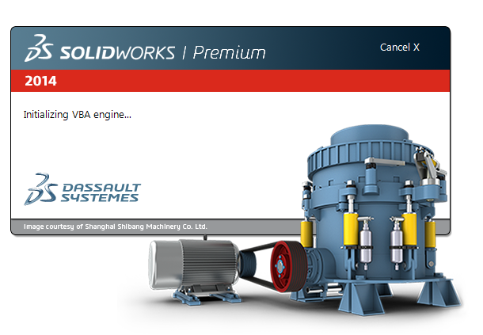
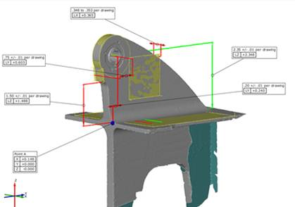
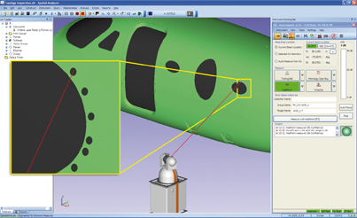
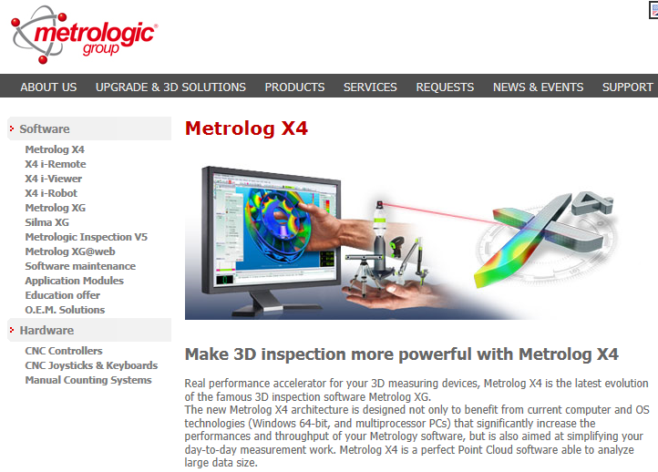
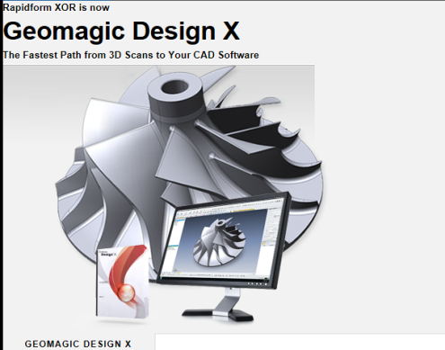
Software Technologies
Software
SolidWorks/Inventor
  used to design parts, fixtures, and form blocks
Metrolog/Spatial Analyzer (Metrology)
  used to run all metrology equipment
Rapidform (Reverse Engineering)
  used to turn scanned point clouds into solid models
DynaForm (Simulation)
  used to run simulations for sheet metal forming to mitigate material and shop time waste.

Slide 6
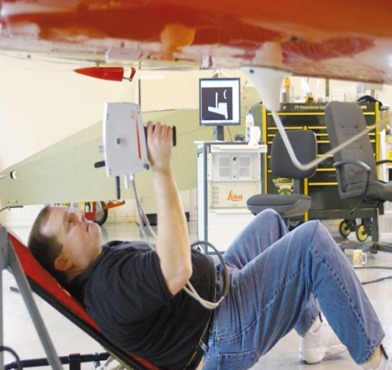
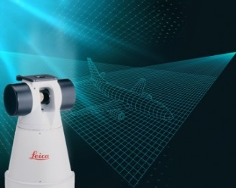
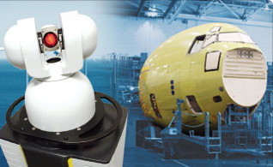
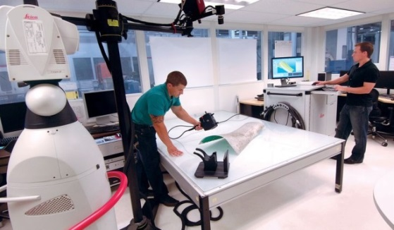
Measurement Technologies
Leica and API 3D Laser Tracker/Scanner
  laser light provides very accurate dimensional measurement of single points, or point clouds
  hand scanner allows for non-contact measurement and point cloud acquisition for large and small parts
  hand probe allows for more accurate contact measurement with part
Nikon Laser Radar Measuring
  laser light travels to and from the target through a reference path of calibrated optical fiber in an environmentally controlled module
  provides automated, non-contact measurement capability for large-volume applications of up to 50 meter radius
ATOS Structured Light Imaging
  Projected bi-dimensional patterns of non-coherent light used to obtain dimensional information

Slide 7
Geometric Analysis Process
Subject Part of Interest
Many items have incomplete or missing technical data
Leveraging the geometric analysis process
we can capture an existing item by scanning and transforming it into a 3D CAD model
Benefits
Reconstruction of a part
Capture critical dimensions & surfaces
Creation of tooling and fixtures
Manufacture of a new item with either traditional methods or direct digital manufacturing
3D Scanning
Point Cloud Data
Polygon
NURBS
Surface/Solid Modeling
CAD Modeling

Slide 8
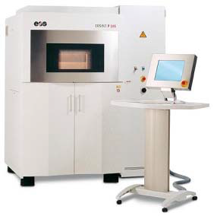
Mechanical Reverse Engineering
Reverse engineering efforts currently involve
  Mechanical engineers
  Machine programming technicians
  Industrial Engineering technicians
AM Processes
AM Projects
  Welding fixtures
  Tooling redesign
  Mold Injection
  Form Fit repairs
  Rapid Prototyping for Die design
  MFG broken/worn components for facility equipment

Slide 9
Capabilities
Coordinate Measurement Machines (CMM)
3D Scanners
  2 Hexagon Portable Measuring Arms
    Touch probe, non-contact laser scanning
  Nvision 3D scanner
  Point Cloud Handling
  Powerful tools to handle multi-million point files and optimize hardware
3D CAD / Modeling
  Catia Geo Magic
  Master Cam PC Demis
  Surf Cam Solid Works
Material Printers/3D Printers
  Fortus 400
  Fortus 900
  Thermo vacuum former
Plastics
  ABS, Polycarbonate, ULTEM 9085

Slide 10
Additive Technologies
ALC | AM Materials | Uses | Equipment
Warner Robins AFB | Extruded ABS, PLA, Ultem, Nylon, Powder bed Gypsum | Fixtures, tooling, adapters, spacers, guides, machine covers, sheet metal forming, fit checks for CNC code | Stratasys 3D Systems
Hill AFB | Extruded ABS, PLA, Ultem, Nylon, Powder bed Gypsum | Functional prototypes, fit checks, molds, jigs, fixtures, plugs, shop equipment, special tools, educational & concept models, blast masking, conforming anodes, tubing, minor industrial ducting, scan to CAD to print | Stratasys 3D Systems
Tinker AFB | Extruded ABS, PLA, Ultem, Nylon, Powder bed Gypsum | Fixtures, forming blocks, tooling, interface cable backshells, gaskets, fit & form, prototyping, couplings, spacers, guides, blast masking, paint masking, plating masking | Stratasys 3D Systems
Similar Additive Manufacturing equipment exists at the different ALCs with similar capabilities
ALCs working to purchase additional industrial type printing machines for the near future.

Slide 11
Reverse Engineering Across AFSC
Organization | Software Tools | 3-D Measurement Systems | Dedicated P.E.s
309th MXSG | Solid Works, Verisurf | 3 CMM, Optical Comparators, Laser Scanners | 5 Full Time
309th CMXG | Solid Works, Polyworks, NX | Laser Tracker, Laser Scanner | 2 Part Time
309th SMXG | AutoDesk Inventor, AutoCAD | New Development, Not R.E. | 2 Full Time
Organization | Software Tools | 3-D Measurement Systems | Dedicated P.E.s
76thCMXG | Metrolog, AutoDesk Inventor, Rapid Form, Solid Works | Leica Laser Scanner | 3 Full Time
76th SMXG | Autodesk Inventor | None | Project Dependent
Organization | Software Tools | 3-D Measurement Systems | Dedicated P.E.s
402 EMXG | Solid Works, AutoDesk Inventor, AutoCAD | None | 1 Full Time
402 CMXG | PCDMIS, Geomagic, NX, | CMM, Optical Comparator, | 3 Full Time
402 SMXG | Solid Works, AutoDesk Inventor | New Development, Not R.E. | 2 Full Time
402 MXSG | AutoCAD, AutoDesk Inventor | CMM | 3 Part Time

Slide 12
AM Printing Capabilities Across AFSC
Organization | Model | Envelope(in) | Material Type
516th SMXG | Stratasys uPrint | 8x6x6 | ABS Plastic
516th SMXG | Stratasys Mojo | 5x5x5 | ABS Plastic
309th CMXG | 3DSystems Projet XXX |  | Plastic
309th MXSG | Stratasys Fortus 900 | 36x24x36 | ABS ,Ultem,DR-100,ABS-ESD,PC
Organization | Model | Envelope(in) | Material Type
76th CMXG | 3DSystems Projet 860 | 20x15x9 | VisiJet PXL
76th PMXG | Stratasys Dimension Elite | 8x8x12 | ABS Plastic
76th SMXG | iDeator12 | 12x12x12 | ABS & PLA
76th SMXG | Makergear M2 | 8x10x8 | ABS & PLA
848 SCMG | Stratasys Dimension SST 768 | 8x8x12 | ABS
Organization | Model | Envelope(in) | Material Type
402 CMXG | Stratasys Fortus 400 mc | 14x10x10 | ABS ,Ultem,DR-100,ABS-ESD,PC
402 CMXG | Stratasys Fortus 900 mc FY-16 Programming | 36x24x36 | ABS ,Ultem,DR-100,ABS-ESD,PC
402 MXSG | MakerBot Replicator 2X | 11x6x6 | ABS Plastic
402 MXSG | Stratasys Fortus 380 mc | 16x14x16 | ABS-M30, PC-ABS, PC, Nylon 12

Slide 13
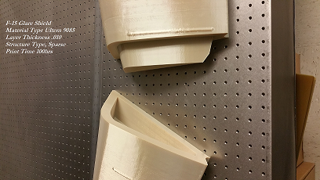
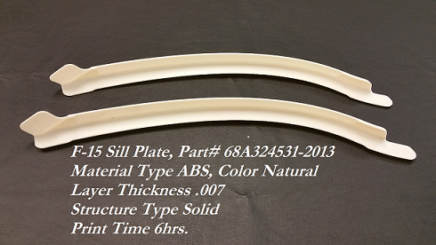
Rapid Manufacturing
Rapid Manufacturing Strategy Examples
Thermoform Mold
F-15 Glare Shield
SPO engineer design
Printed model -handworked first mold
Laser Scanned finished mold into 3D model
Printed Mold- 2 pieces
Mold now produces finished part
Savings
  3D vs Material and Man hours
  $10K cost avoided
F-15 Sill Plate
Difficulties with MFG from drawing
Created model from drawing
Form fit part to F-15
Corrected CAD model before production
Savings
  Material and Production time
  $5.5K cost avoided

Slide 14
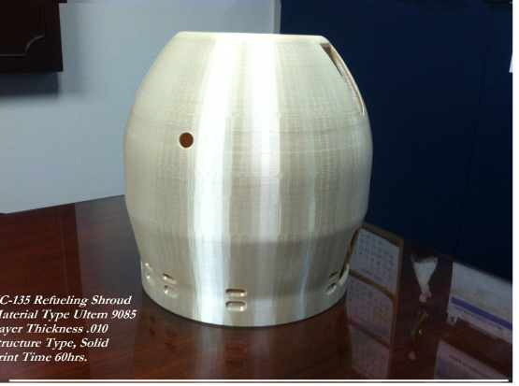
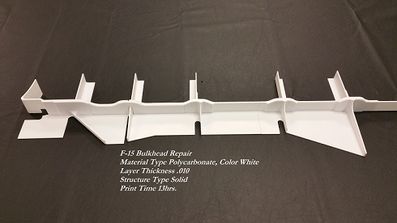
Reverse Engineering Samples
Materials
  Plastics, Polyform, composites, lexan polycarbonite
    Molds, F-15 glare shields, Bulkhead repairs
Process
  Use of models, samples, drawings to gather customer requirements and feedback
  3D scanning to confirm accuracy of a design – Form, Fit, Function, model comparison
  Dimensional verification of all mfg parts for Quality and ISO compliance
  Tool-less fabrication of low volume production parts

Slide 15
Avionics Reverse Engineering
Capabilities
Core Capabilities
We are able to create repair capability on both analog and digital circuits as well as certain field programmable gate arrays. We create efficient processes and procedures, develop more efficient repair processes, develop missing technical data, resolve surges, MICAPs, and backorders, reduce cost and increase reliability, and support depot repair line standup. We utilize the following platforms to conduct our analysis and develop technical data.
Huntron
Comparative component and net testing for fault isolation
Rapid turn time for diagnostic & repair
PinPoint II
Component functional test without schematic; creates schematic drawing
Card edge connector functional test
PXI
Compatible with 600+ different modules for analog, digital, and RF electronic test and measurement applications
Powerful software with specialized timing and synchronization capabilities

Slide 16
Reverse Engineering
Snapshot of Current Work
ALQ-213 CMSP/CMSC
BRAT RFIU/SPD
Developing organic repair capability for both LRUs (approximately 9 CCAs)
Delivering incremental repair capability while at the same time eliminating bad actors
Final product will be a delivered technical order built from the incremental process orders
Conducting extensive DMSMS study on both components of the BRAT to determine where redesign needs to occur
Producing technical data necessary to procure and repair components within RFIU and SPD
Follow-on effort will be to conduct any redesign activities required as discovered by our study
C-5 CED
E-3 40/45 Modification
Complete with the Preliminary Design for the organic repair of the Cooling Air Warning Alarm
Currently in the Preliminary Design Gate for the Input Output Assembly (Main Component)
Quoted and awaiting funding of several LRUs/CCAs within the modification
Working with the SPO to aid in the Sustainment strategy for the future of the modification
Complete redesign of aircraft part
Environmental compliance testing as well as functionality testing will be completed on the design
Project complete through prototype testing. Project currently in the military specification build process for operational and environmental testing
Notes:
16

Slide 17
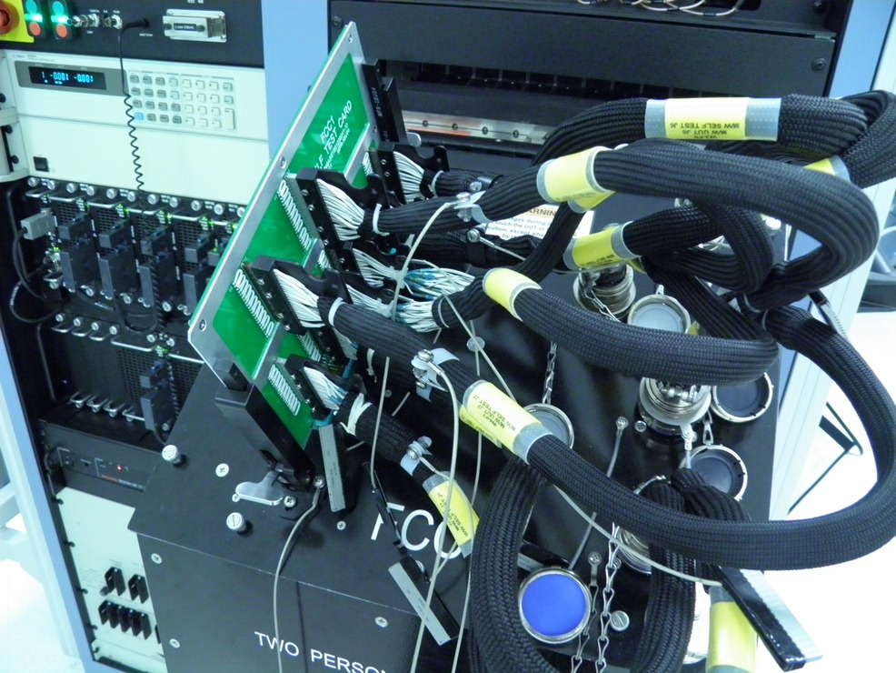
Example Project
Strain Relief
Spacer
Backshell
Card Guide
Dust Cover

Slide 18
Summary
AFSC Reverse Engineering Capability is Mature
Varying Degree of Additive Manufacturing Maturity Indicative of Technology Maturation
AFSC Pushing Industry for AM technology in Metals and Electronics/Avionics Production
Material Properties/Characterization & Qualification Testing are the Largest Impediments to Rapid Implementation

